Slide 1
The Eatwell Guide

Slide 2
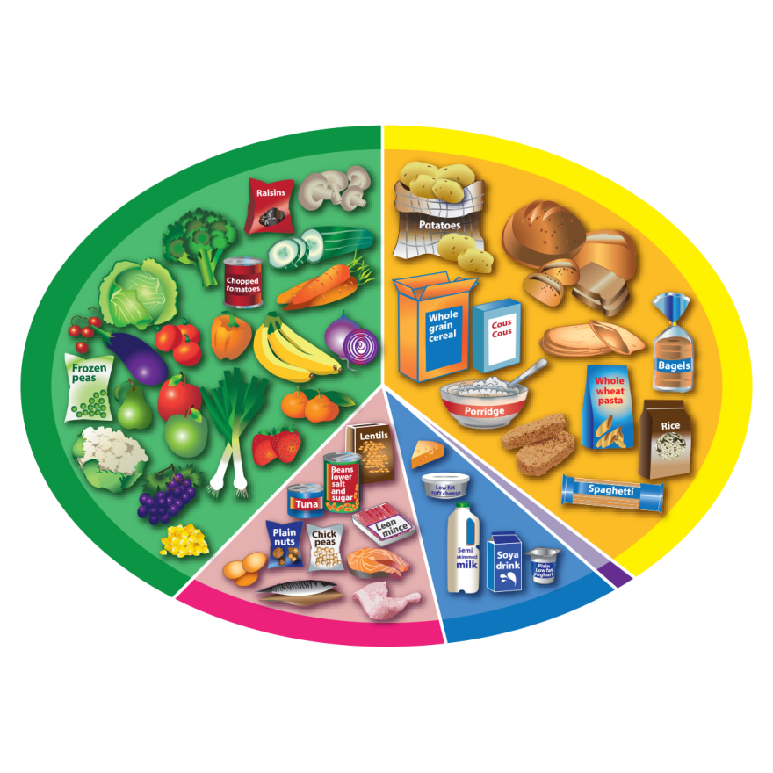
What can you see?
6-8
a day

Slide 3
What do you think each food group might be called?
Let’s take a look!

Slide 4
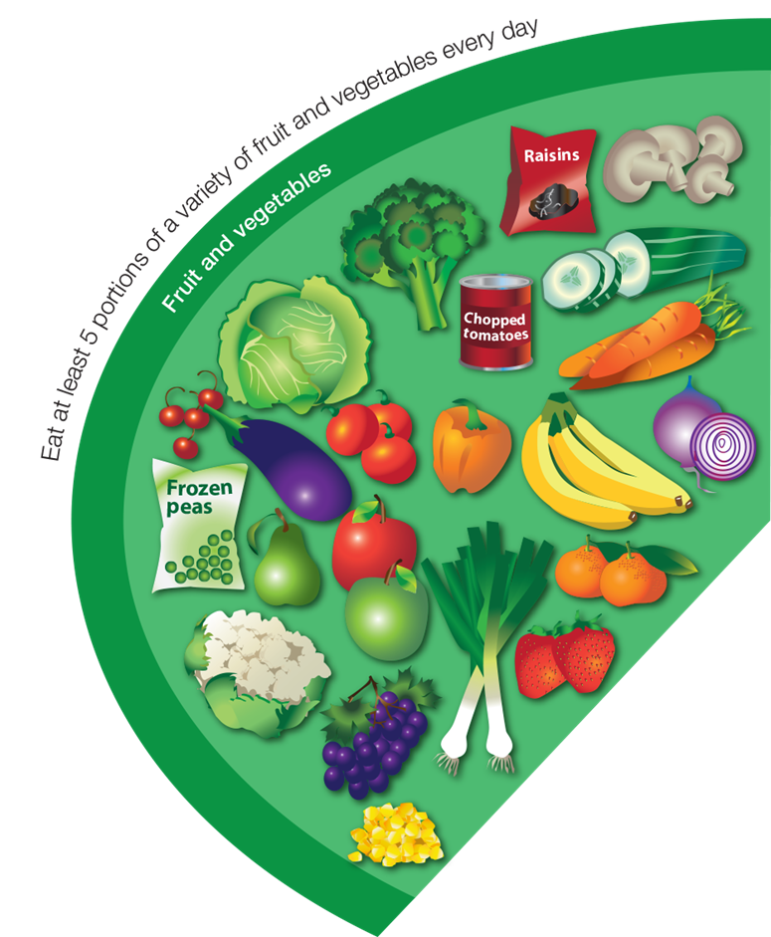
This is the…
Fruit and vegetables group

Slide 5
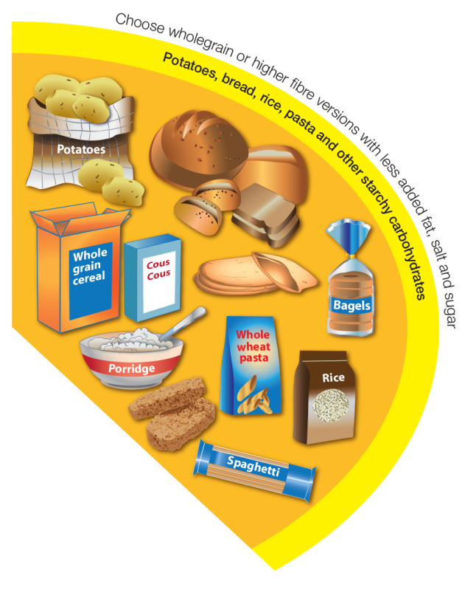
This is the…
Potatoes, bread, rice, pasta and other starchy carbohydrates group

Slide 6
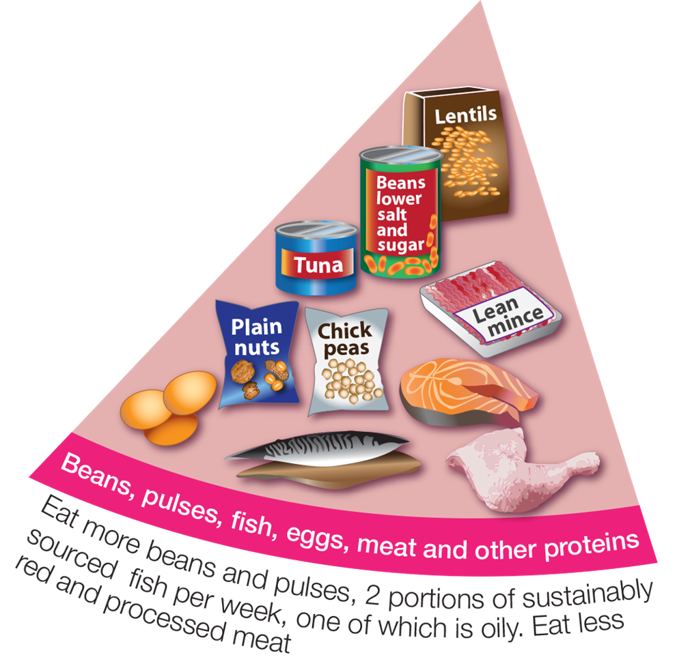
This is the…
Beans, pulses, fish, eggs, meat and other proteins group

Slide 7
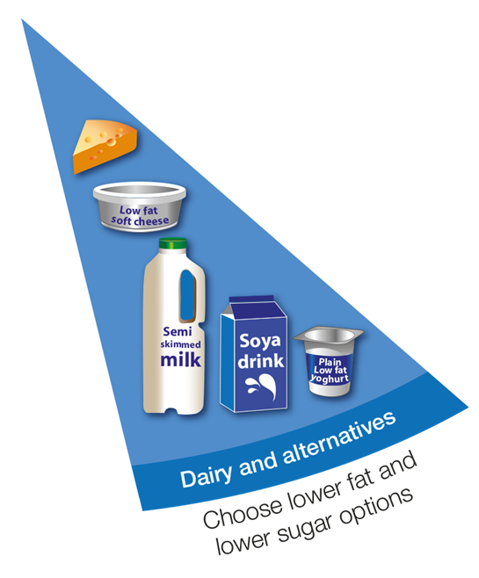
This is the…
Dairy and alternatives group

Slide 8
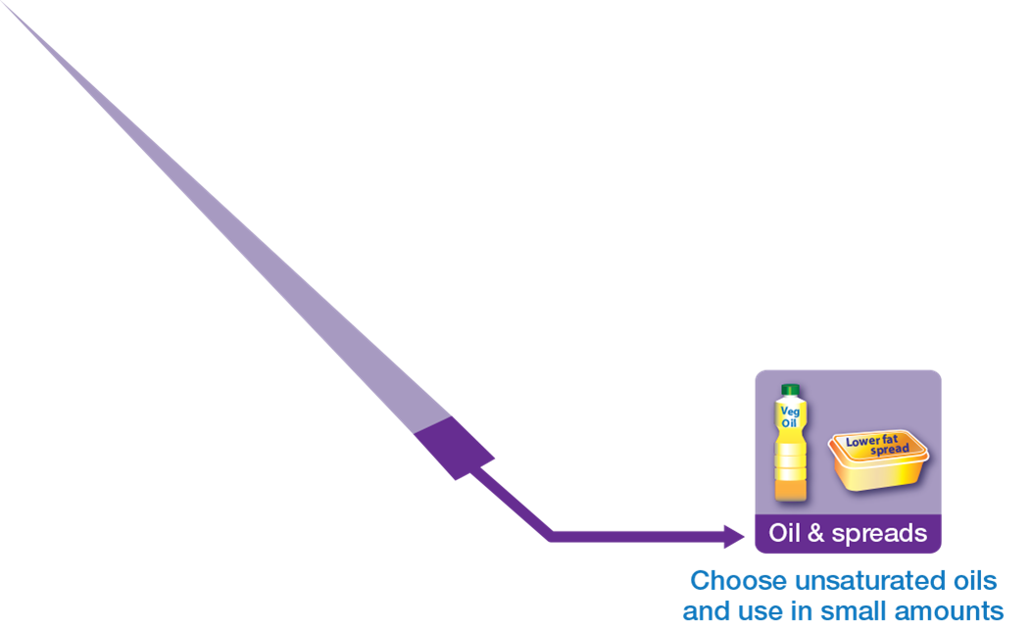
This is the…
Oil and spreads
group

Slide 9
Remember to have plenty to drink!
6-8
a day

Slide 10
The Eatwell Guide
For further information, go to:
www.foodafactoflife.org.uk

