Slide 1
Can I talk about how scientists can also be Christians?
I am successful if:
I know 2 scientists who are Christians;
I can talk about how Christians who are scientists understand Genesis 1;
I share questions I would like to ask about their beliefs.

Slide 2
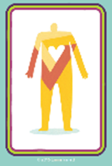
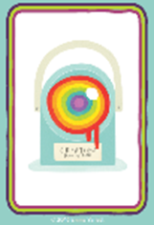

Slide 3
There are many Christian scientists.
They have to think about how their belief in God fits in with what they know about science.

Slide 4
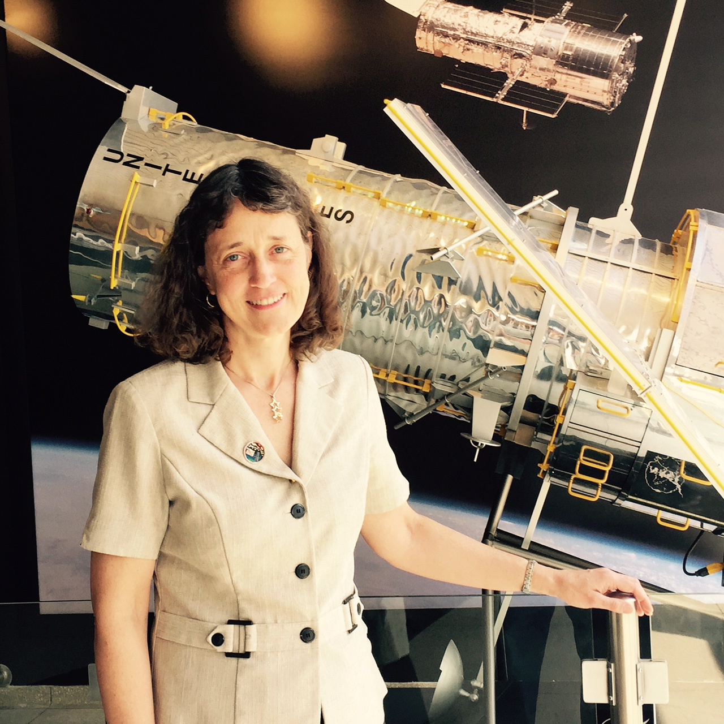
Dr. Jennifer Wiseman is an astrophysicist and a Christian.
She is in charge of the Hubble Space Telescope and even has a comet named after her!

Slide 5
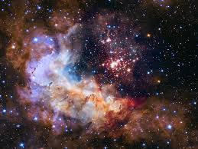
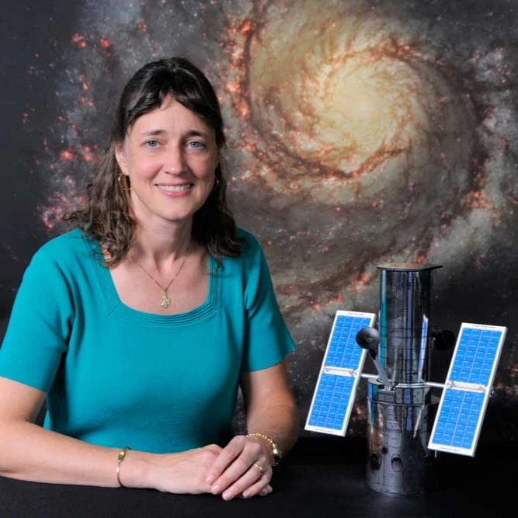
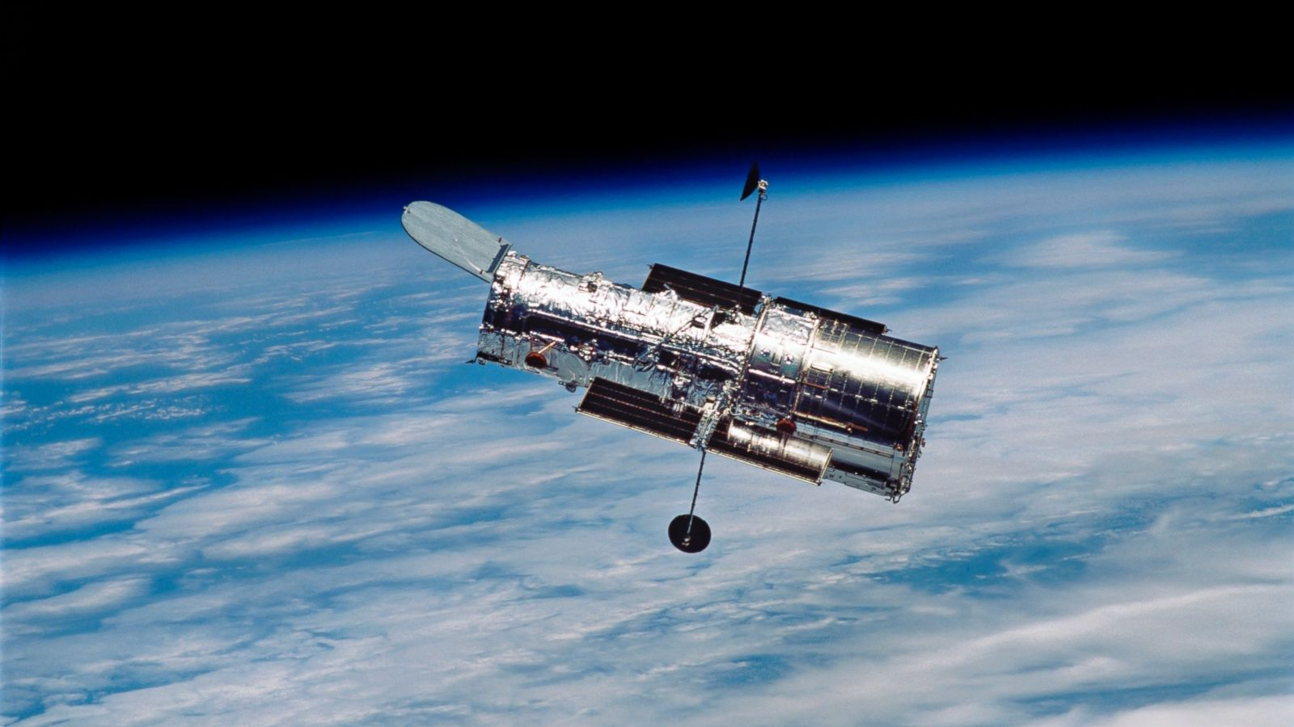
Watch the videos which talk about how she became a scientist and how she thinks about science and religion.
What questions would you like to ask her about science and religion?
Write them on your post it.

Slide 6
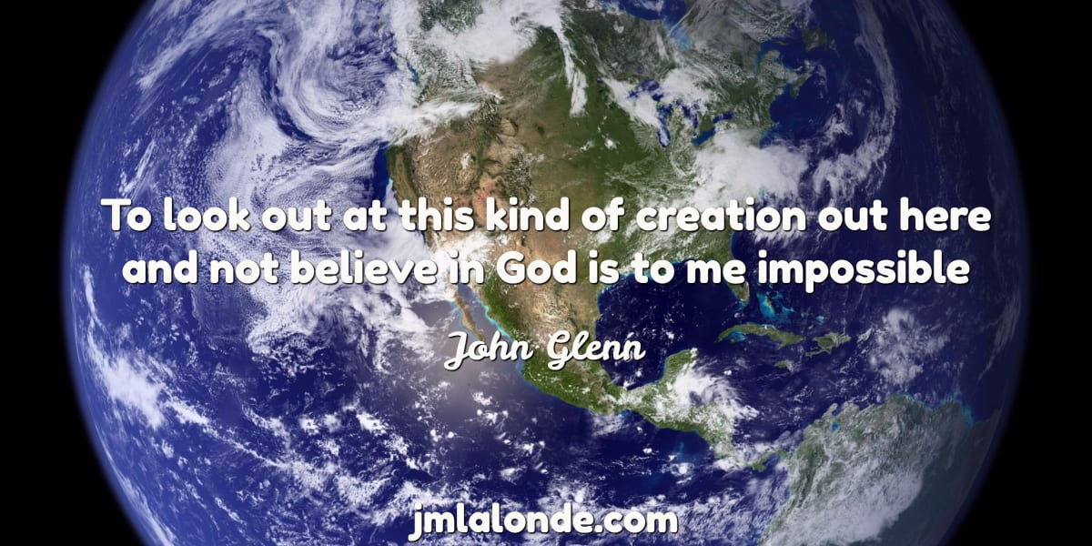
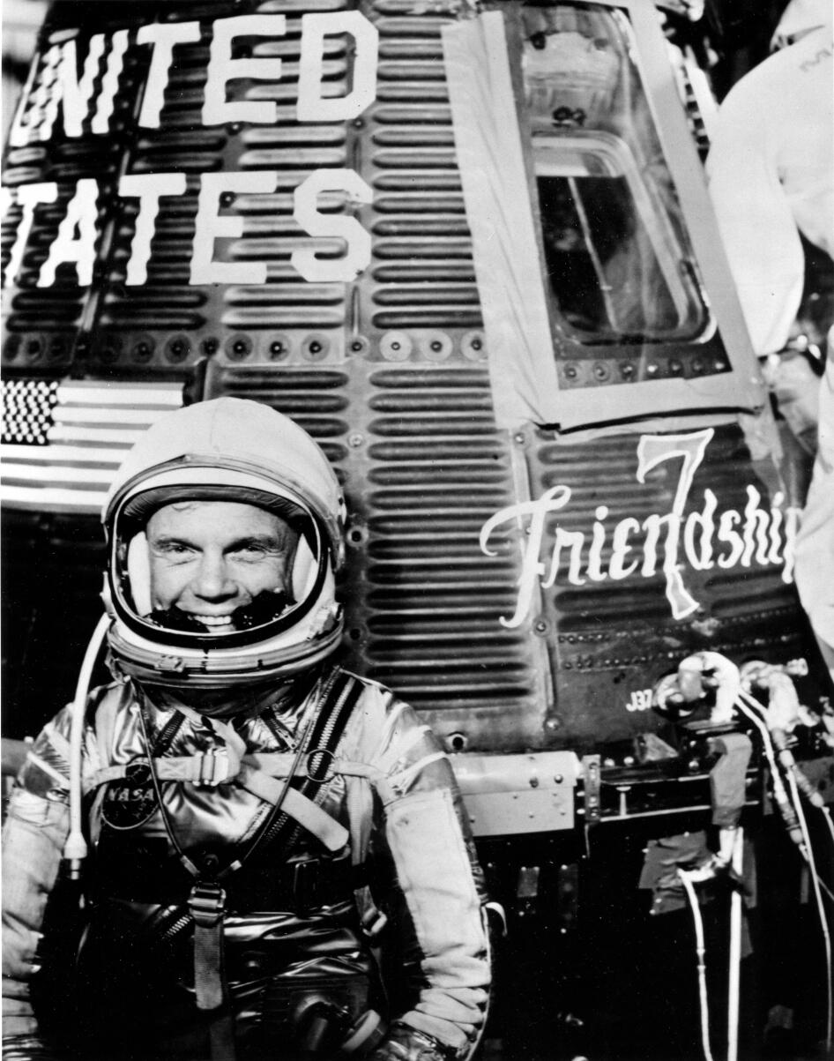

Slide 7
Can I talk about how scientists can also be Christians?
I am successful if:
I know 2 scientists who are Christians;
I can talk about how Christians who are scientists understand Genesis 1;
I share questions I would like to ask about their beliefs.

