Slide 1
How do Scientists think creation happened?
I am successful if:
I can talk about how Genesis can be different text genres;
I know what cosmology and evolution is;
I can explain to someone else how cosmology or evolution works.

Slide 3
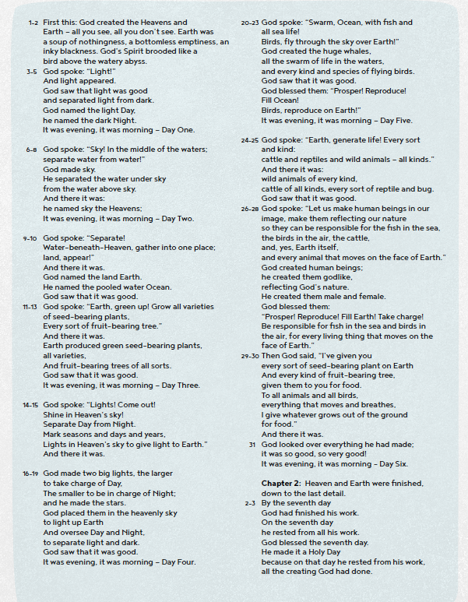
Read this version of the Creation.
What genre of writing is it?
How do you know?
What genre do Christians think it is?
Notes:
This finishes off the work from last week looking at Genesis not being a set genre of text which allows interpretation by different Christian & non-Christian groups.

Slide 4
Scientists today split the creation of the universe into two sections.
Cosmology is about the creation of the stars, earth and universe.
Evolution is about the creation and development of life over millions of years.

Slide 5
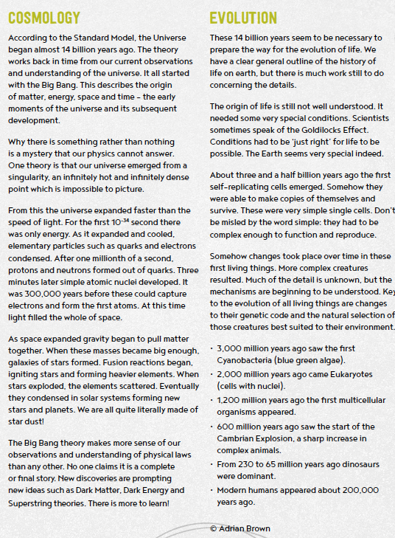
Read these two accounts of creation.
Write and draw a flowchart to explain one of these accounts.
Explain your flowchart to your partner. How accurate is it?

Slide 6
How do Scientists think creation happened?
I am successful if:
I can talk about how Genesis can be different text genres;
I know what cosmology and evolution is;
I can explain to someone else how cosmology or evolution works.

