Slide 1
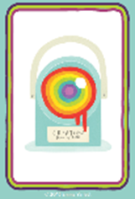

Slide 2
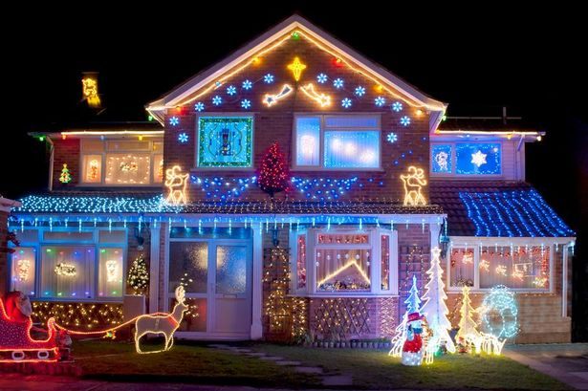
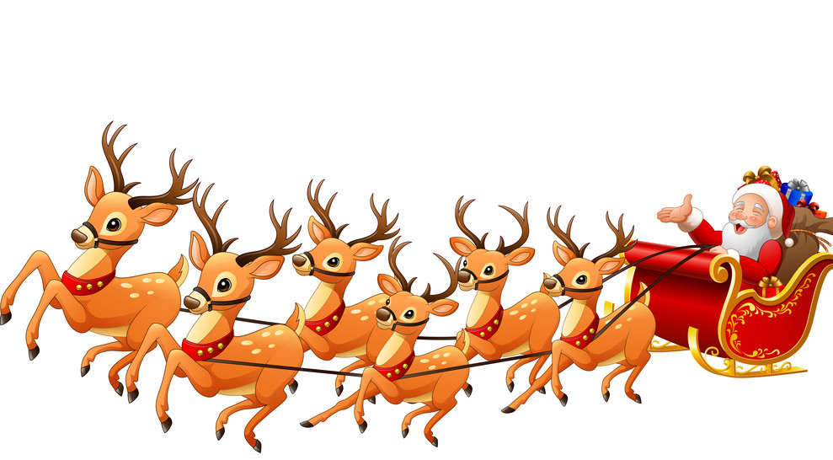
With the person next to you think about Christmas.
Write down as many words to do with Christmas as you can think of

Slide 3
Please sort your words into two lists:
Words about Jesus and Christianity?
Words that are not?
What does that tell you about how people think about Christmas?

Slide 4
Some Christians have made advertising campaigns about the true meaning of Christmas.
https://youtu.be/6PqTmyjqIzg
https://www.youtube.com/watch?v=MOByXwK-g94
Check out the posters on the following slides and design your own advert to show the true meaning of Christmas

Slide 5
Can I explain what the meaning of Christmas is?
I am successful if:
I can list things to do with Christmas;
I can explain what Christians think is the meaning of Christmas;
I design an advert showing the true meaning of Christmas.

Slide 6
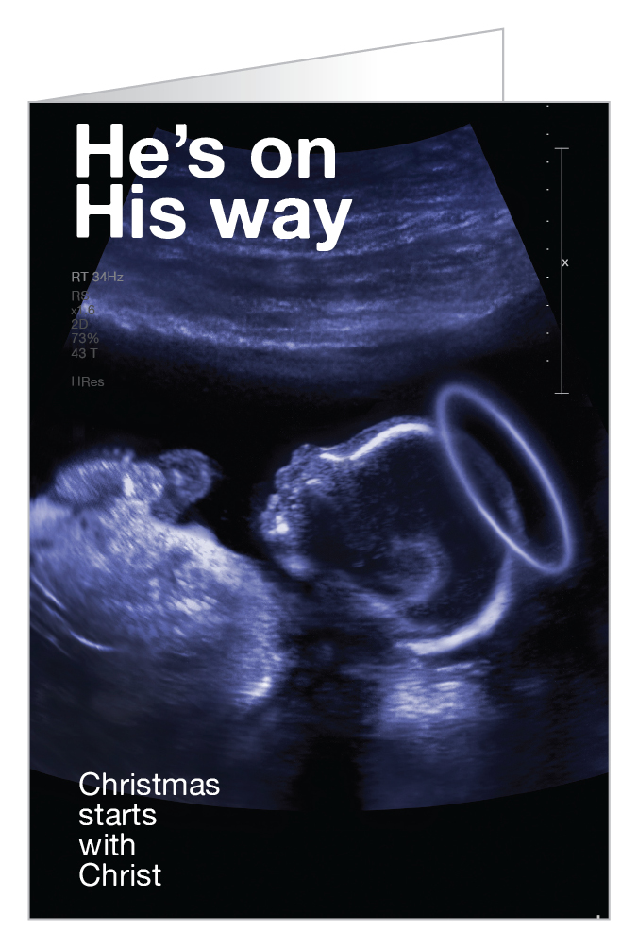
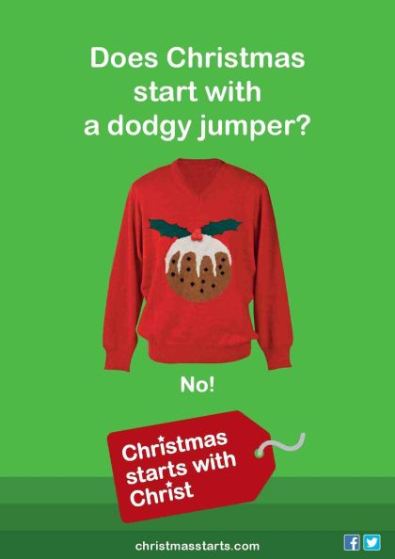

Slide 8
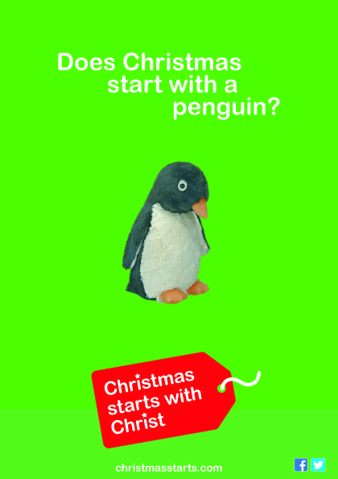

Slide 9
