Slide 1
What qualities did the Messiah need?
I am successful if:
I can explain why the Jewish people wanted a Messiah;
I know what the Old Testament said the Messiah would be like;
I can show the qualities the Jewish people were looking for in a poster.

Slide 3
The Jewish people been taken into exile and the city of Jerusalem and the Temple had been destroyed.

Slide 4
When they returned home it didn’t feel like home. They were still ruled by people from other countries. They hoped a Messiah would come and free them.
What qualities do you think the Messiah should have? Write them down and explain why they need that quality.

Slide 5
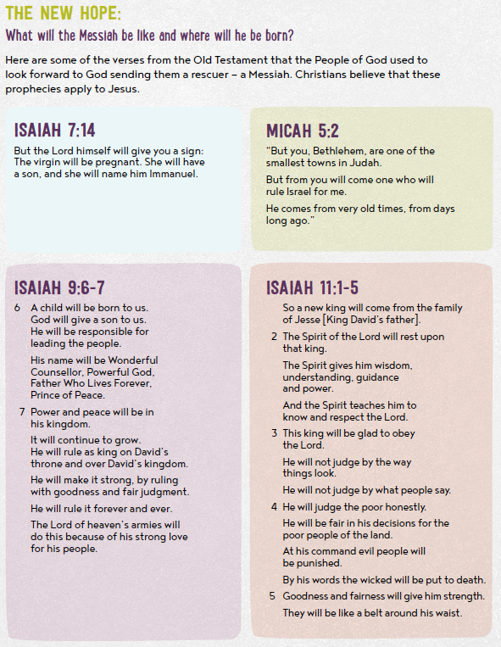
The prophets described this rescuer or Messiah.
Read the prophecies carefully.
Notes:
If you want to read the pasages in full and do not have access to a Bible at home please follow the link: https://www.biblegateway.com/
The translation we use in School is the Good News Version

Slide 6
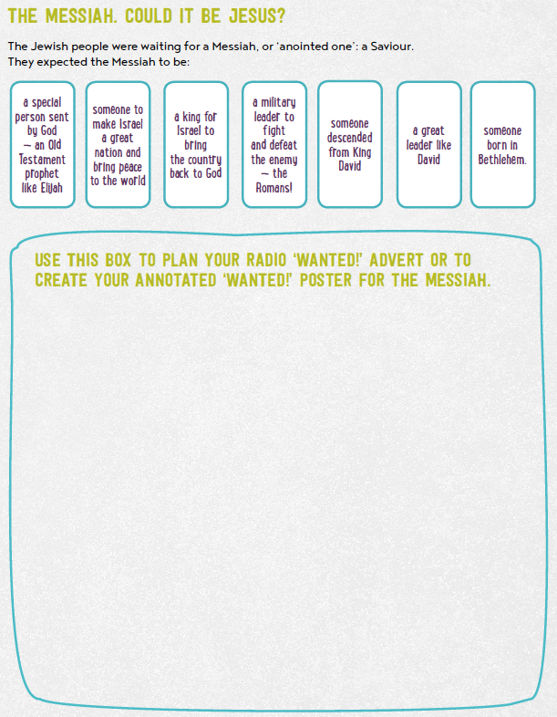
Read the summary information.
Create a wanted poster for the Messiah using the information you have read.

Slide 7
What qualities did the Messiah need?
I am successful if:
I can explain why the Jewish people wanted a Messiah;
I know what the Old Testament said the Messiah would be like;
I can show the qualities the Jewish people were looking for in a poster.

