Slide 1
Find the missing numbers……
1) 2, 4 , __ , 8, __ , ___
2) 5, __ , 15, 20, __ , 30, ___
3) 25, __, 35, 40, ___ , ___
10 , ___ , 30 , ___ , ___ , ___
20 , 30 , __ , ____, 60
16, 18, ? , 22, 24, __ , ___
90, ___, 70, ? 50,__ , 30
20, 25, ___ , 35, ___, 45, ____
10, 8, ___, 4, ___, 0
30, 25, ___, 15, ___, 5, ___
18/11/20

Slide 2
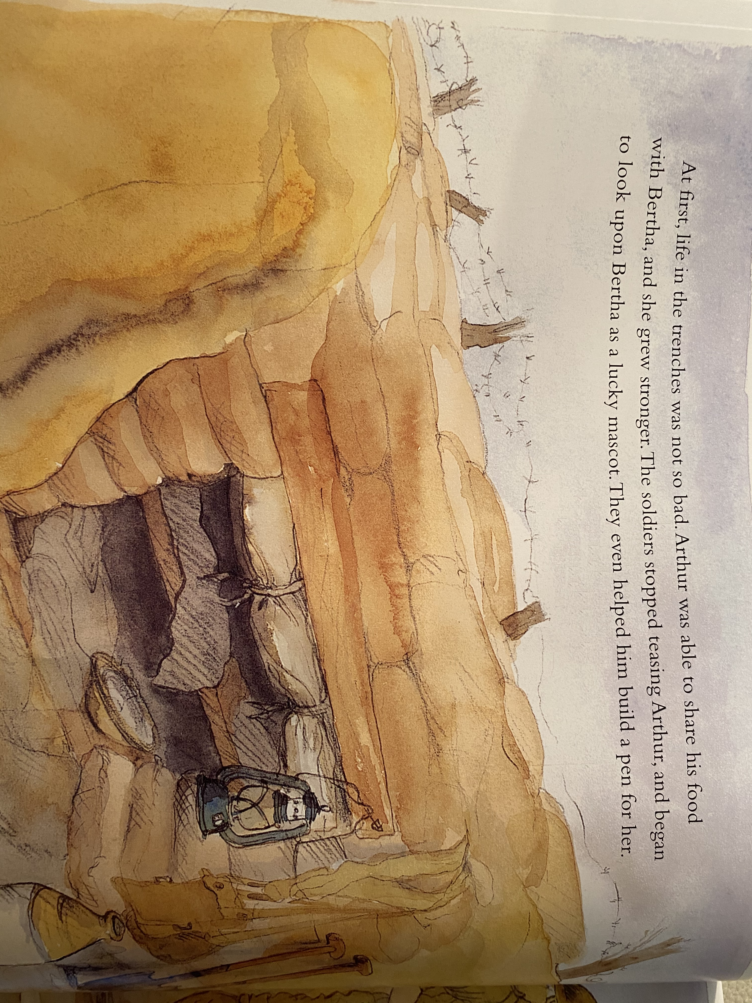
Reading the text Practise reading the following pages with fluency. It might help to read and reread the pages.

Slide 3
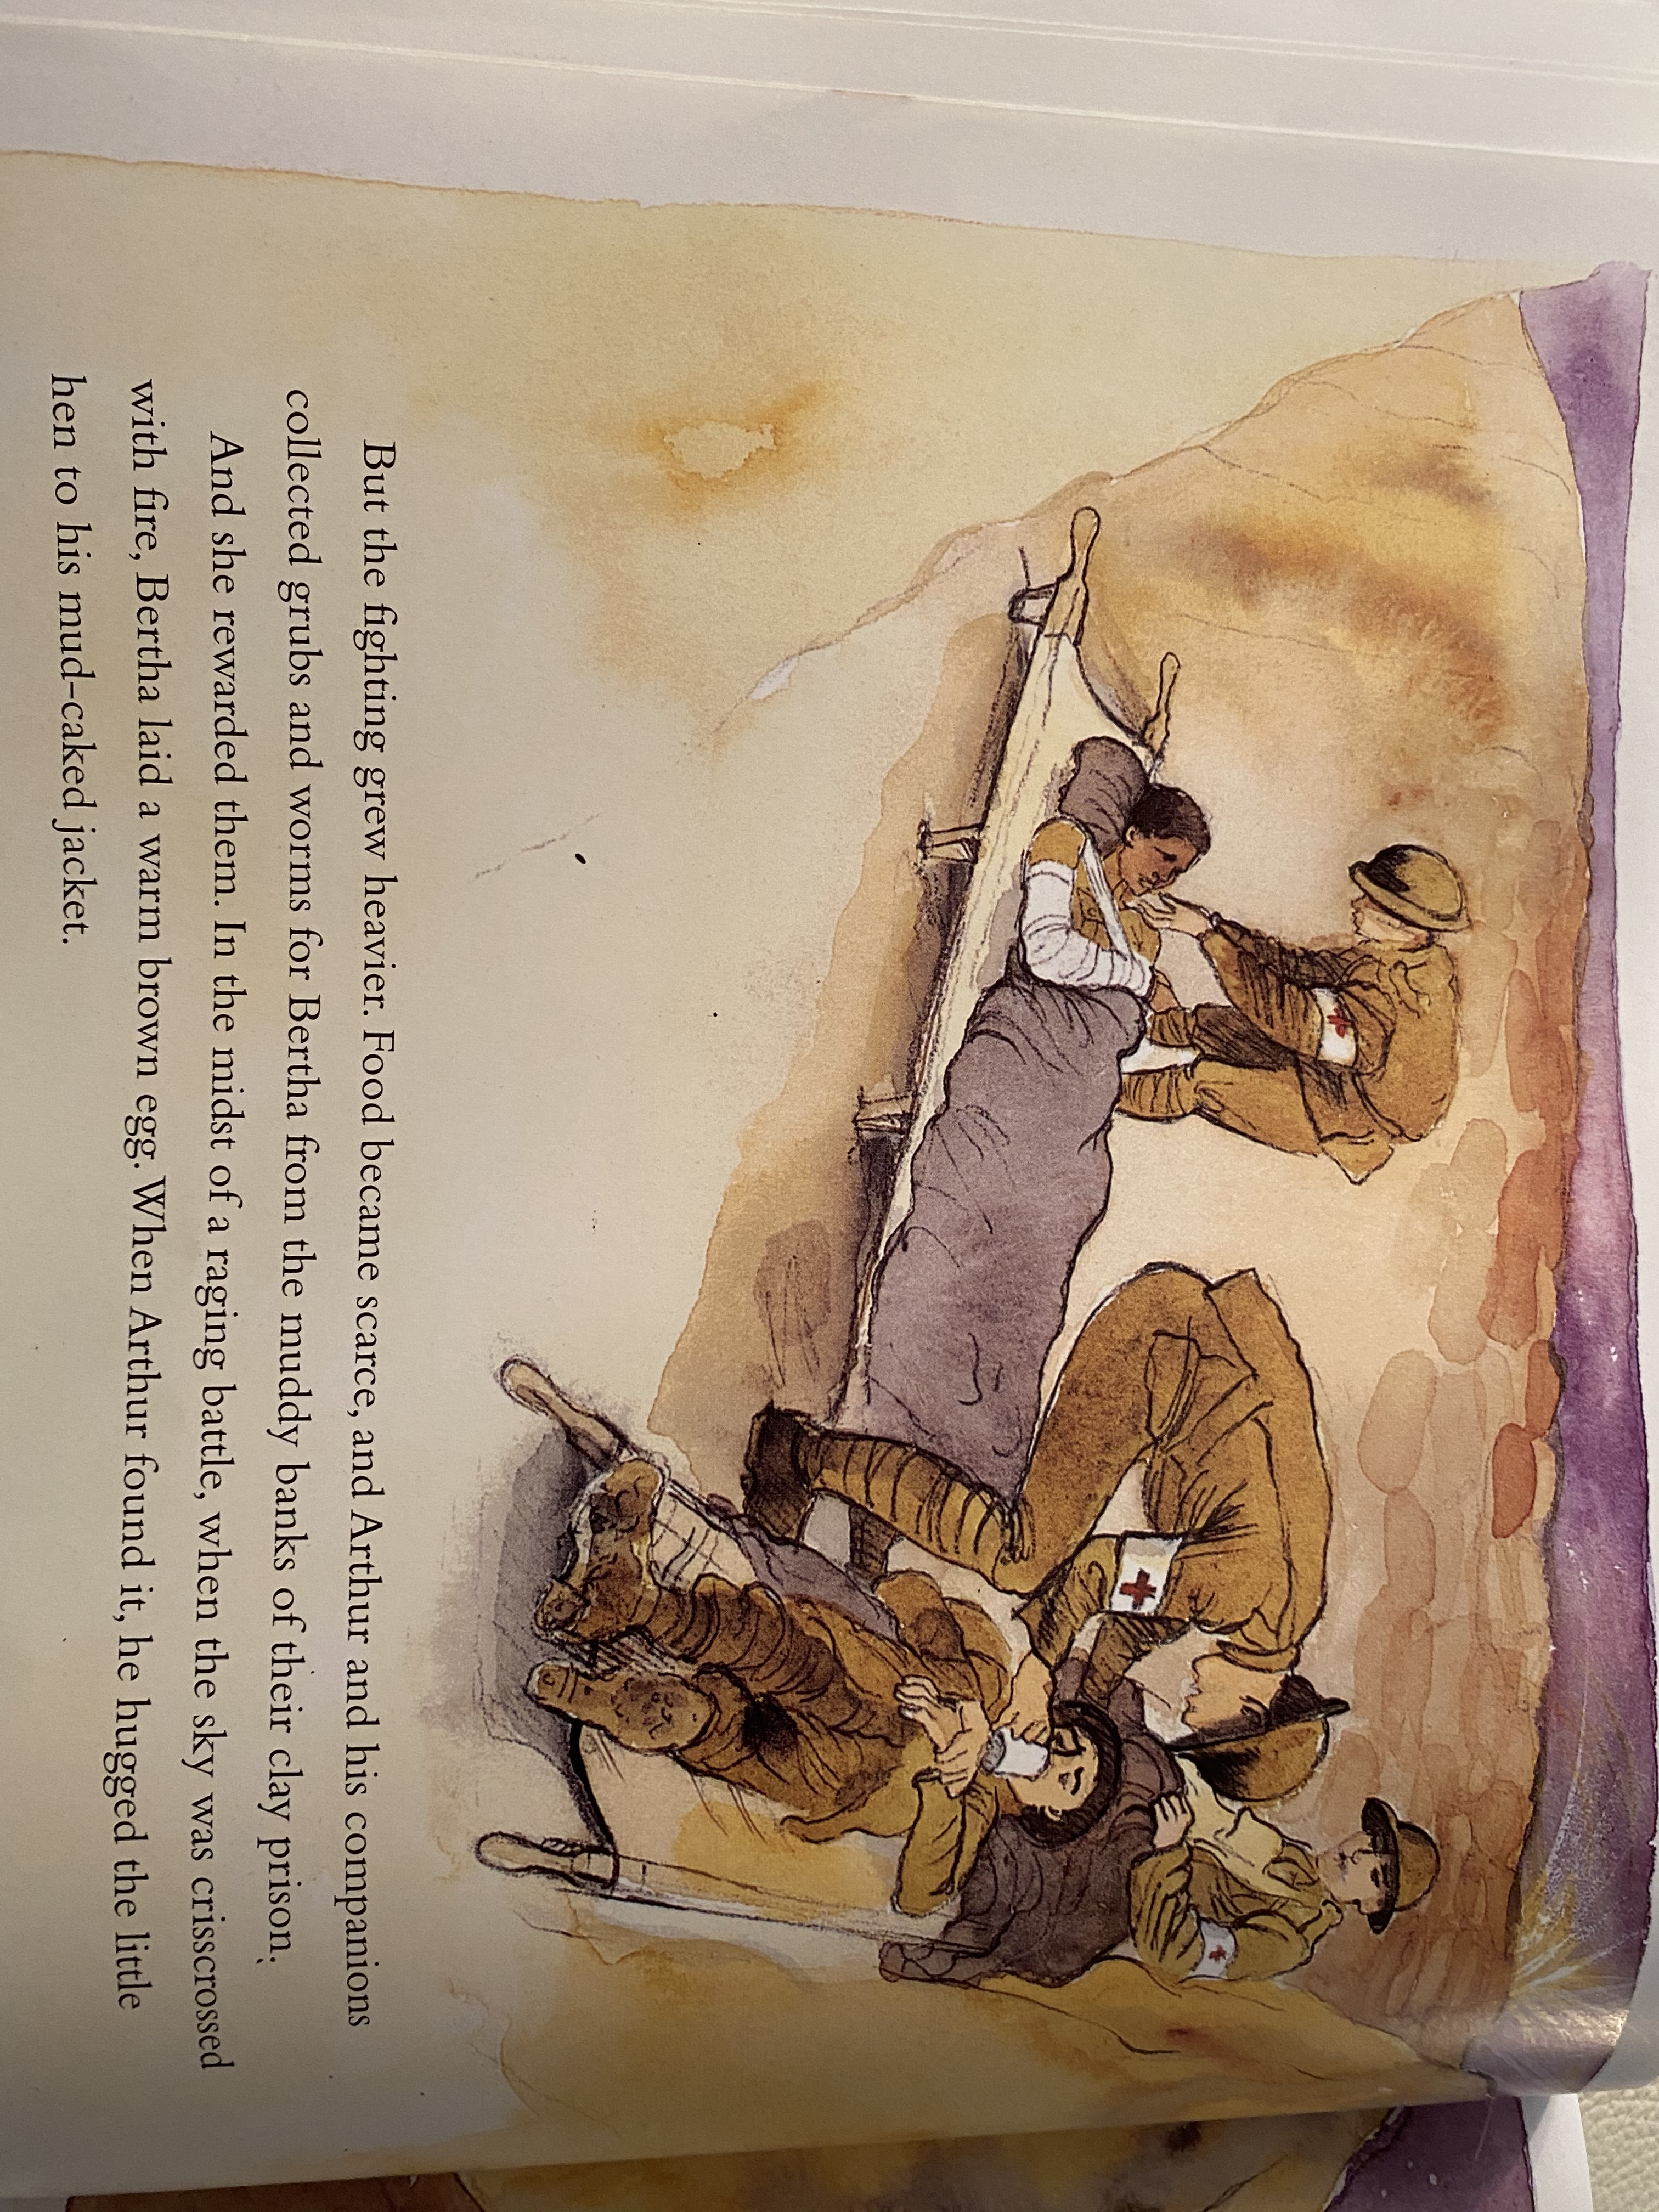

Slide 6
Review your diary entry
Finish it if you haven’t already.
Purple pen your work…
Put full stops and capital letters in if they are missing.
Correct spelling mistakes
Make additions – add words to make your writing more interesting.

Slide 7
Maths!

Slide 8
Click the following link for the teaching video.
https://vimeo.com/471307831
Now complete the Wednesday Maths PowerPoint and complete the attached worksheets.

Slide 9
Handwriting
Complete the attached Handwriting sheet, start at the beginning and work through each day.

Slide 10
RE
Please follow this Oak Academy link.
https://classroom.thenational.academy/lessons/what-is-the-christmas-story-6cwk4r

