Slide 3
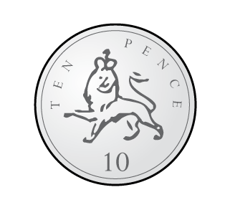
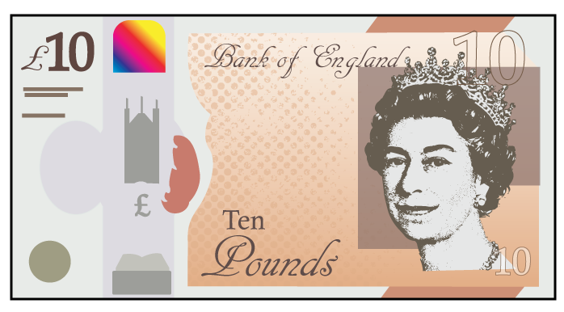
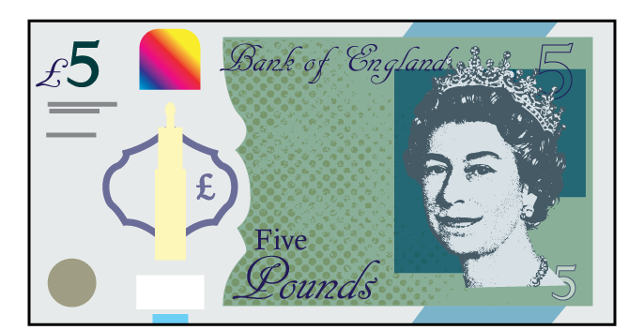
Which of these represent £14

Slide 4
Which of these represent £14

Slide 6
Notes:
Dora, Whitney and Teddy are on a role now.
But this one looks different! Let’s see if they can use what they know
Whitney knows that 100 take away 40 is equal to 60
And Dora knows that 60 take away 2 is equal to 58
So Teddy has realised that 100 takeaway 42 must be equal to 58
Great team work guys!

Slide 7
Notes:
Dora, Whitney and Teddy are on a role now.
But this one looks different! Let’s see if they can use what they know
Whitney knows that 100 take away 40 is equal to 60
And Dora knows that 60 take away 2 is equal to 58
So Teddy has realised that 100 takeaway 42 must be equal to 58
Great team work guys!

Slide 8
Notes:
Dora, Whitney and Teddy are on a role now.
But this one looks different! Let’s see if they can use what they know
Whitney knows that 100 take away 40 is equal to 60
And Dora knows that 60 take away 2 is equal to 58
So Teddy has realised that 100 takeaway 42 must be equal to 58
Great team work guys!

Slide 9
£4
20p
£4
and
20p
Notes:
Dora, Whitney and Teddy are on a role now.
But this one looks different! Let’s see if they can use what they know
Whitney knows that 100 take away 40 is equal to 60
And Dora knows that 60 take away 2 is equal to 58
So Teddy has realised that 100 takeaway 42 must be equal to 58
Great team work guys!

Slide 10
Have a go at questions 1 and 2 on the worksheet

Slide 11
£2
$+$ 20p
$+$2p
$=$ £2 and 23p
$+$ 1p
Notes:
Dora, Whitney and Teddy are on a role now.
But this one looks different! Let’s see if they can use what they know
Whitney knows that 100 take away 40 is equal to 60
And Dora knows that 60 take away 2 is equal to 58
So Teddy has realised that 100 takeaway 42 must be equal to 58
Great team work guys!

Slide 12
Have a go at question 3 on the worksheet

Slide 13
£2
$+$ £1
$+$20p
$=$ £3 and 25p
$+$ 5p
Notes:
Dora, Whitney and Teddy are on a role now.
But this one looks different! Let’s see if they can use what they know
Whitney knows that 100 take away 40 is equal to 60
And Dora knows that 60 take away 2 is equal to 58
So Teddy has realised that 100 takeaway 42 must be equal to 58
Great team work guys!

Slide 14
Have a go at question 4 on the worksheet

Slide 15
£13 and 50p
?
?
£10
£2
£1
50p
Notes:
Dora, Whitney and Teddy are on a role now.
But this one looks different! Let’s see if they can use what they know
Whitney knows that 100 take away 40 is equal to 60
And Dora knows that 60 take away 2 is equal to 58
So Teddy has realised that 100 takeaway 42 must be equal to 58
Great team work guys!

Slide 16
£13 and 50p
£5
?
£10
£5
£2
£1
50p
Notes:
Dora, Whitney and Teddy are on a role now.
But this one looks different! Let’s see if they can use what they know
Whitney knows that 100 take away 40 is equal to 60
And Dora knows that 60 take away 2 is equal to 58
So Teddy has realised that 100 takeaway 42 must be equal to 58
Great team work guys!

Slide 17
Have a go at questions 5 and 6 on the worksheet

