Slide 1
Good Morning Year 2 How are you doing? I hope you are all enjoying your learning at home.

Slide 2
Find the missing numbers……
1) 20 , 30 , __ , 50 , __ , __
2) 15, __ , 25 , 30 , __ , 40 , __
3) 25, __ , 35 , 40 , __ , __
18 , __ , 22 , __ , __ , __
40 , 50 , __ , __ , 80
16, 14 , , 10 , 8 , __ , __
75, __ , 65 , , 55 , __ , 45
20 , 25 , __ , 35 , _ , 45 , __
20 , 18 , __ , 14 , __
60 , 50 , __ , 30 , __ , 10 , __
25/11/20
Please see the next page for another version if this is a bit tricky!

Slide 3
Find the missing numbers……
1) 2 , 3 , __ , 5 , __ , __
2) 10, __ , 30, 40 , __ , 60 , __
3) 2, __ , 6 , 8 , __ , __
8 , __ , 12 , __ , __ , __
10 , 9 , __ , __ , 6
12, 14 , , 18 , 20 , __ , __
5, 10, ___, 20 , 25 , __ , __
60, 50, ___, 30, ___, ____
20, 25, ___, ___, 40, ____
10, 15, 20, ___, 30, ___, ____
25/11/20

Slide 4
Phonics Spend a little time on each of the activities below.
Lexia – Don’t forget to log on to this regularly, if you have a log-in.
Phonics – Practise the games on phonicsplay website.
Spelling Practise - Look, cover, write, check
HF words – Play spooky spellings:
http://www.ictgames.com/mobilePage/spookySpellings/index.html
Choose the Year 1 list if Year 2 words are too tricky.

Slide 5
Reading
Did you guess what animal our new book is about?
Look on the next slide to see our new text.

Slide 6
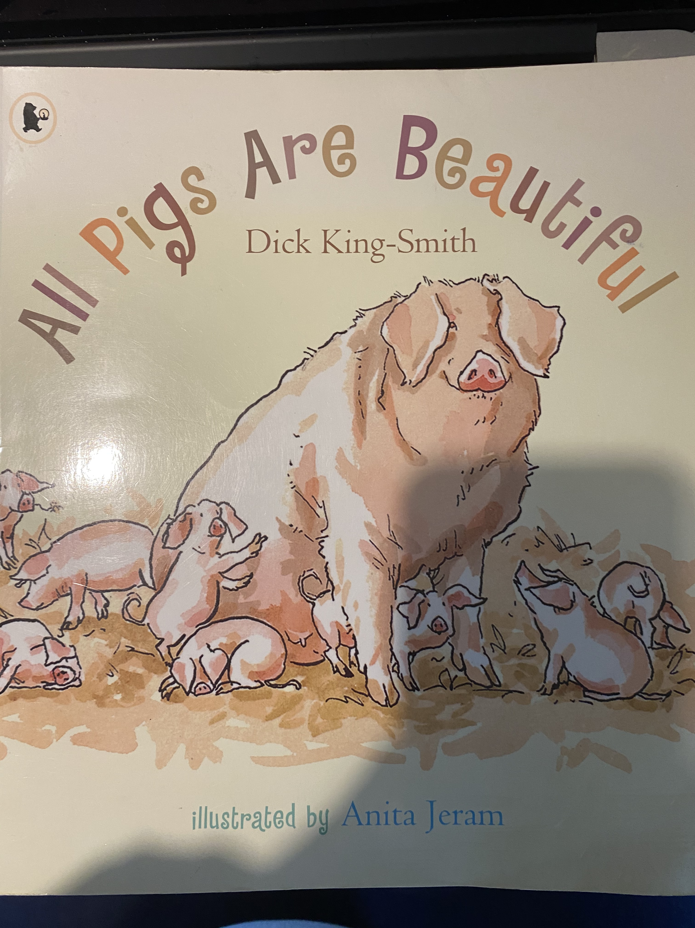

Slide 7
Reading:
Practise reading the following pages. Don’t forget to take notice of the punctuation marks and take a breath when there is a full stop.

Slide 8
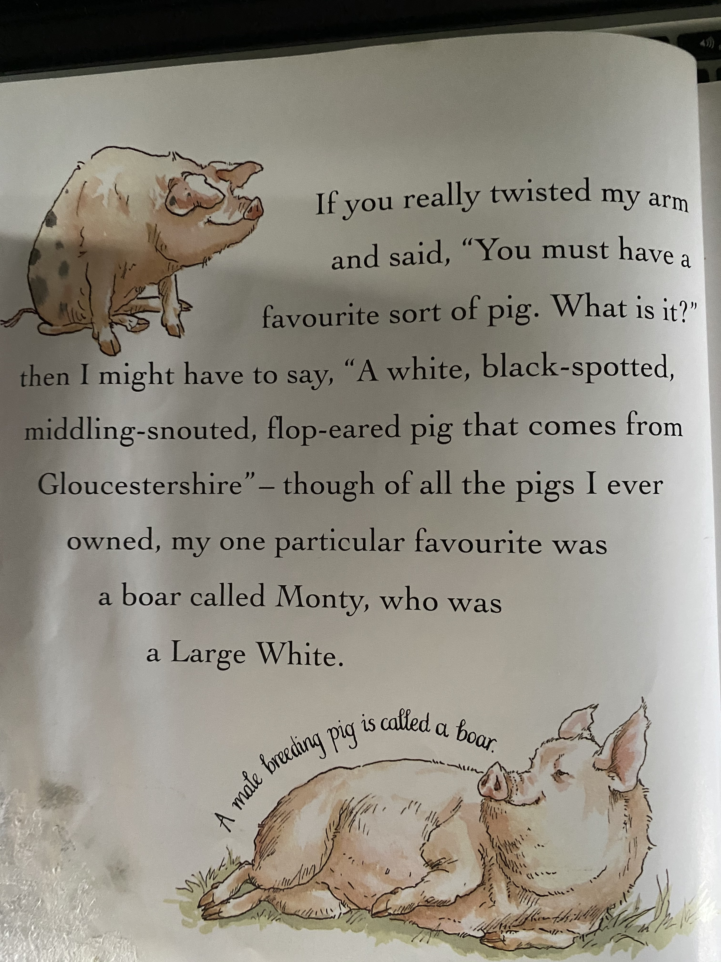

Slide 9
Literacy
This text is written by Dick King Smith, who is a very famous author of books about animals. He also wrote Sophie’s Snail stories.
Beautiful? I can’t believe that ANYONE would think that pigs are beautiful… can you?
Have you ever been to a farm and seen pigs? What are they like? Think of some adjectives to describe them. Beautiful is certainly not one that I would think of.

Slide 10
Literacy
Today’s task is to write a letter to Dick King Smith, persuading him that pigs are NOT beautiful!
Look at the example on the next page…

Slide 11
Dear Dick King Smith,
I am really enjoying your story so far, however, I am wondering why your book is called ‘All pigs are
beautiful?’ Pigs are not beautiful at all. When I have seen pigs they have been as smelly as rotten food and they are monstrous. Pigs live in dirty, muddy conditions and are too noisy.
They are far from cute and some of them are extremely large.
I think that new-born babies or soft, cuddly puppies are beautiful but not pigs!
Yours Sincerely,
Miss Maher

Slide 12
Wake up shake up!
Here is a link to our wake-up shake up song on youtube.
https://www.youtube.com/watch?v=KSbwHzlcgs8
Why don’t you do our wakeup-shakeup routine to give yourself some energy and get both sides of your brain working well.

Slide 13
Click the following link for the teaching video. Finding the total
Maths!
https://vimeo.com/479815623
Now complete the attached worksheets for Wednesday.

Slide 14
Challenge Questions Only complete these if you want a further challenge from the lesson you have already done.

Slide 15
Handwriting
Complete the attached worksheet for Wednesday

Slide 16
P.E
Try and get some exercise; either in your house or perhaps in the garden.

Slide 17
R.E
Follow this link for the R.E unit about the Nativity.
https://classroom.thenational.academy/units/the-nativity-c64a

