Slide 1
Wednesday 25th November 2020

Slide 2
Busy Books
1) Write down the factors for:
A) 32 B) 60 C) 24 D) 48
2) Use the bus stop method to show the reason for your answer: Be careful… some might not divide evenly.
Is 3 a multiple of 78? (Yes/No)
Is 5 a multiple of 65? (Yes/No)
Is 7 a multiple of 85? (Yes/No)
3) Write down the multiples of 6.

Slide 3
Rockstars

Slide 4
Cold Write
Step 1: Read through your planning to remind yourself of the story you are going to write.
Step 2: Take 5 minutes to add anything else to your planning – this could be thoughts, adjectives, speech, etc.
Step 3: Make sure you have planned your beginning, middle and end.
Step 4: Challenge yourself and push yourself to use creative story telling and description.

Slide 5
Checklist
Maximum 4 paragraphs. (This is very tricky, this means you need to be clear, concise and accurate)
Paragraph 1 – Introduction of characters, setting and beginning of the big event/problem.
Paragraph 2 and 3 – Character journey and route to the resolution (Big event – describe what happens and what your characters are going to do to rectify it.)
Paragraph 4 – End your story and make sure you have a resolution for the big event/ problem your characters faced.

Slide 6
Off you go

Slide 7
Break

Slide 8
P.E

Slide 9
Maths
I can understand and use common factors

Slide 12
List the factors of 36
Which number is not a factor of 14?
1 4 7 14
What fraction of the multiples of 7 are odd?
Less than half Half More than half
64 ____ 48 ____ 32

Slide 13
List the factors of 36
Which number is not a factor of 14?
1 4 7 14
What fraction of the multiples of 7 are odd?
Less than half Half More than half
64 ____ 48 ____ 32
1, 2, 3, 4, 6, 9, 12, 18, 36
56
40

Slide 15
1 row of 8 is equal to 8
1 and 8 are factors of 8
Have a think
2 rows of 4 are equal to 8
2 and 4 are factors of 8
The factors of 8 are: 1, 2, 4 and 8

Slide 16
Have a think
1, 2, 3, 4, 6 and 12
The factors of 12 are: ________________
The factors of 8 are: 1, 2, 4 and 8
1, 2 and 4 are factors of 12 and 8
1, 2 and 4 are common factors of 12 and 8
Whitney and Dexter both have dark hair.
They have dark hair in common.

Slide 17
Factors of 15
Factors of 25
1, 5, 25
1, 3, 5, 15
Common factors of 15 and 25
Have a think
1
2
3
5
15
25

Slide 18
Have a go at questions 1 - 3 on the worksheet

Slide 19
What is the highest common factor of 27 and 90?
9
The factors of 27 are 1, 3, 9 and 27
Have a think
The factors of 90 are ________________________________
1, 2, 3, 5, 6, 9, 10, 15, 18, 30, 45 and 90
3 and 30
1 and 90
5 and 18
90
2 and 45
6 and 15
9 and 10

Slide 20
Rosie has 14 tennis balls.
Amir has 24 tennis balls.
Ball containers can hold 2, 4, 8 or 10 balls.
Each child wants to buy containers all of the same size and to have only full containers.
Have a think
1) Which container size could both Amir and Rosie use? _____
2) Which container size could neither Amir nor Rosie use? ______

Slide 21
Rosie has 14 tennis balls.
Amir has 24 tennis balls.
Ball containers can hold 2, 4, 8 or 10 balls.
Each child wants to buy containers all of the same size and to have only full containers.
1) Which container size could both Amir and Rosie use? ______
2

Slide 22
Rosie has 14 tennis balls.
Amir has 24 tennis balls.
Ball containers can hold 2, 4, 8 or 10 balls.
Each child wants to buy containers all of the same size and to have only full containers.
2) Which container size could neither Amir nor Rosie use? ______
10

Slide 23
Have a go at questions 4 - 9 on the worksheet

Slide 24
Lunch

Slide 25
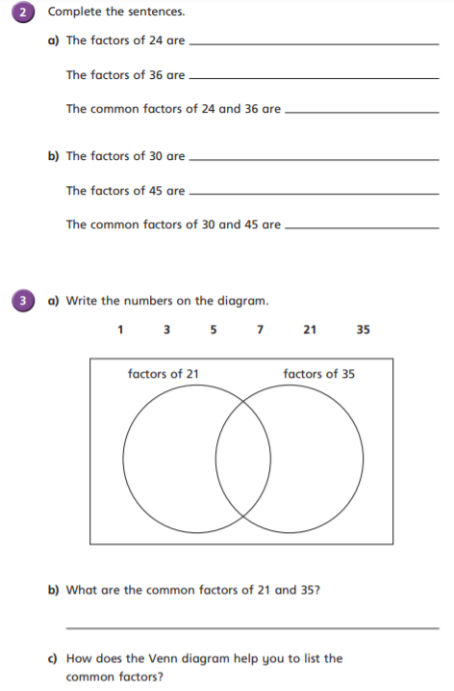
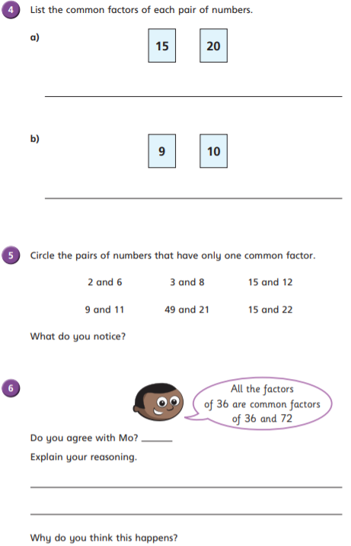
Maths Worksheets – Independent Tasks

Slide 26
Computing L2

