Slide 1
Wednesday 18th November 2020

Slide 2
Busy Books
157,998
Add 68,822
Subtract 49,375
Half it
Create Bar Model for it.
Create a Part Whole Model for it
Write the value of each number e.g. 1 = 100,000 etc

Slide 3
Non- Fiction Information booklets 0900-0940
As we didn’t get enough time yesterday to conduct further research and complete our information booklets, we will complete our booklets this morning.
You should have used:
Headings
Sub Headings
Pictures
Fact boxes
Captions
Glossary (small if used).

Slide 4
Presentation Time

Slide 5
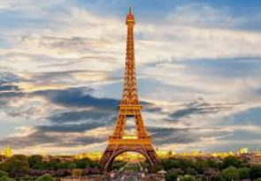
French M. Magee

Slide 6
Break

Slide 7
P.E (Lesson 2 Basketball)

Slide 8
Maths

Slide 9
Maths
I can complete, read and interpret information in tables, including timetables.

Slide 13
Answers:
1A) 28 and 24
1B) 5
1C) 28
1D) 14
1E) Sunday

Slide 15
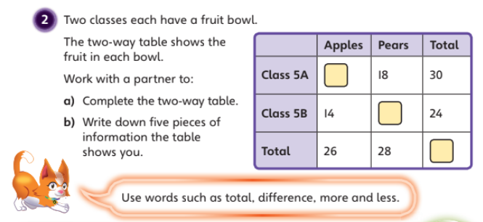
12
10
54

Slide 16
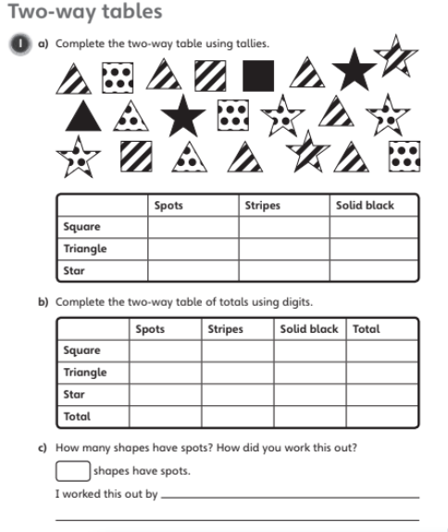

Slide 17
Plenary

Slide 18
Lunch

Slide 19
Newcastle Foundation “Restart a Heart” 1330 - 1430

Slide 20
Purple Pen Corrections Maths and English

