Slide 1
17/11/20
What is….
10p + 3p =
5p + 20p =
30p + 7p=
55p - 6p =
30p + 8p =
25p + 10p =
47p – 20p =
10p + 5p =
20p + 3p =
10) 28p + 30p =
19p – 10p =
16p + 60p =
25p + 10p =
45p – 20p =
25p - 15p =

Slide 2
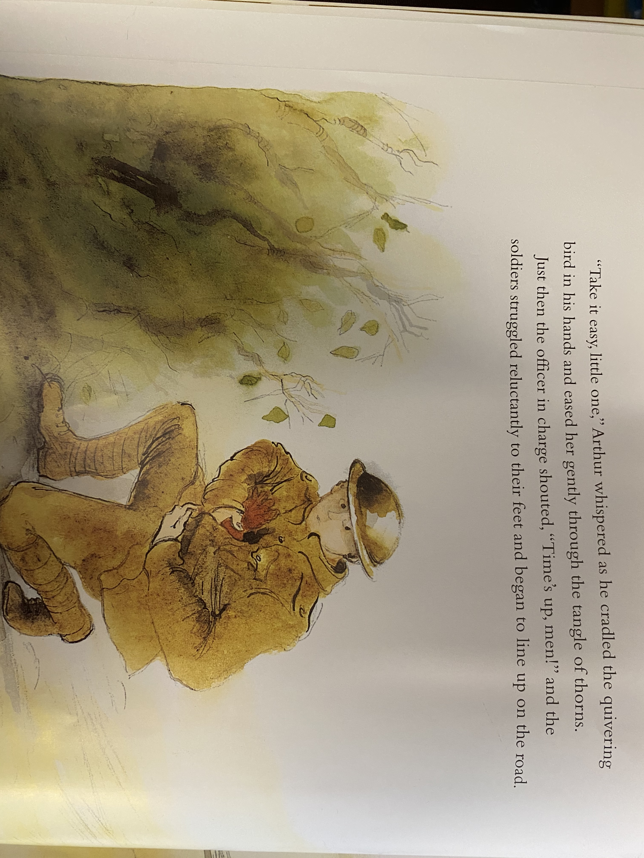
Reading the text Practise reading the following pages with fluency. It might help to read and reread the pages.

Slide 3
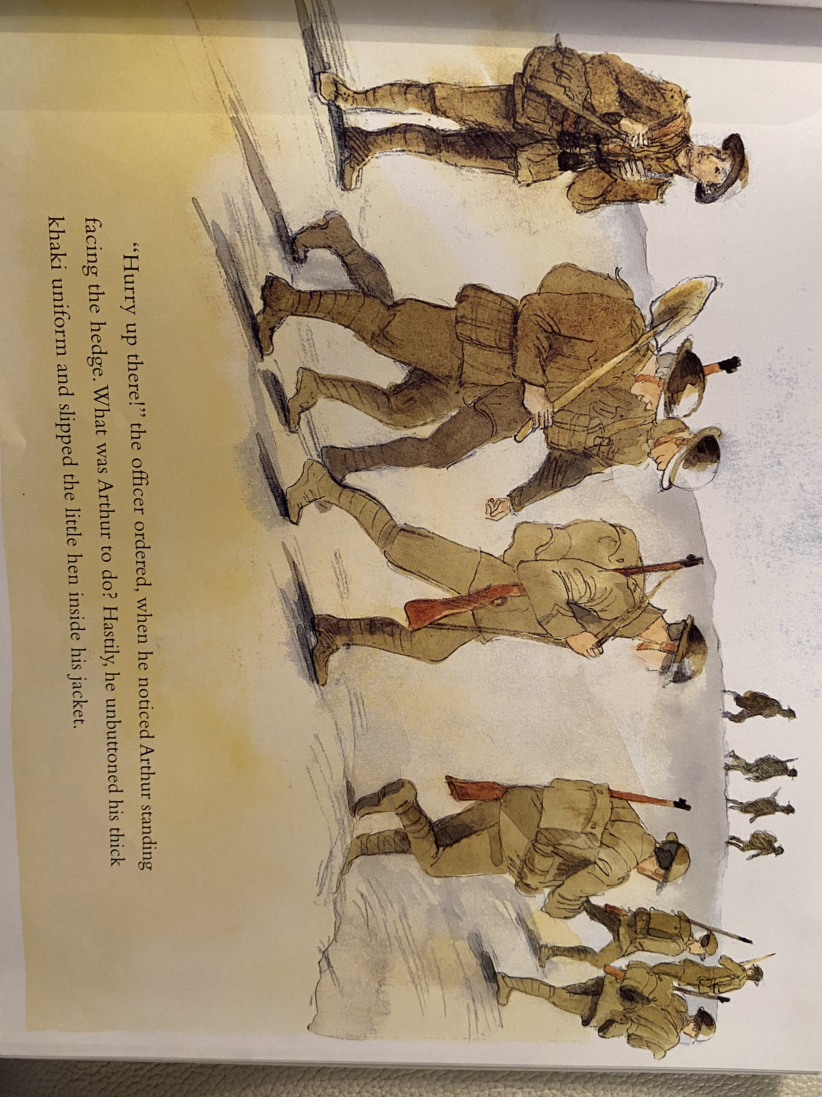

Slide 4
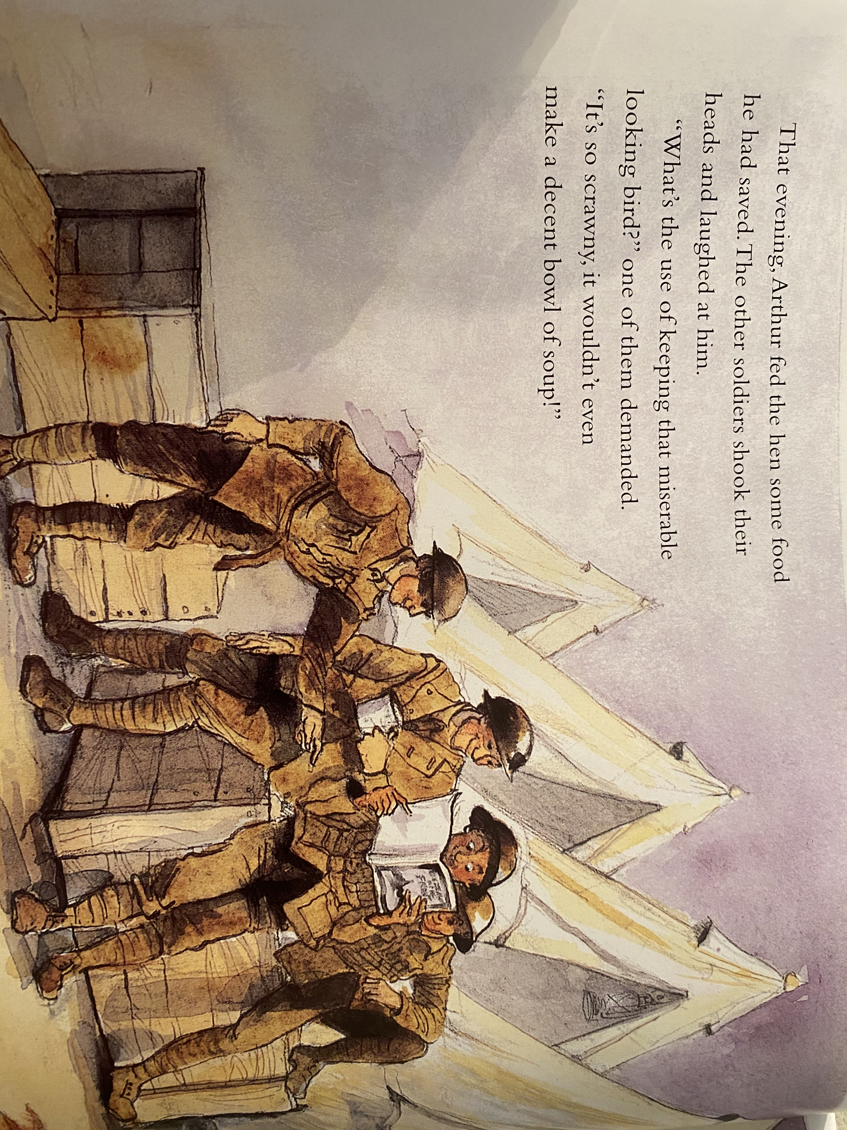

Slide 6
Remind yourself of the features of a diary entry.
Include the date and/or time
Write as if I were there (in first person)
Talk about where events happened
Describe my feelings
Use time conjunctions

Slide 7
Start writing your diary entry as if you are Arthur, living in the trenches. We will be continuing to write the diary tomorrow so don’t worry if you don’t finish. Don’t forget to write ‘Perfect Sentences’ – you can see this checklist on yesterday’s work.

Slide 8
Maths!

Slide 9
Click the following link for the teaching video.
https://vimeo.com/471307411
Now complete the Tuesday Maths PowerPoint and complete the attached worksheets.

Slide 10
Handwriting
Complete the attached Handwriting sheet, start at the beginning and work through each day.

Slide 11
Computing
Please log on to Purple Mash and see the Programming ‘to-do’ called
‘Air Trafic Control’.

