Slide 1


Slide 3




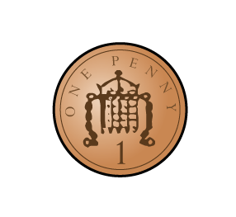

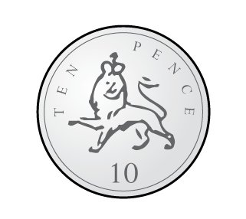
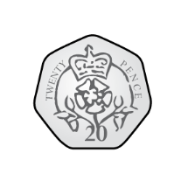
Which of these represent 24

Slide 4
Which of these represent 24

Slide 6

What do you notice?
£1
£2
£5
£10
£20
£50
Two of these have to be made with coins
Notes:
Dora, Whitney and Teddy are on a role now.
But this one looks different! Let’s see if they can use what they know
Whitney knows that 100 take away 40 is equal to 60
And Dora knows that 60 take away 2 is equal to 58
So Teddy has realised that 100 takeaway 42 must be equal to 58
Great team work guys!

Slide 7

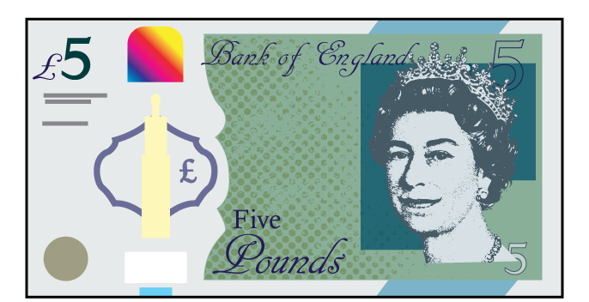
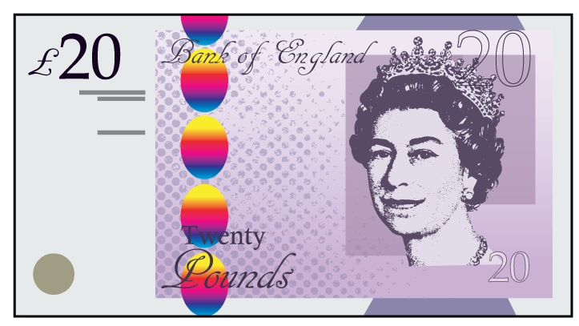

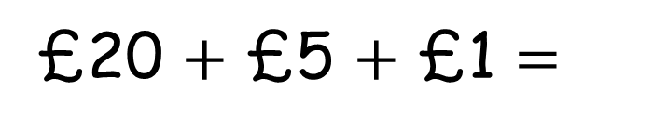
It’s easier to add them if I place the greatest value notes first
£20 $+$ £5 $+$ £1 $=$
£26
Notes:
Dora, Whitney and Teddy are on a role now.
But this one looks different! Let’s see if they can use what they know
Whitney knows that 100 take away 40 is equal to 60
And Dora knows that 60 take away 2 is equal to 58
So Teddy has realised that 100 takeaway 42 must be equal to 58
Great team work guys!

Slide 8

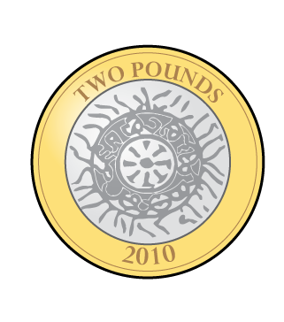
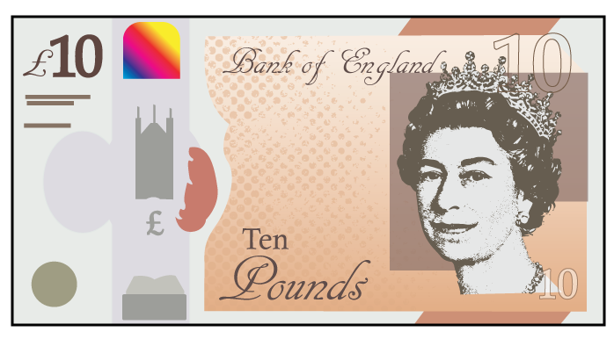
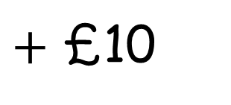
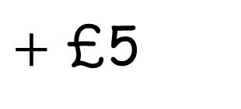
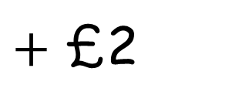
If they’re pictures of notes and coins you could splat paint on them
£10
$+$ £10
$+$ £5
$+$ £2
Notes:
Dora, Whitney and Teddy are on a role now.
But this one looks different! Let’s see if they can use what they know
Whitney knows that 100 take away 40 is equal to 60
And Dora knows that 60 take away 2 is equal to 58
So Teddy has realised that 100 takeaway 42 must be equal to 58
Great team work guys!

Slide 9
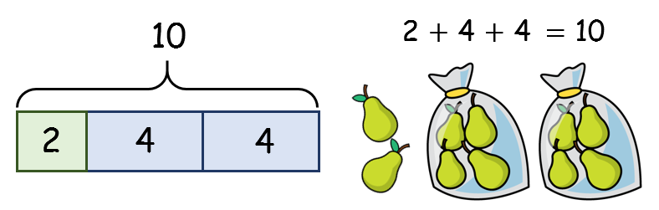
Have a go at questions
1 - 4 on the worksheet

Slide 10

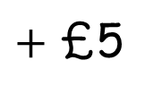
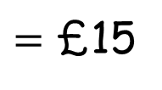
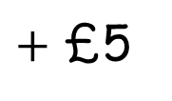
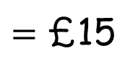
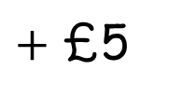
Well my £15 is better because I have notes
No you don’t, I have £15
I have £15
£10
$+$ £5
$=$ £15
£5
$+$ £5
$+$ £5
$=$ £15
Notes:
Dora, Whitney and Teddy are on a role now.
But this one looks different! Let’s see if they can use what they know
Whitney knows that 100 take away 40 is equal to 60
And Dora knows that 60 take away 2 is equal to 58
So Teddy has realised that 100 takeaway 42 must be equal to 58
Great team work guys!

Slide 11
Have a go at questions
5, 6 and 7 on the worksheet

