Slide 1
Good Morning Year 2 Well done for all your hard work, I am enjoying seeing pictures of what you have been doing. Have a lovely day Mrs Southern

Slide 2
Use < or > or = in the boxes to complete the following
1) 50 + 5 67 - 2
2) 29 + 20 41 + 8
3) 20 + 10 15 + 15
95 - 7 75 + 15
30 + 20 25 + 15
43 + 5 44 + 3
25 + 50 40 + 40
38 + 4 30 + 2
60 + 30 25 + 45
90- 4 75 + 25
24/11/20
Please see the next page for another version if this is a bit tricky!

Slide 3
Use < or > or = in the boxes to complete the following
1) 50 67
2) 20 10 + 10
3) 10 + 5 15
4) 20 – 7 10 + 3
29 20 + 7
43 + 5 59
25 20 + 5
40 20 + 10
38 + 4 30 + 2
60 + 30 6 + 3
10 - 4 10 - 6
24/11/20

Slide 4
Phonics Spend a little time on each of the activities below.
Lexia – Don’t forget to log on to this regularly, if you have a log-in.
Phonics – Practise the games on phonicsplay website.
Spelling Practise - Look at the spelling rule in your spellings this week. Write each word out and have a look at what is tricky/unusual about the spelling – just as we would at school.
HF words – Play spooky spellings
http://www.ictgames.com/mobilePage/spookySpellings/index.html
Choose the Year 1 list if Year 2 words are too tricky.

Slide 5
SPAG
Today we are going to learn about coordinating conjunctions. Follow the link to learn what they are and complete the activity and quiz.
https://www.bbc.co.uk/bitesize/topics/z4mh7yc/articles/zwsgydm
Now…
Can you write 3 sentences using coordinating conjunctions? The conjunctions you should use are;
and or but

Slide 6
Literacy
On the next slide there are 5 clues about an animal.
Can you guess what the animal is? Do you notice how the best clues are left until the end? This is so that the reader doesn’t guess the animal straight away.
Now…
Can you write 5 clues about an animal of your choice? Remember to keep the best clue until the end.
Draw a picture of the animal underneath and stick a flap of paper (post-it note or cut a piece of paper) over the top to keep it a secret.
Remember to make sure your spellings are correct and your clues make sense.
I can’t wait to guess all of your animals.

Slide 7
I live on farms and a group of us is known as a flock.
If you find me on my back, I can’t turn over so I am probably in distress
I have rectangular pupils which help me see all the way around me (360 degree vision).
My wool will grow forever which is useful because it can make you a nice wooly jumper!
My mum is known as a ewe and my dad is a ram. I am known as a lamb.
What am I?

Slide 8
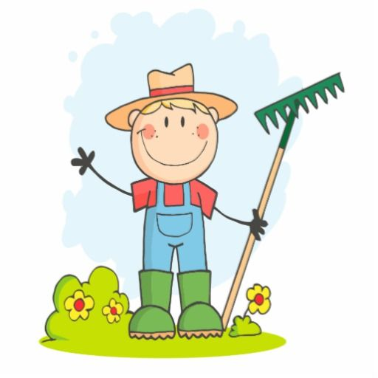
The farmer has just left me some clues about our new book. Can you guess what animal our book is about ?

Slide 9
I live on a farm and have 4 legs.
We learn to run to our mothers’ voices and can recognise our own name by the time we’re only 2 weeks old! How clever is that?
I love food and I can eat ANYTHING!
I am a very chatty animal we communicate by grunting to each other constantly.
We love to roll around in the mud or water but this is to cool our body down.
What am I?

Slide 10
Wake up shake up!
Here is a link to our wake-up shake up song on youtube.
https://www.youtube.com/watch?v=KSbwHzlcgs8
Why don’t you do our wakeup-shakeup routine to give yourself some energy and get both sides of your brain working well.

Slide 11
Click the following link for the teaching video. Compare Money
Maths!
https://vimeo.com/479814464
Now complete the attached worksheets for Tuesday.

Slide 12
Challenge Questions Only complete these if you want a further challenge from the lesson you have already done.

Slide 13
Handwriting
Complete the attached handwriting sheet for Tuesday.

Slide 14
Computing
Last week in our computing lesson we learned what an ‘Algorithm’ is. Can you remember what it is?
That’s right, it is a set of instructions to solve a problem or achieve an objective.
Can you remember making the aeroplane take off? This game is still set as a ‘To do’ on purplemash if you wanted another go.

Slide 15
Computing
Now have a go at the ‘Vehicles’ and the ‘Turtle’ coding tasks which I have set for you on purplemash.
Please get in touch if you can’t log onto your purplemash account.

Slide 16
P.E
If we were at school, you’d be heading outside to do PE with Robbie now.
Instead why don’t you try and do some exercise at home. This might be going for a run around your garden or playing football. You might prefer to do some dancing or follow an exercise program on the computer/TV!

