Slide 1
Tuesday 1st December 2020

Slide 2
SPaG – Adverbs for possibility

Slide 3
What Is an Adverb?
Can you remember what an adverb does? Which of these are adverbs?
Sort them into the correct places in the table.
Adverbs | Not Adverbs
happily
lonely
very
rainy
busy
yesterday
always
totally
smelly
daytime
angrily
furious
sad
daily

Slide 4
Which Word Is Being Modified?
In the following sentences an adverb has been circled, but which word is it modifying?
Sam eats his crisps noisily.
I am so excited about our school trip to the zoo.
She could possibly be the worst driver in the world.
Jacob walked incredibly slowly to the head’s office.
Kara has amazingly bright pink hair at the moment.
verb
adjective
verb
adverb
adjective
Extension:
Can you identify which part of speech the modified words were?

Slide 5
Classifying Adverbs
Adverbs can be grouped into types; time, place, manner, degree, frequency and possibility. Can you group the following?
Adverbs of Time | Adverbs of Place | Adverbs of Manner | Adverbs of Degree | Adverbs of Frequency | Adverbs of Possibility
daily
here
yesterday
downstairs
very
certainly
definitely
fast
everywhere
slowly
happily
never
often
nearly
below
quite
always
now
really
sometimes
incredibly
last year
possibly
maybe

Slide 6
Adverbs of Possibility Scale
Adverbs of possibility tell us how likely something is to happen.
certainly
definitely
maybe
possibly
surely
clearly
obviously
perhaps
probably
Can you order them in terms of how certain something is?
least certain
most certain
How did you organise the adverbs?
Do you and your partner agree on the same order? If not, discuss why.

Slide 7
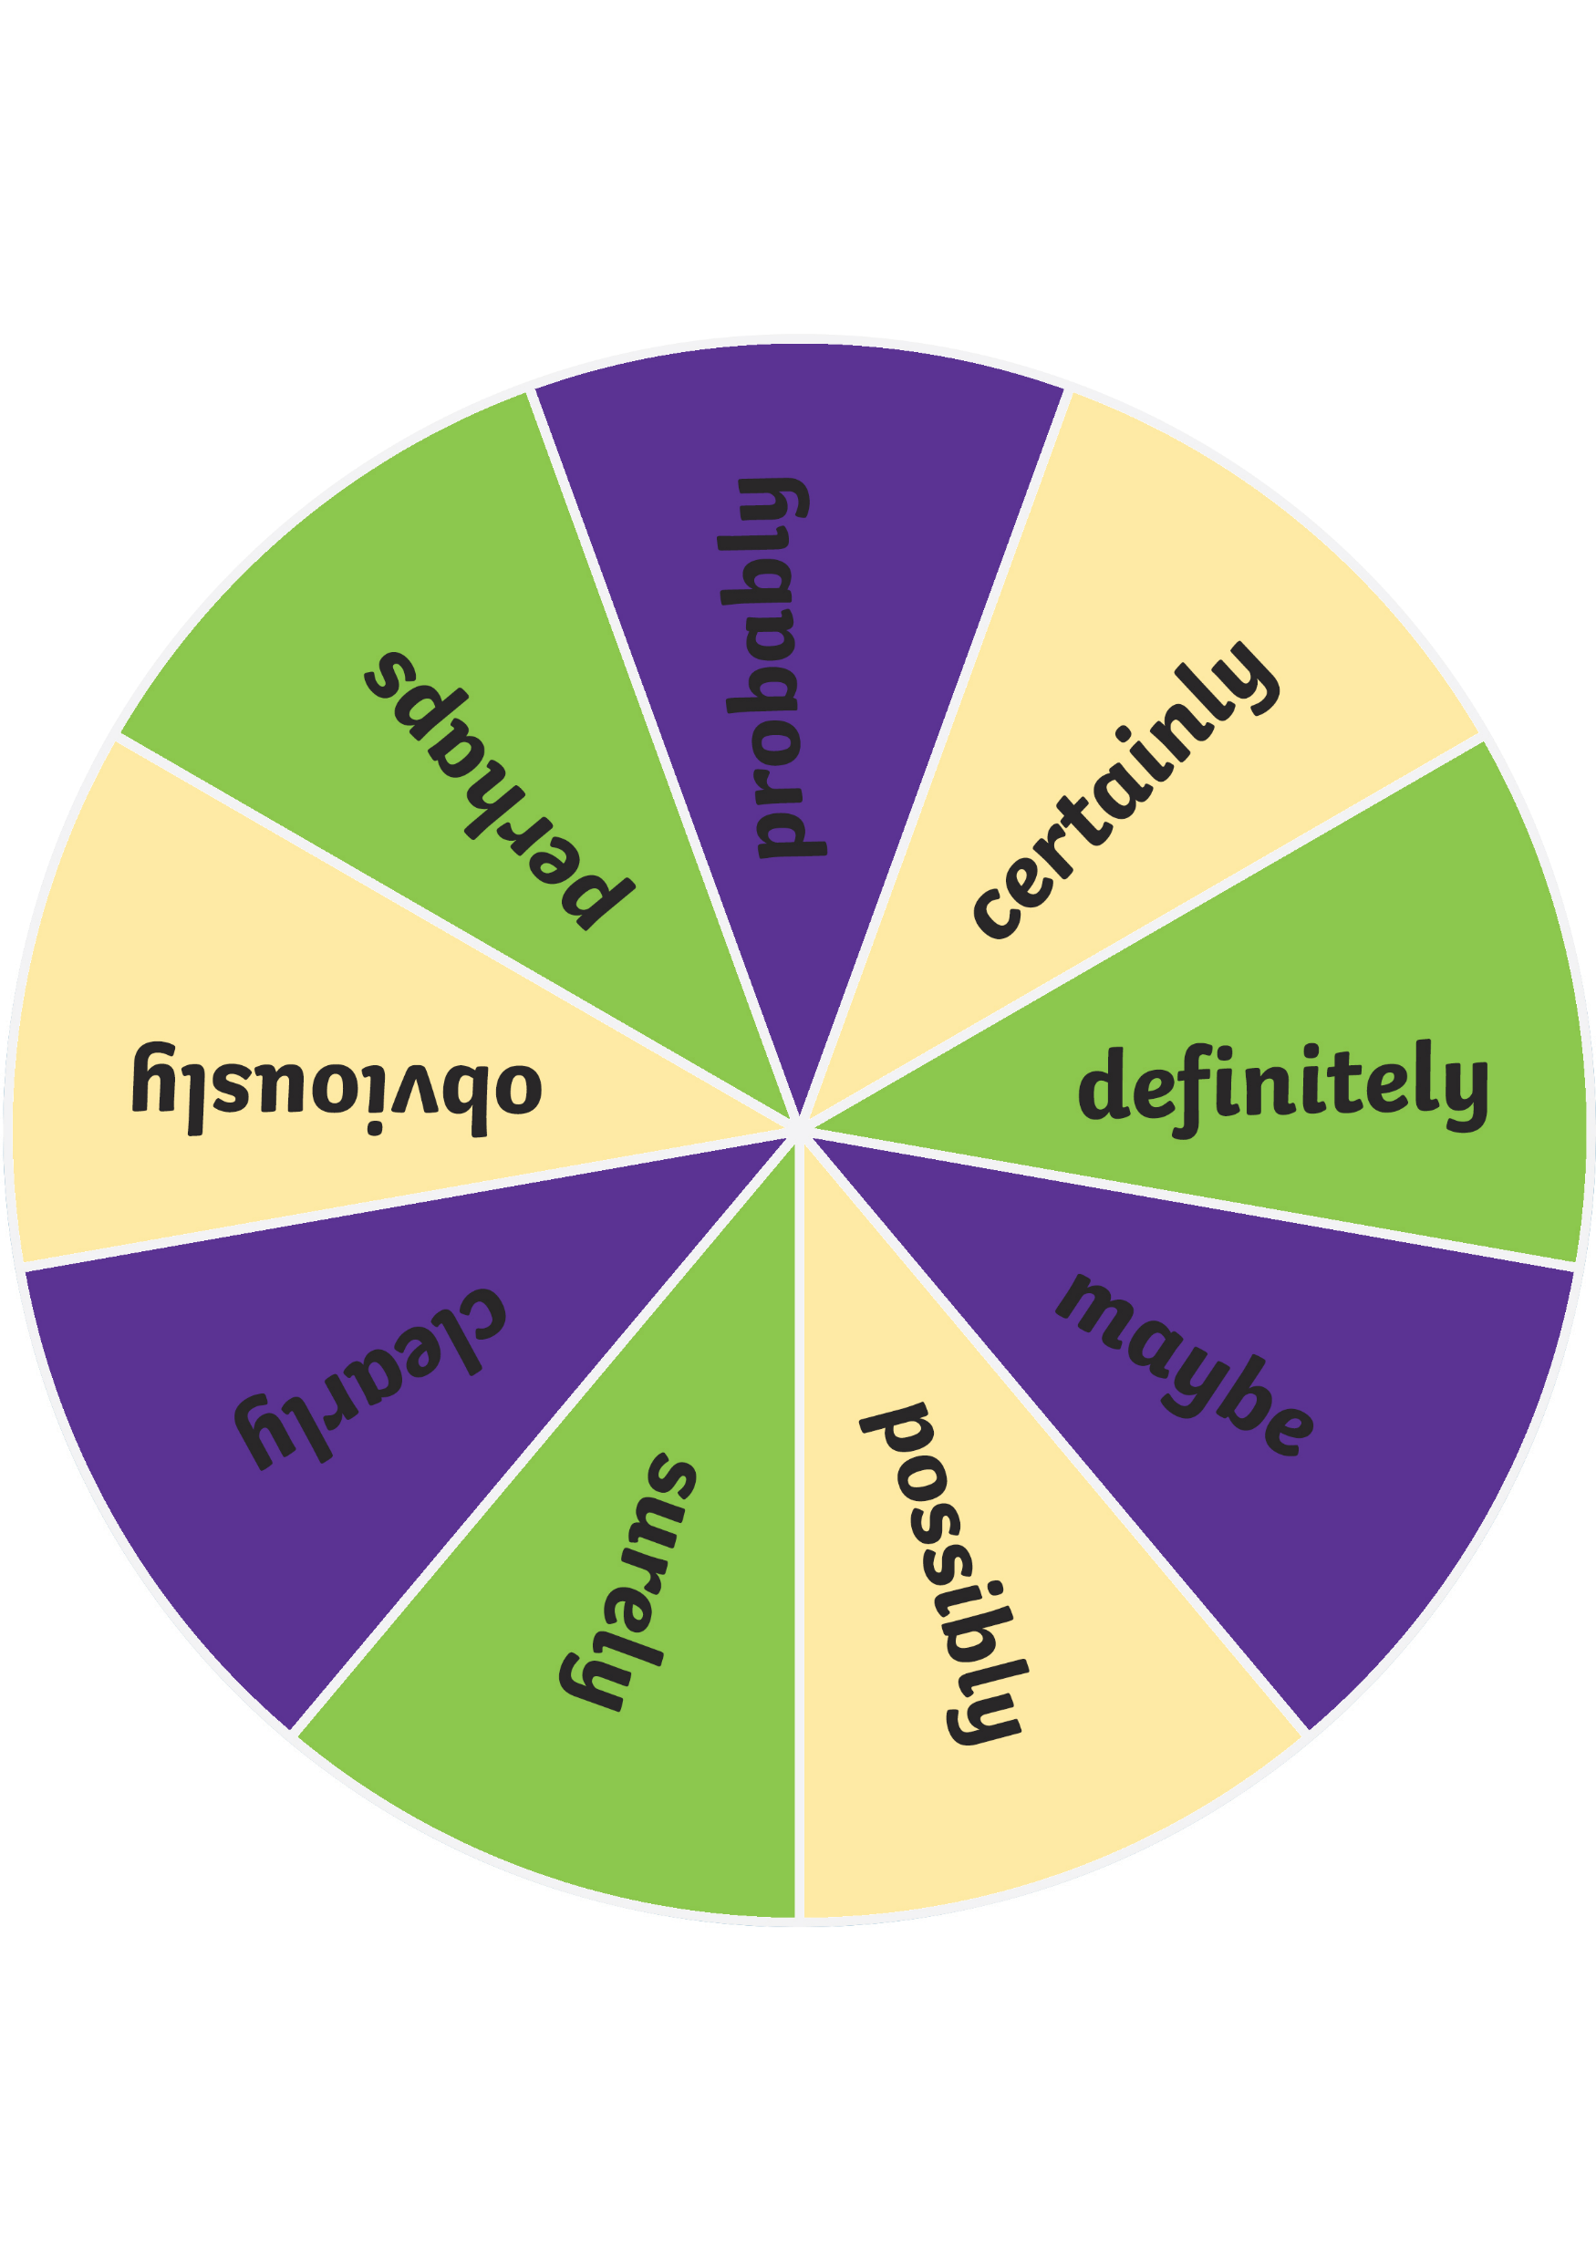
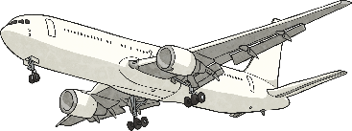
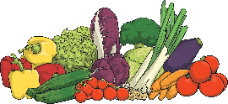
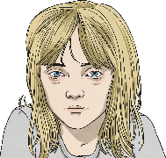
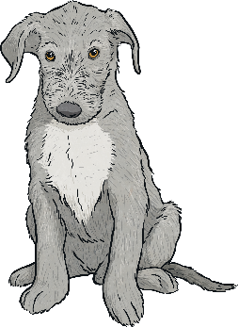
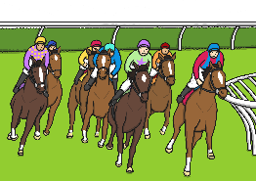
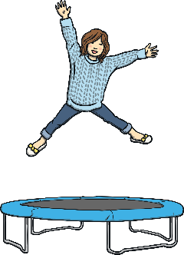
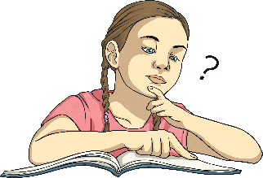
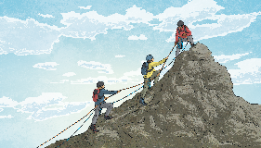
Spin the Wheel
Spin the wheel to select an adverb of possibility to use in your sentence.
Choose a picture to write an interesting sentence about using the adverb of possibility that you have selected to explain how likely something is to happen.
Share your ideas with your partner and compare your sentences.
Spin
Next

Slide 8
How Certain Is It?
What do you think travel will be like fifty years from now? Will we still go on trains and buses or will hoverboards and time travel have taken over? Write a description of what travel will be like using adverbs of possibility to explain how certain you think events are going to be.
certainly
definitely
maybe
possibly
surely
clearly
obviously
perhaps
probably
Example beginning:
Clearly, people will still want to travel in fifty years but the way they do so will definitely be different from today. Trains will probably still exist but they will surely be much faster (and have less delays) than they are these days.

Slide 9
Adverbs of Possibility Quick Quiz 1
Highlight the adverb of possibility in each of the following sentences:
I will probably go to the school disco on Friday.
We will certainly win this football game because we are 12-0 up after just twenty minutes.
If it doesn’t rain, I will possibly play on my trampoline after school.
Surely, we should finish our homework before we go out to play.
Zach is definitely the tallest child in our class.

Slide 10
Adverbs of Possibility Quick Quiz 2
Which event is the author most certain about?
The rabbits are certainly guilty of stealing the carrots from our garden.
Helena was obviously unwell when she arrived at school this morning.
Perhaps I should have explained in more detail what the task entailed.
Maybe we’ll visit the museum again soon.

Slide 11
Adverbs of Possibility Quick Quiz 3
Choose an adverb of possibility to complete each of the following sentences depending on how likely you think that they are to happen:
England will win the next football World Cup.
I will remember to pack a toothbrush.
We will have a BBQ if the weather warms up this weekend.
The sun will come out tomorrow.
Possible Answers
England will perhaps win the next football World Cup.
I will probably remember to pack a toothbrush.
We will possibly have a BBQ if the weather warms up this weekend.
The sun will certainly come out tomorrow.

Slide 12
English
I can read and review a statement and identify if it has been used in the text.

Slide 13
Looking into figurative language…
What figurative languages features does Hans Christian Andersen use: Metaphors, Similes, Personification etc

Slide 14
Really understanding the text…
When you are reading a text it is important to know what has been said and what has not been said.
Diving deeper into the text and searching for true statements helps you fully understand what you have been reading.

Slide 15
Statement | True or False
When the Ogre made the mirror, he was in a really good mood.
The mirror made the loveliest landscapes looked like boiled spinach.
Kay and Gerda didn’t like the Ogre.
Some of the glass was only used for Window panes.
People didn’t have enough space to have a little garden.
The Grandma loved telling stories.
After the frost, the roses bloomed so marvellously.
Gerda seen Kay flying away and knew she had to help.
Kay said “…looked like a magnificent flower or a ten-pointed star.”

Slide 16
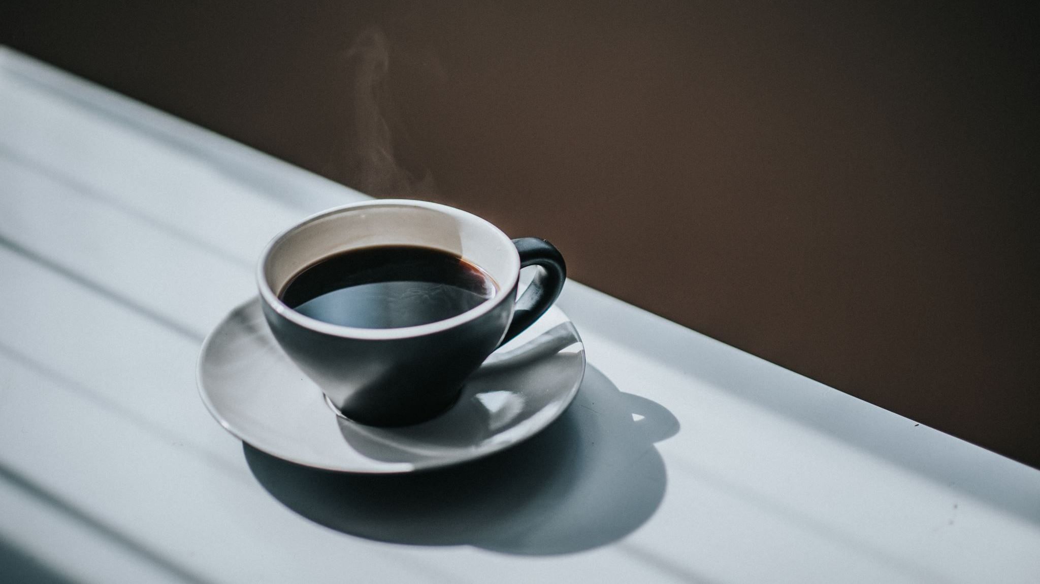
Break

Slide 17
DMM
Write down the prime numbers from:
0 – 30
Write down the factors of:
A) 24 B) 63 C) 80
Complete the sequence:
500, 1000, _____, 2000,______,______,______, 4000
220, 440, 660, _____, ______,______, 1540
Use the bus stop method to work out:
A) 1246 ÷ 2 = B) 6930 ÷ 3 = C) 7590 ÷ 5 =

Slide 18
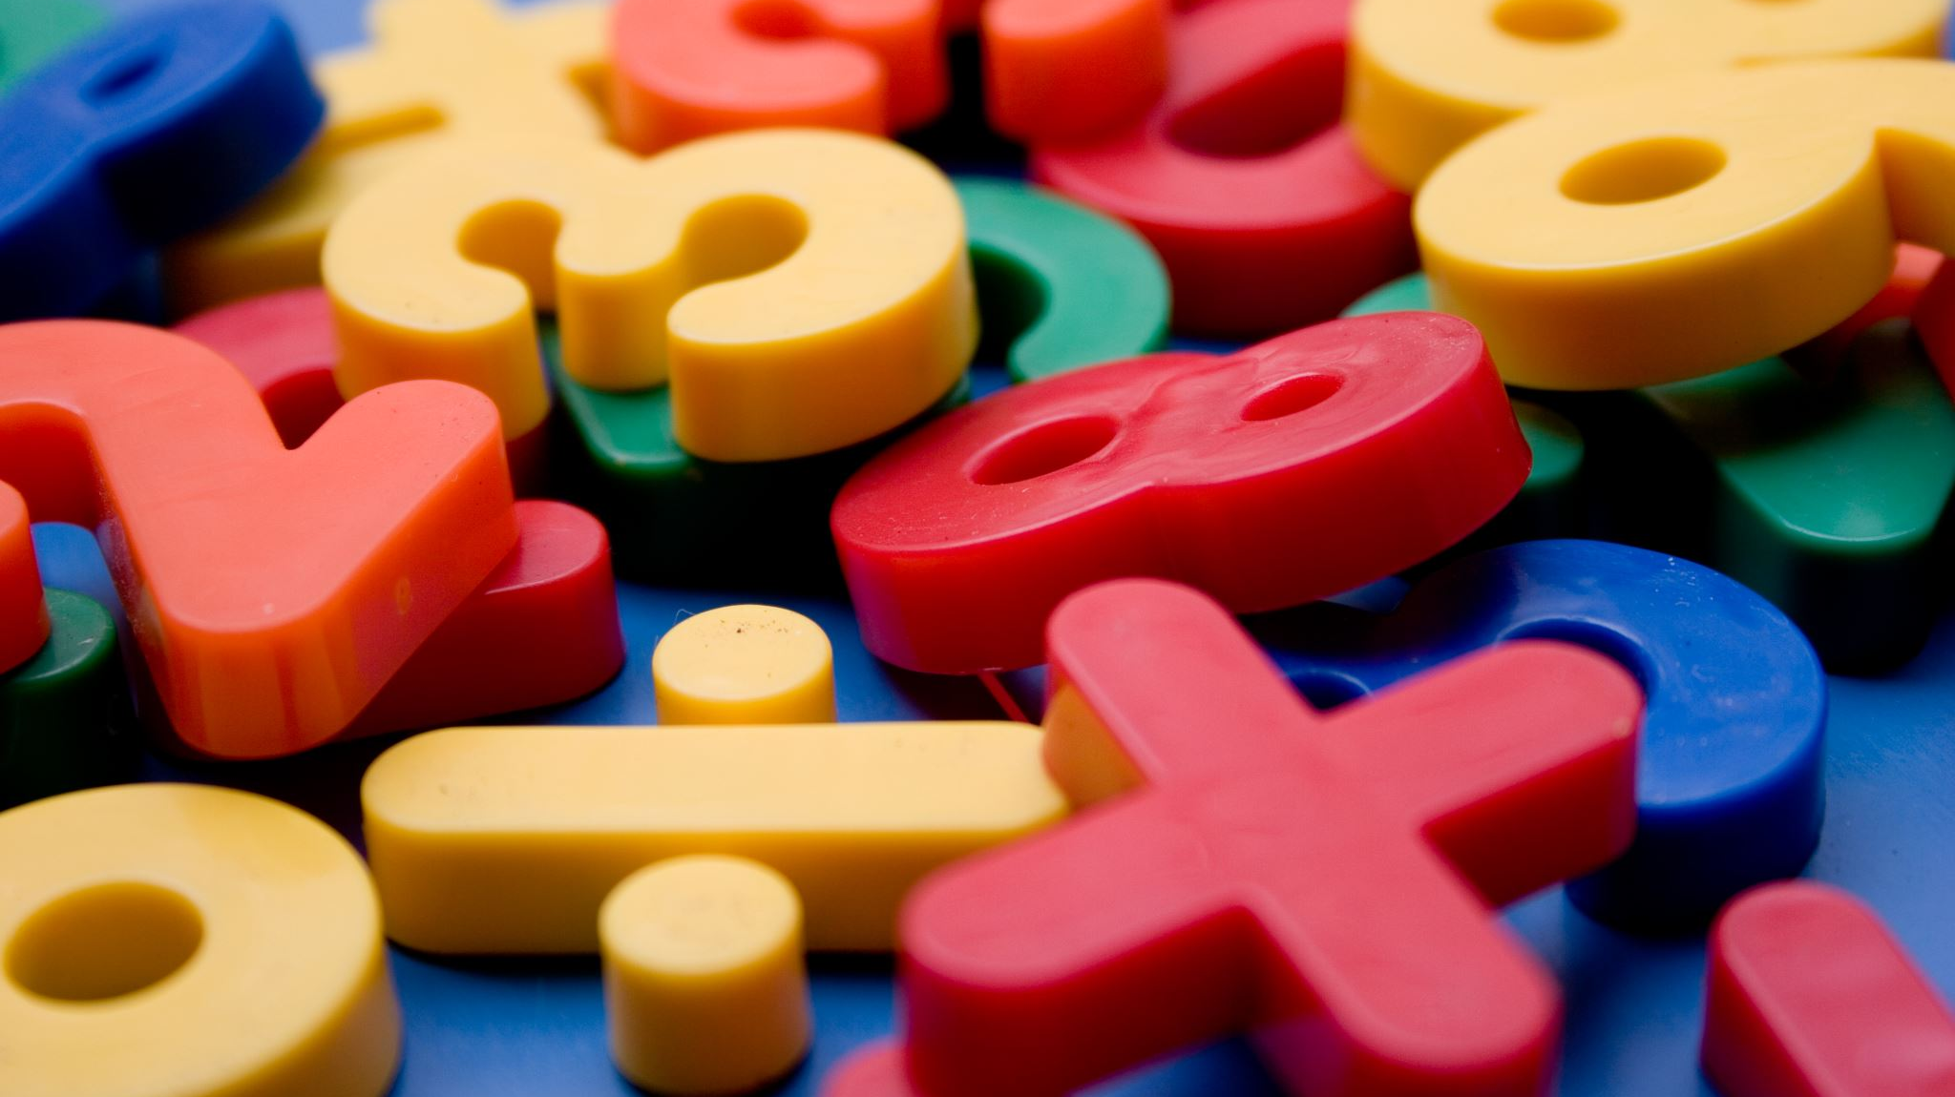
Maths
I can use and solve squared number problems.

Slide 19
1) What is the sum of 6 and 9?
2) What is the product of 6 and 9?
3) 6 × 6 = $−$ 10
4) List the factors of 16

Slide 20
15
1) What is the sum of 6 and 9?
2) What is the product of 6 and 9?
3) 6 × 6 = $−$ 10
4) List the factors of 16
54
46
1, 2, 4, 8, 16

Slide 22
1 row of 9 is equal to 9
1 and 9 are factors of 9
3
3 rows of 3 are equal to 9
3 is a factor of 9
3
Using 9 counters it is possible to make a square.
9 is a square number.

Slide 23
Is 10 a square number?
No

Slide 24
1) Is 4 a square number?
Yes
Have a think
2) Is 6 a square number?
No

Slide 25
Have a think
Does this show that 8 is a square number?
No

Slide 26
Have a go at questions 1 - 5 on the worksheet

Slide 27
3
3
3 rows of 3 counters is equal to 9
3 × 3 = 9
The product of an integer multiplied by itself is a square number.

Slide 28
The product of an integer multiplied by itself is a square number.
3 × 3 = 9
${\text{3}}^{\text{2}}$ = 9
$$\text{"3 }\text{squared} \text{is} \text{equal} \text{to}\text{ 9"}$$
${\text{1) 4}}^{\text{2}}$ =
16
4 multiplied by itself
4 × 2 =
4 × 4 =
Have a think
$$\text{2}$$
25
3) 49 =
${\text{2) 5}}^{\text{2}}$ =
7
5 × 5 =
7
7
__ × __ = 49

Slide 29
Dora is thinking of a square number.
It is odd.
Its digits sum to 7
It is one more than a multiple of 8
25
What number is Dora thinking of?
Have a think
41
4 + 1 = 5
41’s digits sum to 5
1
4
9
16
25
2 + 5 = 7
1 + 6 = 7
24

Slide 30
Have a go at questions 6 - 10 on the worksheet

Slide 31
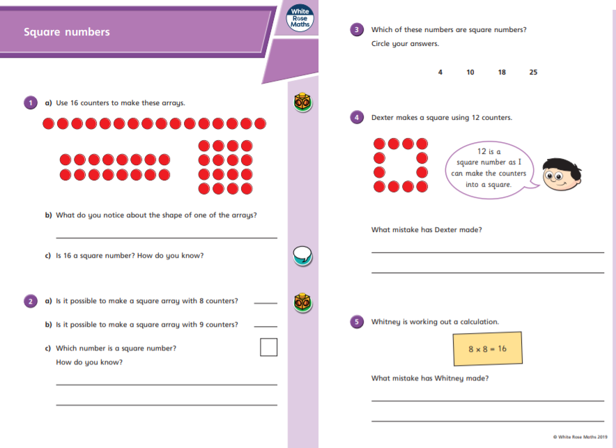

Slide 32
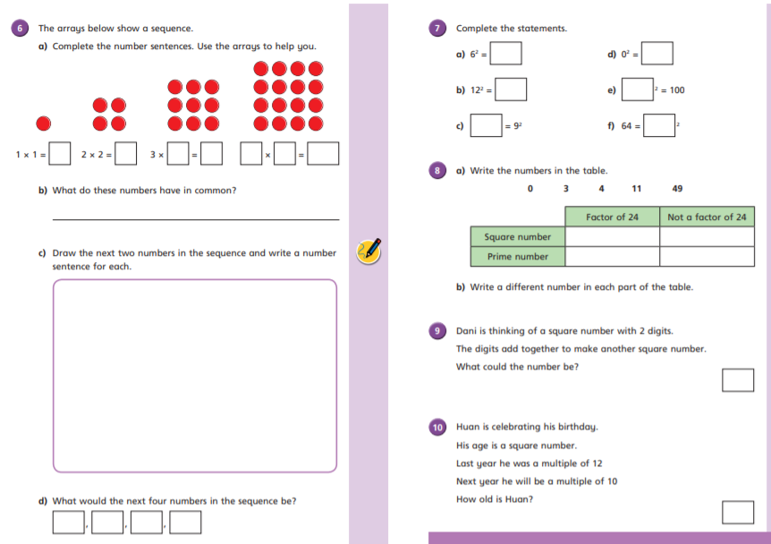

Slide 33
lunch

Slide 34
Geography

