Slide 1
Tuesday

Slide 2
Busy Books
663,804
Add 78,458
Subtract 538,504
Half it
Create Bar Model for it.
Create a Part Whole Model for it
Fill in the missing spaces
663,804- ________ = 86,009 so that means ________ + 86,009=663,804

Slide 3
English I can retrieve, record and present information from non-fiction

Slide 4
Chromebook further research
Magnets and Forces
Friction
Air resistance
Gravity
Magnetic Force

Slide 5
Today…
You are going to create a information booklet (Non-Fiction).
All of your research from yesterday will help you create an information booklet.
Magnets and Forces is your Topic.

Slide 6
You must Include…
Headings
Sub Headings
Pictures
Fact boxes
Captions
Glossary (small if used).
Use lots of information and facts!!!

Slide 8
Presentation Time

Slide 9
Break

Slide 10
Maths

Slide 11
Maths
I can complete, read and interpret information in tables, including timetables.

Slide 14
1) 8 × 6 =
2) 80 × 6 =
3) 8 × 60 = 9 × 60 $−$ _____
4) 60 × 80 =

Slide 15
48
1) 8 × 6 =
2) 80 × 6 =
3) 8 × 60 = 9 × 60 $−$ _____
4) 60 × 80 =
480
60
4,800

Slide 17
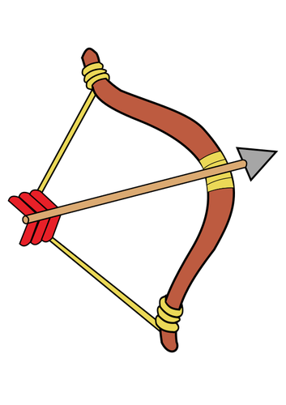
Activity day choices
 | Boys | Girls
Abseiling | 16 | 12
Archery | 14 | 20
Tennis | 9 | 12
1) What does the number 20 mean in the table?
20 girls chose archery
2) How many boys chose archery or tennis?
14 + 9 =
23
Have a think
3) How many girls participated in the activity day?
44
12 + 12 + 20 =

Slide 18
How could we sort these shapes?
 | Circles | Squares | Total
Orange
Blue
Total
2
1
3
3
3
6
5
4
9

Slide 19
Holiday destinations
 | Year 3 | Year 4 | Total
France |  | 5 | 13
Spain | 14 |  | 14
UK | 10 |  | 25
USA | 7 | 13
Total
8
0
15
20
39
33
72
Have a think
France: ___ + 5 = 13
1) Complete the table
2) How many more year 3 pupils went to France than the USA?
USA: 7 + 13 =
20
France: 8
13 $−$ 5 =
1 more pupil
USA: 7
8
Year 3: 8 + 7 + 10 + 14 =
72
39
39 + 33 =
Year 3: 8 + 14 + 10 + 7 =

Slide 20
Distances between UK cities (in miles)
Aberdeen
490 | Cambridge
355 | 149 | Leeds
667 | 343 | 371 | Truro
1) How far is it from Aberdeen to Leeds?
355 miles
Have a think
2) How far is it from Truro to Cambridge?
343 miles
3) Which two cities are closest to each other?
Cambridge and Leeds

Slide 21
Have a go at questions 1 - 3 on the worksheet

Slide 22
Highest mountains on each continent
Name | Height (m) | Continent | Country | First ascent
Everest | 8,848 | Asia | Nepal and China | 1953
Aconcagua | 6,961 | South America | Argentina | 1897
Denali | 6,194 | North America | USA | 1913
Kilimanjaro | 5,895 | Africa | Tanzania | 1889
Elbrus | 5,642 | Europe | Russia | 1874
3) Round Aconcagua’s height to the nearest 100 m.
2) Which mountain was first ascended earliest?
1) In which continent is Denali?
Have a think
North America
7,000 m
Elbrus

Slide 23
Have a go at questions 4 - 5 on the worksheet

Slide 24
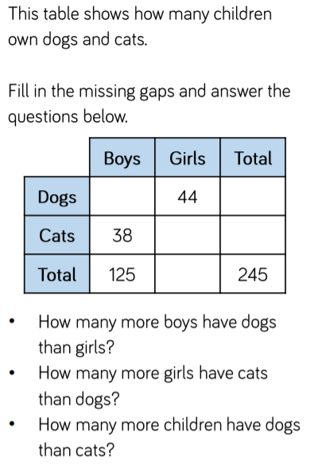
Plenary

Slide 25
Lunch

Slide 26
Geography

