Slide 2
Maths I can draw line graphs.

Slide 5
1) What is the sum of 31 and 79?
2) What is the difference between 31 and 79?
3) Round 73,499 to the nearest 10,000
4) Round 73,967 to the nearest 100

Slide 6
1) What is the sum of 31 and 79?
2) What is the difference between 31 and 79?
3) Round 73,499 to the nearest 10,000
4) Round 73,967 to the nearest 100
110
48
70,000
74,000

Slide 8
Time | 8 am | 10 am | 12 noon | 2 pm | 4 pm | 6 pm
Biscuits in staff room | 57 | 51 | 34 | 20 | 11 | 8
60
55
50
Have a think
45
40
35
Estimate the number of biscuits at 3 pm.
30
Biscuits
25
20
3
15
6
30
15
2
4
20
10
5
1
2
10
0
8 am
10 am
2 pm
4 pm
6 pm
12 noon
Time

Slide 9
Year | 2013 | 2014 | 2015 | 2016 | 2017 | 2018 | 2019
Visitors (millions) | 2.9 | 2.6 | 3.3 | 3 | 4.7 | 4.4 | 4
2.6 million = 2,600,000
5
4.5
Have a think
4
Have a think
3.5
3
In what year do you think a new exhibit was opened?
Visitors (millions)
2.5
2
1.5
1
0.5
2017
0
2013
2014
2015
2016
2017
2018
2019
Year

Slide 10
Centimetres | 0 | 2 | 4 | 6 | 8 | 10 | 12
Inches | 0 | 0.8 | 1.6 | 2.4 | 3.1 | 3.9 | 4.7
5
4.5
4
3.5
3
2.5
Inches
2
Have a think
1.5
1
0.5
0
0
2
4
6
8
10
12
Centimetres
How many inches are equal to 6.5 cm?
What is 4.5 inches in centimetres?
2.6 inches
11 cm

Slide 11
Alex’s run
Mo’s run
Time (minutes) | 5 | 10 | 19 | 28 | 33 | 41 | 47 | 51 | 55 | 59
Distance (km) | 1 | 2 | 3 | 4 | 5 | 6 | 7 | 8 | 9 | 10
Time (minutes) | 4 | 8 | 13 | 18 | 22 | 27 | 31 | 36 | 41 | 44
Distance (km) | 1 | 2 | 3 | 4 | 5 | 6 | 7 | 8 | 9 | 10
10
= Alex
9
= Mo
8
7
6
Have a think
Distance (km)
5
4
3
After 35 minutes, how much further has Mo run than Alex?
2
1
0
5
10
15
20
25
30
35
40
45
50
55
60
2.7 km
Time (minutes)
Mo = 7.8 km
Alex = 5.1 km
7.8 – 5.1 = 2.7 km

Slide 12
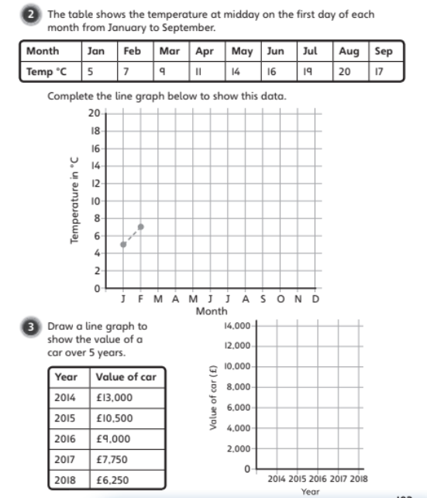
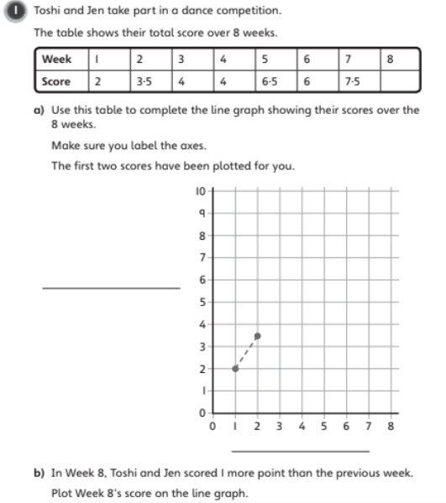
Independent Activity

Slide 13
Challenge

Slide 14
D.M.M 10.11.20
A) Make a bar model for the following numbers:
1. 852 2. 9,346 3. 375,435
B) Create a Part Whole Model for the following:
1. 675 2. 3,321
C) What is the difference between 72,250 and 45,110?
D) What is the total of 4450 and 6678?
E) Write the inverse operation of the following – 1.) 88 + 110 = 198 2.) 978 = 1000 - 22

