Slide 3
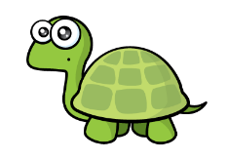
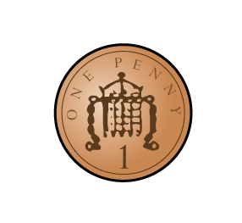
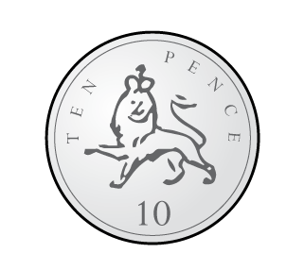
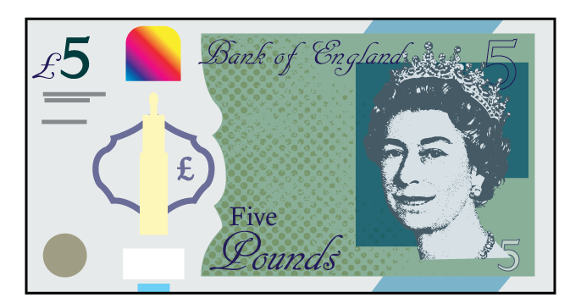
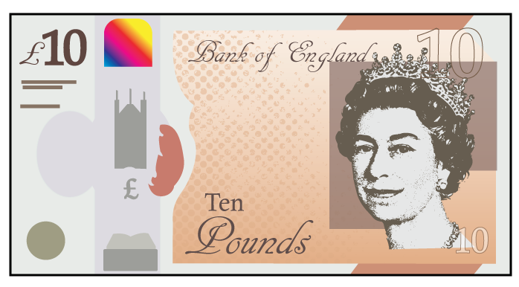
Is Tiny correct?
1)
2)
3)
4)
I have 4 £1 coins
I have three 1p coins and one 10p coin
Five £1 coins are equal to one £5 note
$$=$$
2 £10 notes $=$ 1 £5 note
$$=$$

Slide 4
Is Tiny correct?
1)
2)
3)
4)
I have 4 £1 coins
I have three 1p coins and one 10p coin
Five £1 coins are equal to one £5 note
$$=$$
2 £10 notes $=$ 1 £5 note
$$=$$

Slide 6
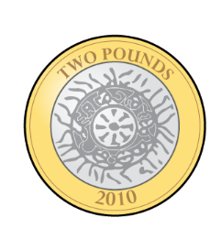
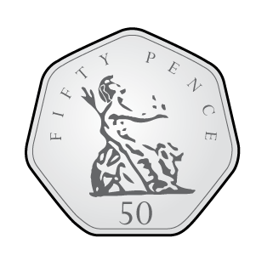
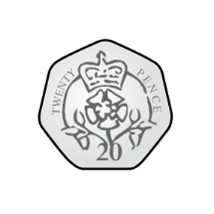
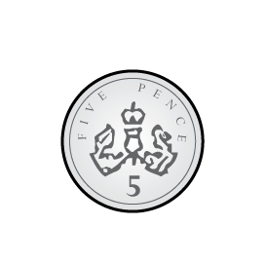
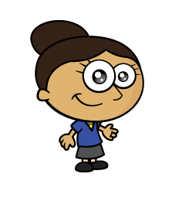
I’d like 27p please
Here’s 27p
Here’s 27p
Here’s 27p
Have a think
Notes:
Dora, Whitney and Teddy are on a role now.
But this one looks different! Let’s see if they can use what they know
Whitney knows that 100 take away 40 is equal to 60
And Dora knows that 60 take away 2 is equal to 58
So Teddy has realised that 100 takeaway 42 must be equal to 58
Great team work guys!

Slide 7
Have a go at questions 1 and 2 on the worksheet

Slide 8
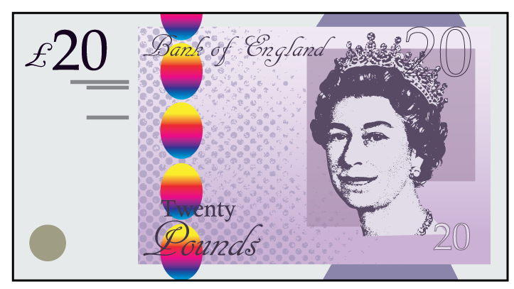
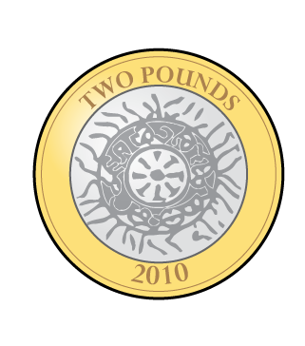
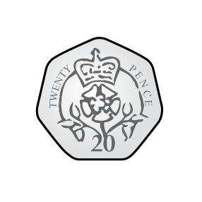
£32 and 64p
Have a think
Notes:
Dora, Whitney and Teddy are on a role now.
But this one looks different! Let’s see if they can use what they know
Whitney knows that 100 take away 40 is equal to 60
And Dora knows that 60 take away 2 is equal to 58
So Teddy has realised that 100 takeaway 42 must be equal to 58
Great team work guys!

Slide 9
Have a go at questions 3 – 6 on the worksheet

Slide 10
Which one doesn’t belong?
Have a think
Notes:
Dora, Whitney and Teddy are on a role now.
But this one looks different! Let’s see if they can use what they know
Whitney knows that 100 take away 40 is equal to 60
And Dora knows that 60 take away 2 is equal to 58
So Teddy has realised that 100 takeaway 42 must be equal to 58
Great team work guys!

Slide 11
Have a go at question 7 on the worksheet

