Slide 1
Good Morning Year 2
What have you had for breakfast today?
I hope it was nice and you are ready for a good day of learning.

Slide 2
26/11/20
100 – 25 =
50 + 35 =
100 – 35 =
40 + 25 =
100 – 15 =
35 + 35 =
100 – 20 =
37 + ___ = 100
42 + ___ = 100
100 – 55 =
85 + ___ = 100
35 + ___ = 100
100 – 49 = ___
___ = 50 + 35
15) ___ = 28 + 40
____ = 100 – 18
Please see the next page for another version if this is a bit tricky!

Slide 3
26/11/20
Use your knowledge of number bonds to help you……
1) 3 + __ = 10
__ + 5 = 10
2 + ___ = 10
__ = 15 + 5
4 + ___ = 10
___ = 12 + 8
6) 14 + ___ = 20
7) 13 + ___ = 20
8) 15 + ___ = 20
18 + ___ = 20
___ + ___ = 20

Slide 4
Phonics
Spend a little time on each of the activities below.
Lexia – Don’t forget to log on to this regularly, if you have a log-in.
Phonics – Practise the games on phonicsplay website.
Spelling Practise - Look, cover, write, check
HF words –:
https://www.ictgames.com/littleBirdSpelling/
Choose the Year 1 list if Year 2 words are too tricky.

Slide 5
All Pigs Are Beautiful
Practise reading the next 4 pages of our text.

Slide 6
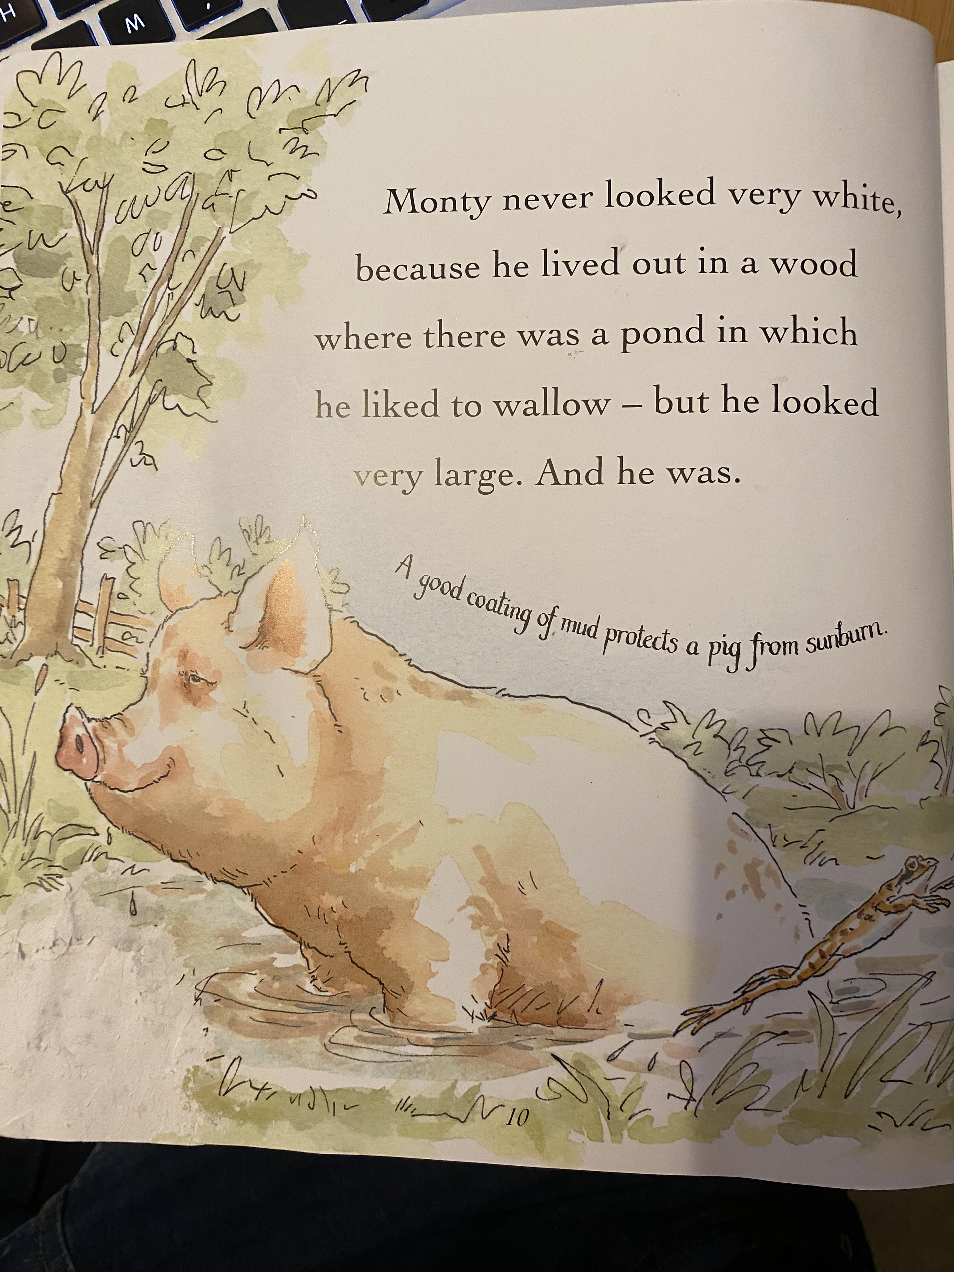

Slide 7
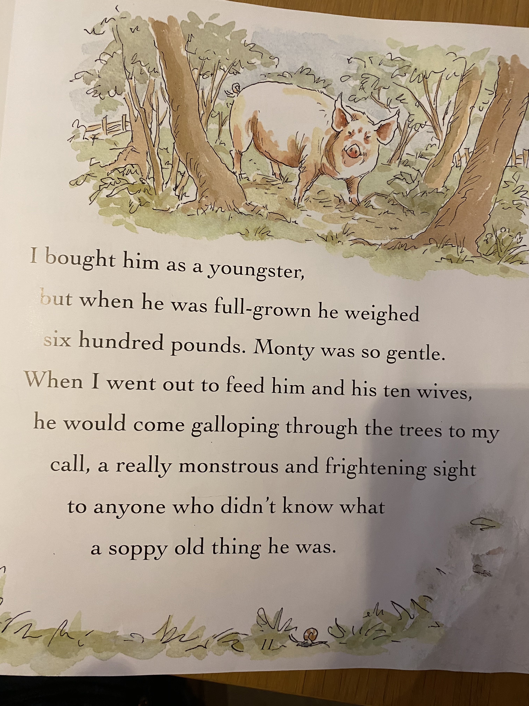

Slide 8
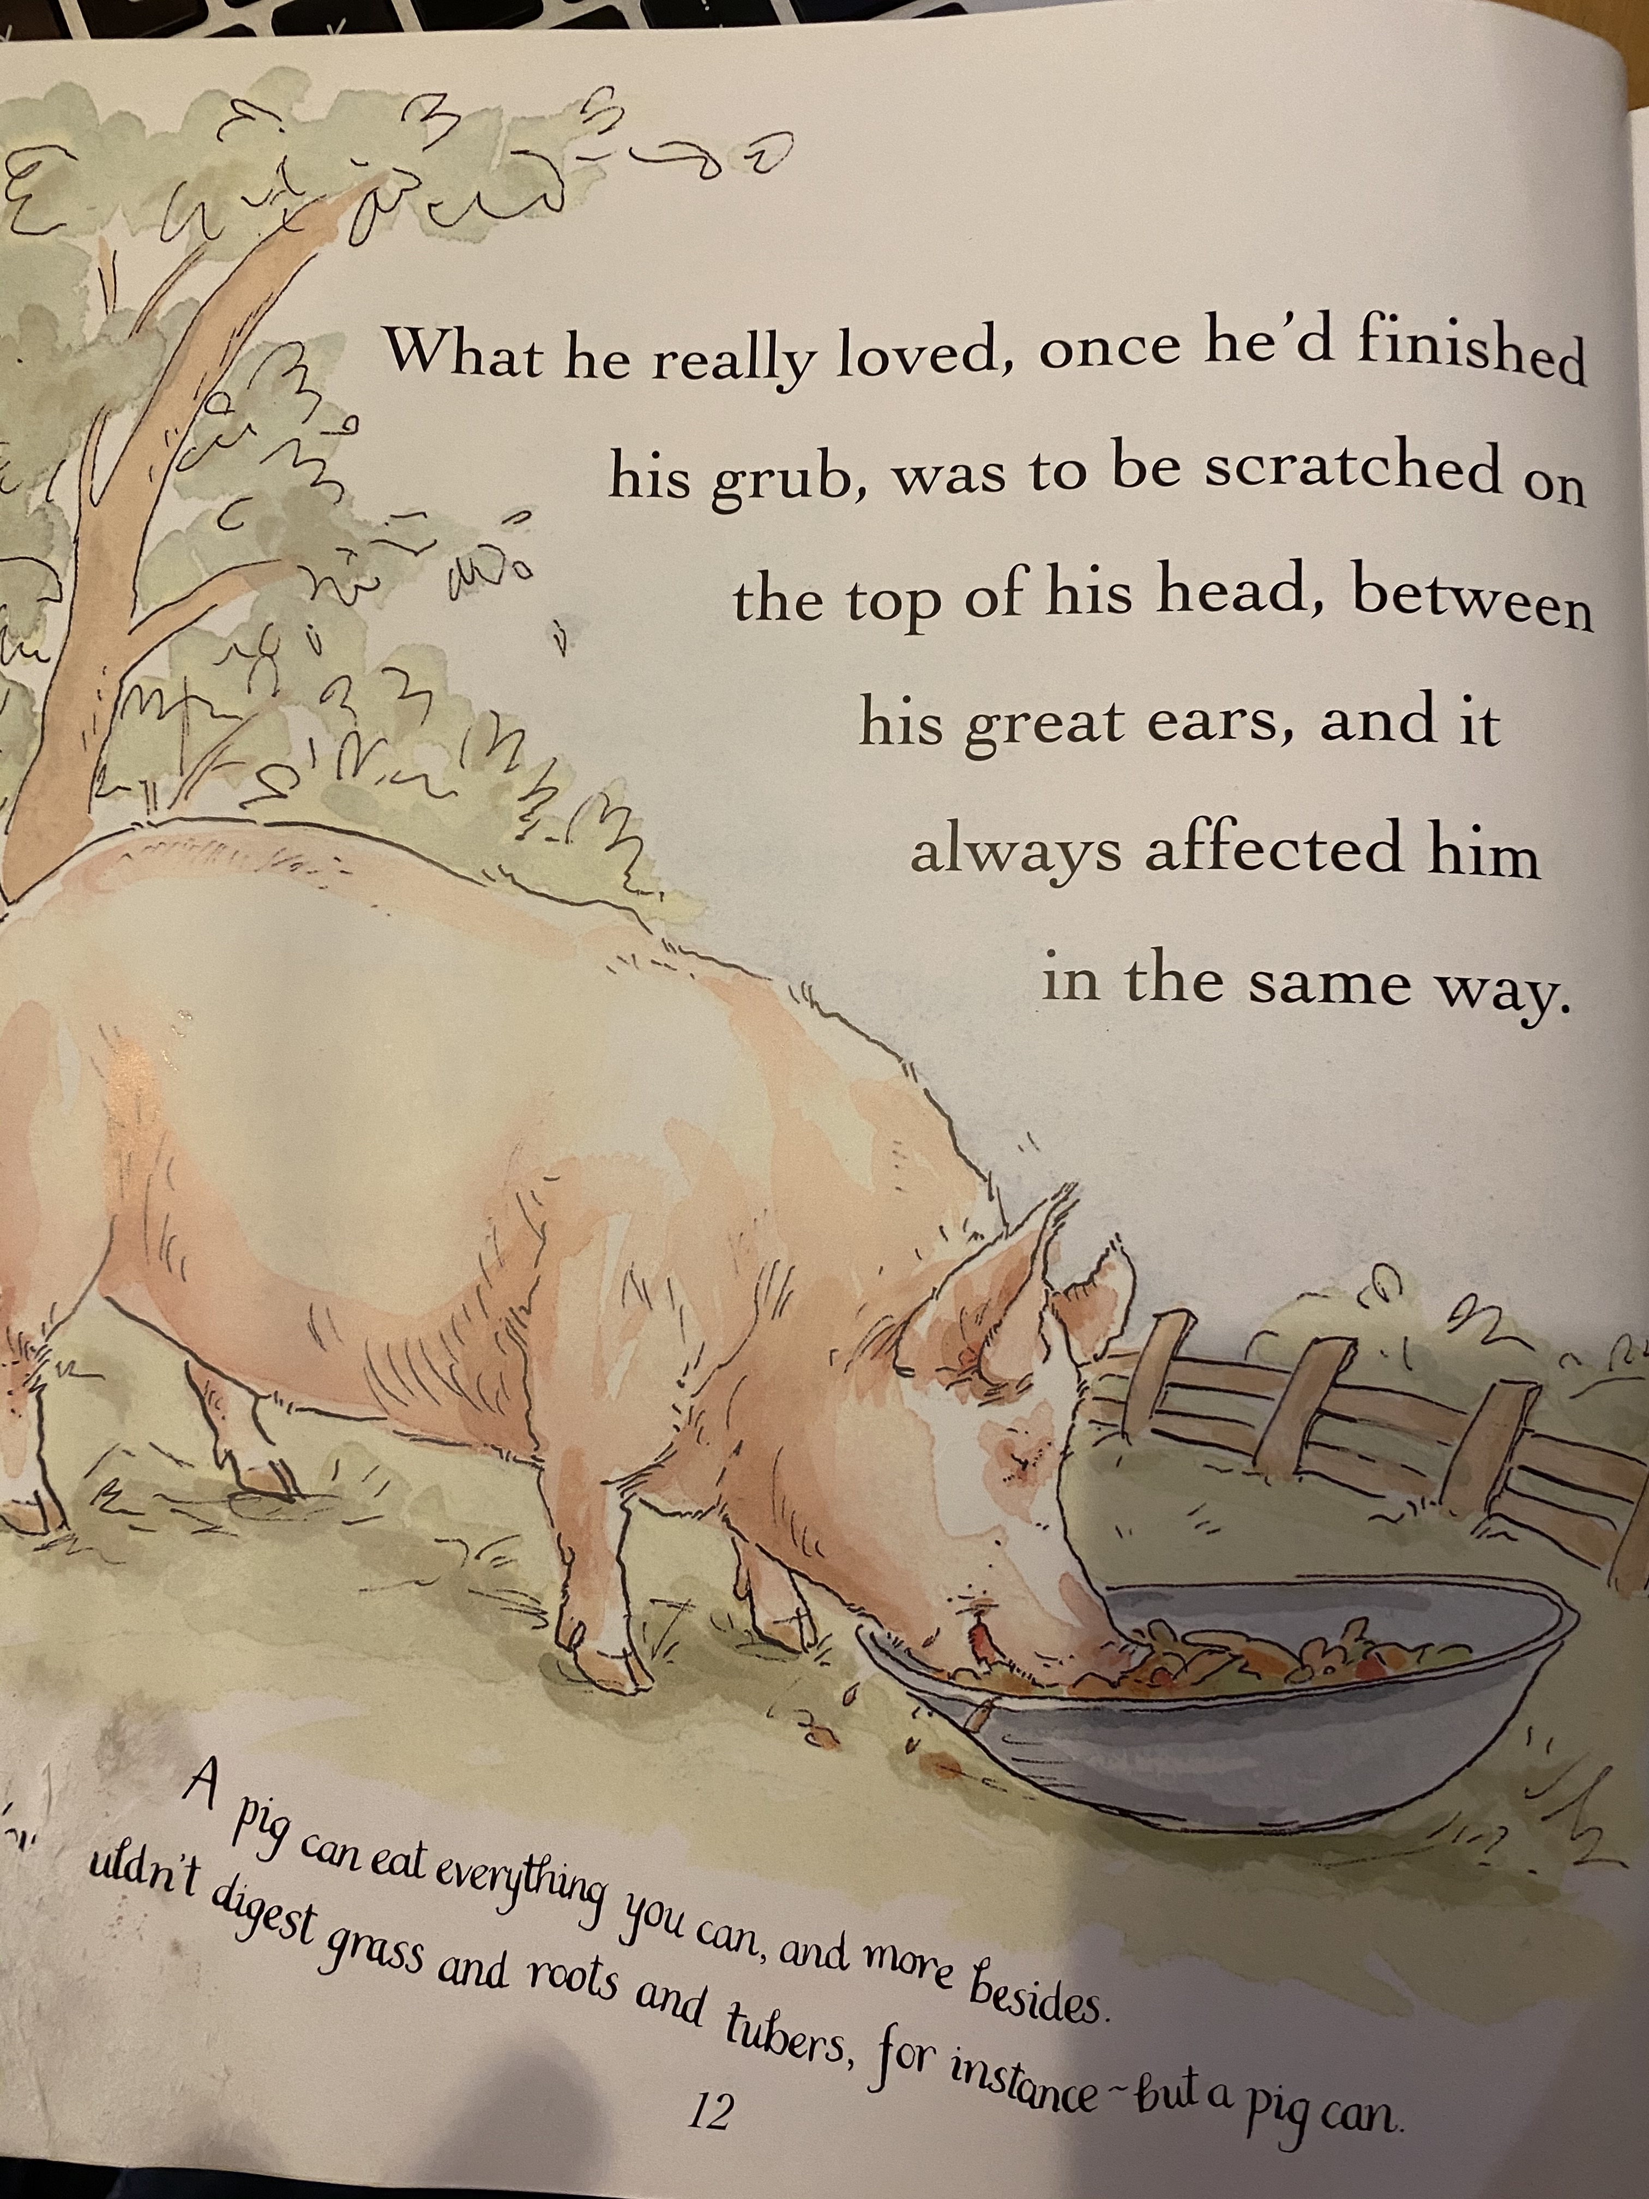

Slide 9
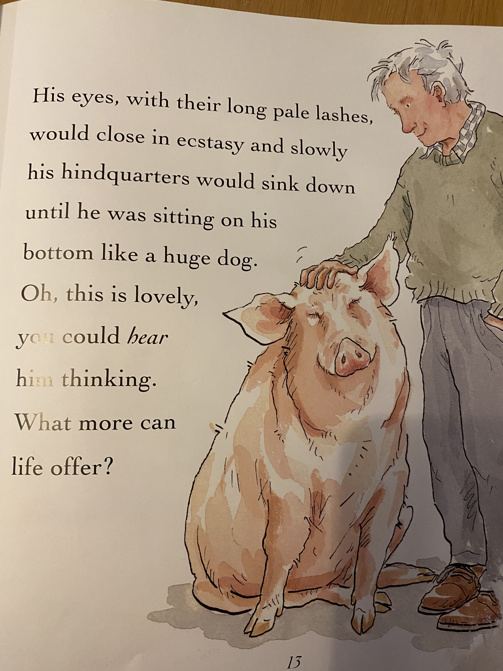

Slide 10
SPAG
Can you remember what a coordinating conjunction is?
Now re-read the pages and this time, pick out the coordinating conjunctions that the author has used.

Slide 11
Literacy
Can you explain what is meant by fiction and non-fiction?
What do you think this text is?
This book is unusual because whilst it looks like a fiction book – with the illustrations and the author’s story, there are also a lot of facts about pigs.

Slide 12
Literacy
Have a look at the attached worksheet.
As you read the sentences, sort them into facts and fiction/opinions.
If you’d like an extra task, why don’t you write some sentences about yourself. Some could be facts and some could be fiction/opinion.
You don’t have to do this task!

Slide 13
Wake up shake up!
Here is a link to our wake-up shake up song on youtube.
https://www.youtube.com/watch?v=KSbwHzlcgs8
Why don’t you do our wakeup-shakeup routine to give yourself some energy and get both sides of your brain working well.

Slide 14
Click the following link for the teaching video.
Finding the difference
Maths!
https://vimeo.com/479816379
Now complete the attached worksheets for Thursday.

Slide 15
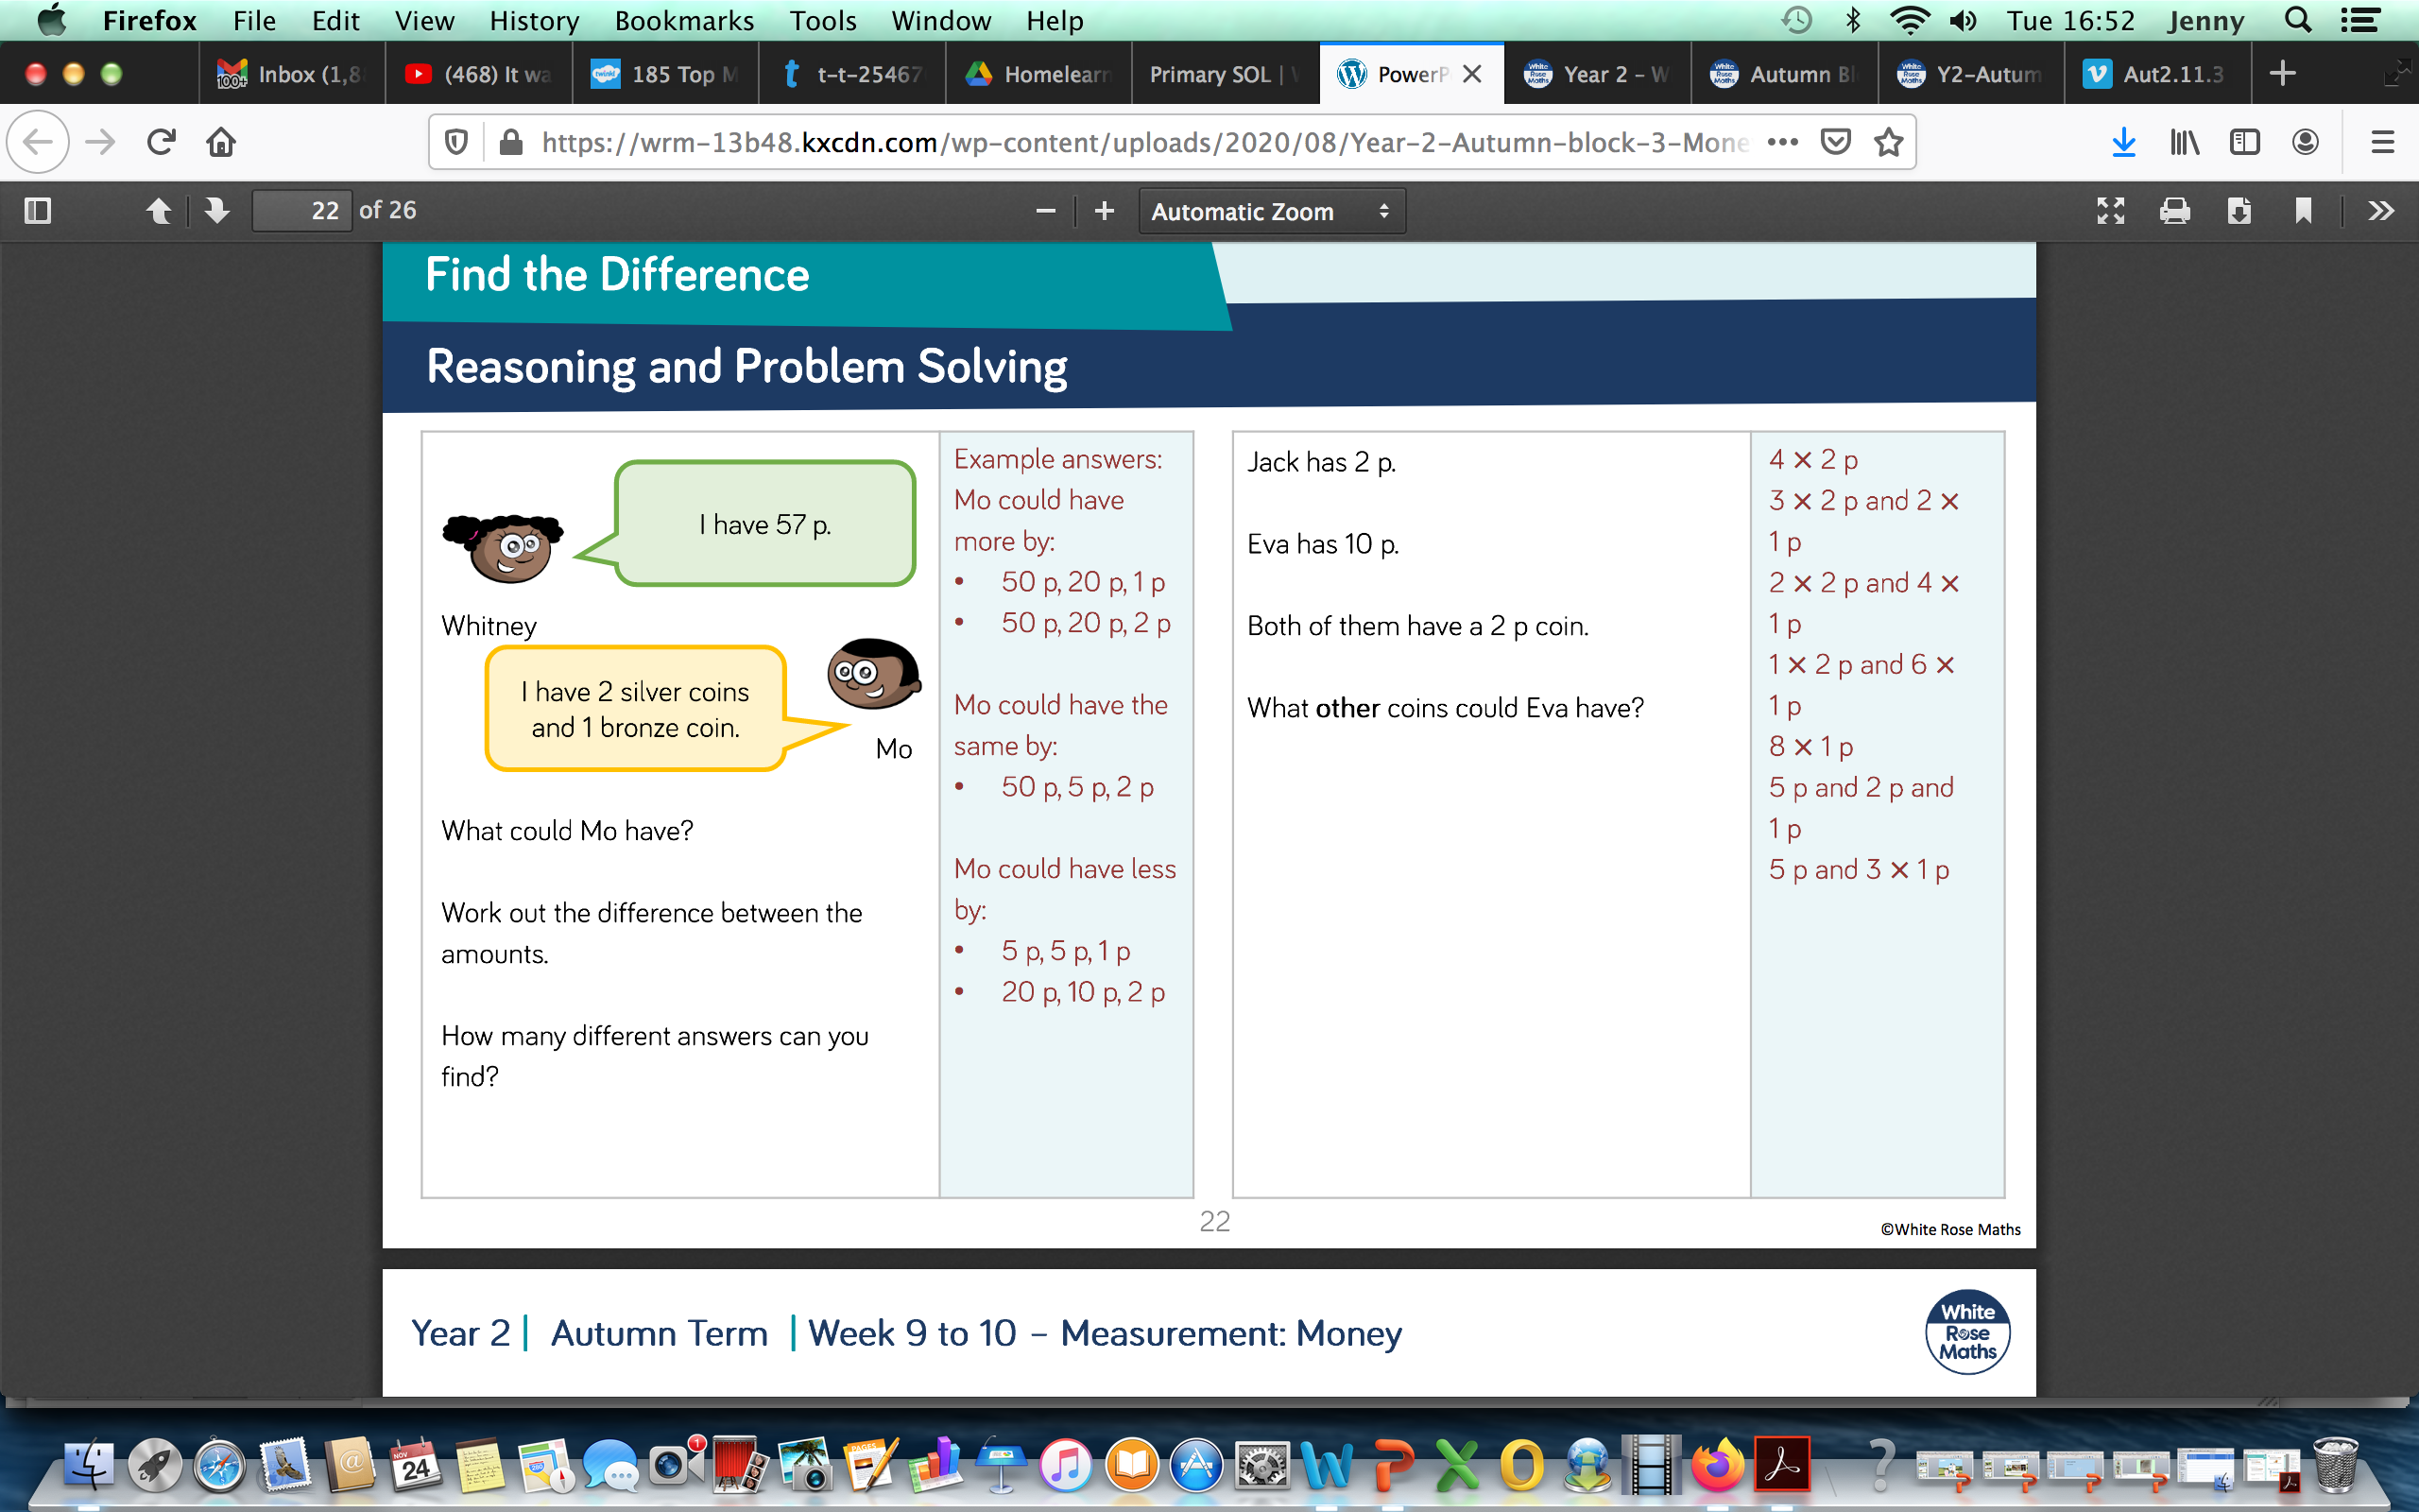
Challenge Questions
Only complete these if you want a further challenge from the lesson you have already done.

Slide 16
Handwriting
Complete the attached worksheet for Wednesday

Slide 17
Milk
Do you like milk?
Where does milk come from? Do you know the journey of milk?
Look at the attached Powerpoint about milk.
Have you got milk in your fridge? What other products have you got that have got milk in?

Slide 18
Milk
Complete the sheet ‘How does milk arrive in the shops’.
If you can, why don’t you make a milkshake or smoothie with some milk.
What flavour did you make?
Can you remember what milk does for your body?

Slide 19
Milk experiment
If you wanted another milk activity to do this afternoon then why don’t you look at the milk experiment on the next page.
If you want to you could draw a picture of what happens and write sentences underneath.

Slide 20
