Slide 1
Thursday 26th November 2020

Slide 2
SPaG
Pronouns: Identify the correct homophones in each sentence. Underline the correct one.
1. When I was in class, I was asked to read allowed/aloud.
2. “It has been such a great day because I have past/passed my exams!” exclaimed Sarah.
3. The student had made a mistake in their books. However they were allowed/aloud to alter/altar it.
4. I was welcomed into the house as a guest/guessed.
5. The car was speeding through Heddon and flew passed/past the Police.

Slide 3
Commando Joes

Slide 4
Break

Slide 5
Maths
I can use multiplication and division to identify common factors.

Slide 6
20
30
1 x 20
1 x 30
2 x 15
5 x 6
2 x 10
3 x 10
4 x 5
Common Factors – 1,2,5,10

Slide 7
Complete the Factors for each
12
18
70
36
50
28

Slide 8
Identify the Common Factors
20
40

Slide 9
Identify the Common Factors
15
45

Slide 11
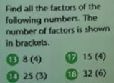
Before we begin…

Slide 12
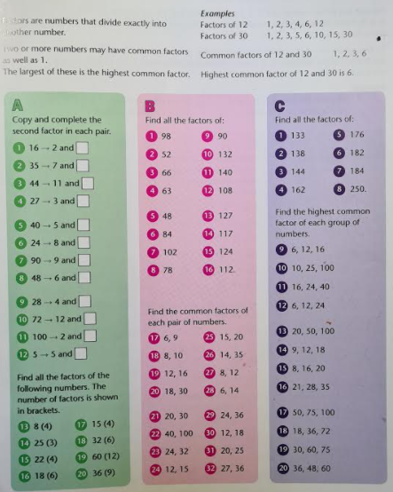
Independent Activity

Slide 13
Plenary

Slide 14
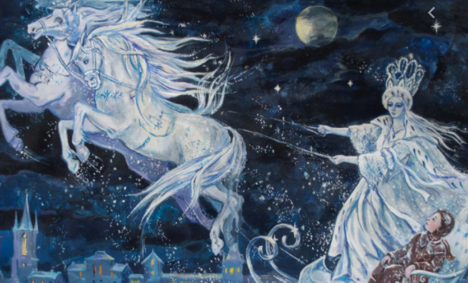
English
Comprehension – Snow Queen (The First Story)

Slide 15
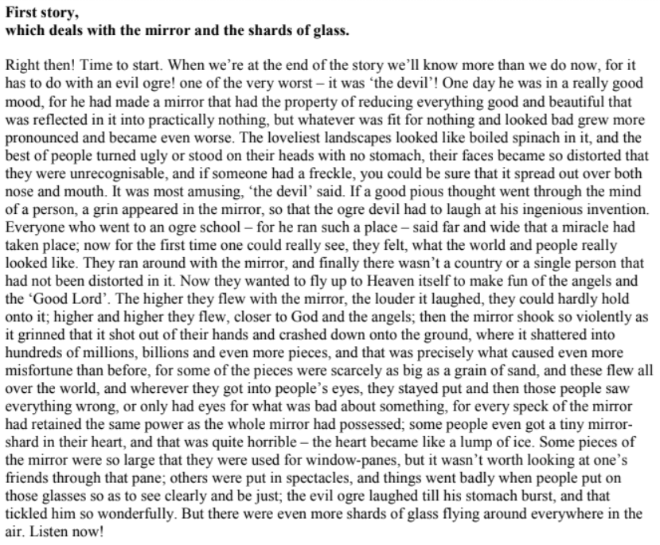

Slide 16
Comprehension
1.) What did the Evil Ogre make? How did it make him feel?
2.) What did the mirror do?
3.) Why did they want to fly up to heaven with the mirror?
4.) What happened when they kept flying higher?
5.) What happens when the shards of glass get into people’s eyes?
6.) When it says “some people even got a tiny mirror shard in their heart, and that was quite horrible – the heart became like a lump of ice.” What do you think this means?
7.) Some of the shards of glass were used for…
8.) How does the author grab your attention at the end of the First story?

Slide 17
Lunch

Slide 18
Christmas Cards

Slide 19
Rehearsal for Christmas

