Slide 1
Thursday 19th November 2020

Slide 2
Busy Books
555,110
Add 670,050
Subtract 369,375
Half it
Create Bar Model for it.
Create a Part Whole Model for it
Write the value of each number e.g. 5 = 500,000 etc

Slide 3
Commando Joes (0915 – 1030)

Slide 4
Snack

Slide 5
Story

Slide 6
Maths
I can complete, read and interpret information in tables, including timetables.

Slide 7
Two – way tables are…
Tricky ☹
So let’s look at Q2 and Q4 from Tuesday.
It is all about using the information they have given you and taking it a step at a time.

Slide 8
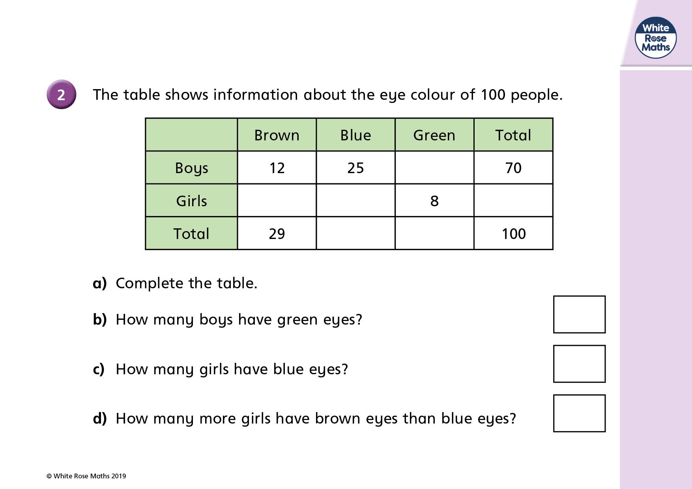

Slide 10
Maths
I can complete, read and interpret information in tables, including timetables.

Slide 13
What is 3:55 pm in the 24 hour clock?
2) A journey starts at 8:15 and ends at 8:50
How long is the journey?
3) A journey starts at 9:25 and ends at 10:10
How long is the journey?
A film is 1 hour 20 minutes long.
It ends at 6 p.m.
What time did it start?

Slide 14
What is 3:55 pm in the 24 hour clock?
2) A journey starts at 8:15 and ends at 8:50
How long is the journey?
3) A journey starts at 9:25 and ends at 10:10
How long is the journey?
A film is 1 hour 20 minutes long.
It ends at 6 p.m.
What time did it start?
15:55
35 minutes
45 minutes
4:40 p.m.

Slide 16
Year 5
 | 09:00 | 10:10 | 10:25 | 10:40 | 11:45 | 12:00
Mon | Maths | Maths | Play | English | English | Lunch
Tues | Maths | Play | English | English | English | Lunch
Weds | PE | PE | Play | Maths | Maths | Lunch
Thurs | English | Play | English | Maths | PSHE | Lunch
Fri | English | English | Play | Maths | PSHE | Lunch
1) How long is playtime on Monday?
15 minutes
2) How long do the children study English on Thursday?
15 minutes
1 hour 10 minutes
+ 15 minutes
= 1 hour 25 minutes
10:25 10:40
3) How much time is there for PSHE?
Have a think
15 minutes × 2 =
30 minutes

Slide 17
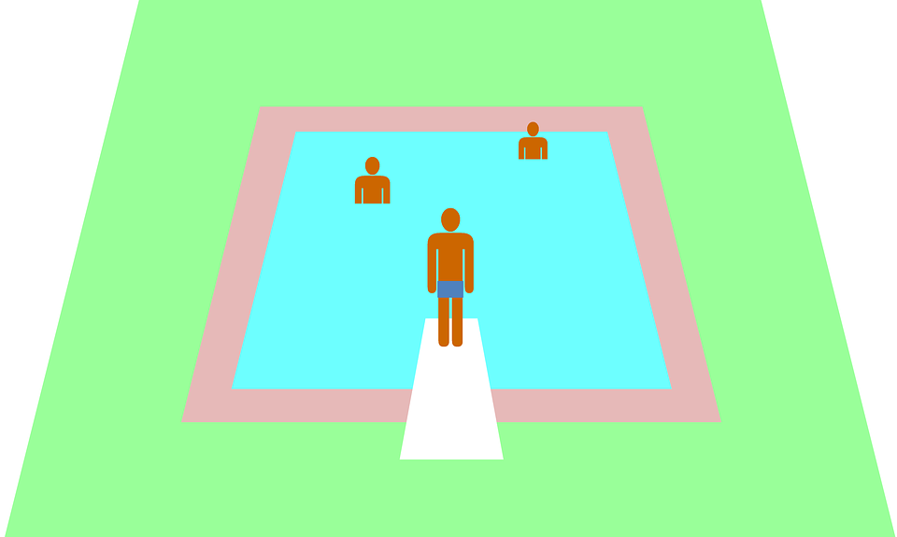
Bus timetable
Bus station | 11:30 | 12:30 | 13:30 | 14:30
School | 11:37 | 12:37 | 13:37 | 14:37
Swimming pool | 12:03 | 13:03 | 14:03 | 15:03
Health centre | 12:20 | 13:20 | 14:20 | 15:20
Library | 12:35 | 13:35 | 14:35 | 15:35
11:30
11:37
12:03
12:20
12:35

Slide 18
Bus timetable
Bus station | 11:30 | 12:30 | 13:30 | 14:30
School | 11:37 | 12:37 | 13:37 | 14:37
Swimming pool | 12:03 | 13:03 | 14:03 | 15:03
Health centre | 12:20 | 13:20 | 14:20 | 15:20
Library | 12:35 | 13:35 | 14:35 | 15:35
Annie leaves the health centre at 13:55
What time will she arrive at the library?
14:35
She catches the 14:20 bus from the health centre.

Slide 19
Bus timetable
Bus station | 11:30 | 12:30 | 13:30 | 14:30
School | 11:37 | 12:37 | 13:37 | 14:37
Swimming pool | 12:03 | 13:03 | 14:03 | 15:03
Health centre | 12:20 | 13:20 | 14:20 | 15:20
Library | 12:35 | 13:35 | 14:35 | 15:35
Have a think
2) How long does it take the 14:37 bus from the school to the arrive at the library?
58 minutes
15:35
1 hour = 60 minutes
15:37
23 minutes
35 minutes
14:37
15:00
15:35

Slide 20
Have a go at the questions 1 - 3 on the worksheet

Slide 21
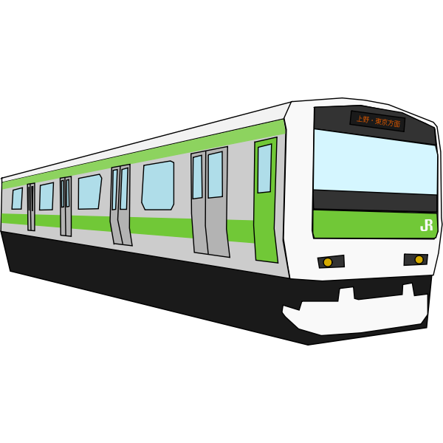
Train timetable from Birmingham to London
Birmingham | 08:10 | 08:30 | 09:10 | 09:30
Rugby | 08:41 |  | 09:41 | 10:01
Milton Keynes | 09:02 | 09:20 | 10:02 | 10:22
Watford | 09:16 |  |  | 10:36
London | 09:33 | 09:49 | 10:31 | 10:53
Milton Keynes
09:02
Milton Keynes
09:20
Birmingham
08:10
Rugby
08:41
Watford
09:16
London
09:33
Birmingham
08:30
Rugby
Watford
London
09:49

Slide 22
Train timetable from Birmingham to London
Birmingham | 08:10 | 08:30 | 09:10 | 09:30
Rugby | 08:41 |  | 09:41 | 10:01
Milton Keynes | 09:02 | 09:20 | 10:02 | 10:22
Watford | 09:16 |  |  | 10:36
London | 09:33 | 09:49 | 10:31 | 10:53
Have a think
1) What time does the 10:01 from Rugby arrive at Watford?
10:36
2) How long does it take to travel from Birmingham to Watford?
6 mins
1 hour
08:10
1 hour 6 minutes
09:10
09:16

Slide 23
Train timetable from Birmingham to London
Birmingham | 08:10 | 08:30 | 09:10 | 09:30
Rugby | 08:41 |  | 09:41 | 10:01
Milton Keynes | 09:02 | 09:20 | 10:02 | 10:22
Watford | 09:16 |  |  | 10:36
London | 09:33 | 09:49 | 10:30 | 10:53
1) The 08:30 train from Birmingham takes 1 hour 19 minutes to get to London.
The 09:30 train from Birmingham takes 4 minutes longer to get to London.
Have a think
Why do you think this is?

Slide 24
Have a go at the questions 4 - 5 the worksheet

Slide 25
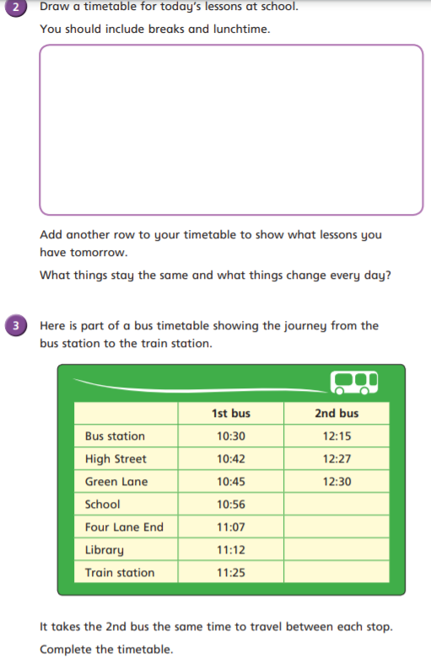

Slide 27
Lunch

Slide 28
Computing Virtual Space lesson 2

