Slide 1
Thursday 19th November
Maths

Slide 2
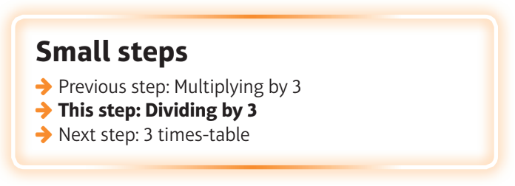
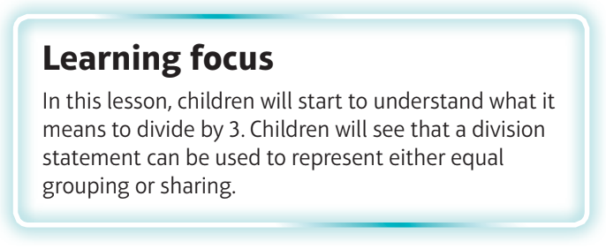
What are we learning?
I can divide by 3.

Slide 3
Watch the video
https://vimeo.com/475444308

Slide 4
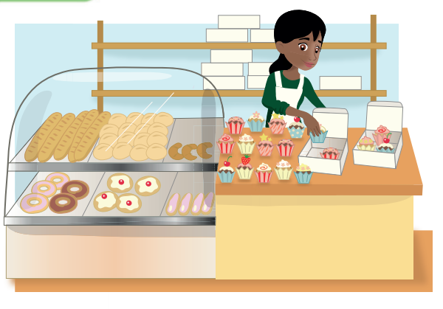
Each box holds 3 cup cakes. How many boxes are needed for 9 cupcakes?
Each box holds 3 cupcakes. How many cupcakes are needed for all of the cupcakes?
David buys 27 cakes. He shares them equally between 3 people. How many cakes do they get each?

Slide 5
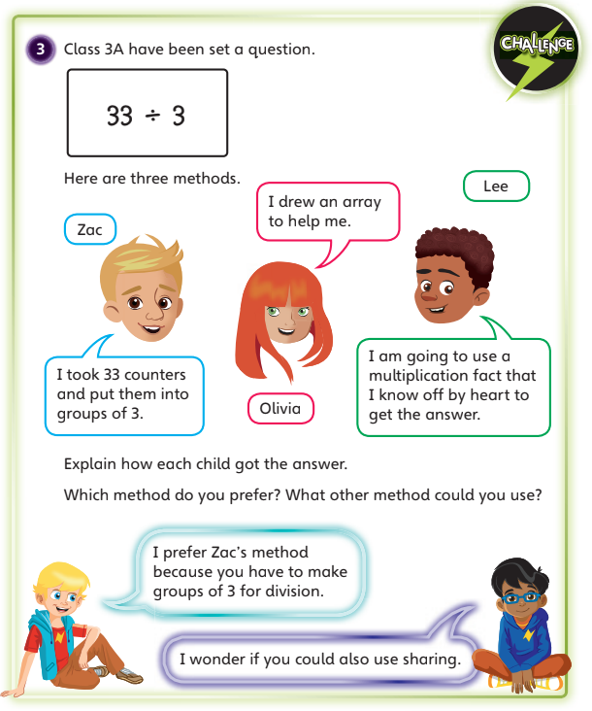

Slide 6
