Slide 1
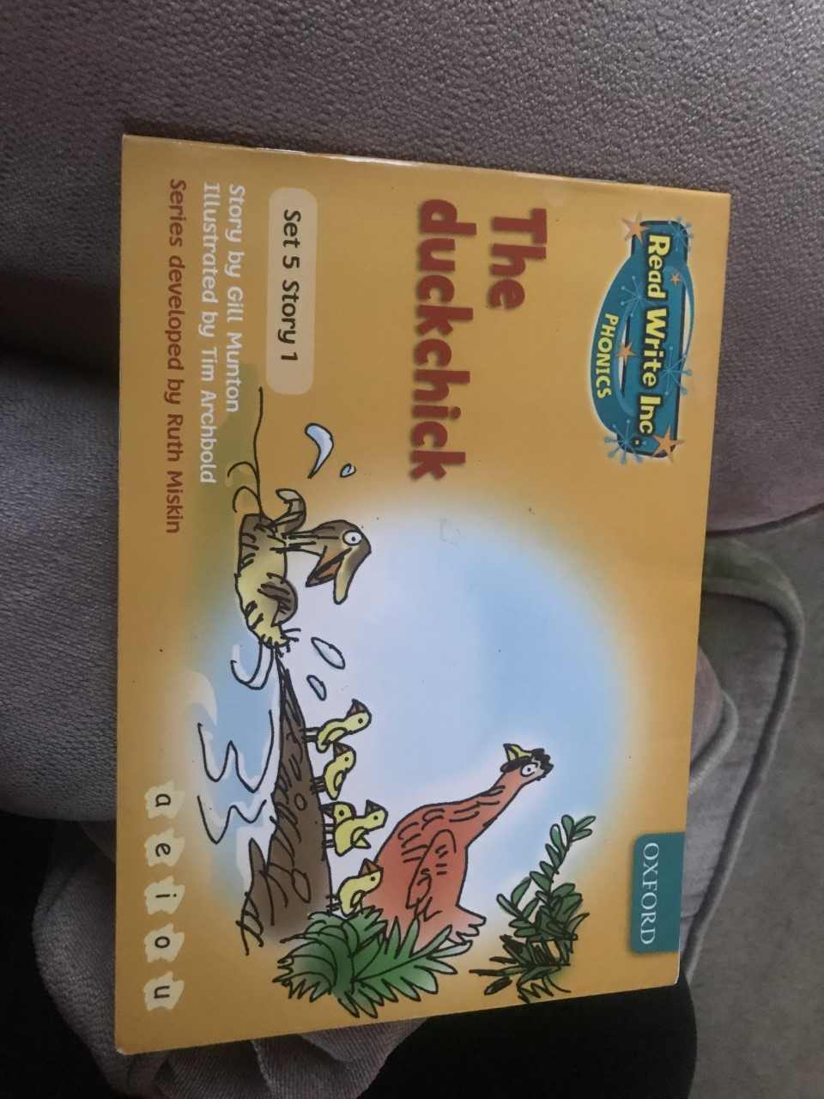


Slide 2
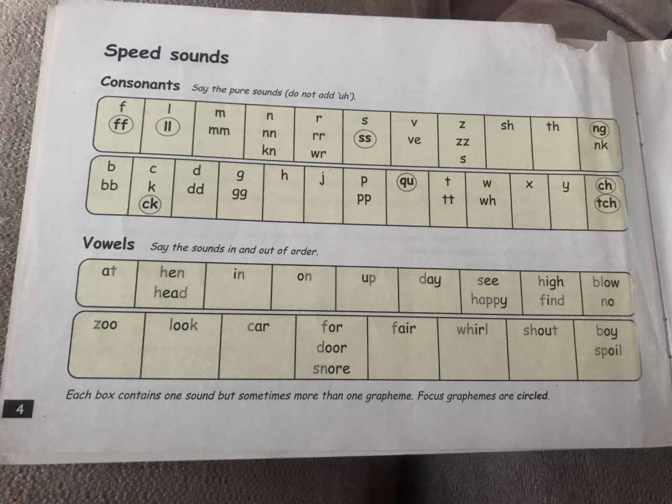

Slide 3
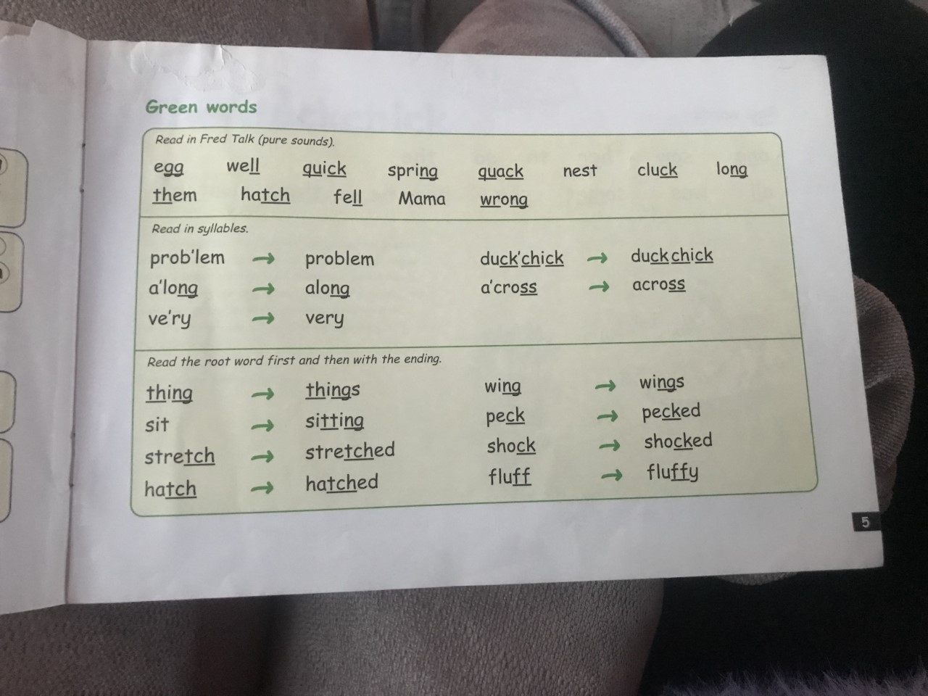

Slide 4
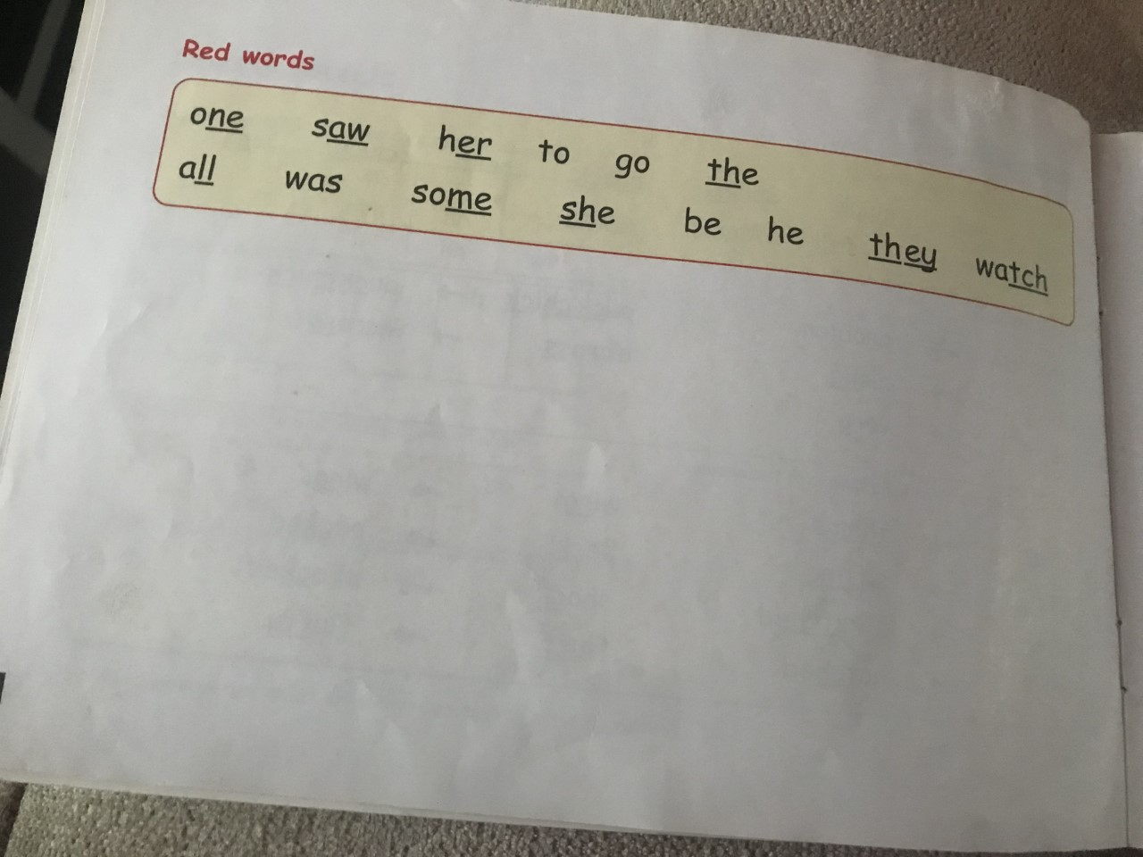

Slide 5
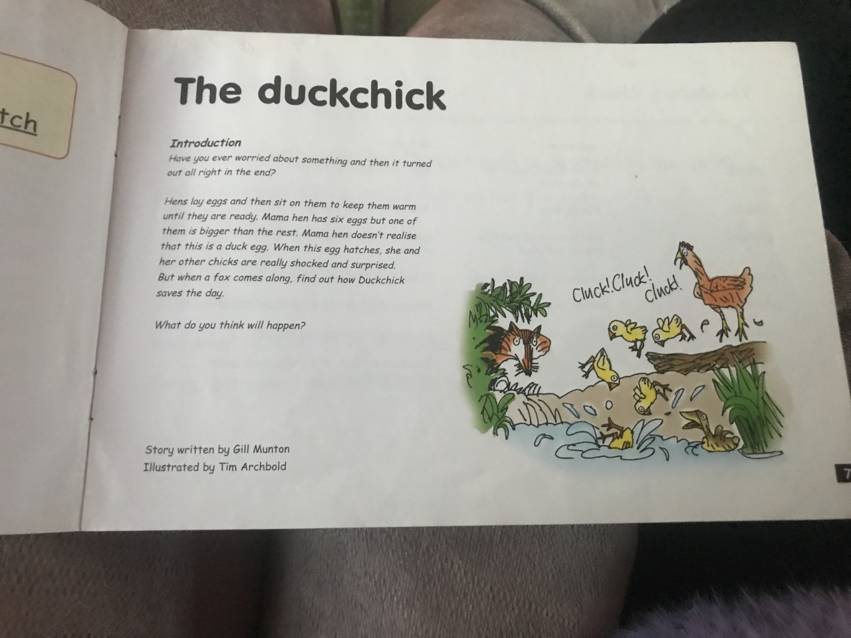

Slide 6
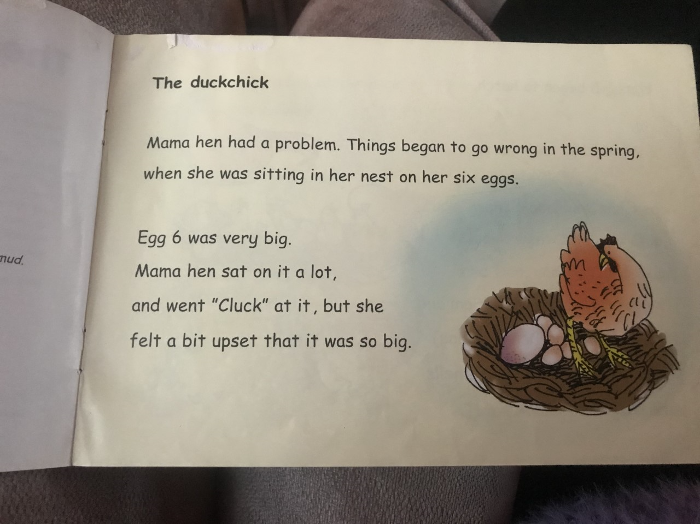

Slide 7
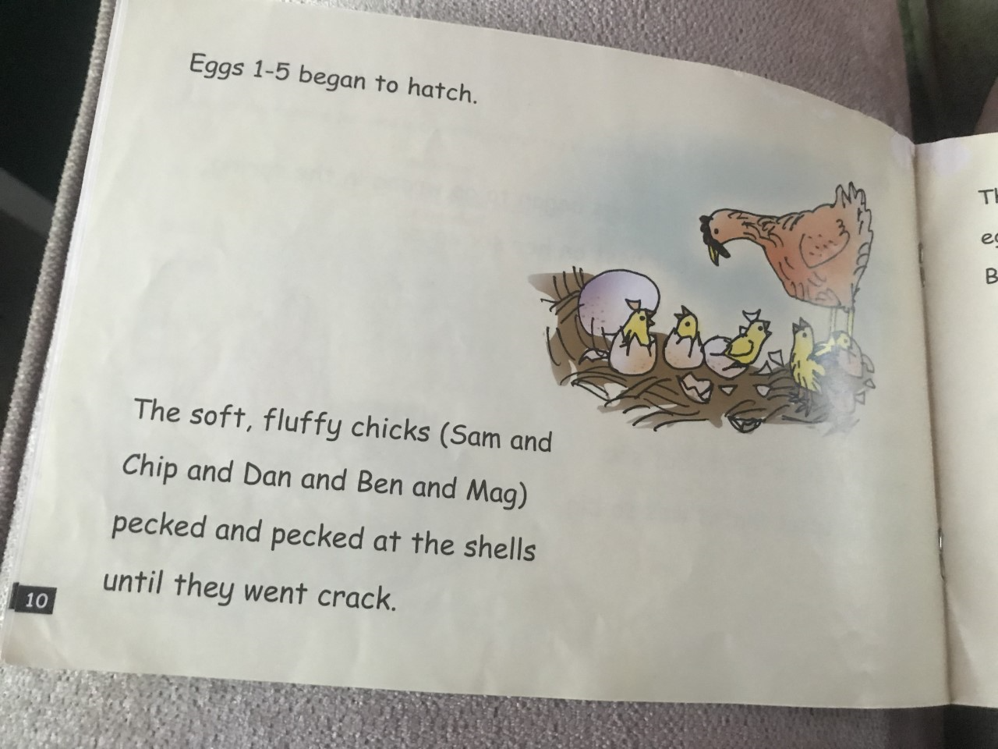

Slide 8
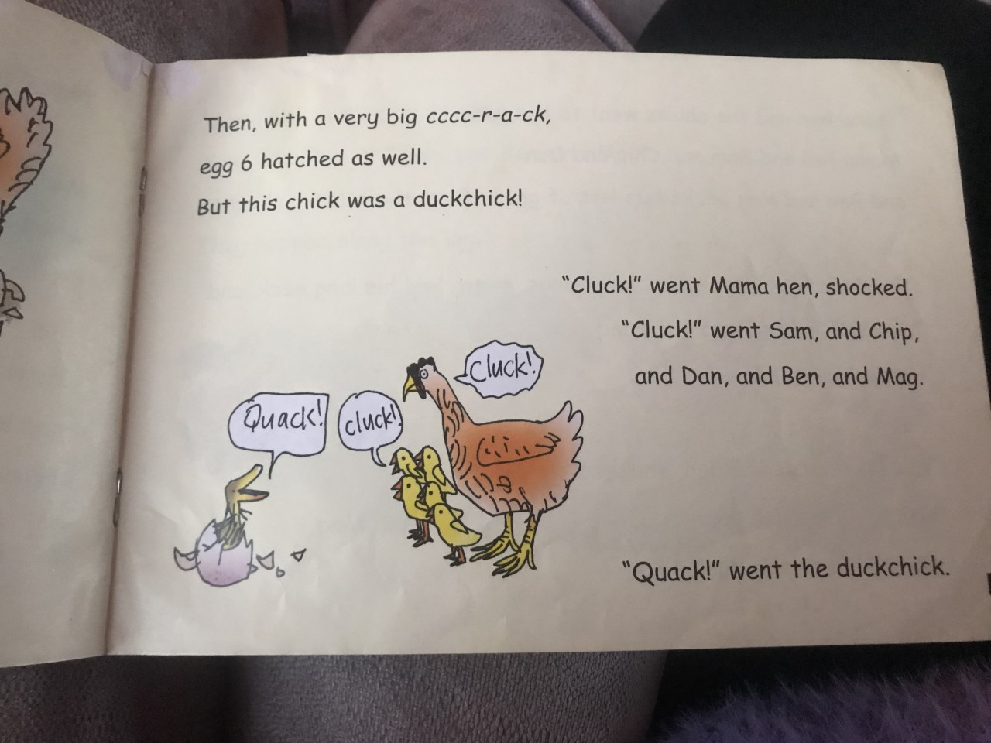

Slide 9
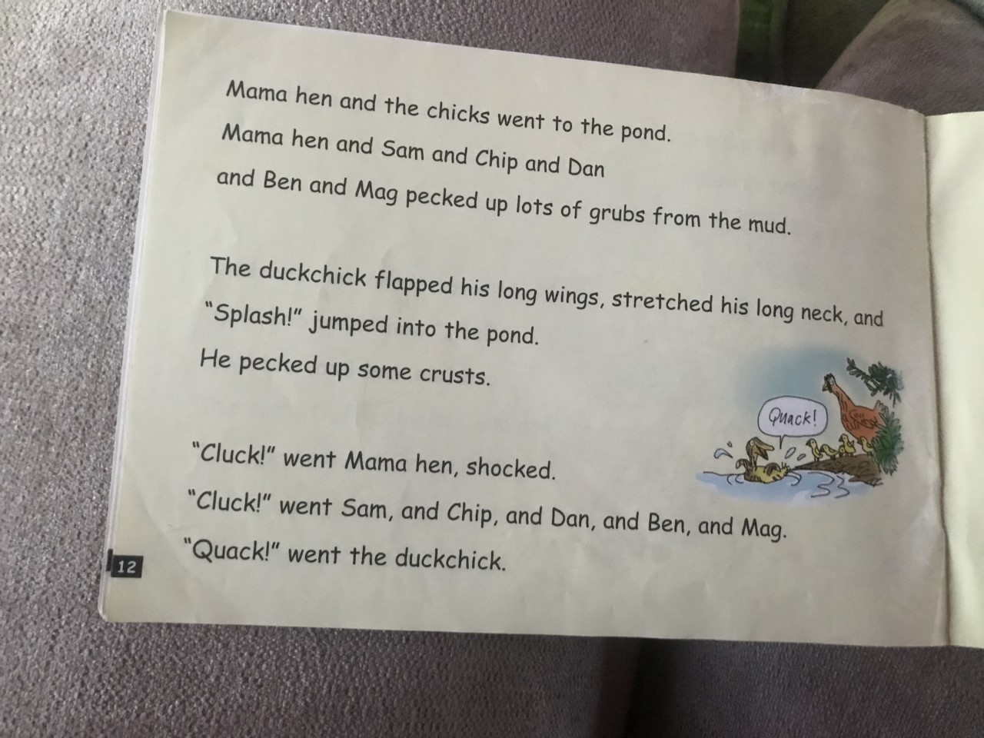

Slide 10
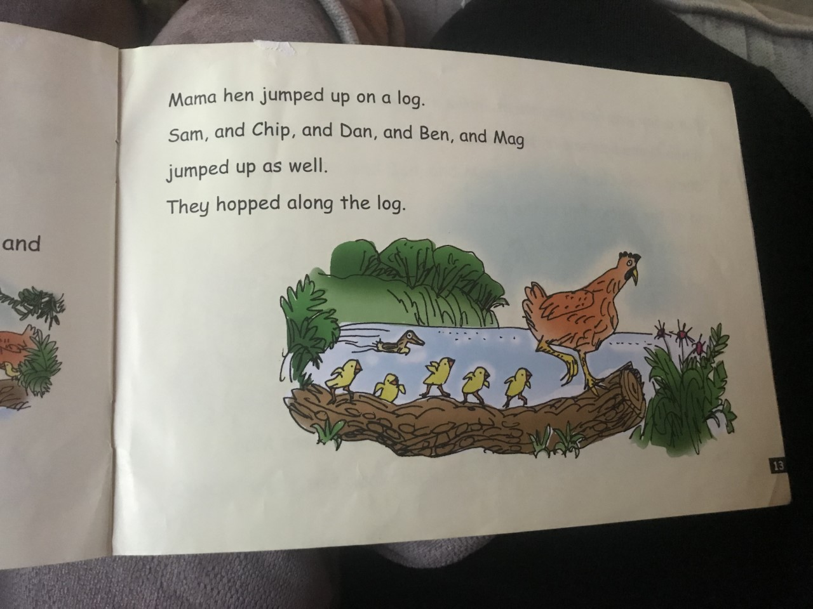

Slide 11
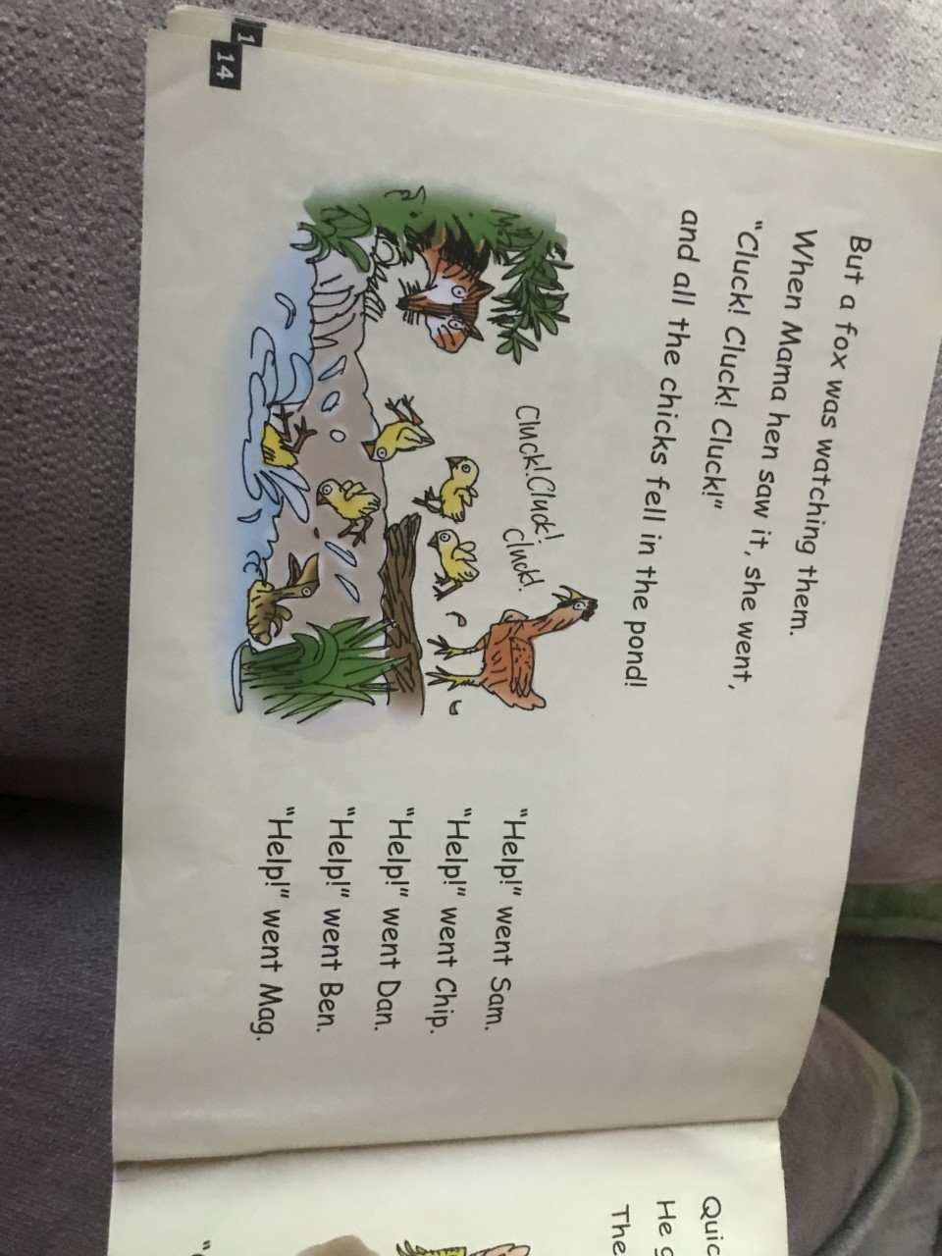

Slide 12
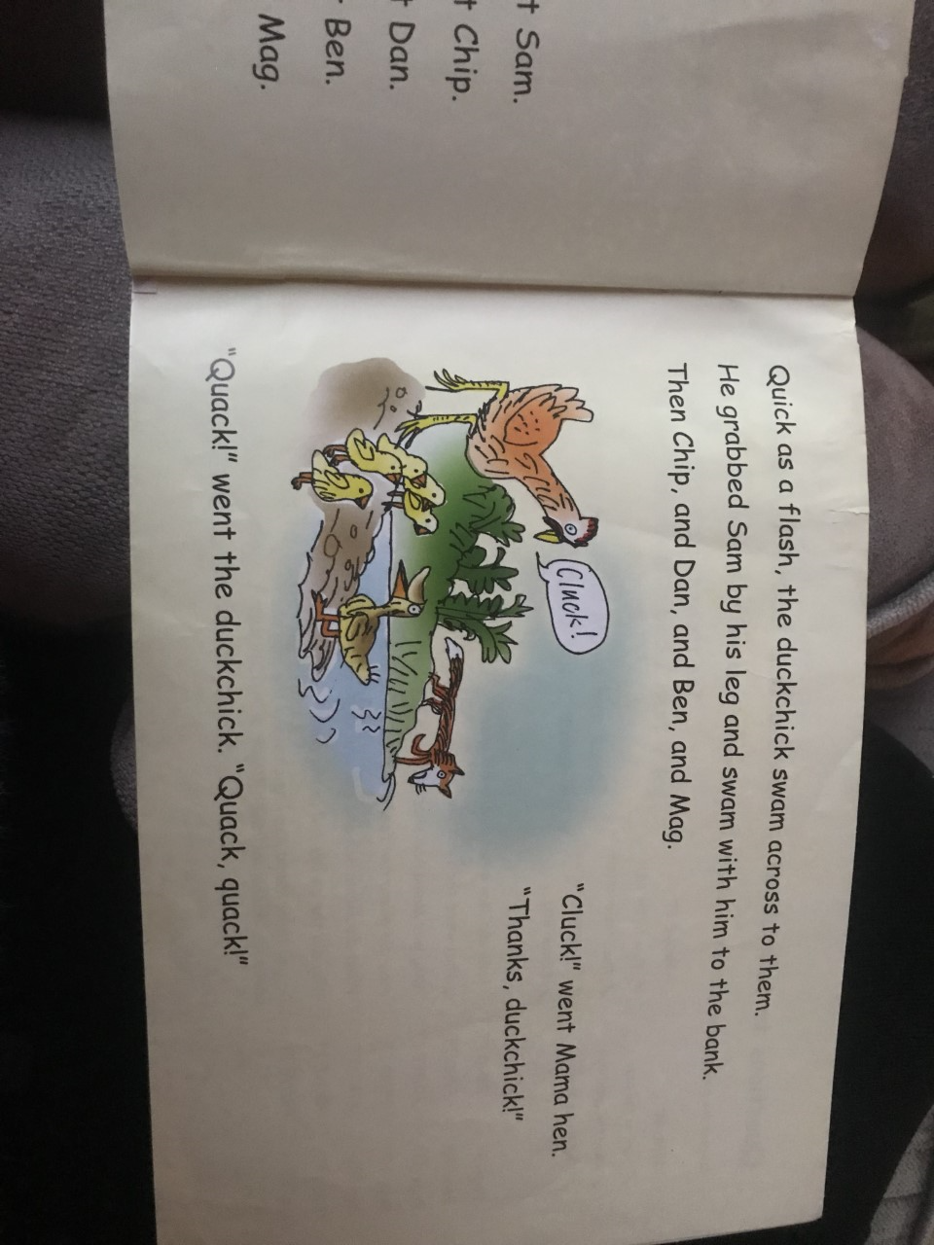

Slide 13
Wednesday task : questions to read and answer- write down the correct answer out of the choices.
1) What did mama hen sit on?
Mama hen sat on a bed/ nest/ log.
2) How many eggs did mama hen have?
Mama hen had ten / six / seven eggs.
3) What did mama hen jump onto?
Mama hen jumped onto a fox / log /dog.
4) Who was watching the chicks?
A dog / man /fox was watching the chicks.
5) Who swam to help the chicks?
The fox / dog / duckchick swam to help the chicks.

Slide 14
Wednesday task : suffix ed
Can you make these sentences make sense by adding suffix ed.
He splash in the pond.
She jump in the water.
The duckchick flapp it’s wings.
She stretch her arms.

