Slide 1
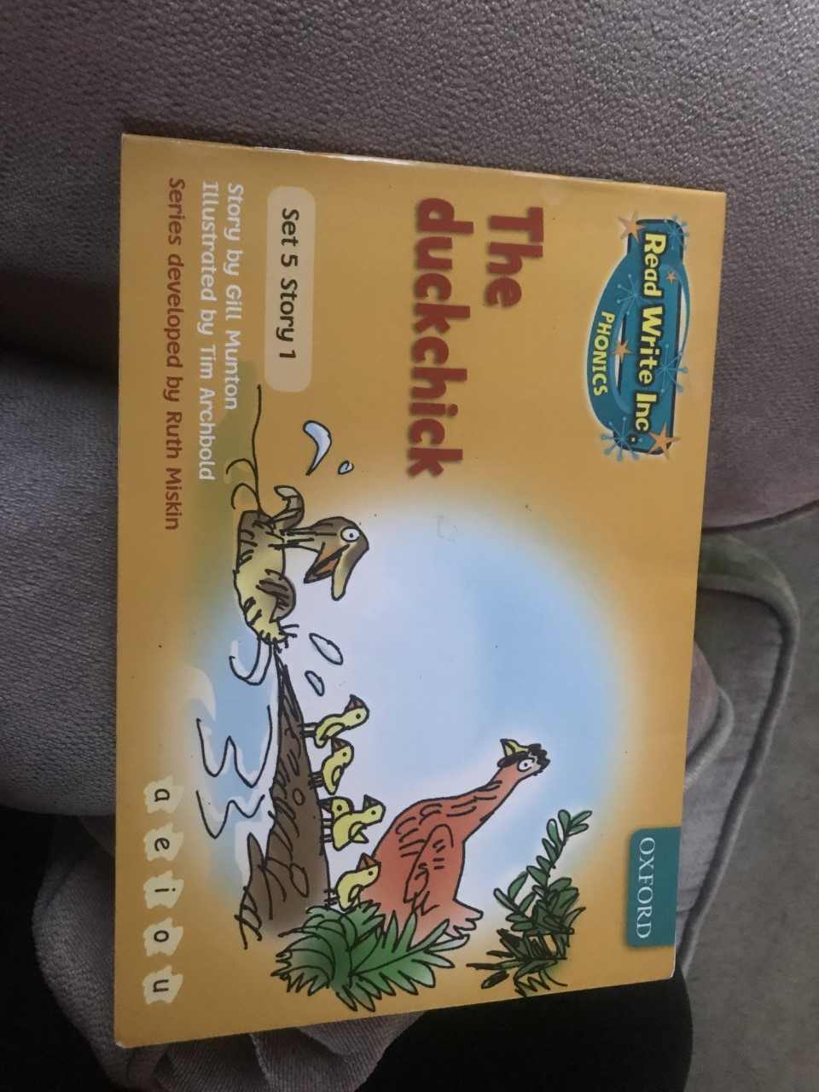


Slide 2
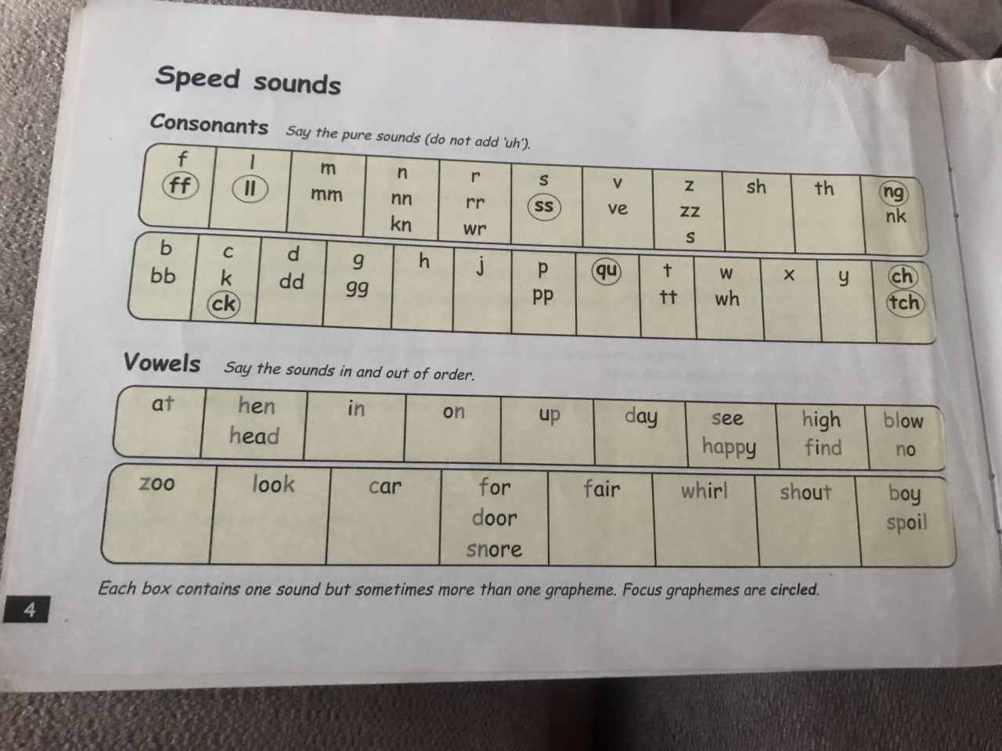

Slide 3
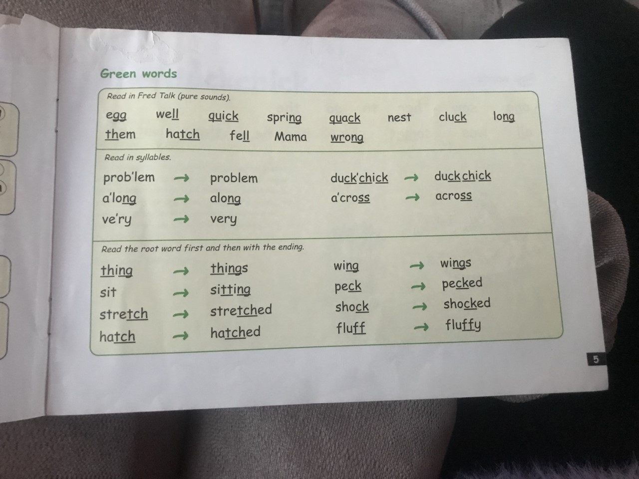

Slide 4
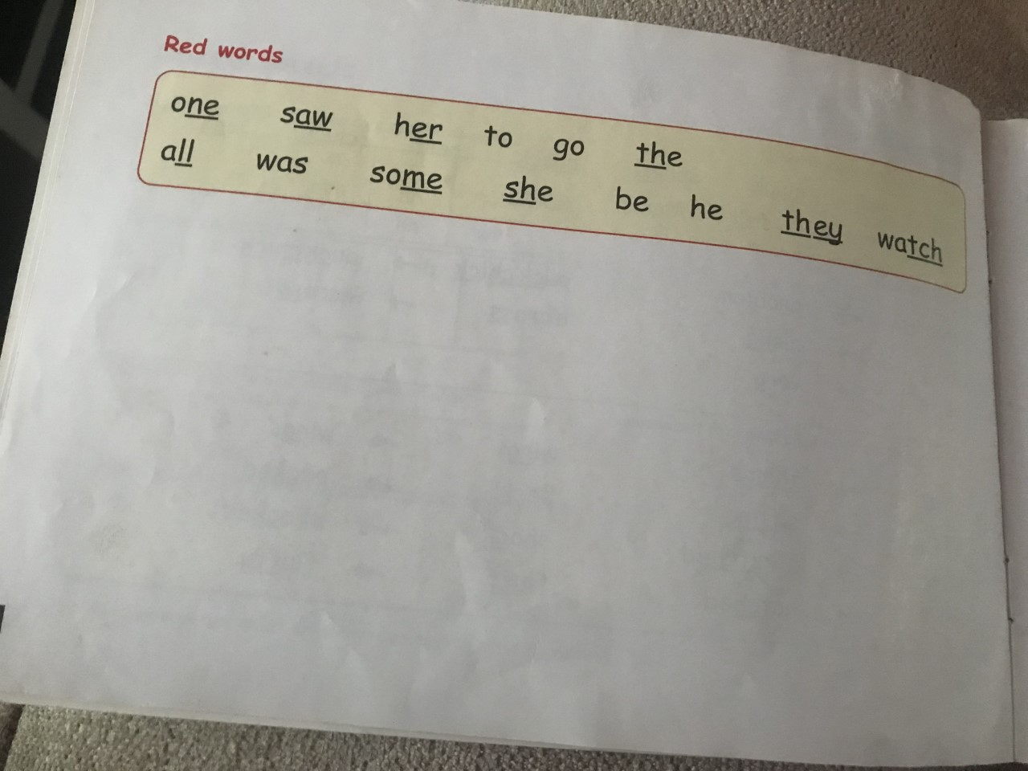

Slide 5
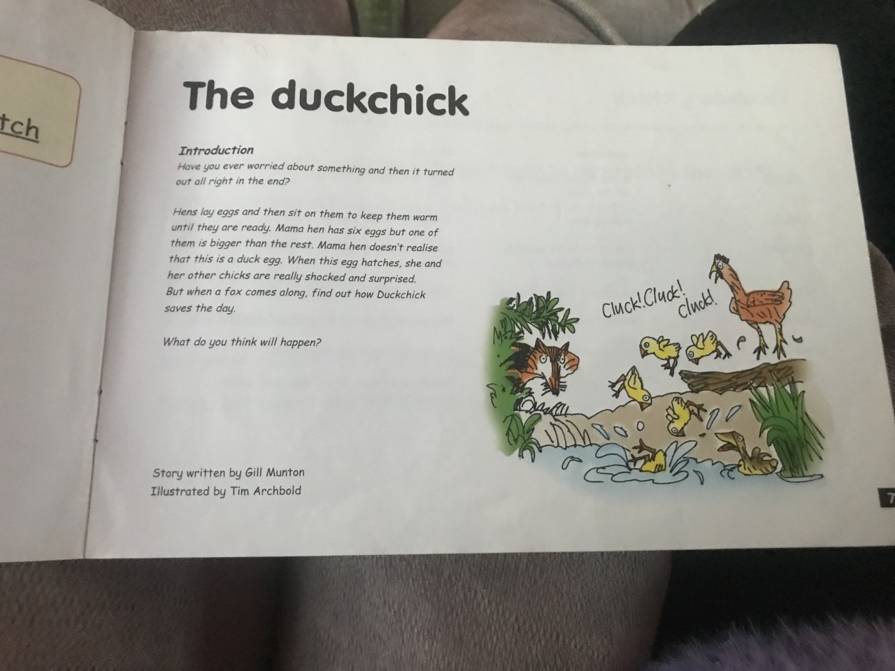

Slide 6
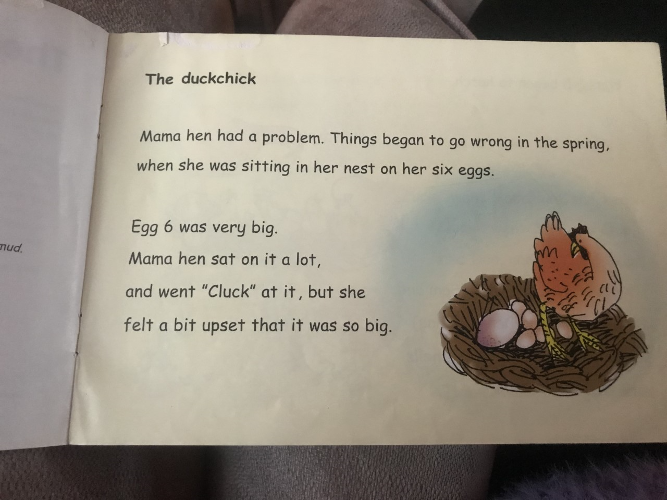

Slide 7
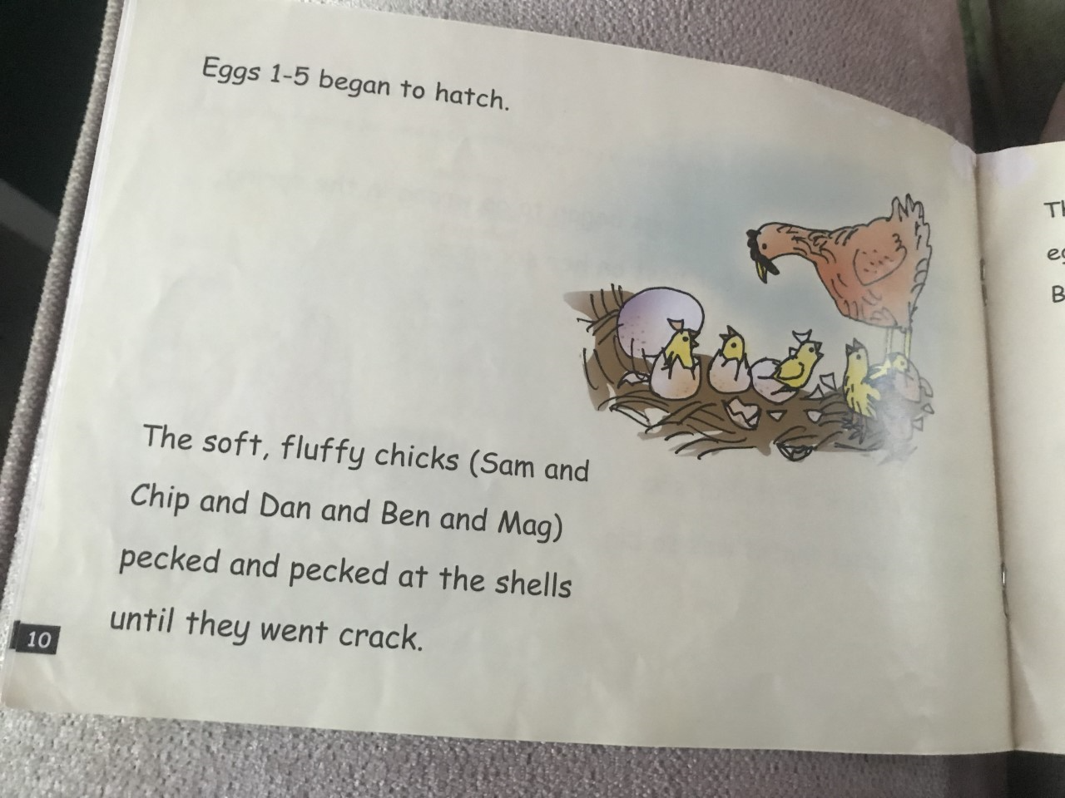

Slide 8
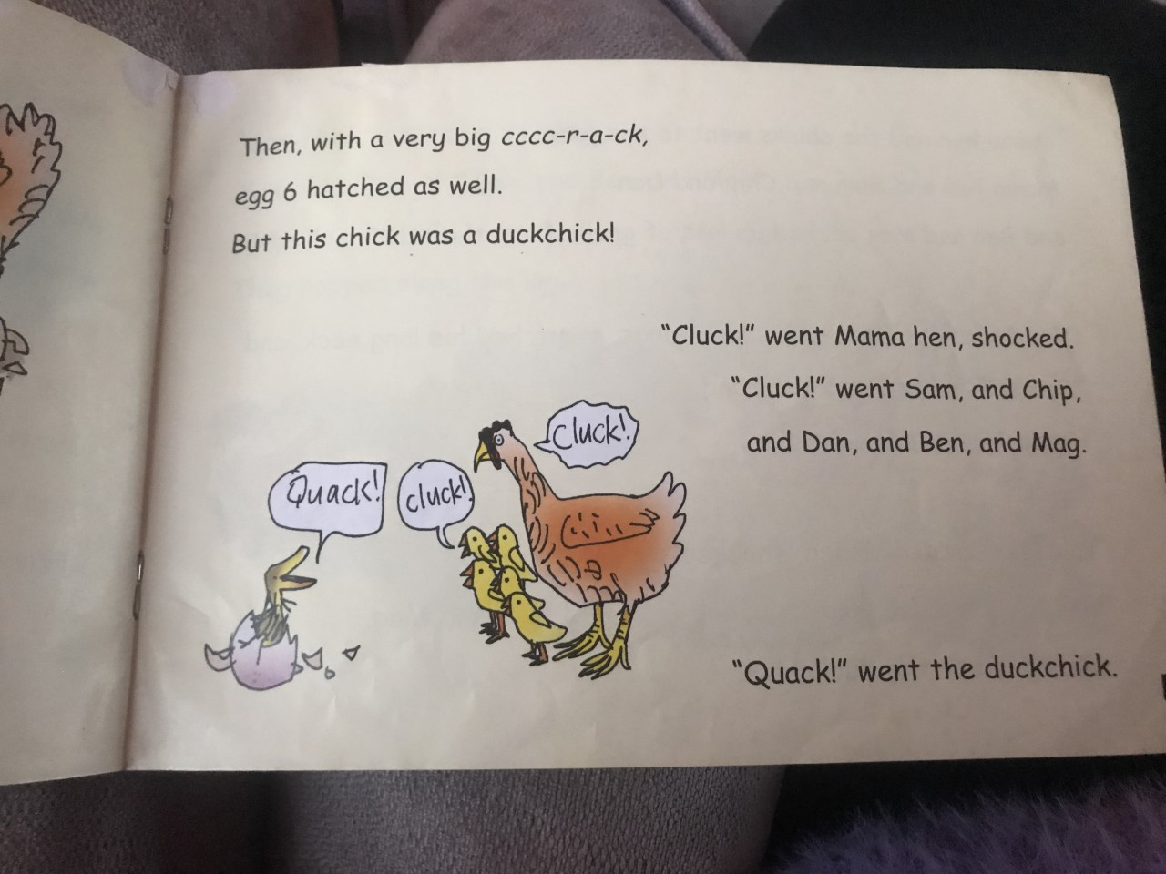

Slide 9
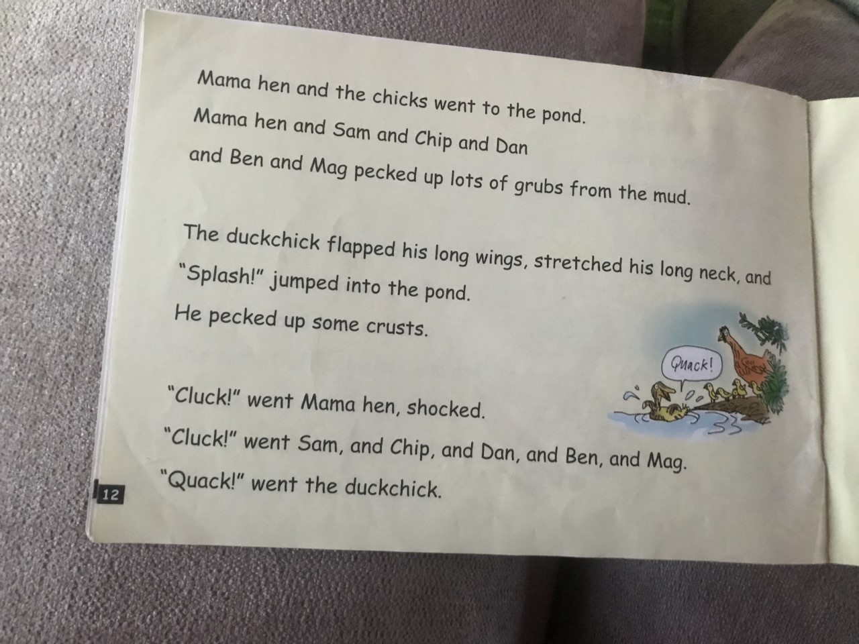

Slide 10
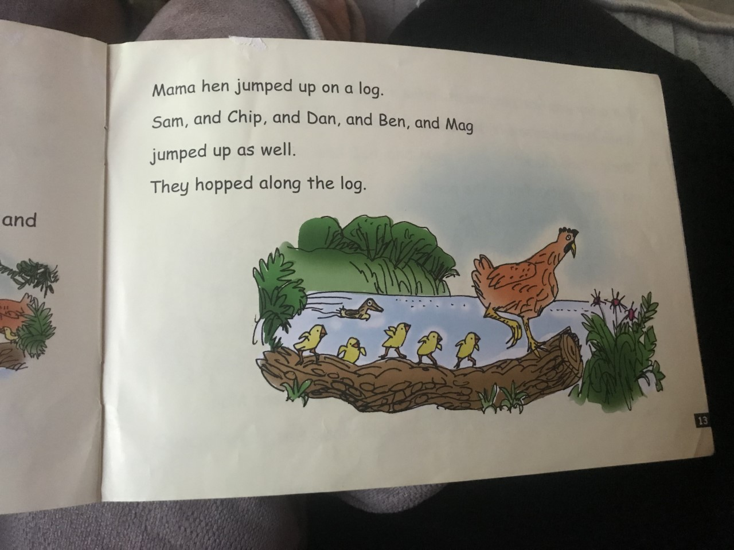

Slide 11
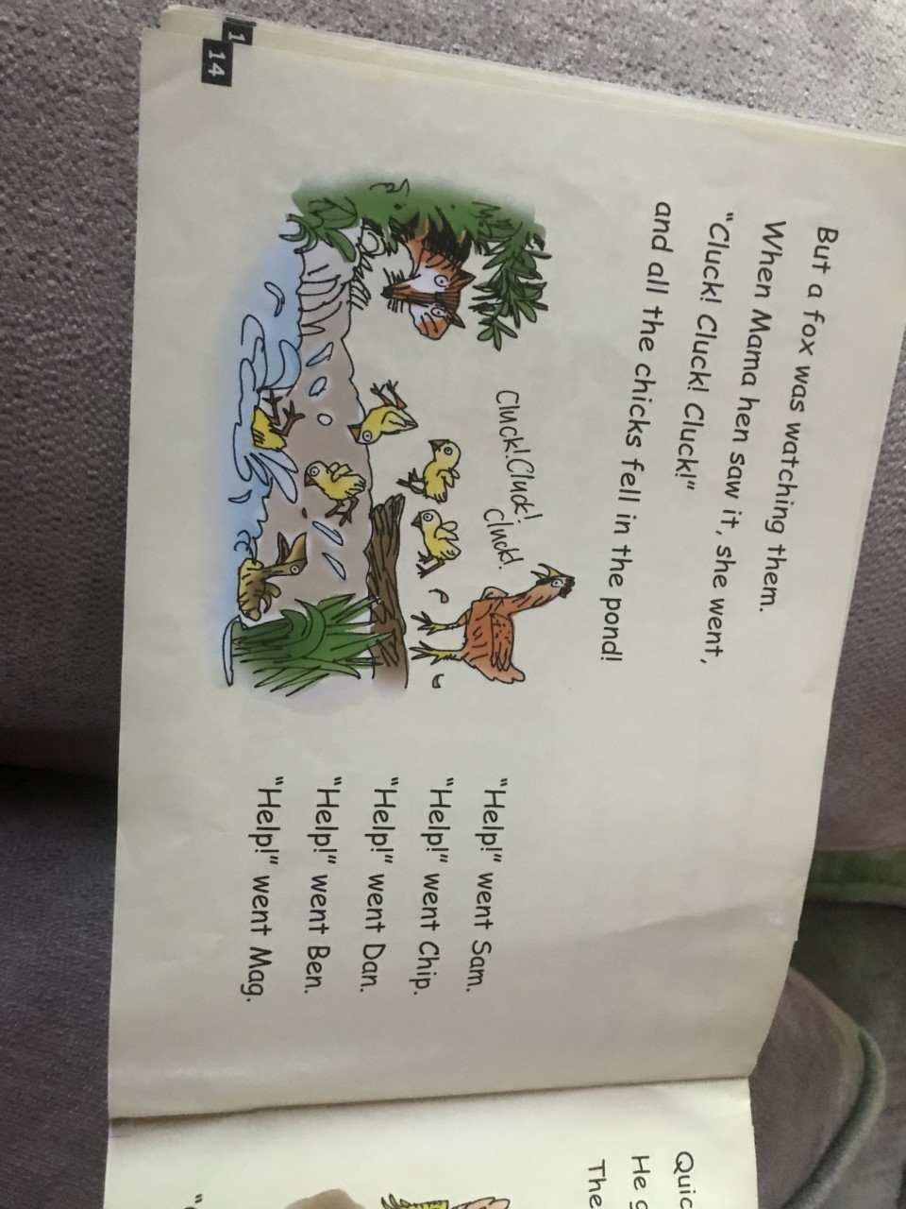

Slide 12
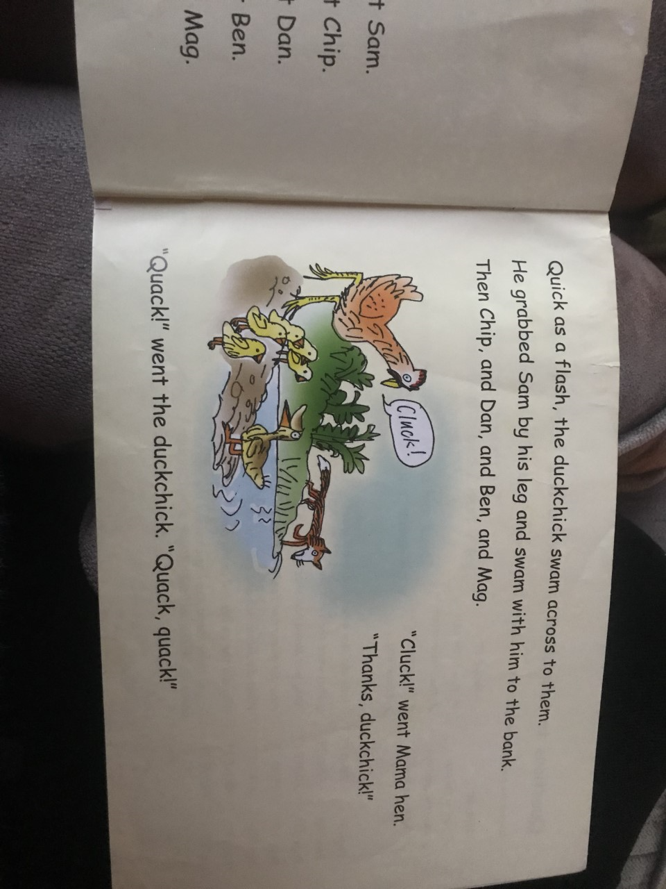

Slide 13
Tuesday (Monday repeated)- Task 1: Write out red words
Some be
Saw he
Her they
All watch
Watch
One
To
The
Go
Was
she

Slide 14
Tuesday Task 2- Hold a sentence:
1) Things began to go wrong in the spring.
2) The duckchick flapped his long wings and jumped into the pond.

