Slide 1
Tuesday 24th November 2020

Slide 2
SPaG
Using Pronouns to avoid repetition .

Slide 4
How Can We Avoid Repetition?
Repetition is when something that is said or written is used over and over again, for example:
Gary ate supper when Gary got home. Gary enjoyed the food.
After its first use, instead of repeating 'Gary', we could replace further uses with pronouns to avoid repetition, such as:
Gary ate his supper when he got home. He enjoyed the food.
noun
pronoun
pronoun
alternate noun
We can also replace the noun 'supper' with another noun which means the same thing (or simply use 'it').

Slide 5
Pronouns
How many different pronouns can you think of? Don’t forget to include personal, possessive, relative and reflexive pronouns.
yourself
Pronouns
his
themselves
it
our
I
they
who
you
mine
which
he
yours
that
she
theirs
myself

Slide 6
Pronoun or Not?
Keeping in mind that ‘a pronoun is a word which takes the place of a noun’, sort the following words into the correct circles.
orange
yours
himself
Larry
it
that
them
home
piano
him
Pronouns
Not Pronouns

Slide 7
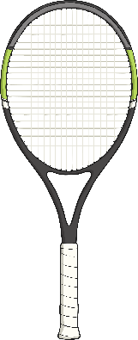
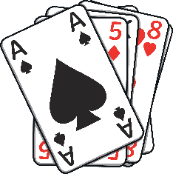
Spot the Pronouns
Read the sentences below and spot the pronouns which take the place of a noun. There could be more than one.
Ash loves to play tennis; she is really good at it.
Peter went for a walk and he stopped when he arrived at the cafe.
“The flute is his, not ours,” replied Tomasz.
We taught ourselves how to play cards over the summer break.

Slide 8
Spot the Pronouns
Were you able to spot the pronouns which take the place of a noun?
Ash loves to play tennis; she is really good at it.
Peter went for a walk and he stopped when he arrived at the cafe.
“The flute is his, not ours,” replied Tomasz.
We taught ourselves how to play cards over the summer break.

Slide 9
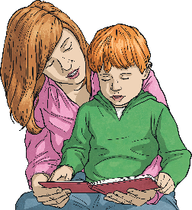
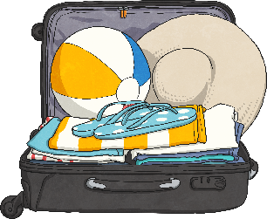
Replacing Nouns
Read the sentences below and replace certain nouns with pronouns to avoid repetition.
The Queen wore a crown. The crown was very sparkly.
Sam was clever because Sam loved reading.
When the Collins arrived, the Collins realised that
the suitcase was not the Collins' suitcase.
My sister and I love chocolate – my sister
and I wanted to eat the whole cake.
Is there more than one pronoun which could make sense?

Slide 10
Replacing Nouns
Did you add pronouns to avoid repetition? Could more than one pronoun make sense in the sentence?
The Queen wore a crown. It was very sparky.
Sam was clever because he loved reading.
When the Collins arrived, the Collins realised
that the suitcase was not theirs.
My sister and I love chocolate –
we wanted to eat the whole cake.

Slide 11
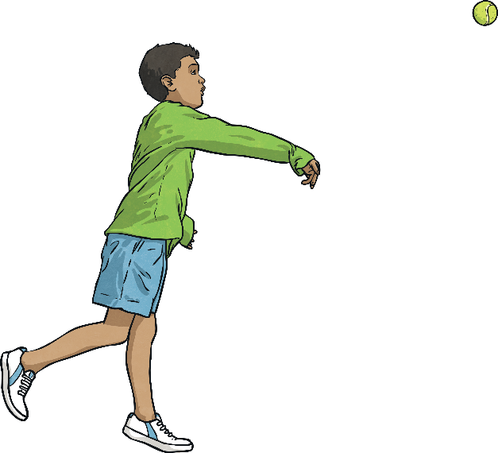
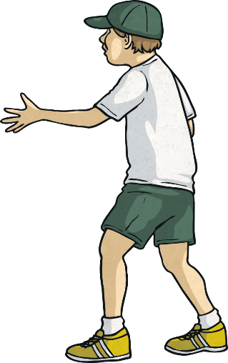
Avoid the Repetition!
Look at the sentence below. How many different pronouns and alternative nouns can you use in one minute to avoid repetition? Write your answers on a whiteboard.
Jamie threw the ball to his friend and the ball almost hit his friend in the face.
Start
End

Slide 12
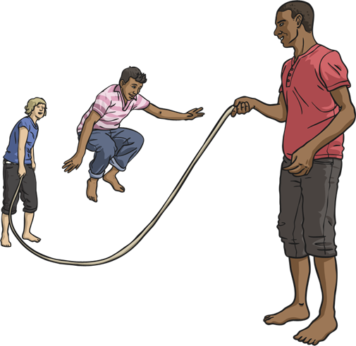
Avoid the Repetition!
Look at the sentence below. How many different pronouns and
alternative nouns can you use in one minute to avoid repetition? Write your answers on a whiteboard.
The children laughed as the children skipped over the rope while Leroy held onto the rope.
Start
End

Slide 13
Avoid the Repetition!
Read the following passage of text. How many pronouns and alternative nouns can you use to stop this story from being repetitive?
Jenny carefully took the toothbrush out of the cupboard and brushed her teeth with it. Jenny's face became covered in foam so she took the towel and wiped her face with it.
Jenny carefully took the toothbrush out of the cupboard and brushed her teeth with the toothbrush. Jenny's face became covered in foam so Jenny took the towel and wiped her face with the towel.
Start
End

Slide 14
Avoid the Repetition!
Read the following passage of text. How many pronouns and alternative nouns can you use to stop this story from being repetitive? Don't take out so many nouns that the text no longer makes sense.
Keenan took his dogs, Max and Suki, to the local park. Keenan took them off the lead there and Max ran forward. Keenan followed him so Max ran faster and Keenan could not keep up with him. Eventually, Max stopped and he had a lie down on the floor. Keenan and Suki lay next to him so they could recover.
Keenan took his dogs, Max and Suki, to the local park. Keenan took Max and Suki off the lead at the local park and Max ran forward. Keenan followed Max so Max ran faster and Keenan could not keep up with Max. Eventually, Max stopped and Max had a lie down on the floor. Keenan stroked Max. Keenan and Suki lay next to Max so Keenan and Suki
could recover.
Start
End

Slide 15
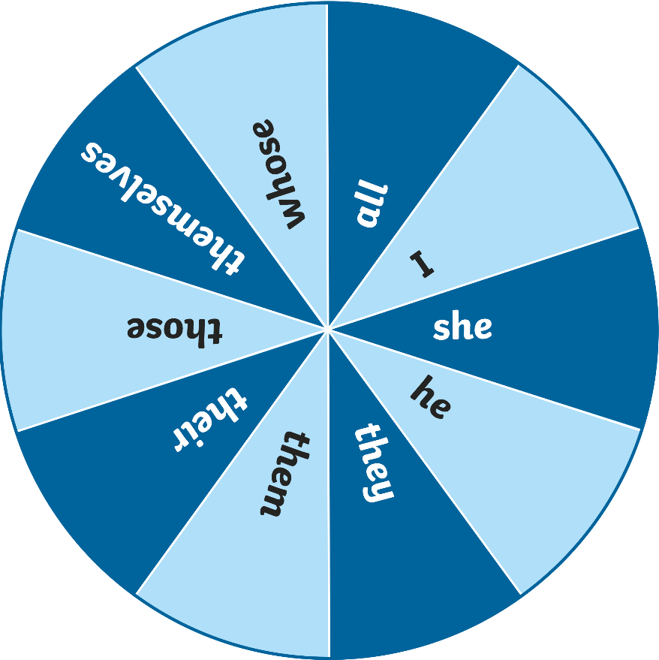
They Have Been Matched!
Spin the wheel to select a pronoun.
Spin
Next Slide
Spin the spinner to choose a pronoun. On your whiteboards, write your own sentences about this picture which include the pronoun the spinner has selected, and an alternative noun to avoid repetition.

Slide 16
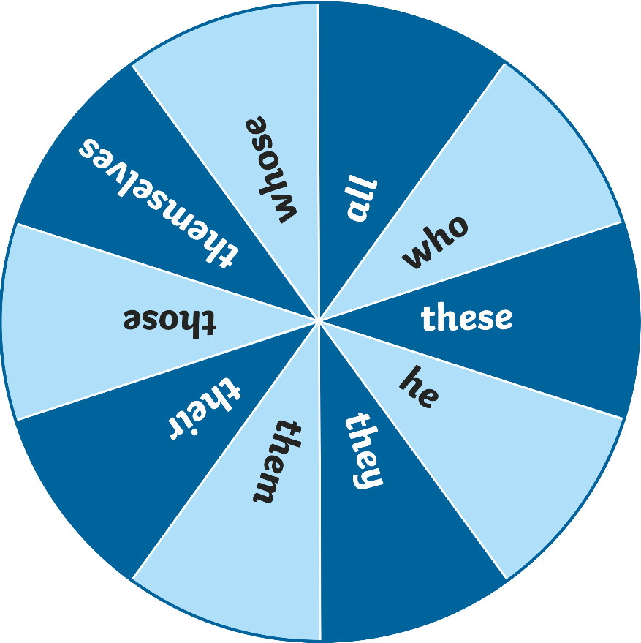
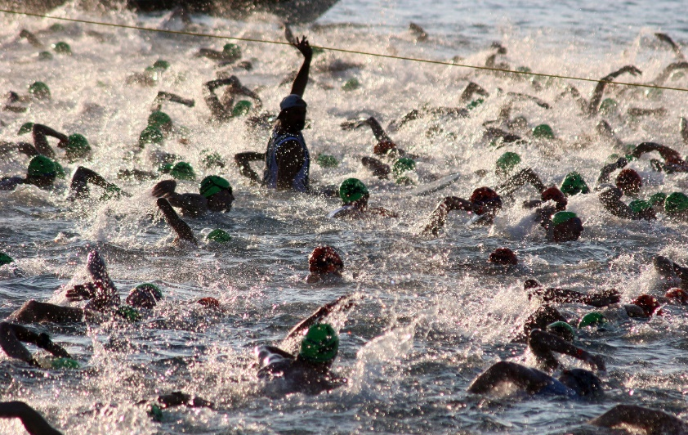
They Have Been Matched!
Spin the wheel to select a pronoun.
Spin
Next Slide
Spin the spinner to choose a pronoun. On your whiteboards, write your own sentences about this picture which include the pronoun the spinner has selected, and an alternative noun to avoid repetition.

Slide 17
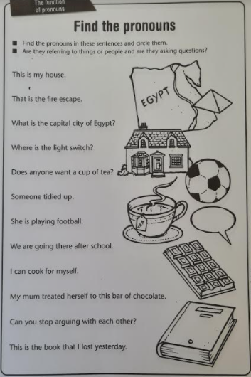

Slide 18
Planning for a cold write
Tomorrow you will complete a cold write.
This is a writing task to evaluate what you have learned so far.
You are going to write a fictional story!!!
You will need to have a beginning, middle and end.
You need to remember to describe character and set effectively but make sure you don’t use all your time doing so.

Slide 19
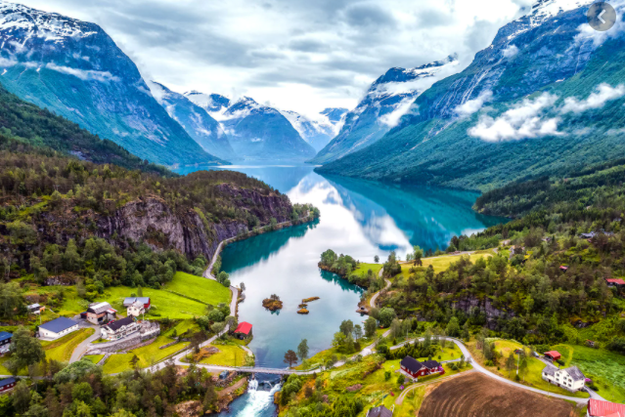
To help you…
You are going to pick one of these pictures to set your story and inspire you with ideas.

Slide 20
In your planning use a Spider Diagram
What happens in the Beginning?
What is the big event that happens in your story?
Genre – Adventure, Mystery, Action etc
My Fictional Story
What happens in the Middle?
How does the story fix itself when the big event happens?
What happens in the End?
Where is it set?
Characters (names and traits)

Slide 21
Break

Slide 22
Bus stop Method…
Yesterday we were able to identify the multiples of a specific number but we found it hard to check our answer using the bus stop method.
Let’s refresh our memory from Y4 and complete some together before we start looking at Factors.
88 ÷ 8 = 45 ÷ 9 =
96 ÷ 2 = 50 ÷ 10 =
54 ÷ 3 = 144 ÷ 12 =
85 ÷ 5 =

Slide 23
Maths
Factors – I can identify factors and understand their relationship with multiplication and division.

Slide 26
40
4
26

Slide 27
What is a factor?
2 rows of 3 are equal to 6
2 × 3 = 6
3 columns of 2 are equal to 6
3 × 2 = 6
2 and 3 are factors of 6
Have a think
Are there any other factors of 6?

Slide 28
1 row of 6 is equal to 6
1 × 6 = 6
6 columns of 1 are equal to 6
6 × 1 = 6
1 and 6 are factors of 6
The factors of 6 are: 1, 2, 3 and 6

Slide 29
18 × 1
9 × 2
Factor pair
18
3 × 6
6 × 3
The factors of 18 are: 1, 2, 3, 6, 9 and 18

Slide 30
Have a think
__ × 1
10 × 2
20
20
5 × 4
1, 2, 4, 5, 10 and 20
The factors of 20 are: _________________

Slide 31
Have a think
25 × 1
25
5 × 5
1, 5, 5 and 25
1, 5 and 25
The factors of 25 are: _________________

Slide 32
Have a go at questions 1 to 4 on the worksheet

Slide 33
1, 3 and 7 are all factors of a number between 40 and 50
Have a think
What is the number?
42
The number must be a multiple of 3 and 7
3
6
9
12
15
18
21
24
27
30
33
36
7
14
21
28
35
42
49
56
63
70
77
84

Slide 34
List the factors of these numbers:
2
5
17
What do you notice?
29
1 and 2
Have a think
1 and 5
1 and 17
1 and 29
They all only have 2 factors

Slide 35
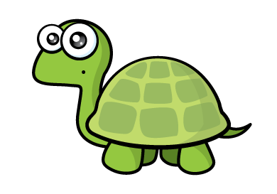
0.5 × 22 = 11
This means that 0.5 is a factor of 11
Factors have to be integers (whole numbers).
Have a think
What are the factors of 11?
1 and 11

Slide 36
Have a go at questions 5 to 9 on the worksheet

Slide 37
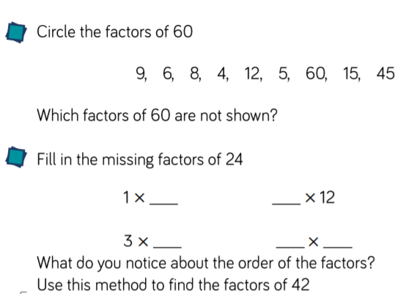

Slide 38
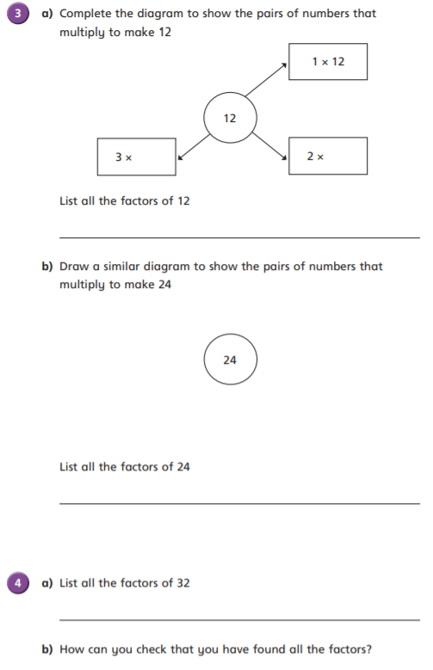

Slide 39
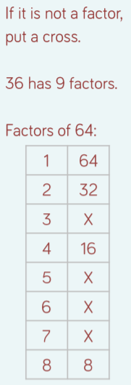
Challenge:

Slide 40
Plenary

Slide 41
D.M.M
What is the difference between:
A) 100 and 58 B) 5,005 and 1,005 C) 79,540 and 65,780
What is the total of:
A) 900 and 500 B) 7,500 and 800 C) 60,350 and 9,677
Complete the sequence:
A)100, ____,____, 400,____.
B) 850, 820, 790, ____, ____,____
C) 3,645, 3845, 4045,_____,_____,____.
Write down the multiples of 5

Slide 42
Lunch

Slide 43
Geography Lesson 4
Scandinavia

