Slide 1
I can multiply by 1 and 0
Click the blue arrow to watch the video
Click the red arrow to see the worksheet

Slide 5
12
12
13
11

Slide 7
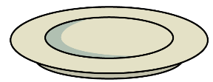
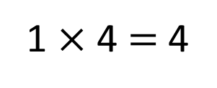
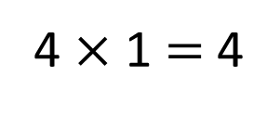
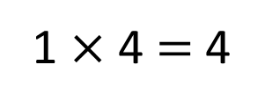
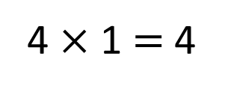
There are 4 plates.
Each plate has 1 doughnut on it.
There are 4 doughnuts altogether.
There is 1 plate.
The plate has 4 doughnuts on it.
There are 4 doughnuts altogether.

Slide 8
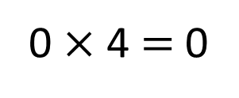
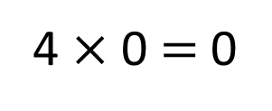
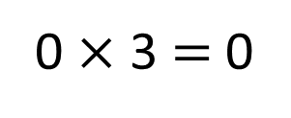
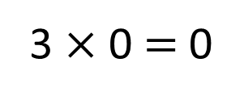
There are 4 plates.
Each plate has 0 doughnuts on it.
There are 0 doughnuts altogether.
Have a think
There are 3 plates.
Each plate has 0 doughnuts on it.
There are 0 doughnuts altogether.

Slide 9
Have a go at questions 1 – 4 on the worksheet

Slide 10
2-times table | 4-times table | 8-times table
What’s the same?
What’s different?
When one of the factors is 0,
the product is 0
One of the factors is 0
The factor that is not 0
One of the factors is not 0
The product is 0

Slide 11
2-times table | 4-times table | 8-times table
What’s the same?
What’s different?
One of the factors is 1
The factor that is not 1
When one of the factors is 1, the product is equal to the other factor.
One of the factors is not 1
The product
The product is the same as one of the factors.

Slide 12
Have a go at questions 5 – 8 on the worksheet

Slide 13
When there are 2 factors and one of the factors is 1, the product is equal to the other factor.
When one of the factors is 1, the product is equal to the other factor.
When there are 3 factors and one of the factors is 1, the product is equal to the product of the other factors.

Slide 14
Have a go at the rest of the worksheet

