Slide 1
16.11.20
What is…..
30 + 70 =
25 + ___ = 100
55 + ___ = 100
35 + ___ = 100
75 + ___ = 100
45 + ___ = 100
___ + 40 = 100
50 + ___ = 100
75 + ___ = 100
10) 100 – 25 =
11) 100 – 35 =
100 – 55 =
100 – 95 =
100 - 40 =
100 – 15 =
100 – 65 =
100 – 5 =
100 – 45 =

Slide 2
Can you write some perfect sentences about your weekend? Remember a perfect sentence must: - Sentences MUST start with a capital letter and end with a full stop -Key words spelt correctly -Sentences should make sense -Include expanded noun phrases where you can ie; I rode my fast, blue bike

Slide 3
The Little Hen and The Great War Last week we read up to the part where Arthur has just noticed the hen in the hedges. Click through the slides to listen to the next part of the story.

Slide 4
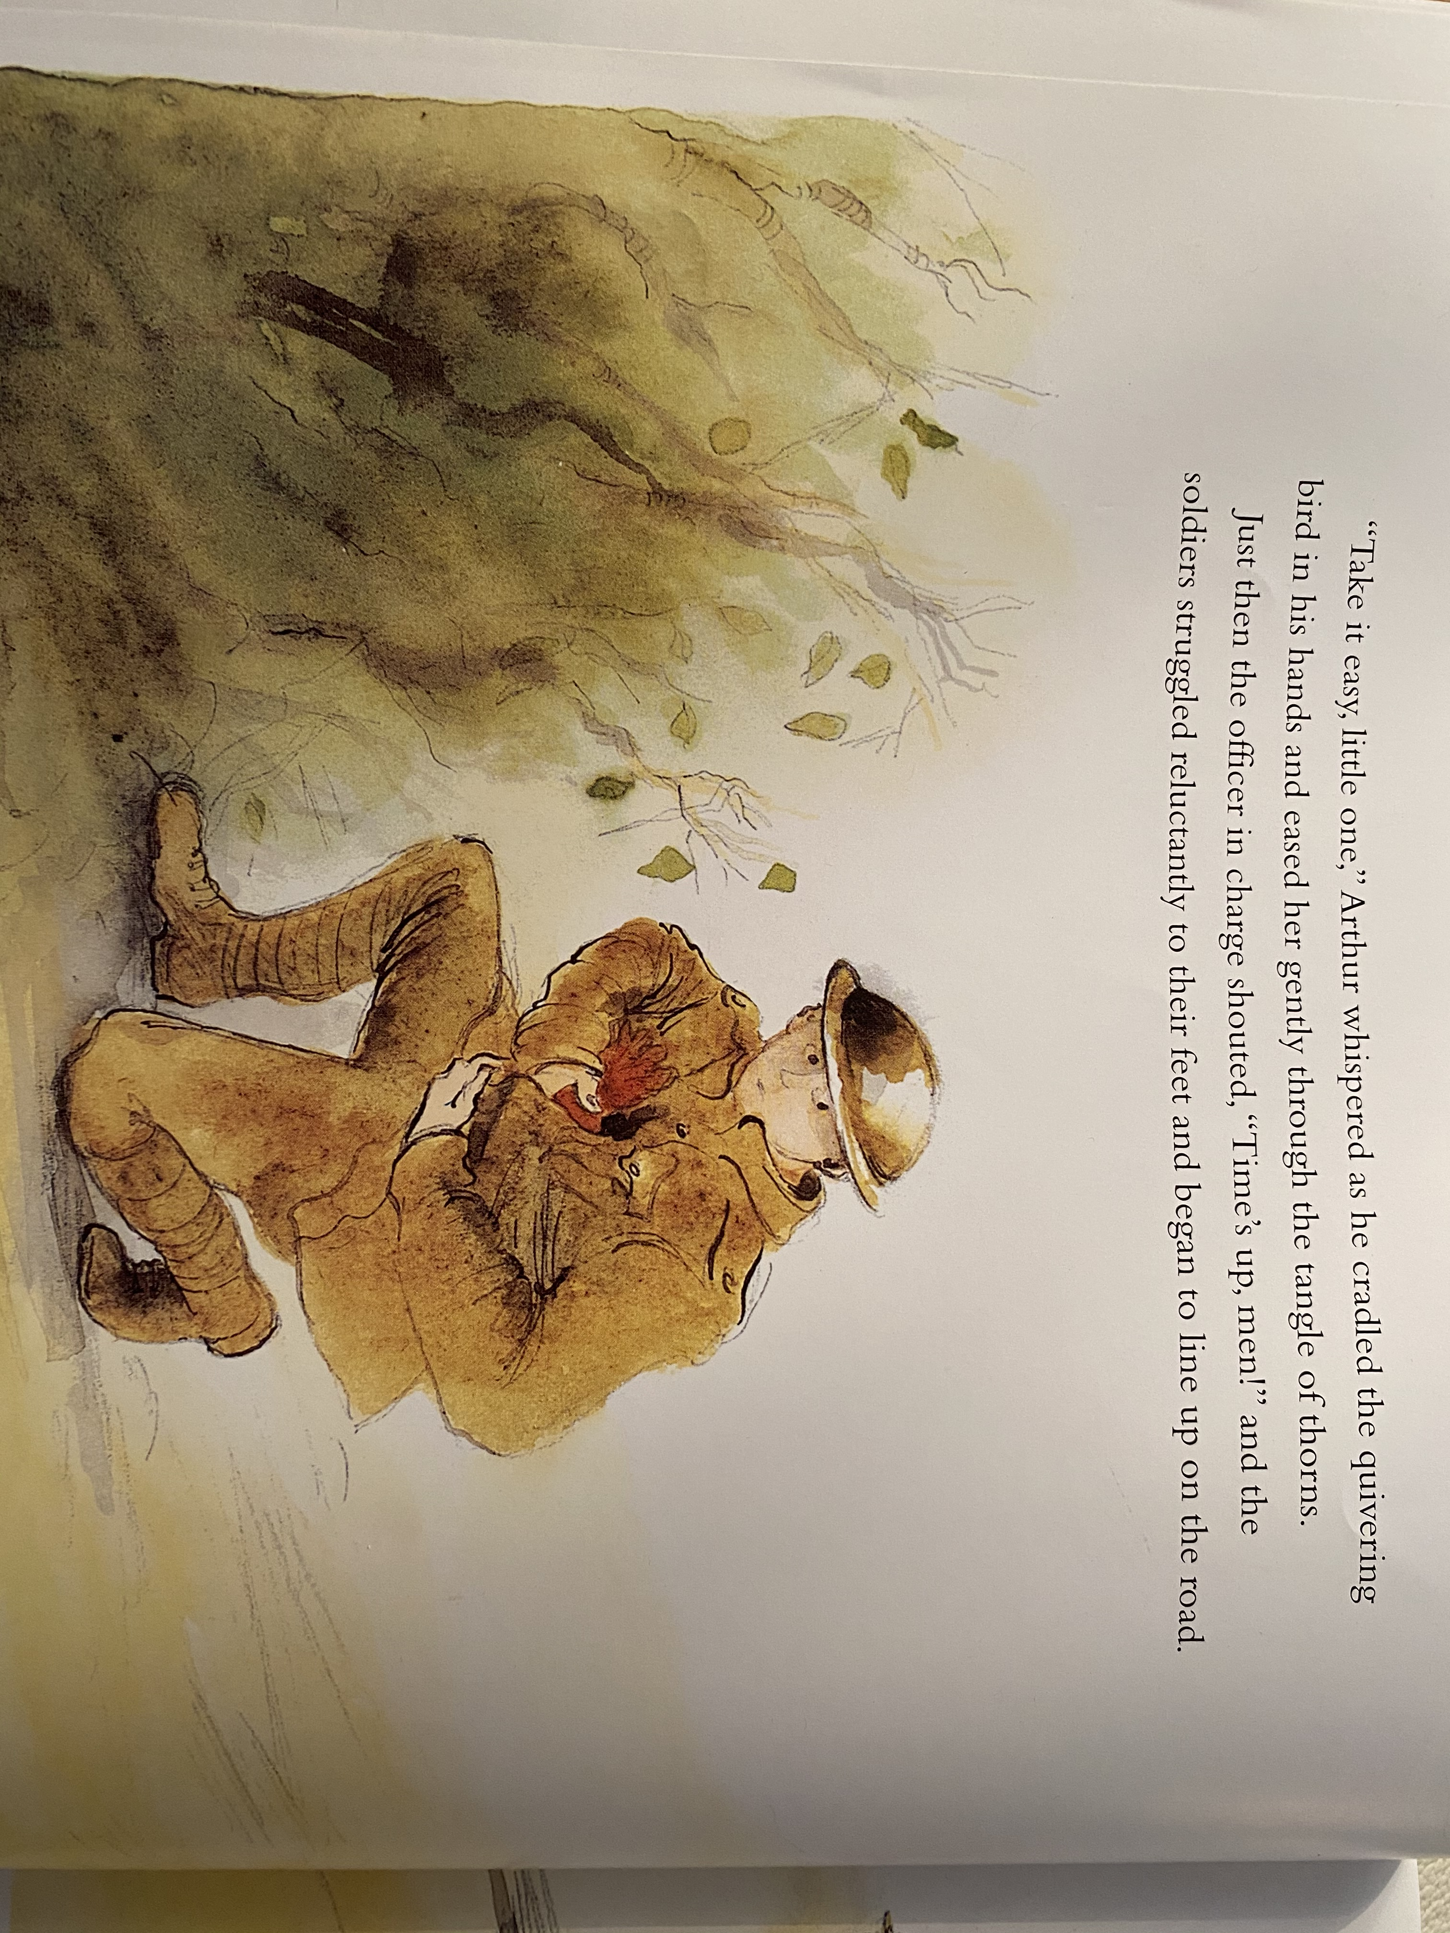

Slide 12
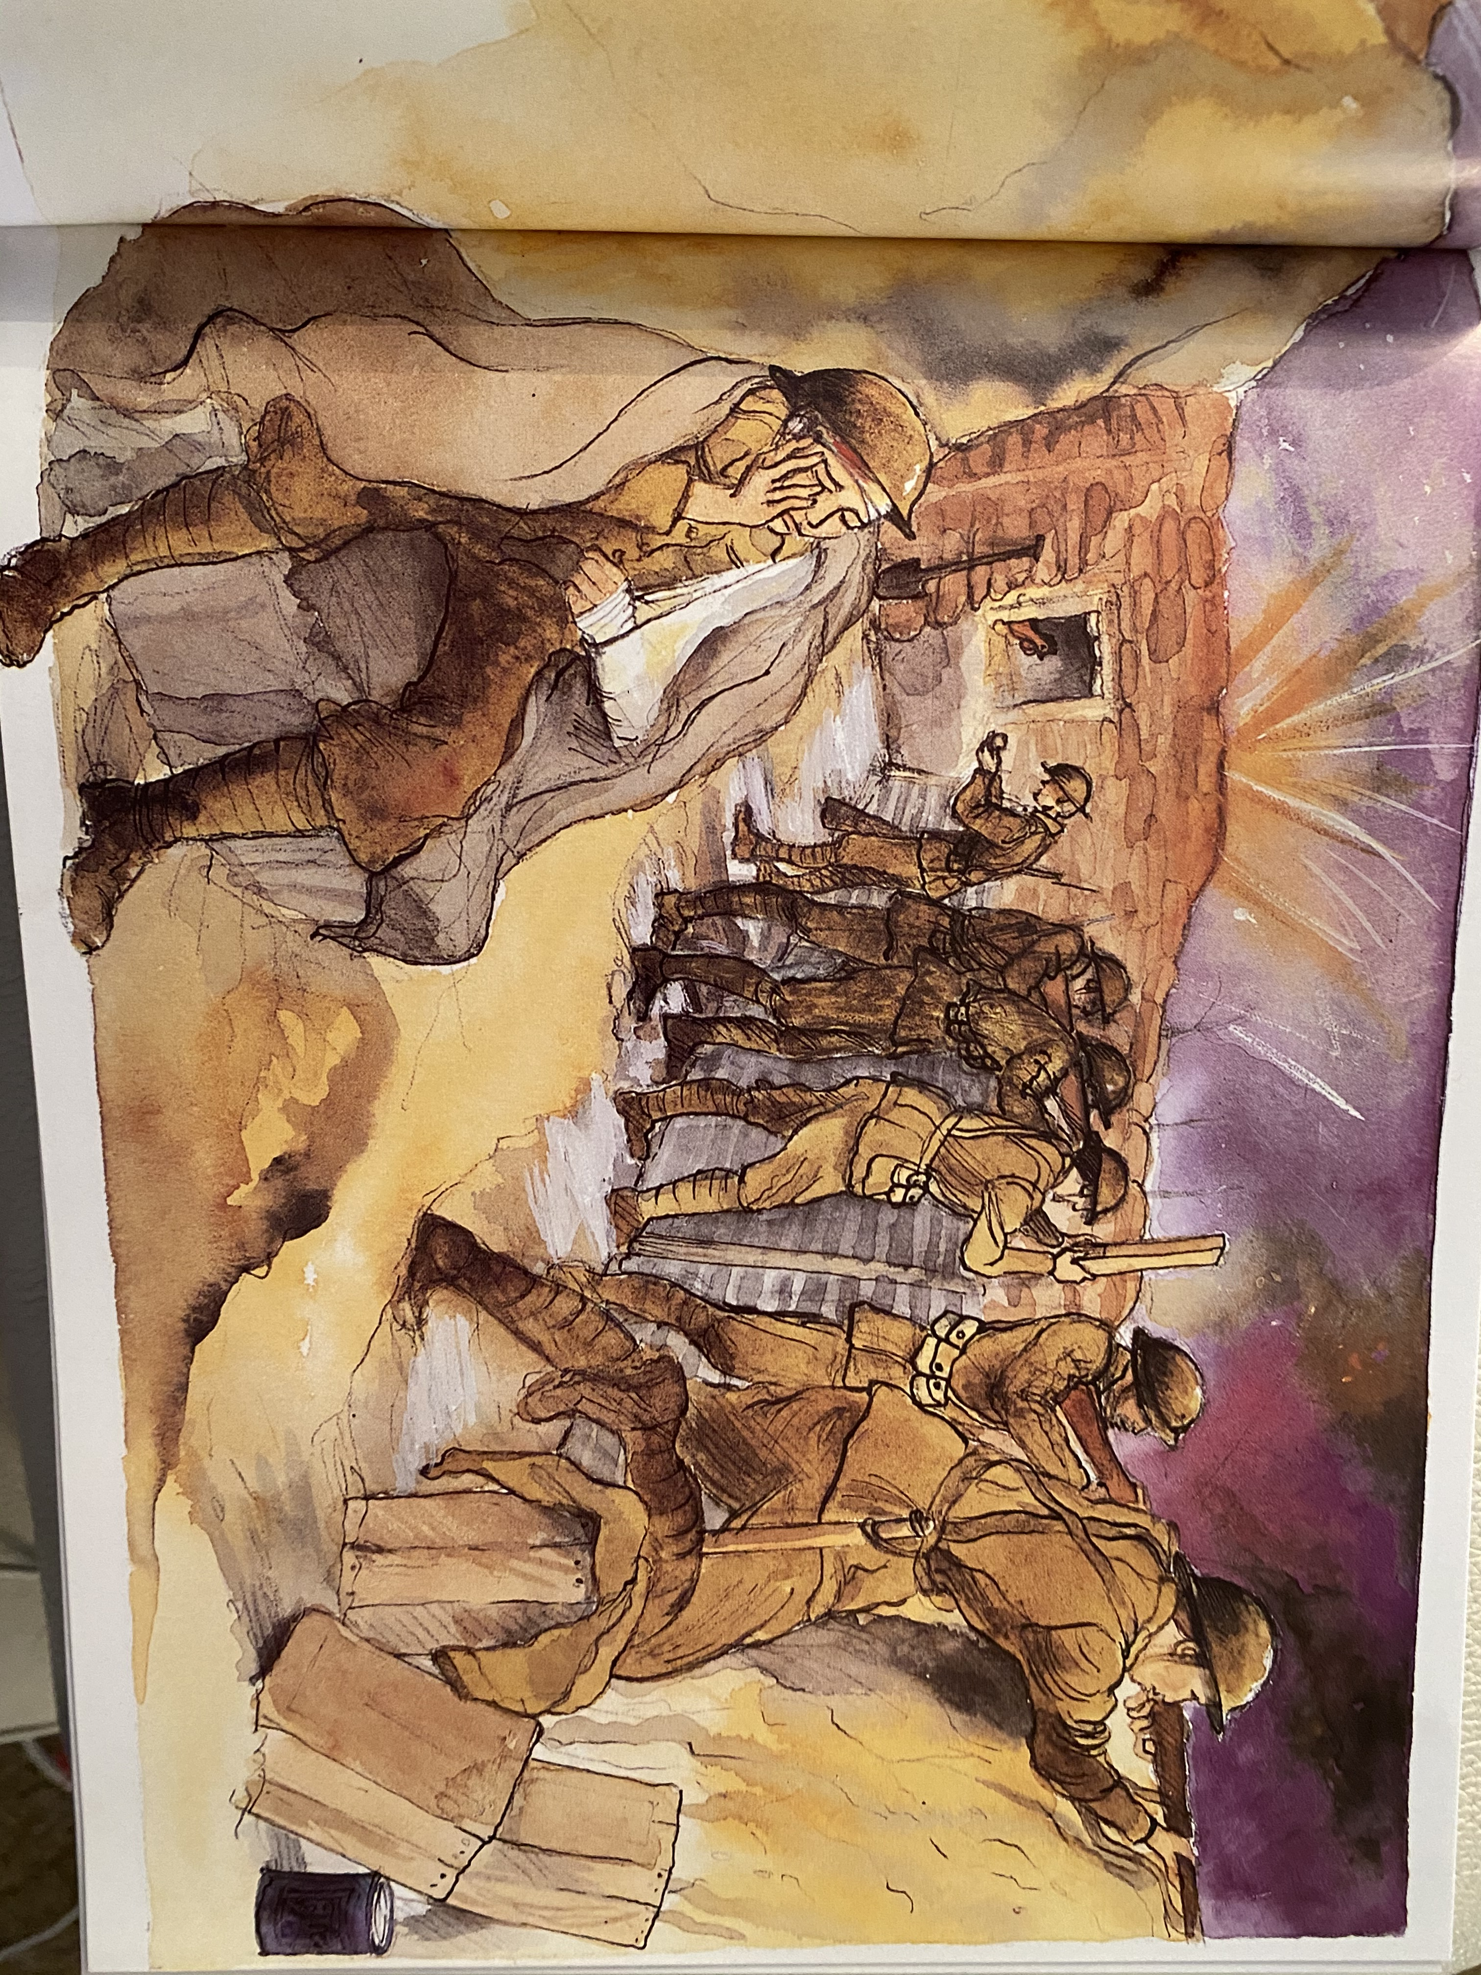
What do you think life was like in the trenches?
Look at the following pictures and make a note of some adjectives about the trenches.

Slide 13
This week, you are going to pretend that you are Arthur, a soldier during the war and living in the awful trenches. You are going to write a diary entry about what you are doing and how are you feeling.
Look at the diary entry on the following page:

Slide 14
Thursday 15th November 1916
Dear Diary,
We've been marching for what seems like days. Over hills, along dusty roads, through old villages. Often the French villages have piles of rubble lying around, where stray shells have landed. The countryside would be beautiful if it were not for the echoes of bombs. I miss our farm at home, the smells and the animals. What I would do to be back home now, working on the farm!
Today was a slightly different day though. We were just having a rest on the dusty roadside, when, out of the corner of my eye, I spotted something moving. It was a little hen caught under some collapsed rubble! Next, I tried to patch it up as best I as I could. The older soldiers were laughing at me. They think I'm silly rescuing this little hen. But I'm just going to ignore them.

Slide 15
Plan your diary entry:
Write a list of three things (events) you want to include in your diary. This might be what you have been doing, how you are feeling, what you have been eating etc.
Next to each ‘event’ write some adjectives to include to describe it.

Slide 16
Maths!

Slide 17
Click the following link for the teaching video.
https://vimeo.com/471306740
Now complete the Monday Maths PowerPoint and complete the attached worksheets.

Slide 18
Handwriting
Complete the attached Handwriting sheet, start at the beginning and work through each day.

Slide 19
Memories
Thinking about Remembrance Day, we particularly think about the soldiers who have fought for our country.

Slide 20
Watch the following video, think about the memories the man has.
https://www.youtube.com/watch?v=gEAnre-s4-o
Fill in the attached sheet with your memories.

