Slide 3
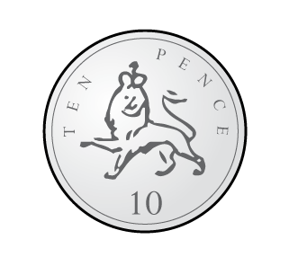
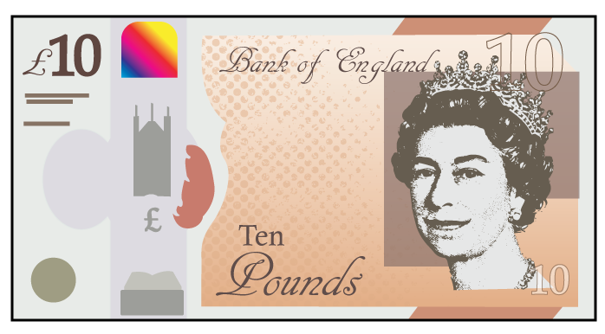
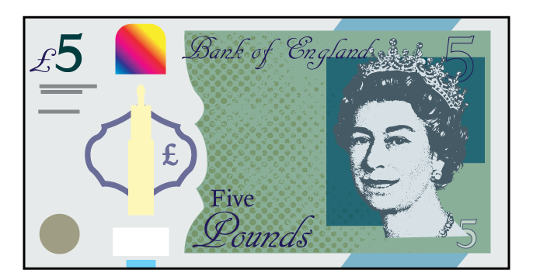
Compare the amounts

Slide 4
Compare the amounts
$$>$$
$$>$$
$$<$$

Slide 6
$$=$$
Have a think
$$=$$
$$=$$

Slide 7
$$=$$
$$=$$
$−$ £7
$+$ £7
$$=$$

Slide 8
Have a go at question 1 on the worksheet

Slide 9
20p
Notes:
Dora, Whitney and Teddy are on a role now.
But this one looks different! Let’s see if they can use what they know
Whitney knows that 100 take away 40 is equal to 60
And Dora knows that 60 take away 2 is equal to 58
So Teddy has realised that 100 takeaway 42 must be equal to 58
Great team work guys!

Slide 10
20p
Notes:
Dora, Whitney and Teddy are on a role now.
But this one looks different! Let’s see if they can use what they know
Whitney knows that 100 take away 40 is equal to 60
And Dora knows that 60 take away 2 is equal to 58
So Teddy has realised that 100 takeaway 42 must be equal to 58
Great team work guys!

Slide 11
50p
Have a think
Notes:
Dora, Whitney and Teddy are on a role now.
But this one looks different! Let’s see if they can use what they know
Whitney knows that 100 take away 40 is equal to 60
And Dora knows that 60 take away 2 is equal to 58
So Teddy has realised that 100 takeaway 42 must be equal to 58
Great team work guys!

Slide 12
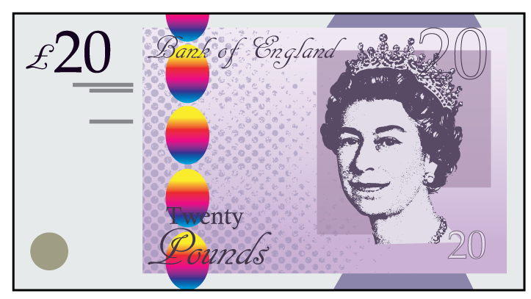
Have a think
£20
Notes:
Dora, Whitney and Teddy are on a role now.
But this one looks different! Let’s see if they can use what they know
Whitney knows that 100 take away 40 is equal to 60
And Dora knows that 60 take away 2 is equal to 58
So Teddy has realised that 100 takeaway 42 must be equal to 58
Great team work guys!

Slide 13
£20
£20
Notes:
Dora, Whitney and Teddy are on a role now.
But this one looks different! Let’s see if they can use what they know
Whitney knows that 100 take away 40 is equal to 60
And Dora knows that 60 take away 2 is equal to 58
So Teddy has realised that 100 takeaway 42 must be equal to 58
Great team work guys!

Slide 14
Have a go at questions 2 and 3 on the worksheet

Slide 15
?
?
?
?
Have a think
Notes:
Dora, Whitney and Teddy are on a role now.
But this one looks different! Let’s see if they can use what they know
Whitney knows that 100 take away 40 is equal to 60
And Dora knows that 60 take away 2 is equal to 58
So Teddy has realised that 100 takeaway 42 must be equal to 58
Great team work guys!

Slide 16
?
?
?
?
Notes:
Dora, Whitney and Teddy are on a role now.
But this one looks different! Let’s see if they can use what they know
Whitney knows that 100 take away 40 is equal to 60
And Dora knows that 60 take away 2 is equal to 58
So Teddy has realised that 100 takeaway 42 must be equal to 58
Great team work guys!

Slide 17
?
?
?
?
?
?
?
Notes:
Dora, Whitney and Teddy are on a role now.
But this one looks different! Let’s see if they can use what they know
Whitney knows that 100 take away 40 is equal to 60
And Dora knows that 60 take away 2 is equal to 58
So Teddy has realised that 100 takeaway 42 must be equal to 58
Great team work guys!

Slide 18
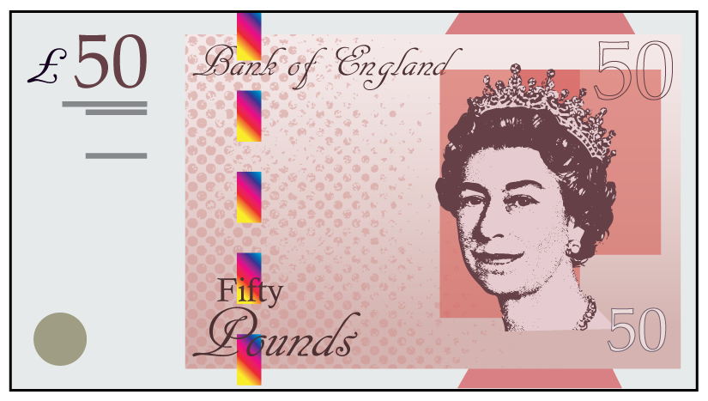
?
?
?
?
Notes:
Dora, Whitney and Teddy are on a role now.
But this one looks different! Let’s see if they can use what they know
Whitney knows that 100 take away 40 is equal to 60
And Dora knows that 60 take away 2 is equal to 58
So Teddy has realised that 100 takeaway 42 must be equal to 58
Great team work guys!

Slide 19
Have a go at questions 4 and 5 on the worksheet

