Slide 3
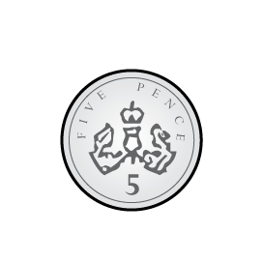
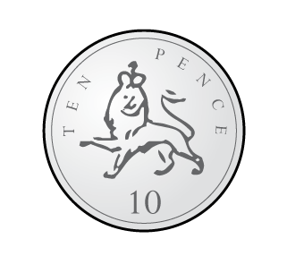
1)
2)
3)

Slide 4
1)
2)
3)
$$<$$
$$<$$
$$<$$

Slide 6
What do you notice?
1p
2p
5p
10p
20p
50p
Notes:
Dora, Whitney and Teddy are on a role now.
But this one looks different! Let’s see if they can use what they know
Whitney knows that 100 take away 40 is equal to 60
And Dora knows that 60 take away 2 is equal to 58
So Teddy has realised that 100 takeaway 42 must be equal to 58
Great team work guys!

Slide 7
What do you notice?
Notes:
Dora, Whitney and Teddy are on a role now.
But this one looks different! Let’s see if they can use what they know
Whitney knows that 100 take away 40 is equal to 60
And Dora knows that 60 take away 2 is equal to 58
So Teddy has realised that 100 takeaway 42 must be equal to 58
Great team work guys!

Slide 8
Have a go at the question 1 on the worksheet

Slide 9
Hmmm, this one is tricky
Easy, 3 tens, 30
Easy, 3 tens, 30
Ahhhhhhh…
Notes:
Dora, Whitney and Teddy are on a role now.
But this one looks different! Let’s see if they can use what they know
Whitney knows that 100 take away 40 is equal to 60
And Dora knows that 60 take away 2 is equal to 58
So Teddy has realised that 100 takeaway 42 must be equal to 58
Great team work guys!

Slide 10
Ahh! I can use what I know…
This one is tricky too, I can’t count in 20s
20
40
60
80
2
4
6
8
Notes:
Dora, Whitney and Teddy are on a role now.
But this one looks different! Let’s see if they can use what they know
Whitney knows that 100 take away 40 is equal to 60
And Dora knows that 60 take away 2 is equal to 58
So Teddy has realised that 100 takeaway 42 must be equal to 58
Great team work guys!

Slide 11
I’ve got two ways I can find the value of these coins
Notes:
Dora, Whitney and Teddy are on a role now.
But this one looks different! Let’s see if they can use what they know
Whitney knows that 100 take away 40 is equal to 60
And Dora knows that 60 take away 2 is equal to 58
So Teddy has realised that 100 takeaway 42 must be equal to 58
Great team work guys!

Slide 12
Have a go at questions 2, 3 and 4 on the worksheet

Slide 13
My coin is HUGE!
I’ve got
20p $+$ 5p $+$ 1p
No, I’ve got more money than you
I’ve got more money than you
Notes:
Dora, Whitney and Teddy are on a role now.
But this one looks different! Let’s see if they can use what they know
Whitney knows that 100 take away 40 is equal to 60
And Dora knows that 60 take away 2 is equal to 58
So Teddy has realised that 100 takeaway 42 must be equal to 58
Great team work guys!

Slide 14
Have a go at questions 5, 6 and 7 on the worksheet

