Slide 1
Good Morning Year 2 Today is the last day of November. Can you work out how many days there are until Christmas day? I hope you had a relaxing weekend and are excited for today’s learning.

Slide 2
30/11/20
Number bonds to 100
20 + ___ = 100
70 + ___ = 100
60 + ___ = 100
40 + ___ = 100
90 + ___ = 100
80 + ___ = 100
100 + ___ = 100
10 + ___ = 100
Try this challenge!
9) 25 + ___ =100
10) 75 + ___=100
11) 35 + ___ = 100
12) 85 + ___ = 100
13) 15 + ___ = 100
14) 55 + ___ = 100
15) 95 + ___ = 100
16) 45 + ___ = 100

Slide 3
Phonics Spend a little time on each of the activities below.
Lexia – Don’t forget to log on to this regularly, if you have a log-in.
Phonics – Practise the games on phonicsplay website.
Spelling Practise - Look, cover, write, check
HF words –:
https://www.ictgames.com/littleBirdSpelling/
Choose the Year 1 list if Year 2 words are too tricky.

Slide 4
English on Purple Mash
I hope you really enjoyed the first chapter of ‘Anna and the Third Leaf’. Well done to everyone who answered the questions and completed the activities.
Today, when you are ready log on to Purple Mash and look in your 2dos you will see Chapter 2 and activities linked to it.
Happy Reading! I look forward to seeing your work on Purple Mash!

Slide 5
Wake up shake up!
Here is a link to our wake-up shake up song on youtube.
https://www.youtube.com/watch?v=KSbwHzlcgs8
Why don’t you do our wakeup-shakeup routine to give yourself some energy and get both sides of your brain working well.

Slide 6
Click the following link for the teaching video for two-step money problems.
Maths!
https://vimeo.com/479817217
Now complete the attached worksheets for Monday.

Slide 7
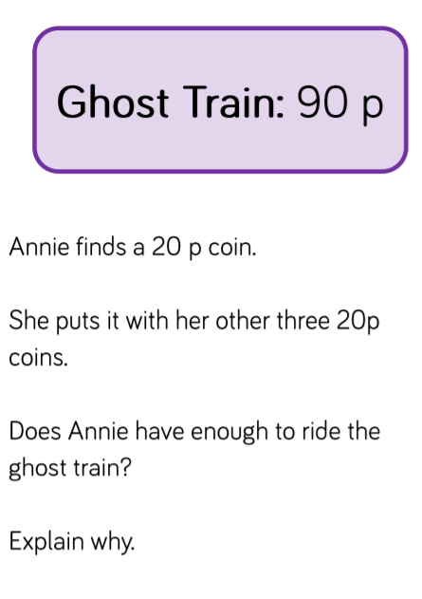
Challenge Questions Only complete these if you want a further challenge from the lesson you have already done.

Slide 8
Your Christmas Challenge!
As we are unable to go to Church this year for our Christmas service, we are putting together a whole school ‘virtual’ service.
Even though, we are self isolating we can still take part! We are going to think about Christmas symbols. Today we will find out about Christmas symbols, tomorrow we will make our own and on Wednesday we’ll write a prayer to go with it.
Read the Christmas Symbols PPT and complete the activity.

Slide 9
Christmas is coming!
On Friday, you started to learn our carol. Keep on listening and practising.
https://www.youtube.com/watch?v=gbEHFB6WLx4&feature=share

