Slide 1
Monday

Slide 2
Busy Books
900,426
Add 48,968
Subtract 110,000
Half it
Create Bar Model for it.
Create a Part Whole Model for it
Fill in the missing spaces
900,426 - ________ = 36,752 so that means ________ + 36,752 = 900,426

Slide 3
Assembly

Slide 4
Rockstars

Slide 5
Maths
I can read and interpret tables.

Slide 8
1) Double 23
Double 27
Jenny has 24 stickers.
Imran has half as many stickers as Jenny.
How many stickers do the two friends have altogether?
4) 6 + 8 + 4 + 2 =

Slide 9
1) Double 23
Double 27
Jenny has 24 stickers.
Imran has half as many stickers as Jenny.
How many stickers do the two friends have altogether?
4) 6 + 8 + 4 + 2 =
46
54
24 + 12 =
36
20

Slide 11
Weekly swimming pool attendance
Day of the week | Mon | Tues | Weds | Thurs | Fri | Sat | Sun
Swimmers | 31 | 16 | 18 |  | 37 |  | 41
103 people swim at the weekend.
How many people swim on Saturday?
62
Weekend = 103
Sat = ? | Sun = 41
103 – 41 =
62
Have a think
2) On Thursday there are double the
number of swimmers than on Tuesday.
How many people swim on Thursday?
32

Slide 12
Year 5 pupils’ heights
Have a think
Name | Height (cm)
Ahmed | 130
Ella | 100
Hilary | 96
Louise | 129
Tom | 107
1) Ahmed is how much taller than the shortest pupil?
130 – 96 =
34 cm
2) How many pupils are under one and a quarter metres tall?
3
1 m = 100 cm
125 cm
$\frac{\text{1}}{\text{4}}$ m = 25 cm
3) Jack is taller than Hilary and shorter than Tom. How tall could Jack be?
97 cm to 106 cm

Slide 13
Have a go at questions 1 - 3 on the worksheet

Slide 14
Favourite film types
Year 2
Year 5
Film type | Number of children
Action | 5
Cartoon | 32
Comedy | 18
Sci-Fi | 3
Film type | Number of children
Action | 15
Cartoon | 14
Comedy | 23
Sci-Fi | 11
Have a think
1) How many more year 5 pupils than year 2 pupils preferred Sci-Fi?
11 – 3 =
8

Slide 15
Favourite film types
Year 2
Year 5
Film type | Number of children
Action | 5
Cartoon | 32
Comedy | 18
Sci-Fi | 3
Film type | Number of children
Action | 15
Cartoon | 14
Comedy | 23
Sci-Fi | 11
Have a think
2) What is the most popular film type in both year groups combined?
Cartoon: 32 + 14 =
46
Cartoon
Comedy: 18 + 23 =
41

Slide 16
Favourite film types
Year 2
Year 5
Film type | Number of children
Action | 5
Cartoon | 32
Comedy | 18
Sci-Fi | 3
Film type | Number of children
Action | 15
Cartoon | 14
Comedy | 23
Sci-Fi | 11
Have a think
3) How many children are there in year 2?
32 + 18 + 5 + 3 =
58
58
5 + 32 + 18 + 3 =
50
+
8

Slide 17
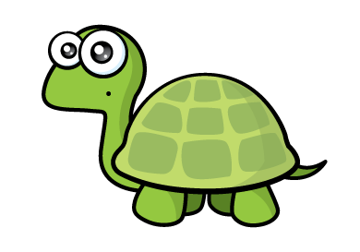
Garden bird survey
1) How many children saw more than 3 birds in their garden?
Number of birds | Number of children
0
1
2
3
4
5 +
5
Have a think
The highest number of birds seen was 5
2) Explain why Tiny is incorrect.
3 children saw at least 5 birds.
We do not know how many birds these children saw.

Slide 18
Have a go at questions 4 - 6 on the worksheet

Slide 19
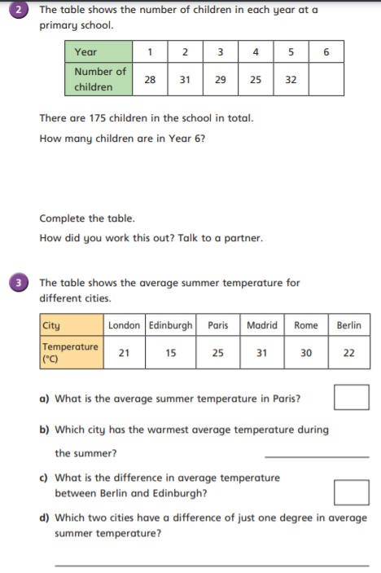
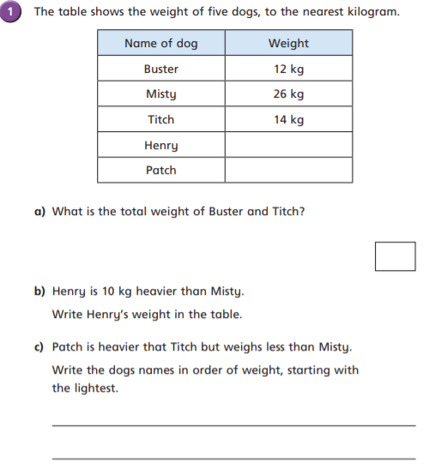

Slide 21
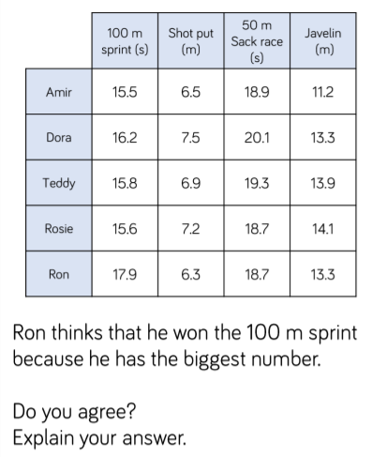
Plenary

Slide 22
Break

Slide 23
Design Technology – Pullies and Gears L1

Slide 25
Aim
To recognise levers, gears and pulleys.
To build a lever, gear and pulley.

Slide 26
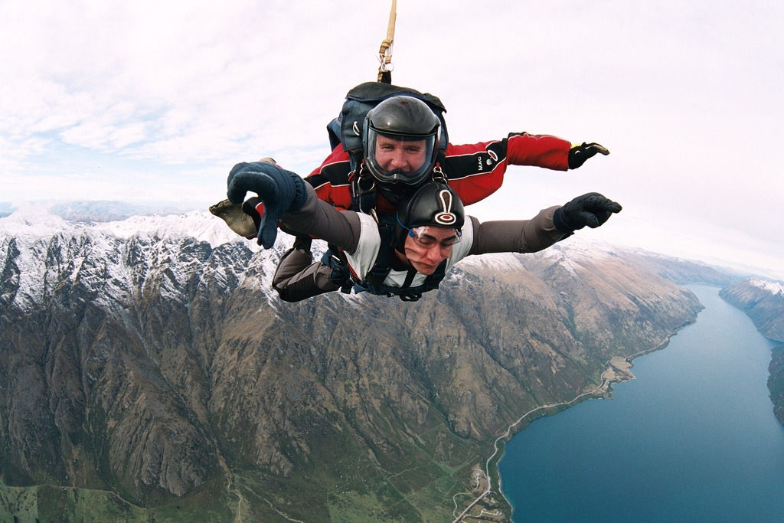
Recap
These sky divers have jumped out of an aeroplane and are falling quickly towards earth.
What forces are affecting them?
Gravity
Air Resistance
Photo courtesy of mnapoleon (@flickr.com) - granted under creative commons licence - attribution

Slide 27
This submarine is diving downwards and forwards into the sea. What forces are affecting it?
gravity
Driving forces of the engines
water resistance
upthrust of the water

Slide 28
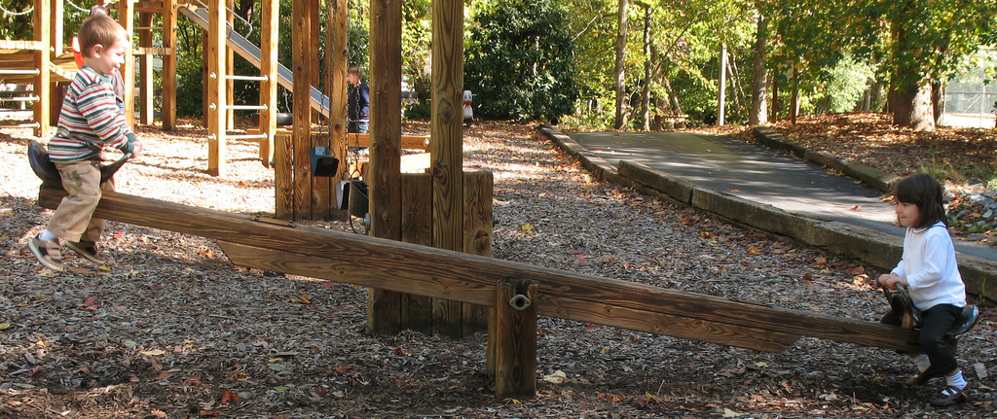
Introduction
Levers, gears and pulleys are all mechanisms that make jobs easier to do.
Or sometimes just for fun!
Photo courtesy of hoyasmeg (@flickr.com) - granted under creative commons licence - attribution

Slide 29
Levers
Levers are the simplest type of mechanism. They are really good at lifting objects and can be used to make objects easier to lift.
Here are three levers. Which lever will make lifting the block easiest?
Let’s find out …
A
B
C
Answer

Slide 30
Gears
Gears are toothed wheels that lock together and turn one another.
The wheels are usually different sizes so that one gear speeds up to slow down the next gear. Gears are also used to change the direction of movement.
How will turning a small gear wheel affect the speed of a larger gear wheel?
Let’s find out…
Answer
If the first gear wheel is smaller (and has fewer teeth) than the second one, then the second (bigger) gear doesn’t have to move as quickly to keep up with the smaller gear. So the second gear wheel turns more slowly than the first.
Photo courtesy of davidjmarland (@flickr.com) - granted under creative commons licence - attribution

Slide 31
Pulleys
Pulleys are like gears but the two wheels do not lock together.
Instead the wheels are joined by a belt. Pulleys can be used to change the speed, direction or force of a movement.
Photo courtesy of sean_hickin (@flickr.com) - granted under creative commons licence - attribution

Slide 32
Lever, Gear or Pulley?
On the tables are a selection of objects that use levels, gears and pulleys to work.
Can you work out which mechanism each object uses? Label the object on your sheet with the name of the mechanism.

Slide 33
Activity
Can you make a pulley to carry an object between 2 tables?
Can you make an object that uses 1 gear wheel to spin 5 other gear wheels even faster?
Can you make a lever to pick something up without using your hands?

Slide 34
Plenary
Which mechanism would be most suited to these jobs?
A
Hoisting a flag up a flagpole

Slide 35
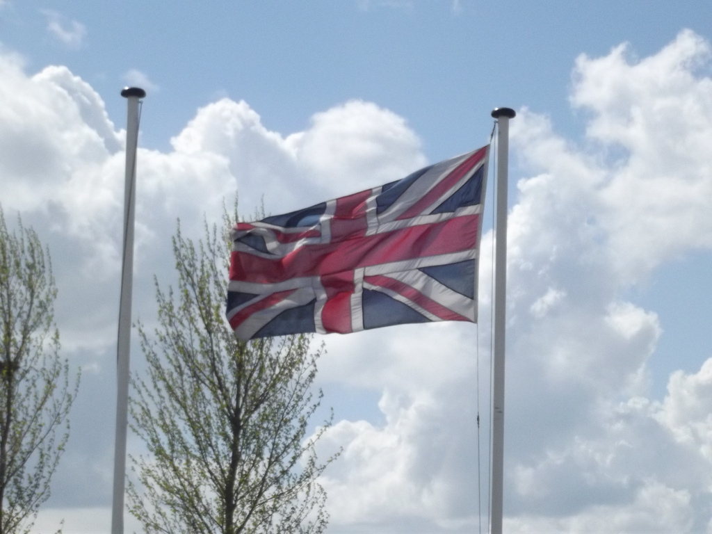
A pulley.
Photo courtesy of ell brown (@flickr.com) - granted under creative commons licence - attribution

Slide 36
Plenary
Which mechanism would be most suited to these jobs?
B
Making one wheel turn faster than another.

Slide 37
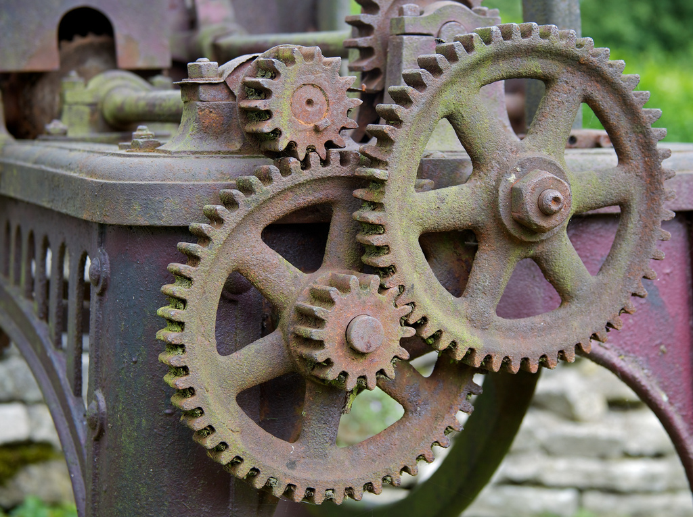
A gear.
Photo courtesy of BinaryApe (@flickr.com) - granted under creative commons licence - attribution

Slide 38
Plenary
Which mechanism would be most suited to these jobs?
C
Making a heavy sack easier to lift.

Slide 39
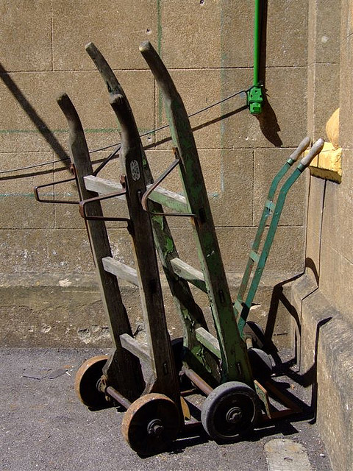
A lever.
Photo courtesy of Elsie esq. (@flickr.com) - granted under creative commons licence - attribution

Slide 40
R.E – Mr Wheatley

Slide 41
Lunch

Slide 42
R.E – Mr Wheatley

Slide 43
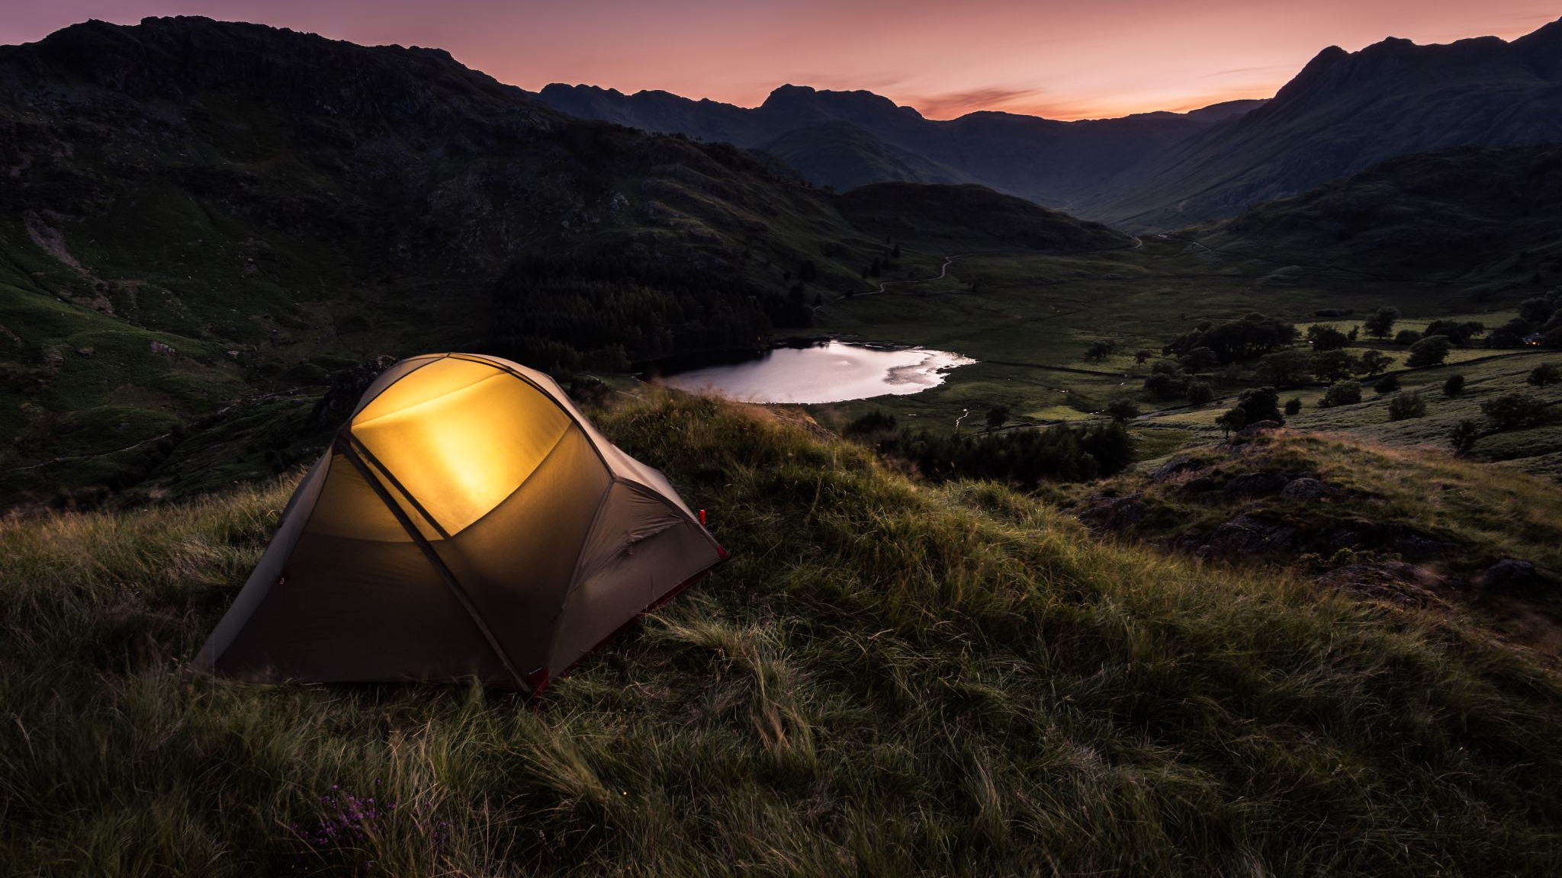
English I can retrieve, record and present information from non-fiction

Slide 44
Non Fiction
Your objective today is to record all the information you can from Videos, Books and the internet.
You are going to create a Non-Fiction – Information booklet (Tuesday Lesson)
Before you create one you need to have lots of information.

Slide 45
First we are going to watch…
https://www.youtube.com/watch?v=kmtDbF3b4ns
Record any information you feel would be necessary in your books.
Ideas for headings, sub headings, examples for diagrams, fact boxes, mini glossary etc.

Slide 46
Magnets and Forces – Print outs

Slide 47
Chromebooks

Slide 48
Let’s share…
What have you found?
Tell your partner.
Tell the class
Any extra information you think is important then write it down also.

