Slide 1
Tuesday 10th November
10.11.20

Slide 2
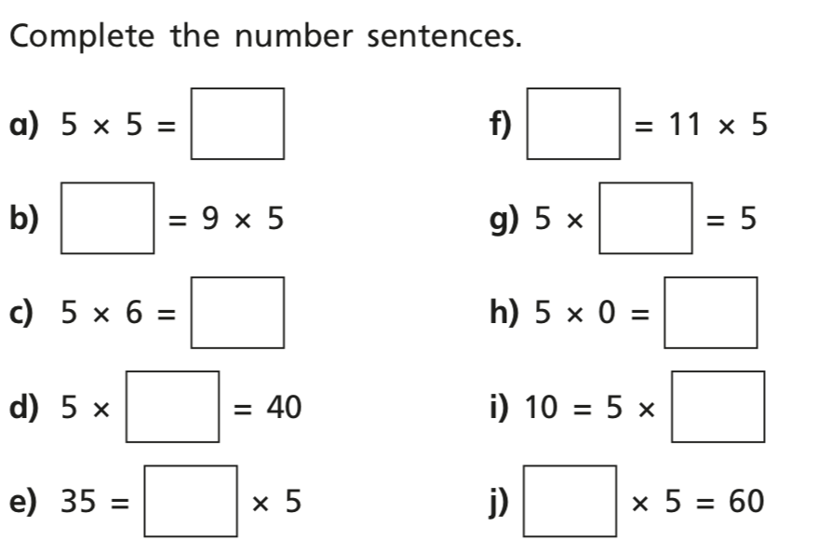
DMM

Slide 3
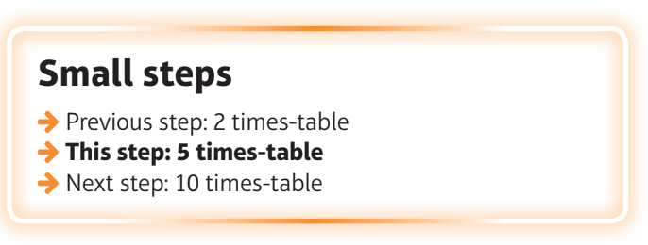
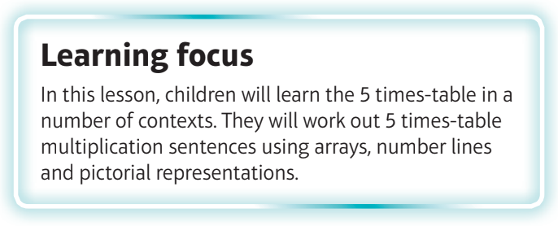
What are we learning?
I can recall facts from the 5 times tables.

Slide 4
Watch this video
https://vimeo.com/469788983

Slide 5
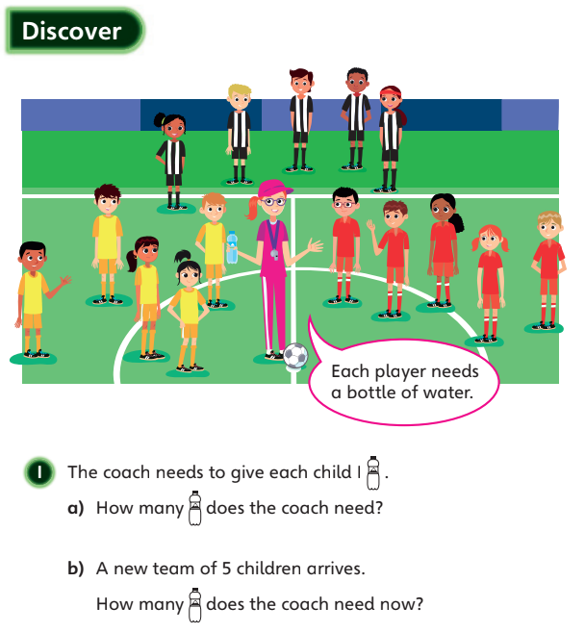

Slide 6
