Slide 1
Monday 9th November
09.11.20

Slide 2
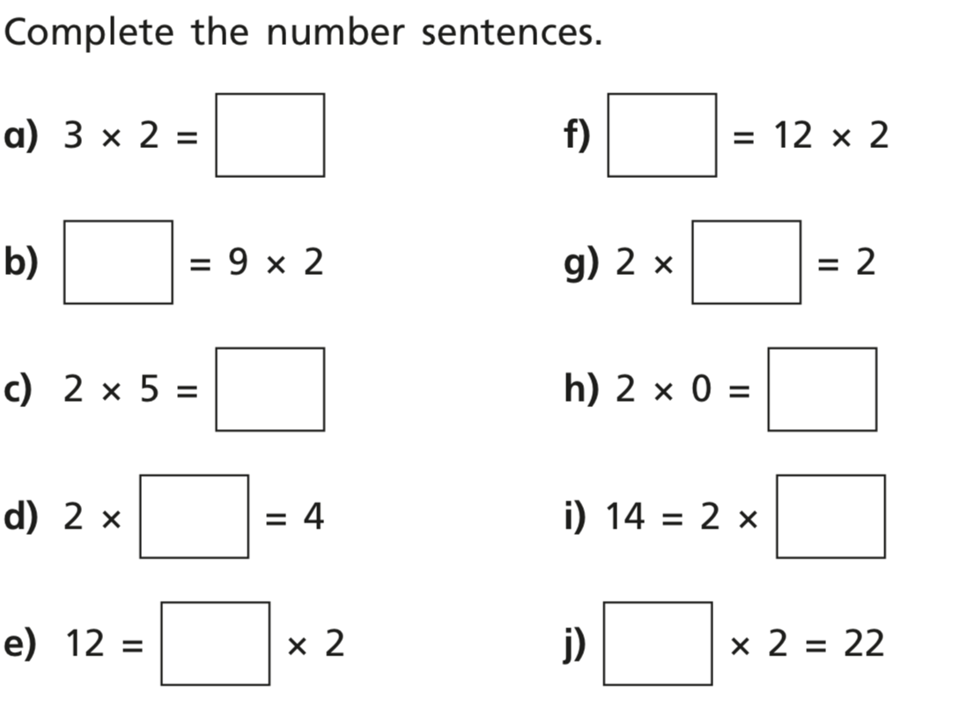
Dmm

Slide 3
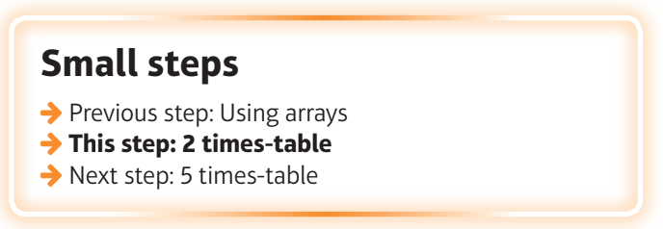
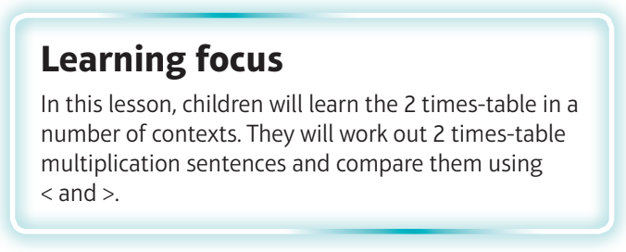
What are we learning?
I can recall facts from the 2 times tables.

Slide 4
Watch the video
https://vimeo.com/469788481

Slide 5
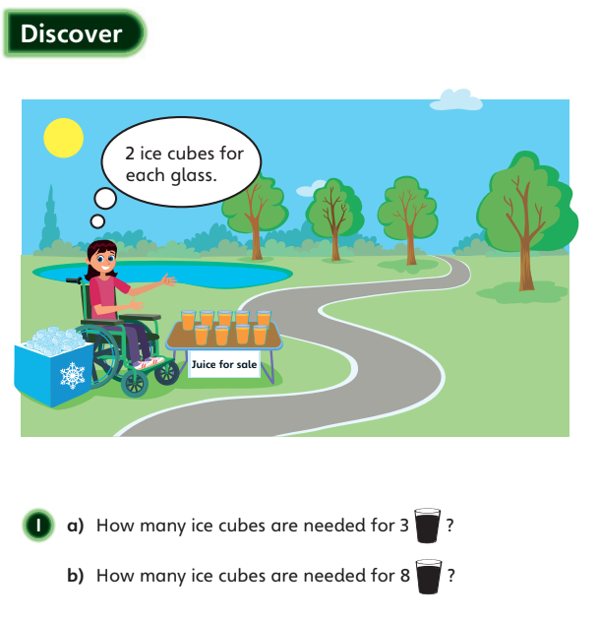

Slide 6
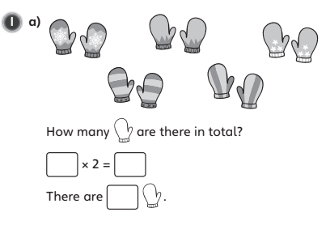
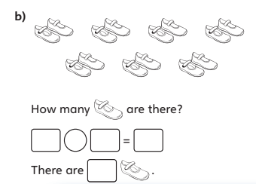

Slide 7
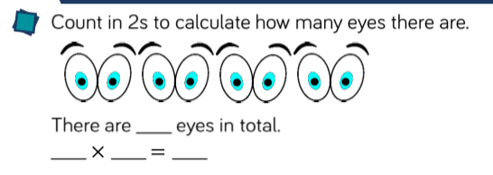

Slide 8
