Slide 1
Friday 13th November
13.11.20

Slide 2
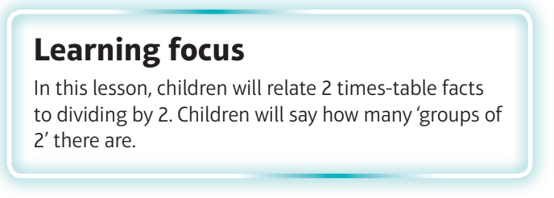
What are we learning?
I can divide by 2.

Slide 3
Watch the video
https://vimeo.com/471011802

Slide 5
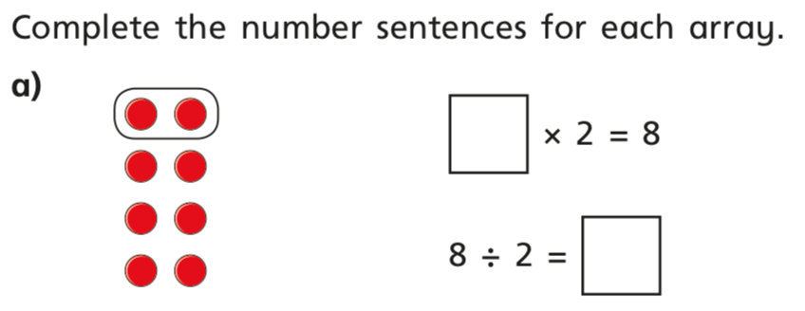
In books

Slide 6
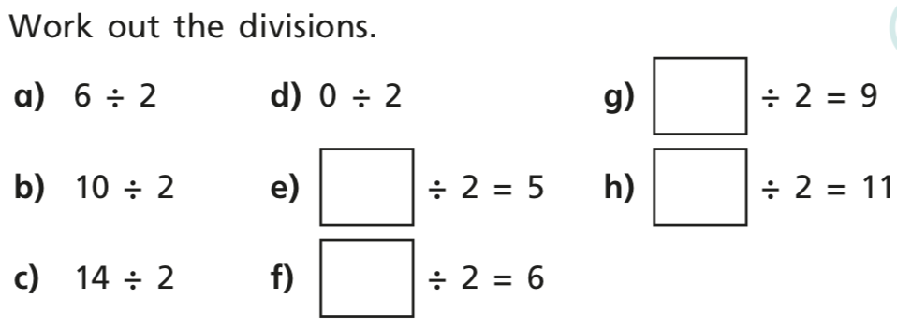
In books

