Slide 1
I can add fractions
23.11.20

Slide 2
Can you complete these fraction pyramids? Each box is the sum of the two boxes below it. Remember to convert to mixed numbers when you spot an improper fraction!

Slide 3
a)
b)
c)

Slide 4
d)
e)
f)
g)
Whose method do you prefer? Why?

Slide 5
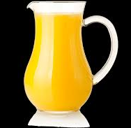
Give your answer as a mixed number...

Slide 9
Were you correct?

Slide 10
Challenge!

