Slide 1
I can multiply and divide by 6.
Click on the blue arrow to watch the video.
Click on the red arrow for the worksheet.

Slide 2
Complete the table.
Complete the missing numbers.
7 $×$ 6 $=$ ___ $×$ 7
$$×$$ | 1 | 10 | 100 | 1,000
6 |  | 60
1 $×$ 6 $=$ ____
2 $×$ 6 $=$ ____
4 $×$ 6 $=$ ____
8 $×$ 6 $=$ ____

Slide 3
Complete the table.
Complete the missing numbers.
7 $×$ 6 $=$ ___ $×$ 7
$$×$$ | 1 | 10 | 100 | 1,000
6 |  | 60
6
600
6,000
1 $×$ 6 $=$ ____
6
12
2 $×$ 6 $=$ ____
4 $×$ 6 $=$ ____
24
48
8 $×$ 6 $=$ ____
6

Slide 5
What do you see?
6
3
There are ____ equal groups of ____
$+ + +$
3
3
3
$+ + =$
3
3
3
18
$× =$
18
$× =$
18
3
6
6
3

Slide 6
What do you see?
3
6
There are ____ equal groups of ____
6
6
6
$+ + =$
18
$× =$
18
$× =$
18
3
6
6
3

Slide 7
Have a go at question 1 on the worksheet

Slide 8
There are 24 eggs altogether.
$÷ =$
4
24
6

Slide 9
There are 24 eggs altogether.
$÷ =$
4
24
6

Slide 10
7
There are ___ rows of ___
There are ___ columns of ___
6
7
6

Slide 11
6 $×$ 7 $=$ 42
7 $×$ 6 $=$ 42
42 $÷$ 6 $=$ 7
42 $÷$ 7 $=$ 6

Slide 12
Have a go at question 2 – 4 on the worksheet

Slide 13
3 $×$ 6 $=$ 18
18 $÷$ 6 $=$ 3
6 $×$ 3 $=$ 18
18 $÷$ 3$=$ 6
3 tens $×$ 6 $=$ 18 tens
30 $×$ 6 $=$ 180
180 $÷$ 6 $=$ 30
6 tens $×$ 3 $=$ 18 tens
60 $×$ 3 $=$ 180
180 $÷$ 3 $=$ 60

Slide 14
6 $×$ 30 $=$ 180
180 $÷$ 6 $=$ 30
3 $×$ 60 $=$ 180
180 $÷$ 3$=$ 60
6 $×$ 300 $=$ 1,800
1,800 $÷$ 6 $=$ 300
3 $×$ 600 $=$ 1,800
1,800 $÷$ 3$=$ 600
6 $×$ 3 hundreds $=$ 18 hundreds
3 $×$ 6 hundreds $=$ 18 hundreds

Slide 15
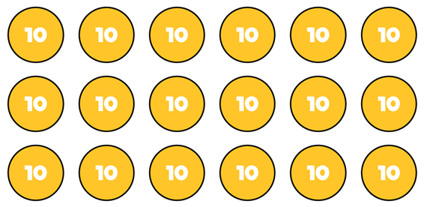
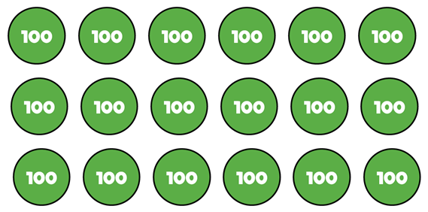
Have a think
18 $÷$ 6 $=$ 3
180 $÷$ 6 $=$ 30
1,800 $÷$ 6 $=$ 300
54 $÷$ 6 $=$ ______
9
90
540 $÷$ 6 $=$ ______
900
5,400 $÷$ 6 $=$ ______

Slide 16
Have a go at the rest of the worksheet

