Slide 1
I can multiply and divide by 3.
Click on the blue arrow for the video.
The worksheet is on the website.

Slide 2
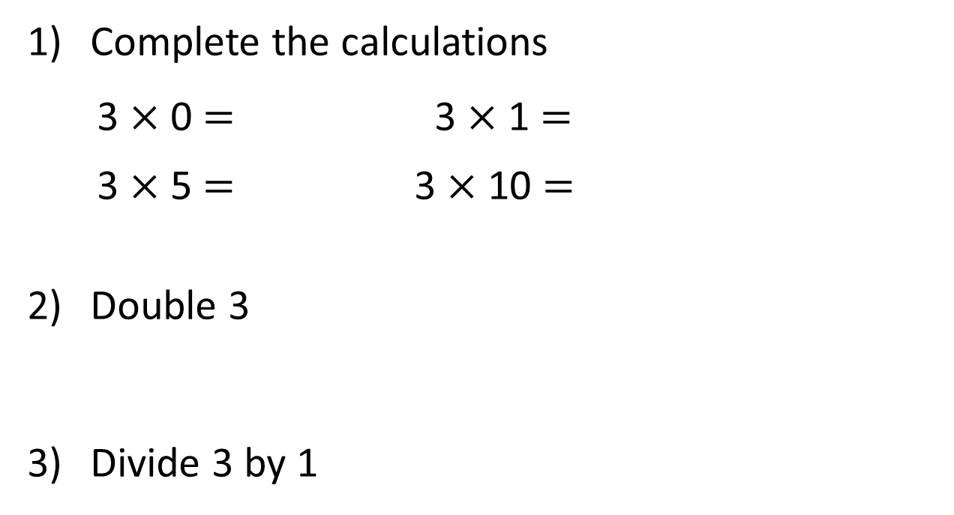
Complete the calculations
3 $×$ 0 $=$ 3 $×$ 1 $=$
3 $×$ 5 $=$ 3 $×$ 10 $=$
Double 3
Divide 3 by 1

Slide 3
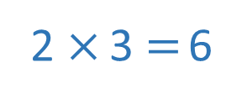
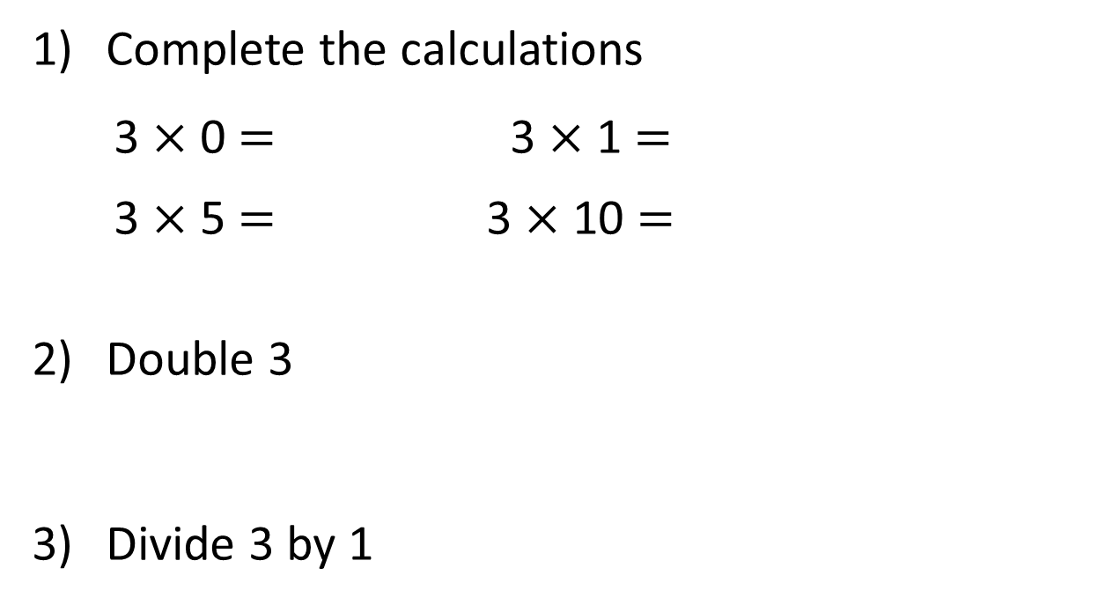
Complete the calculations
3 $×$ 0 $=$ 3 $×$ 1 $=$
3 $×$ 5 $=$ 3 $×$ 10 $=$
Double 3
Divide 3 by 1
0
3
15
30
2 $×$ 3 $=$ 6
3

Slide 5
Complete the missing numbers.
5
3
There are ____ equal groups of ____
3
3
15
$+ + + + =$
3
3
3
$× =$
5
3
15
$× =$
3
5
15

Slide 6
Which number story matches the picture?
2 $×$ 3 $=$ 6 or 3 $×$ 2 $=$ 6
Have a think
Whitney plants 2 pots of flowers with 3 flowers in each pot.
She plants 6 flowers altogether.
Whitney plants 3 pots of flowers with 2 flowers in each pot.
She plants 6 flowers altogether.

Slide 7
Have a go at question 1 on the ‘Multiply by 3’ worksheet

Slide 8
3
1 $×$ 3 $=$ 3
3 $×$ 1 $=$ 3
0
3
3
3
2 $×$ 3 $=$ 6
3 $×$ 2 $=$ 6
0
3
6
3
3
3
3 $×$ 3 $=$ 9
0
3
6
9

Slide 9
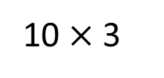
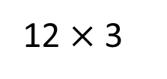
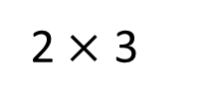
12 $×$ 3 $=$ 10 $×$ 3 $+$ 2 $×$ 3
Is Jack correct?
12 $×$ 3
10 $×$ 3
2 $×$ 3
Have a think

Slide 10
Have a go at the rest of the ‘Multiply by 3’ worksheet

Slide 11
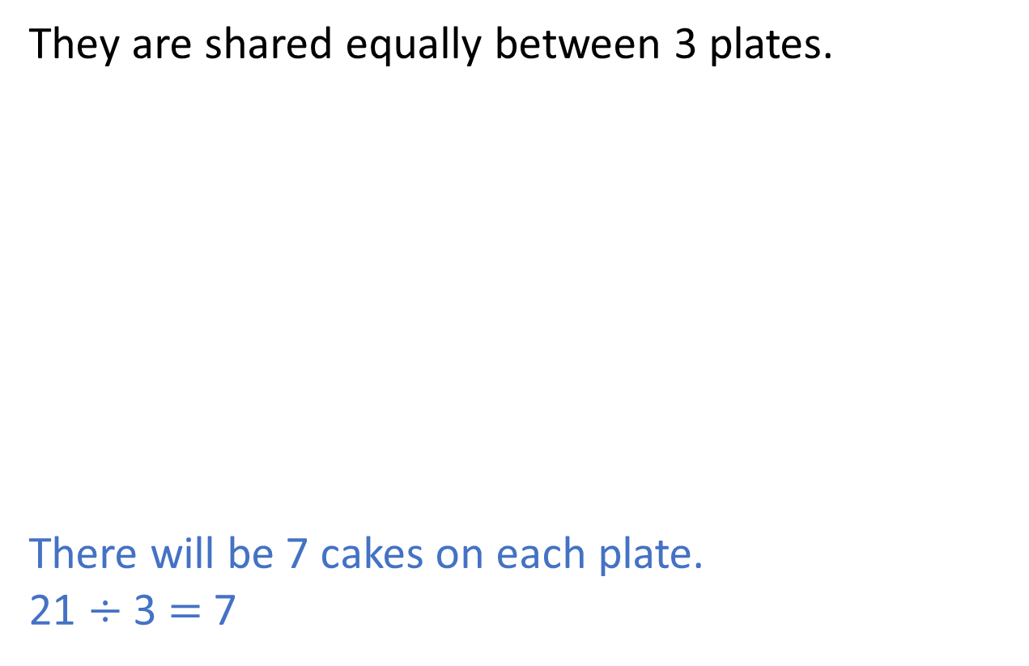
Here are 21 cakes.
They are shared equally between 3 plates.
There will be 7 cakes on each plate.
21 $÷$ 3 $=$ 7

Slide 12
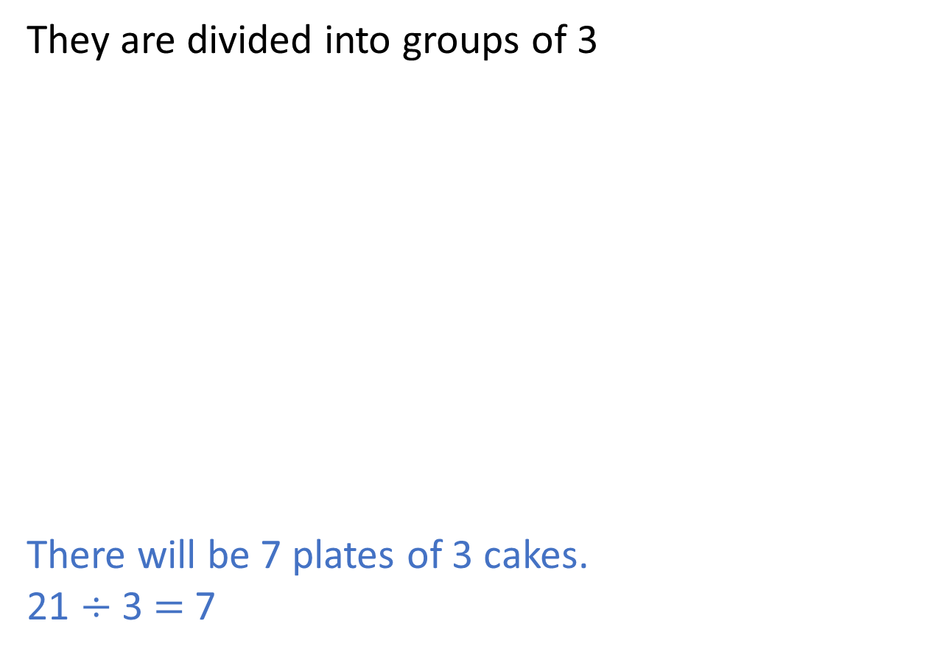
Here are 21 cakes.
They are divided into groups of 3
There will be 7 plates of 3 cakes.
21 $÷$ 3 $=$ 7

Slide 13
Have a go at questions 1 – 3 on the ‘Divide by 3’ worksheet

Slide 14
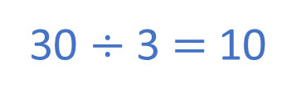
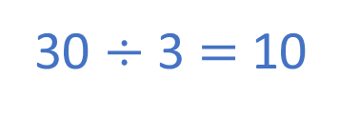
Which bar model shows 30 $÷$ 3?
30
3 | 3 | 3 | 3 | 3 | 3 | 3 | 3 | 3 | 3
30 divided into 10 groups of 3
30 $÷$ 3 $=$ 10
30
10 | 10 | 10
30 divided into 3 equal groups
30 $÷$ 3 $=$ 10

Slide 15
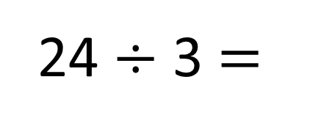
24 $÷$ 3 $=$
A baker has 24 tarts.
She puts 3 tarts into each box.
How many boxes can she fill?
8
$+$ 3
0
3
6
9
12
15
18
21
24
$−$ 3
0
3
6
9
12
15
18
21
24

Slide 16
Have a go at the rest of the ‘Divide by 3’ worksheet

