Slide 2
Monday 23rd November 2020

Slide 3
Morning Activity
Silent Reading
Practice times tables

Slide 4
Assembly

Slide 5
Rockstars

Slide 6
Maths
I can identify and use multiples.

Slide 8
Key Vocabulary

Slide 9
What is a multiple?
https://www.youtube.com/watch?v=qKV_TiZqaMY

Slide 11
1) Which number is not in the 4 times table?
4 12 14 20 24
2) Which number is in the 5 and 7 times tables?
5 7 25 50 70
Fill in the missing numbers in the sequence.
____ 15 ____ 21 24
Fill in the missing numbers in the sequence.
30 ____ 20 ____ 10

Slide 12
1) Which number is not in the 4 times table?
4 12 14 20 24
2) Which number is in the 5 and 7 times tables?
5 7 25 50 70
Fill in the missing numbers in the sequence.
____ 15 ____ 21 24
Fill in the missing numbers in the sequence.
30 ____ 20 ____ 10
12
18
25
15

Slide 14
Have a think
What do all these numbers have in common?
123
72
6
3
12
27
60
They are all in the 3 times table.
They are all multiples of 3

Slide 15
Have a think
Which of these numbers are in the 7 times table?
5
70
84
35
79
15
43
The circled numbers are all multiples of 7

Slide 16
Multiples of 2
0 2 4 6 8 10 12 14
Multiples of 4
0 4 8 12 16 20 24 28
Multiples of 6
0 6 12 18 24 30 36 42
Have a think
1) Give an example of a number which is a multiple of 2, 4 and 6
12
0
even
2) All the multiples of an even number are _____ .

Slide 17
All the multiples of an even number are even, so all the multiples of an odd number must be odd.
Have a think
Explain how you know that Tiny is incorrect.
Use an odd multiplication table to help you.
5 is odd and has odd multiples (for example 15) and even multiples (for example 20).
11 is odd and has odd multiples (for example 55) and even multiples (for example 88).

Slide 18
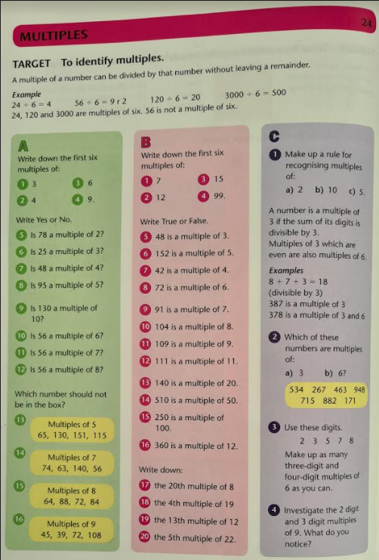
Target Maths A, B & C
Pick your challenge!!!

Slide 19
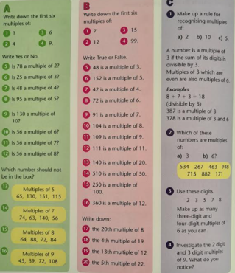

Slide 20
Challenge

Slide 21
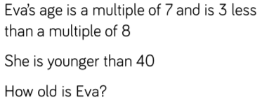
Plenary

Slide 22
Break

Slide 23
DT – Making a Pulley

Slide 24
https://www.youtube.com/watch?v=LiBcur1aqcg

Slide 25
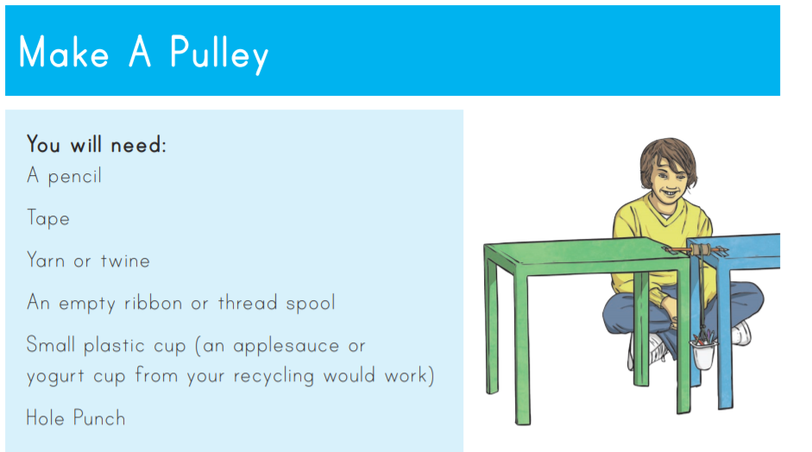

Slide 26
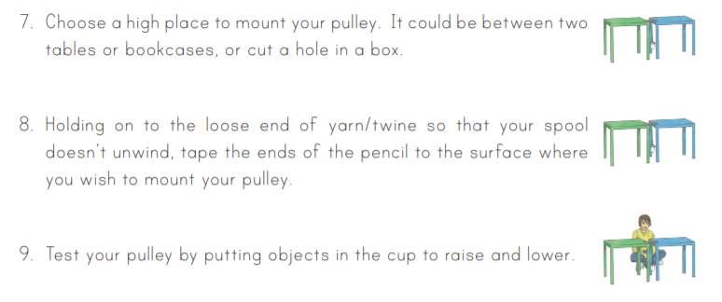

Slide 27
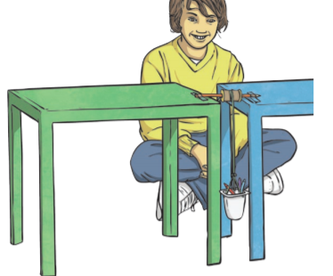
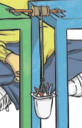
In your books…
Draw a diagram of how your pulley is going to work.
Use the picture to help you.
Label the drawing and explain what is happening in the drawing.
Give a couple of examples of how pullies might be used in our world today.

Slide 28
R.E

Slide 29
Lunch

Slide 30
R.E

Slide 31
English
I can predict what might happen from details stated and implied

Slide 32
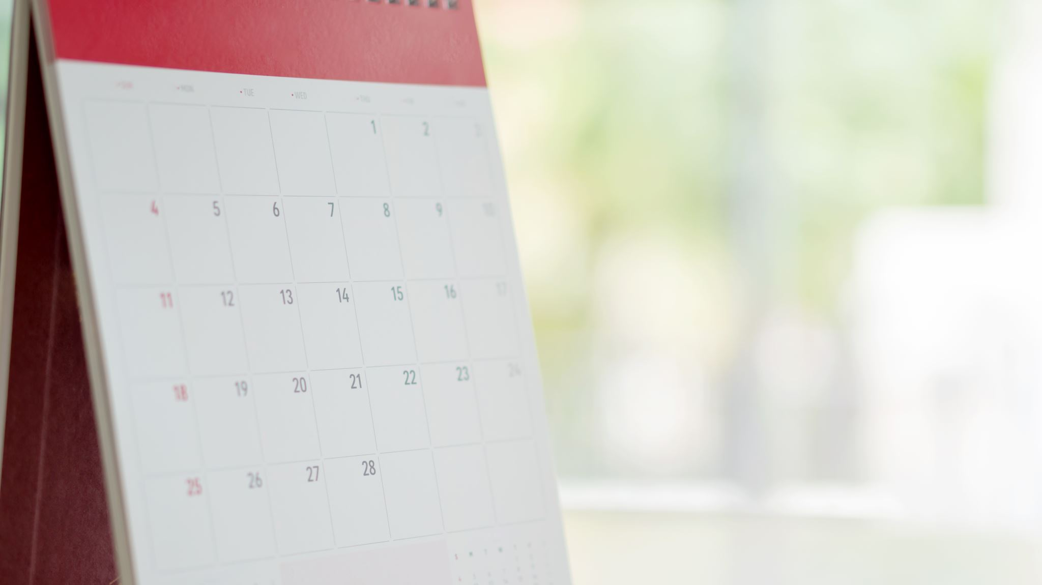
What can you remember from Friday’s Lesson?

Slide 33
When we are looking at a new text…
We look at the clues and provide evidence…
What Genre do you think it might be and why?
What would you like to know about it? (Questions) “Who, Where, What, When and Why?”
Likes and Dislikes (Why?)
Predictions – I predict that…. because…
Important information – Characters, Setting etc.

Slide 34
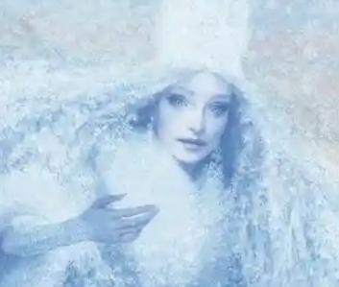
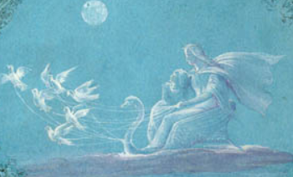
Extracts

Slide 35
Record your thoughts
What Genre do you think it might be and why?
What would you like to know about it? (Questions) “Who, Where, What, When and Why?”
Likes and Dislikes (Why?)
Predictions – I predict that…. because…
Important information – Characters, Setting etc.

Slide 36
Let’s share our ideas

Slide 37
In your book you are going to create…
Likes and Dislikes
Predictions
Genre
Thoughts and Feelings
Questions
Important Information

Slide 38
Home time

