Slide 3
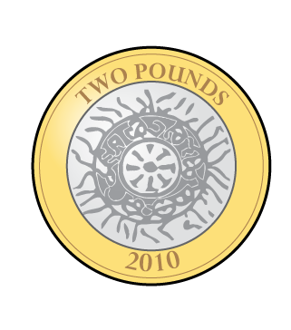
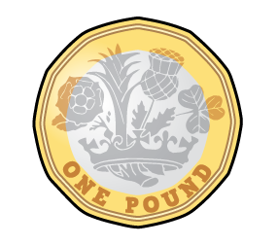
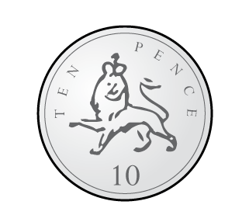
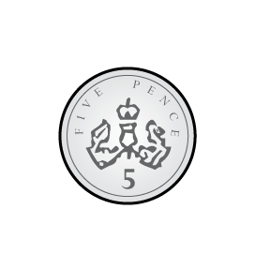
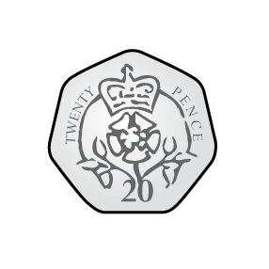
Which coin has the greater value?
1)
2)
3)

Slide 4
Which coin has the greater value?
1)
2)
3)
$$>$$
$$>$$
$$<$$

Slide 6
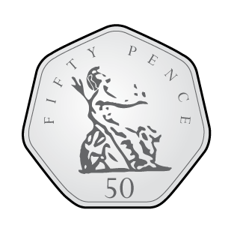
Ron and Whitney are playing spot the difference.
Have a
think
Notes:
Jack has built some towers using cubes. Let’s have a look.
How many towers has he built? Well there are 1, 2, 3, 4 towers
Jack hs built 4 towers
How many cubes are there in each tower? Well there are 1, 2, 3, 4, 5 cubes in each tower
So how many towers has Jack usef in total? Well there are 4 towers with 2 cubes in each tower, so Jack has used 2, 4, 6, 8 cubes
Did you see how I used my 2 times-table to help me then? Counting in 2s is rsally useful.
We can write this as a multiplication sentence. Something multiplied by something is equal to something.
Well Jack built 4 towers with 2 cubes in each tower and he used 8 cubes in total. So 4 multiplied by 2 is 8
OR
We can also write this as 2 multiplied by 4 is equal to 8

Slide 7
7p
Notes:
Whitney has also been building towers using cubes. Let’s havwe a look.
Pause the video here and see if you can answer these questions.
How did you get on?
Did Whitney use more or less cubes than Jack? That’s right she used less cubes because she built less towers

Slide 8
10p
£1 and 17p
£1 and 7p
Have a think
Notes:
Whitney has also been building towers using cubes. Let’s havwe a look.
Pause the video here and see if you can answer these questions.
How did you get on?
Did Whitney use more or less cubes than Jack? That’s right she used less cubes because she built less towers

Slide 9
Have a go at question 1 on the worksheet

Slide 10
Dora and Teddy go to the shop.
Have a think
90p
?
40p
50p
What is the difference in price?
Notes:
Dexter has ALSO been building towers of cubes. His look a little different don’t they? Think about it carefully though. Pause here and have a go at answering these questions.

Slide 11
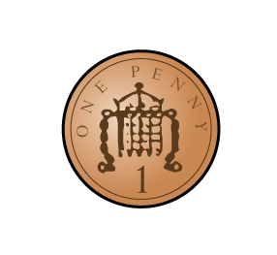
Dora and Teddy go to the shop.
84p
70p
80p
84p
68p
16p
What is the difference in price?
Notes:
Dexter has ALSO been building towers of cubes. His look a little different don’t they? Think about it carefully though. Pause here and have a go at answering these questions.

Slide 12
Dora and Teddy go to the shop.
55p
23p
30p
50p
55p
23p
32p
What is the difference in price?
Notes:
Dexter has ALSO been building towers of cubes. His look a little different don’t they? Think about it carefully though. Pause here and have a go at answering these questions.

Slide 13
Have a go at questions 2 and 3 on the worksheet

Slide 14
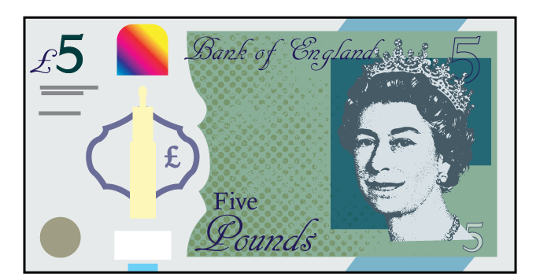
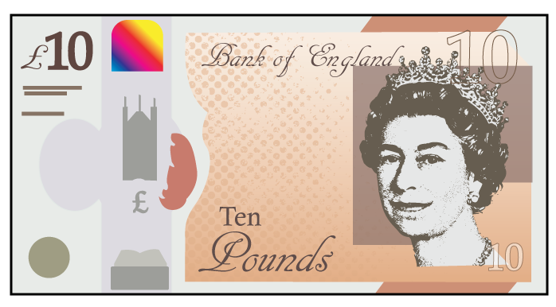
Jack and Whitney are counting money.
Have a think
£11 and 20p
?
£4
£15 and 20p
Who has more, and how much more do they have?
Notes:
Dexter has ALSO been building towers of cubes. His look a little different don’t they? Think about it carefully though. Pause here and have a go at answering these questions.

Slide 15
Have a go at questions 4 and 5 on the worksheet

Slide 16
Dora
Jack
Whitney
£5 and 23p
£6 and 48p
£2 and 2p
Jack
Who has the most money?
How much more does Dora have than Whitney?
How much more does Jack have than Dora?
£1 and 25p
Have a think
£3 and 21p
£5 and 23p
£6 and 23p
£6 and 48p
£1
25p
Notes:
Dexter has ALSO been building towers of cubes. His look a little different don’t they? Think about it carefully though. Pause here and have a go at answering these questions.

Slide 17
Have a go at questions 6 and 7 on the worksheet

