Slide 1
Hinduism

Slide 2
Monday 16th November

Slide 3
I am successful if...
I can find out more about how Hindu’s worship God.

Slide 4
Who founded Hinduism?

Slide 5
Where did Hinduism begin?

Slide 6
Hinduism in the world today

Slide 7
Last week
https://www.bbc.co.uk/programmes/p02n5xj7
Last week you watched a video about Simran and Vraj. In the video, you saw Simran holding a tray with a small flame over her brother’s head. She talks about hindu deities and Hindu beliefs.
Can you remember what Simran said about the Gods? How many are there?

Slide 8
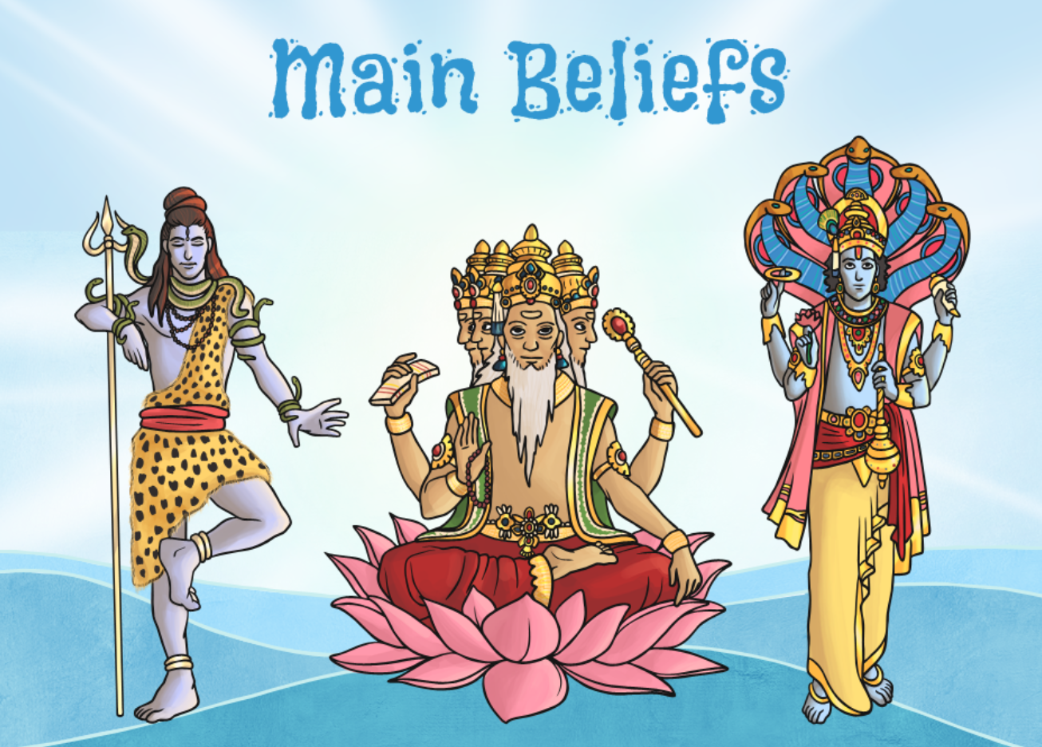

Slide 12
Puja
We are going to find out how Simran and Vraj show their faith in God through puja, Hindu worship.
Bell | To wake the deity up for worship
Flowers | Represents the beauty and fragrance of the created world
Diva lamp | For aarti - this symbolises that worship removes darkness
Water in a pot | Represents life
Spoon | Used to give water to worshippers after it has been blessed
Murti | To worship
Sweets or sugar | An offering of food for the deity

Slide 13
Watch the video
https://www.bbc.co.uk/bitesize/clips/zh2hyrd

