Slide 1
Good Morning Year 2 Did you sleep well? Can you work out how many hours you were asleep? I hope you are wide awake for today’s learning.

Slide 2
27/11/20
Add 10 to these
numbers
40
70
25
54
6
78
100
95
Subtract 10 from these
Numbers
9) 20
10) 70
11) 36
12) 87
13) 100
14) 51
15) 99
16) 108

Slide 3
Phonics Spend a little time on each of the activities below.
Lexia – Don’t forget to log on to this regularly, if you have a log-in.
Phonics – Practise the games on phonicsplay website.
Spelling Practise - Look, cover, write, check
HF words –:
https://www.ictgames.com/littleBirdSpelling/
Choose the Year 1 list if Year 2 words are too tricky.

Slide 4
English on Purple Mash
Today we are going to start reading a new book on Purple Mash. You can read it by yourself or with an adult.
It’s called ‘Anna and the Third Leaf’. I think you will really enjoy it.
Today we will read the first chapter and then do some activities about the story.
So when you are ready log on to Purple Mash and look in your 2dos.

Slide 5
Wake up shake up!
Here is a link to our wake-up shake up song on youtube.
https://www.youtube.com/watch?v=KSbwHzlcgs8
Why don’t you do our wakeup-shakeup routine to give yourself some energy and get both sides of your brain working well.

Slide 6
Click the following link for the teaching video. Finding Change
Maths!
https://vimeo.com/479816820
Now complete the attached worksheets for Friday.

Slide 7
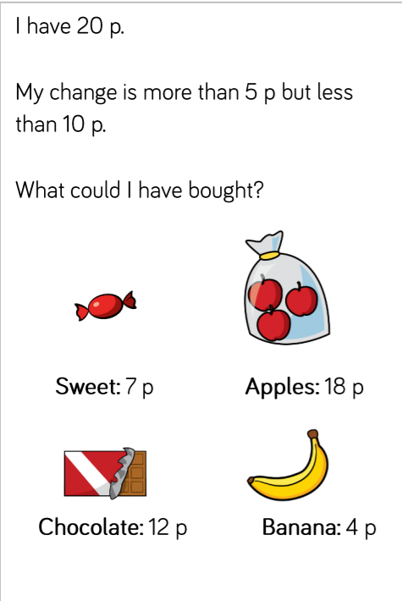
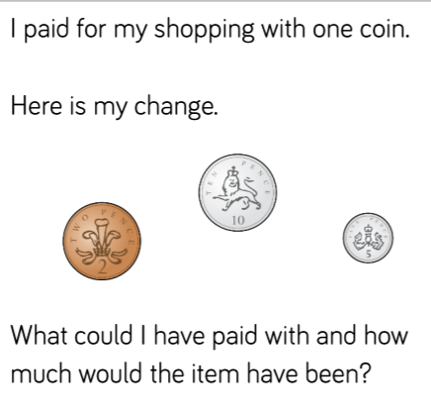
Challenge Questions Only complete these if you want a further challenge from the lesson you have already done.

Slide 8
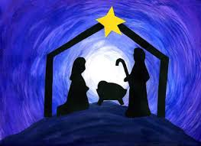
It’s nearly Christmas!
Use this link to start learning the Christmas carol, It Was On A Starry Night.
It’s one of my favourites!
https://www.youtube.com/watch?v=gbEHFB6WLx4&feature=share

Slide 9
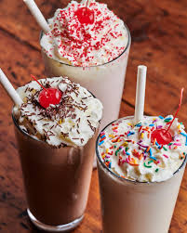
Milk
I hope you enjoyed learning all about milk yesterday.
Today there is a Purple Mash Art activity for you to do about milkshake.
Have fun and be creative!

