Slide 1
Friday 20th November 2020

Slide 2
Spellings

Slide 3
Rockstars

Slide 4
English –Initiation
I can use questioning, inference, prediction and evidence to discover a new text.

Slide 5
New Text

Slide 6
When we are looking at a new text…
We look at the clues and provide evidence…
What Genre do you think it might be and why?
What would you like to know about it? (Questions) “Who, Where, What, When and Why?”
Likes and Dislikes (Why?)
Predictions – I predict that…. because…
Important information – Characters, Setting etc.

Slide 7
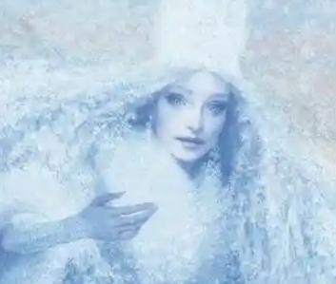
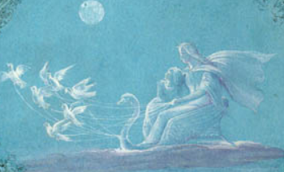
Extracts

Slide 8
Record your thoughts
What Genre do you think it might be and why?
What would you like to know about it? (Questions) “Who, Where, What, When and Why?”
Likes and Dislikes (Why?)
Predictions – I predict that…. because…
Important information – Characters, Setting etc.

Slide 9
Let’s share our ideas

Slide 10
Break

Slide 11
DMM
1) Complete the sequence:
A) 55, 65, ____, _____, _____, 105. B) 874, 854, 834,____, 794, _____, ______.
C) 7800,_____,_____, 2000,______ 2200.
2) Complete the following:
E.g.) 100 x 10 = 1000 A) 200 x 10 = B) 5,000 x 10 = C) 70,000 x 10 =
E.g) 100 ÷ 10 = 10 A) 900 ÷ 10 = B) 6500 ÷ 100 = C) 100,000 ÷ 1000 =
3) Use the bus stop method to work out:
A) 999 ÷ 9 = B) 740 ÷ 4 = C) 500 ÷ 2 = D) 864 ÷ 8 =

Slide 12
Maths

Slide 13
Maths
Statistics
Year One
Maths | Year 5 | Statistics | Timetables | Lesson 1 of 5: Holiday Activity Timetables

Slide 15
Aim
I can read and interpret information presented in a simple timetable.
Success Criteria
I can read 24-hour time.
I can answer questions about the information shown in a timetable.
I can calculate how much time has passed in minutes.

Slide 16
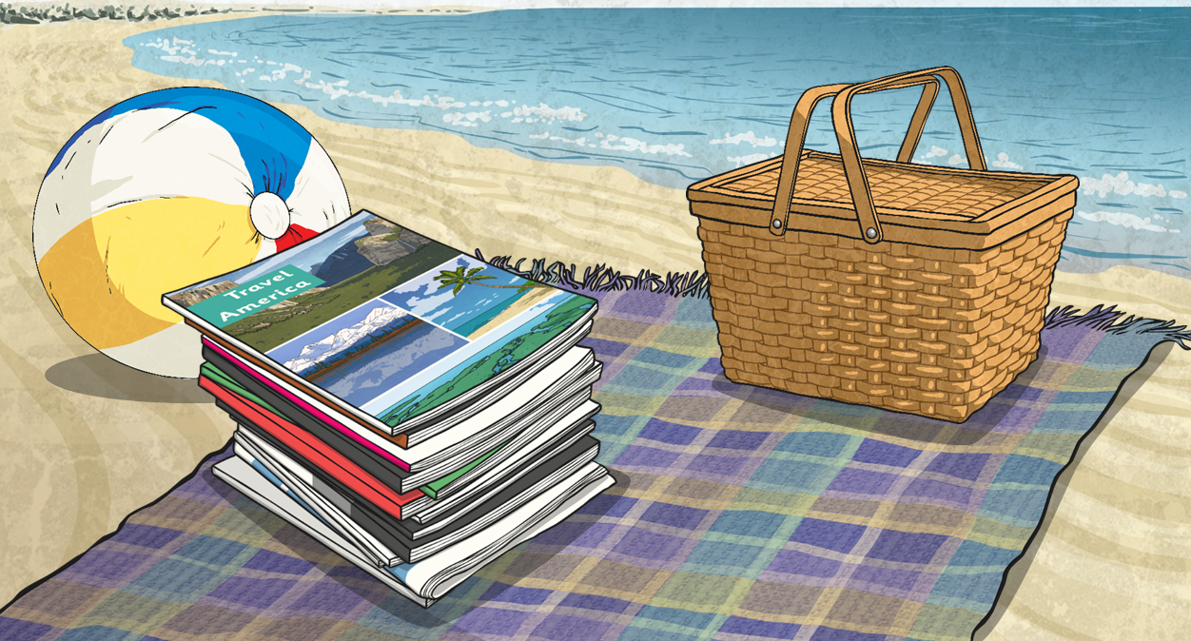
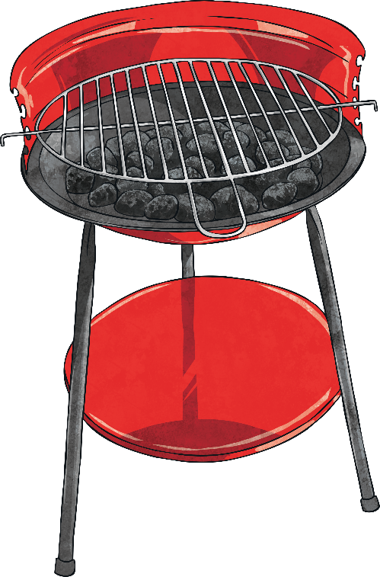
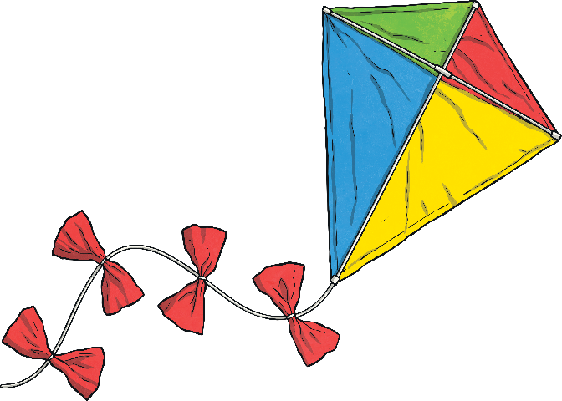
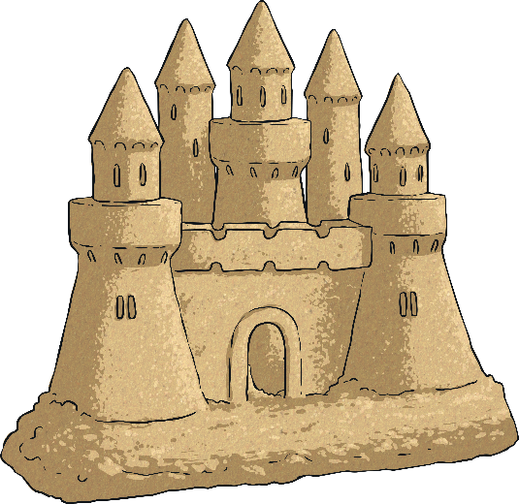
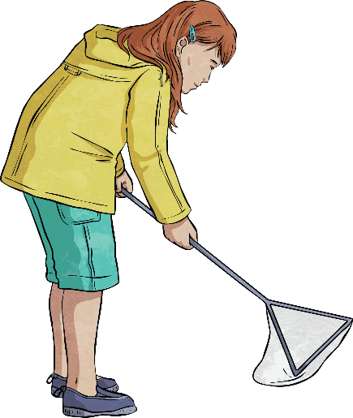
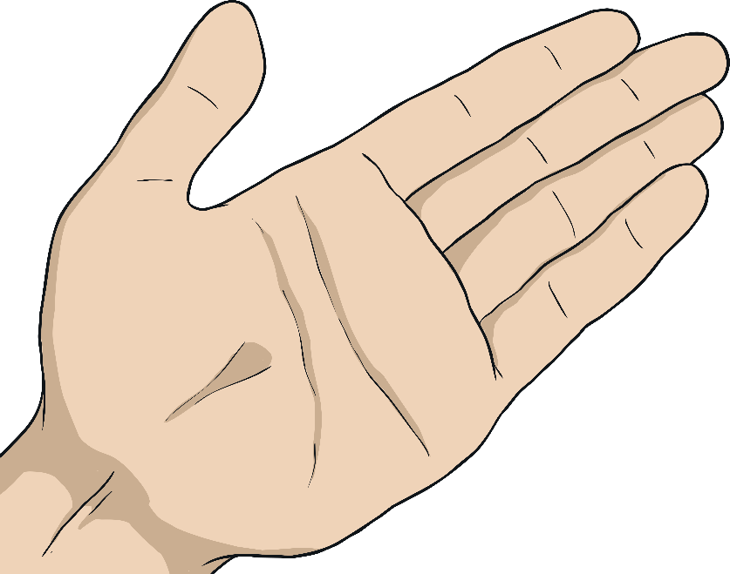
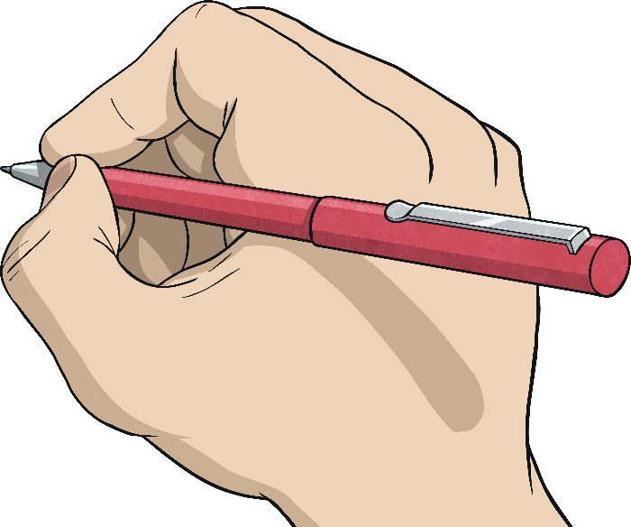
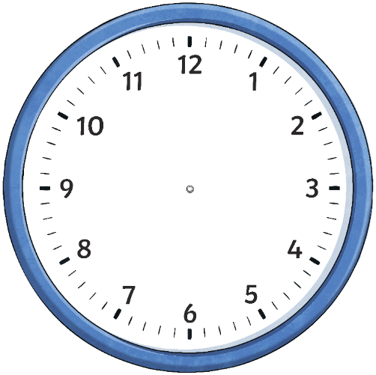
Telling the Time
Rhys is choosing which summer holiday activities to do at holiday camp. Which analogue clock shows the time that the holiday activity starts?
Fun in the Sun
Beach volleyball
9:10 a.m.
Beach barbecue
18:55
Rock pool treasure hunt
13:15
Beach disco
17:05
Sandcastle building
competition
7:25 p.m.
Kite flying
on the beach
8:40 a.m.
Now you’re ready for
your beach holiday!
Next
Next
Next
Next
Next

Slide 17
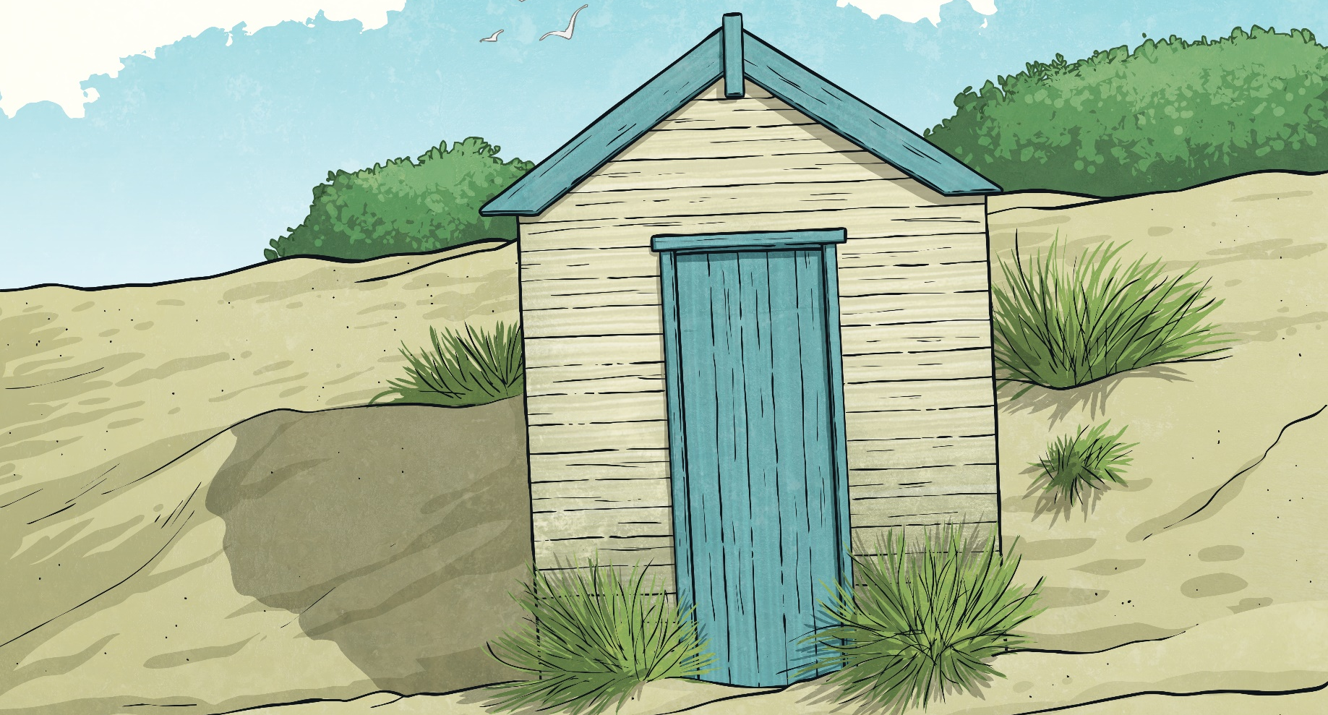
The 24-Hour Clock
This clock and table show each hour in the day written in 12-hour time and 24-hour time.
12:00 a.m. = 00:00 | 12:00 p.m. = 12:00
1:00 a.m. = 01:00 | 1:00 p.m. = 13:00
2:00 a.m. = 02:00 | 2:00 p.m. = 14:00
3:00 a.m. = 03:00 | 3:00 p.m. = 15:00
4:00 a.m. = 04:00 | 4:00 p.m. = 16:00
5:00 a.m. = 05:00 | 5:00 p.m. = 17:00
6:00 a.m. = 06:00 | 6:00 p.m. = 18:00
7:00 a.m. = 07:00 | 7:00 p.m. = 19:00
8:00 a.m. = 08:00 | 8:00 p.m. = 20:00
9:00 a.m. = 09:00 | 9:00 p.m. = 21:00
10:00 a.m. = 10:00 | 10:00 p.m. = 22:00
11:00 a.m. = 11:00 | 11:00 p.m. = 23:00
From midday to midnight, add 12 to the hours to convert 12-hour time to 24-hour time.
Midnight can be referred to as both 00:00 and 24:00 to show the start and the end of a day, although it is more usually written as 00:00.
From midday to midnight, subtract 12 from the hours to convert 24-hour time to 12-hour time.

Slide 18
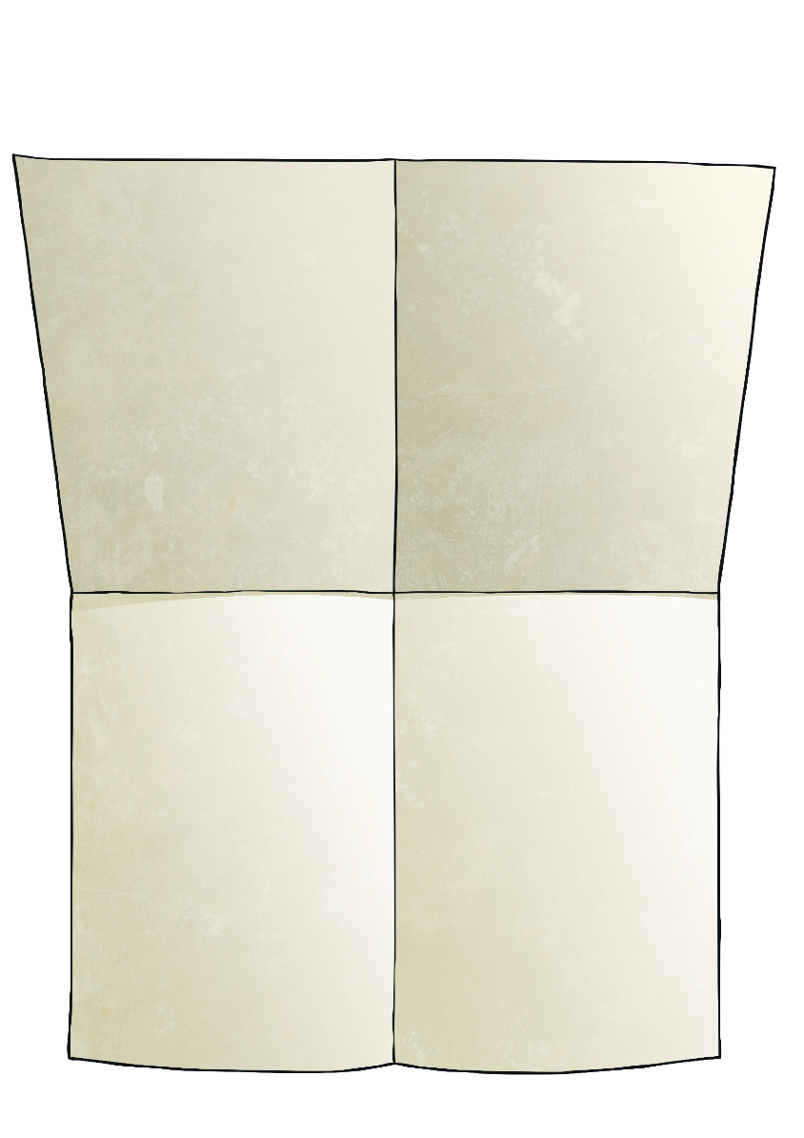
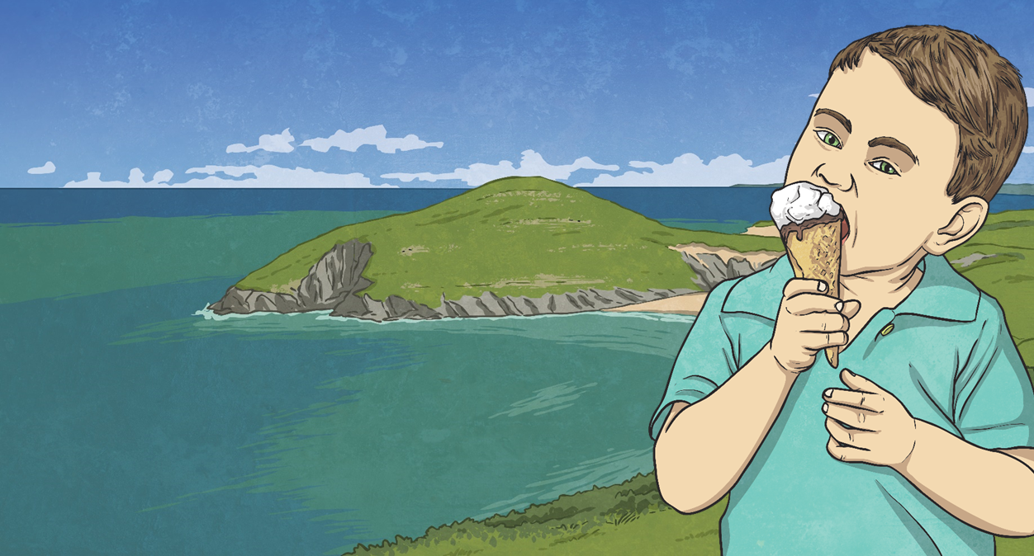
The 24-Hour Clock
Convert these 12-hour times to 24-hour times.
8:30 p.m.
2:00 a.m.
20:30
02:00
4:15 p.m.
7:57 a.m.
16:15
07:57

Slide 19
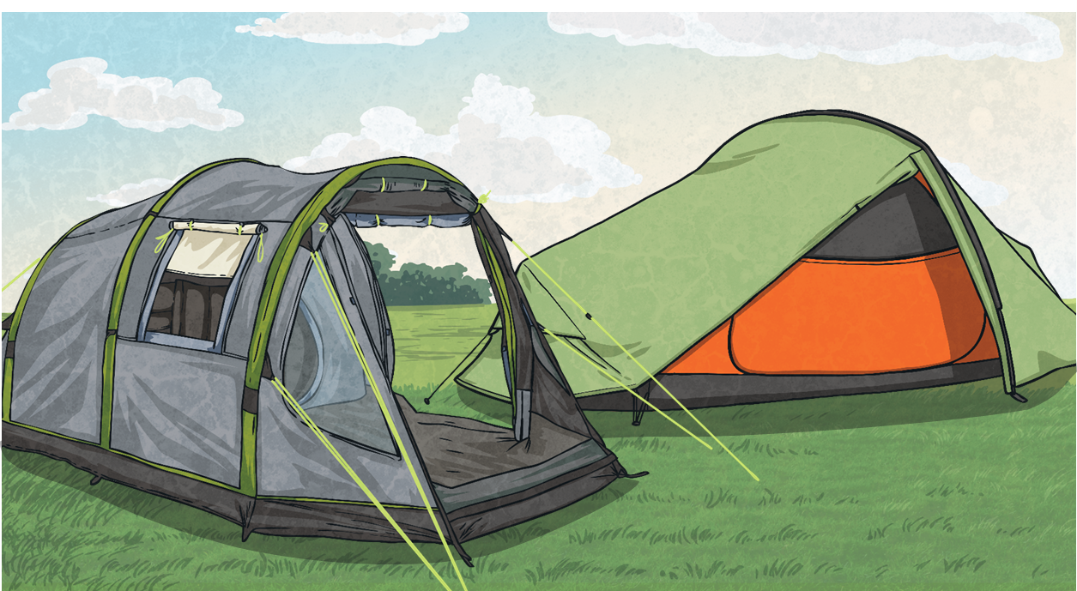
The 24-Hour Clock
Convert these 24-hour times to 12-hour times.
06:36
14:22
6:36 a.m.
2:22 p.m.
11:37
Don’t forget to use a.m. or p.m.
20:01
11:37 a.m.
8:01 p.m.

Slide 20
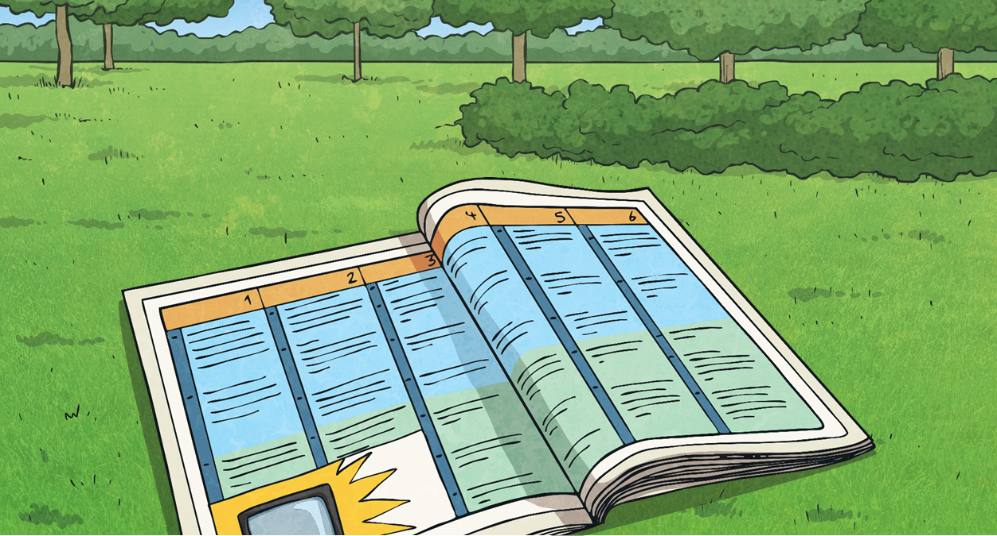
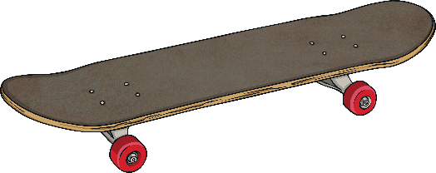
Holiday Fun
There are lots of fantastic activities for Rhys to do at the summer holiday activity camp.
Mini tennis 09:30
Swimming 14:30
Choose four of the activities
for Rhys to do today.
Crazy golf 11:25
What would be the best way
to write down the activities,
in time order, so that Rhys
knows when to do them?
Football 15:10
Skateboarding 10:15
Mountain biking 12:45

Slide 21
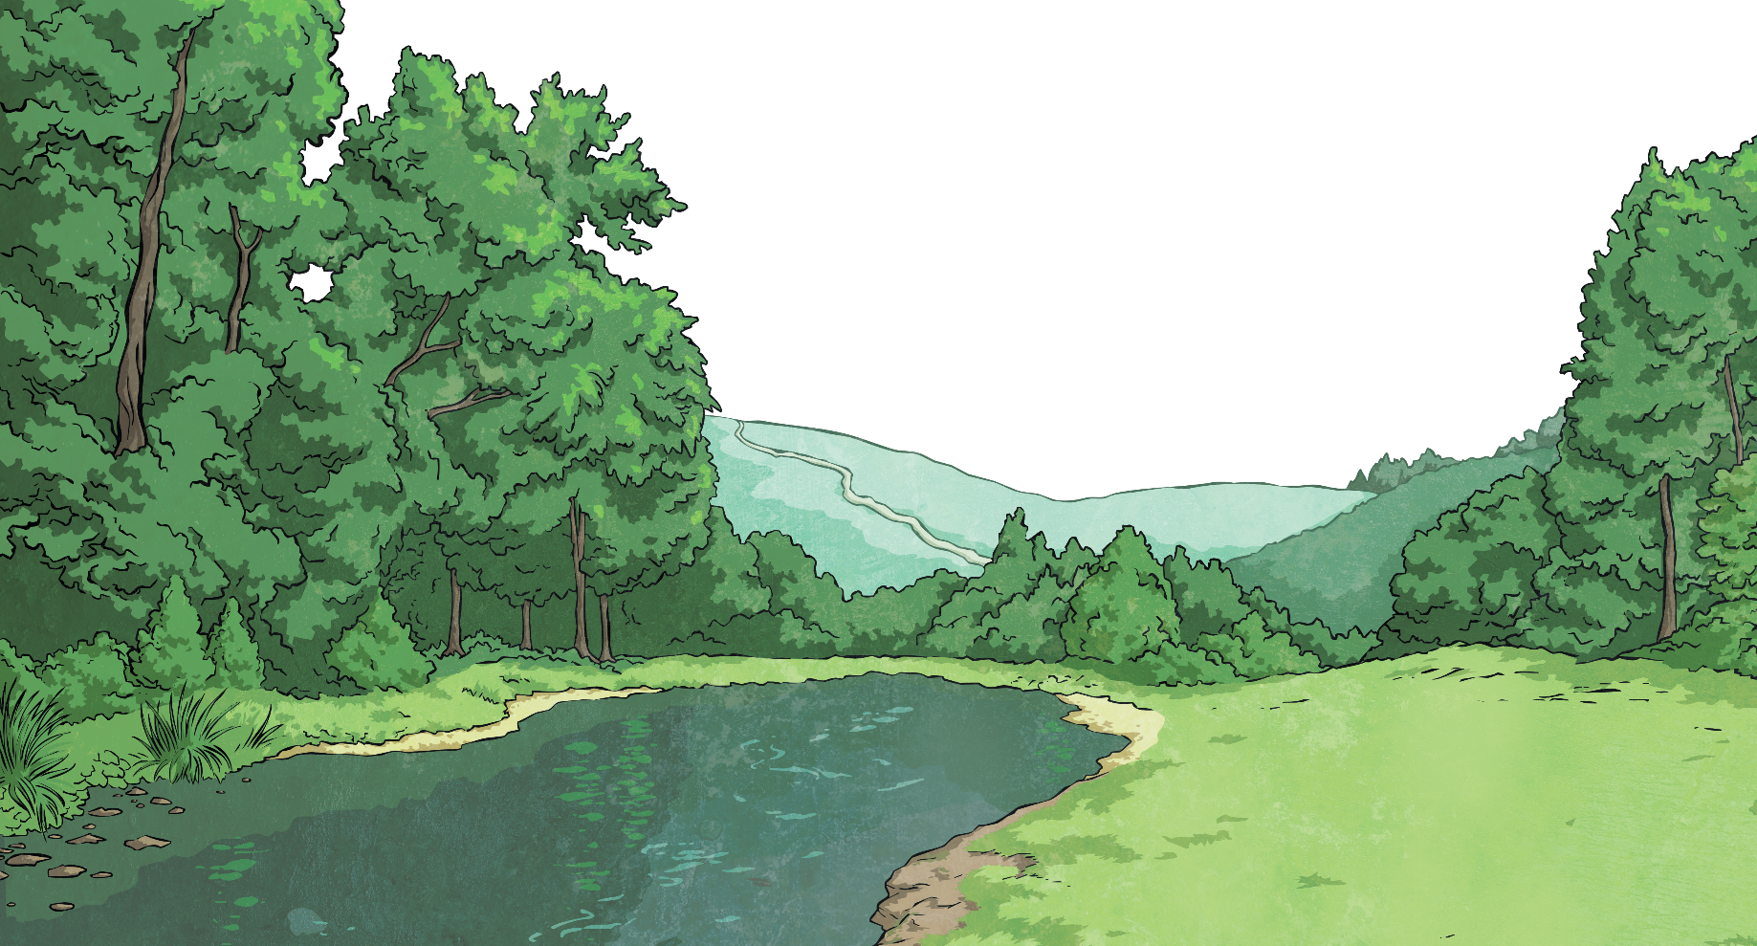
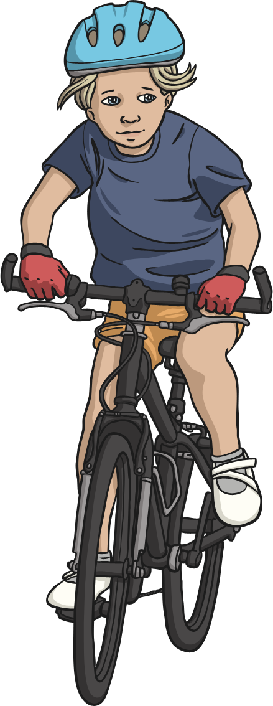
Holiday Fun
Can you think of other situations in which timetables are used?
Rhys wrote down the activities he chose in a timetable. Timetables show us which activities are happening at which time.
Twinkl Holiday Camp
Activity | Start Time
Mini tennis | 09:30
Painting | 10:45
Mountain biking | 12:45
Lunch | 13:30
Swimming | 14:30
Twinkl Holiday Camp
Activity | Start Time
Mini tennis | 09:30
Painting | 10:45
Mountain biking | 12:45
Lunch | 13:30
Swimming | 14:30
This timetable uses a 24-hour clock.

Slide 22
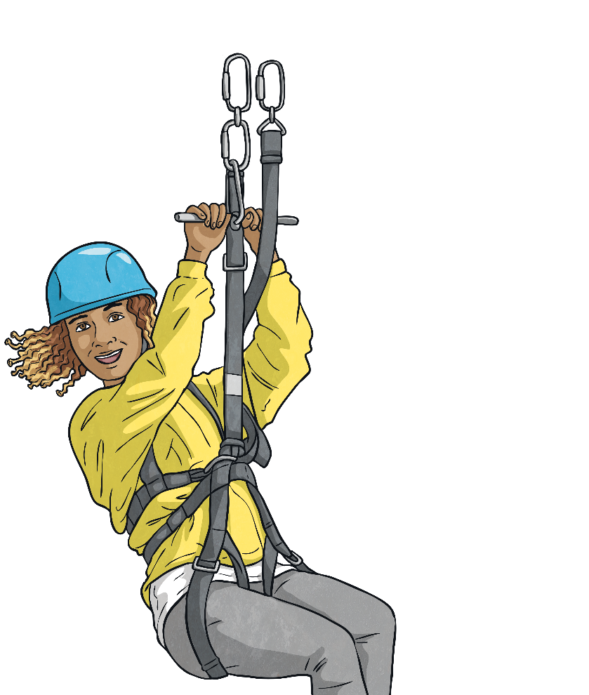
Reading Timetables
Here is a timetable of the activities for the next day. Rhys is in the Red Group. The two groups are doing activities at different times.
We can read and interpret timetables to answer questions about the timings of planned activities.
?
What activity will Red Group be doing at 12:45?
Twinkl Holiday Camp
Activity | Red Group | Blue Group
Mini tennis | 09:30 | 09:20
Painting | 10:45 | 10:10
Mountain biking | 12:45 | 10:55
Lunch | 13:25 | 12:55
Football | 14:15 | 13:40
Home Time | 15:10 | 15:00
Mountain biking | 12:45

Slide 23
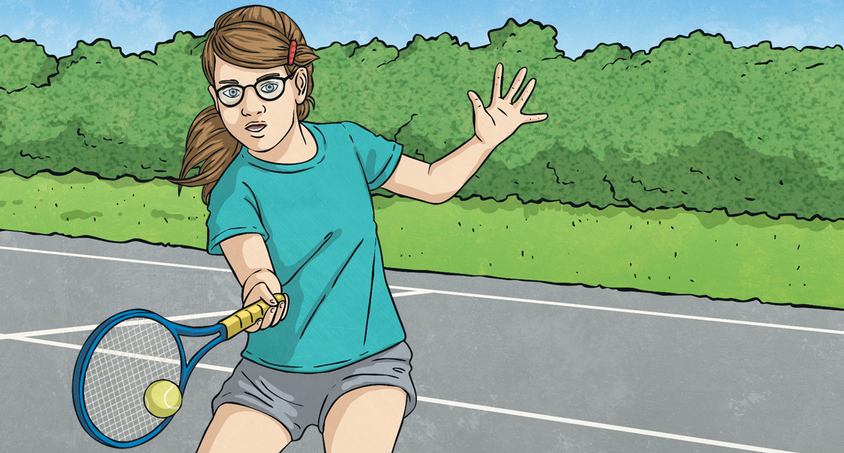
Reading Timetables
For how many minutes will Blue Group be playing mini tennis?
Twinkl Holiday Camp
Activity | Red Group | Blue Group
Mini tennis | 09:30 | 09:20
Painting | 10:45 | 10:10
Mountain biking | 12:45 | 10:55
Lunch | 13:25 | 12:55
Football | 14:15 | 13:40
Home Time | 15:10 | 15:00
!
Mini tennis
09:20
10:10
40 + 10 = 50
+ 40 minutes
+ 10 minutes
09:20
10:00
10:10

Slide 24
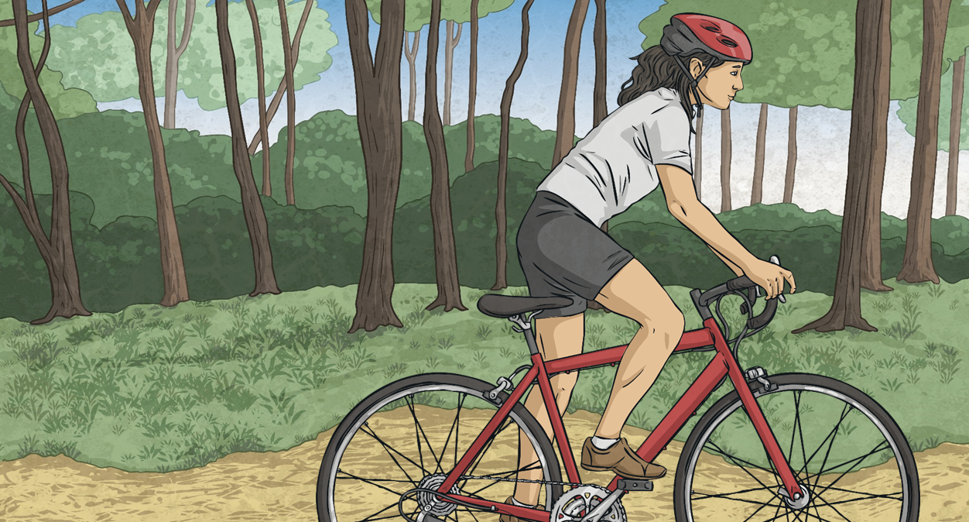
Reading Timetables
For how many minutes will Red Group be mountain biking? Use the number line to help you work it out.
Twinkl Holiday Camp
Activity | Red Group | Blue Group
Mini tennis | 09:30 | 09:20
Painting | 10:45 | 10:10
Mountain biking | 12:45 | 10:55
Lunch | 13:25 | 12:55
Football | 14:15 | 13:40
Home Time | 15:10 | 15:00
=
40 minutes
12:45
13:00
13:25

Slide 25
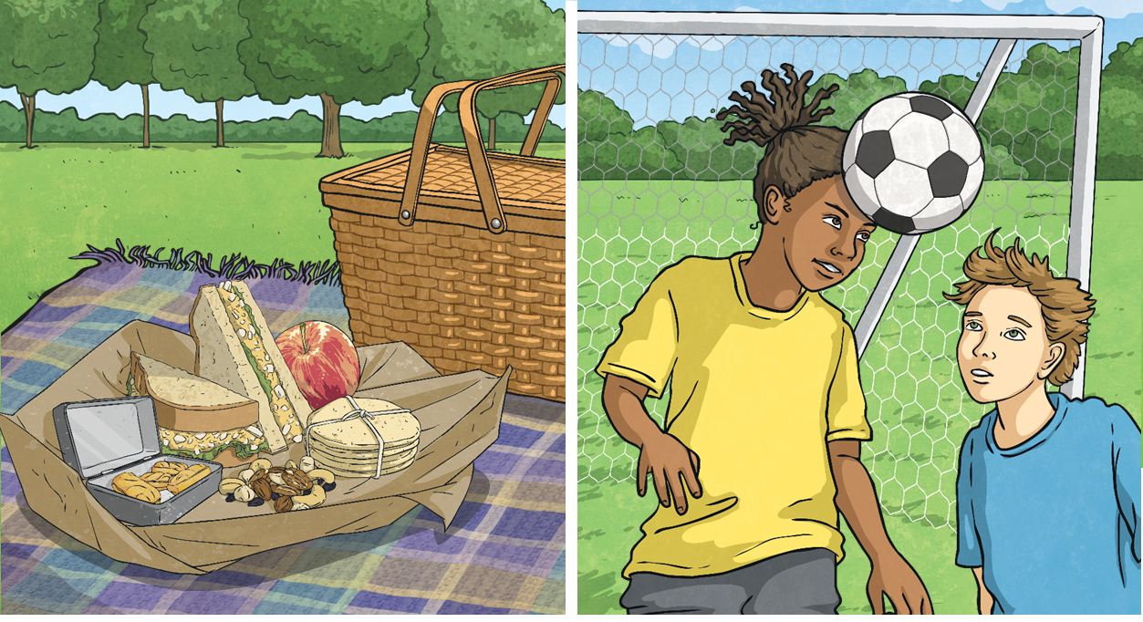
Reading Timetables
For how many minutes in total will it take Blue Group to have lunch and play football? Use the number line to help you to work it out.
Twinkl Holiday Camp
Activity | Red Group | Blue Group
Mini tennis | 09:30 | 09:20
Painting | 10:45 | 10:10
Mountain biking | 12:45 | 10:55
Lunch | 13:25 | 12:55
Football | 14:15 | 13:40
Home Time | 15:10 | 15:00
=
125 minutes
Lunch
Football
Home Time
12:55
13:40
15:00
13:00
14:00
12:55
13:40
15:00

Slide 26
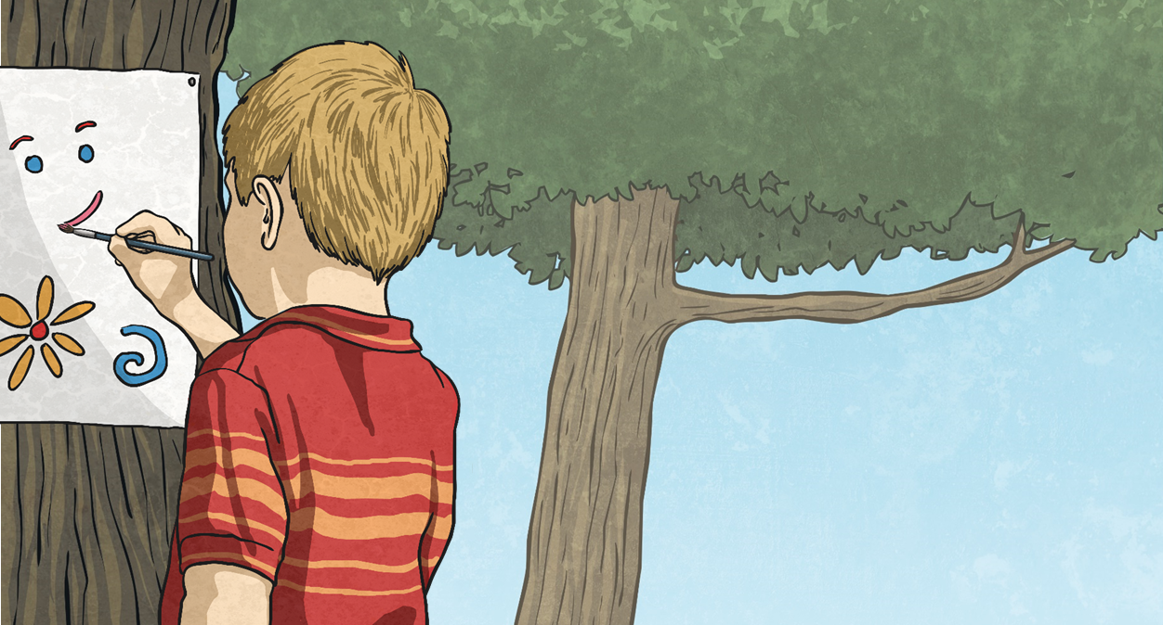
Reading Timetables
For how many minutes longer will Red Group be painting than Blue Group?
Twinkl Holiday Camp
Activity | Red Group | Blue Group
Mini tennis | 09:30 | 09:20
Painting | 10:45 | 10:10
Mountain biking | 12:45 | 10:55
Lunch | 13:25 | 12:55
Football | 14:15 | 13:40
Home Time | 15:10 | 15:00
=
Painting
10:45
12:45
10:10
10:55
120 minutes
45 minutes
120 - 45 = 75
75 minutes

Slide 27
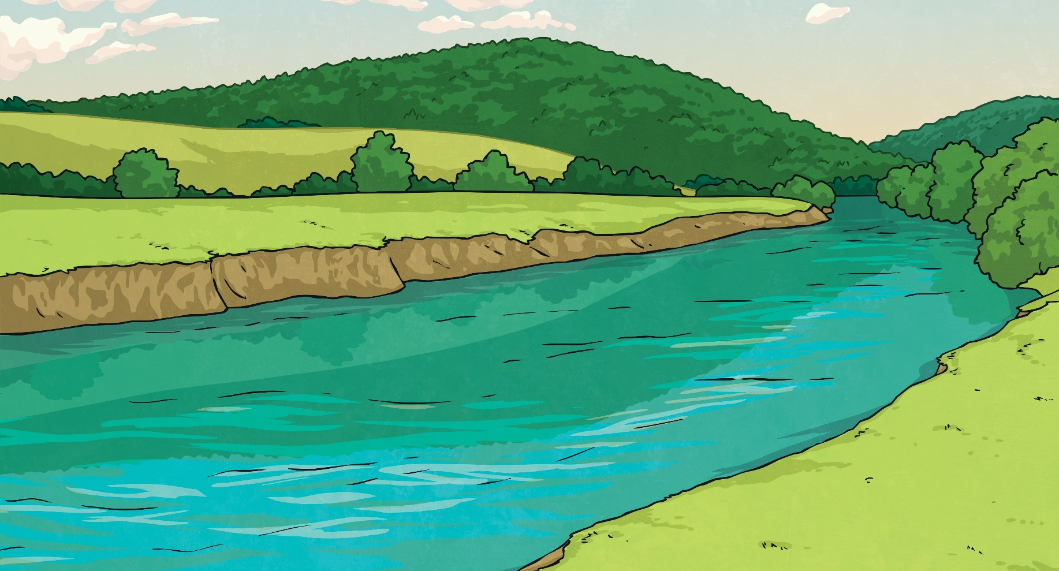
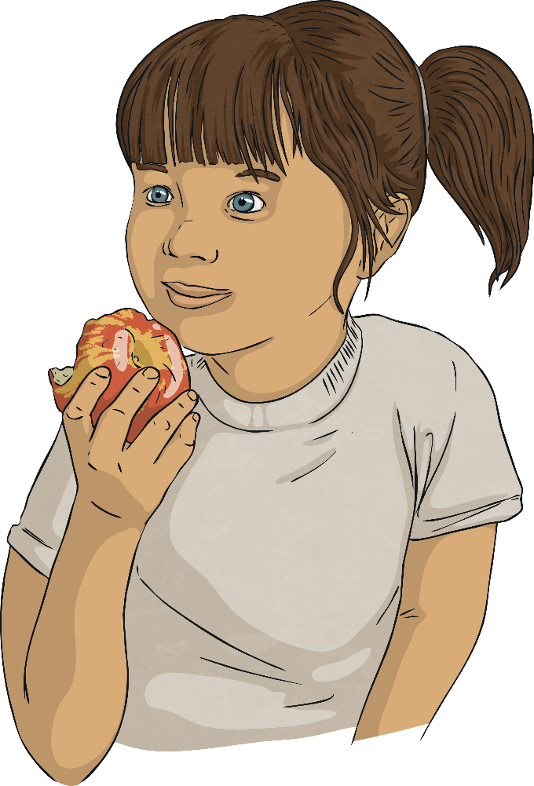
Reading Timetables
Red Group will have lunch for 50 minutes.
Use this information to fill in the gap in the table.
Twinkl Holiday Camp
Activity | Red Group | Blue Group
Mini tennis | 09:30 | 09:20
Painting | 10:45 | 10:10
Mountain biking | 12:45 | 10:55
Lunch | 13:25 | 12:55
Football |  | 13:40
Home Time | 15:10 | 15:00
14:15

Slide 28
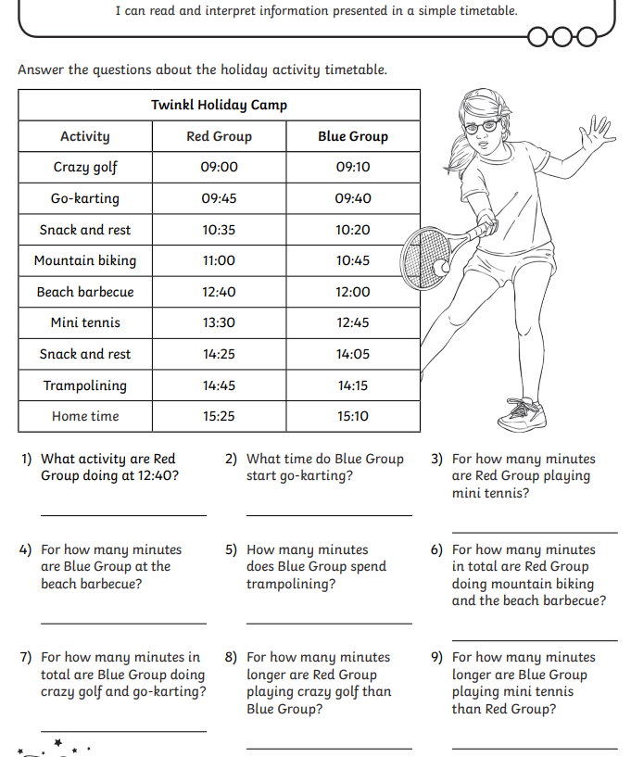

Slide 29
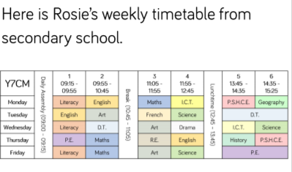

Slide 30
Lunch

Slide 31
Marking our homework

Slide 32
Science

Slide 33
Assembly

Slide 34
Hometime

