Slide 1
Friday 13th November 2020

Slide 2
Friday 13th November 2020

Slide 3
Spellings

Slide 4
Rockstars

Slide 5
Handwriting

Slide 6
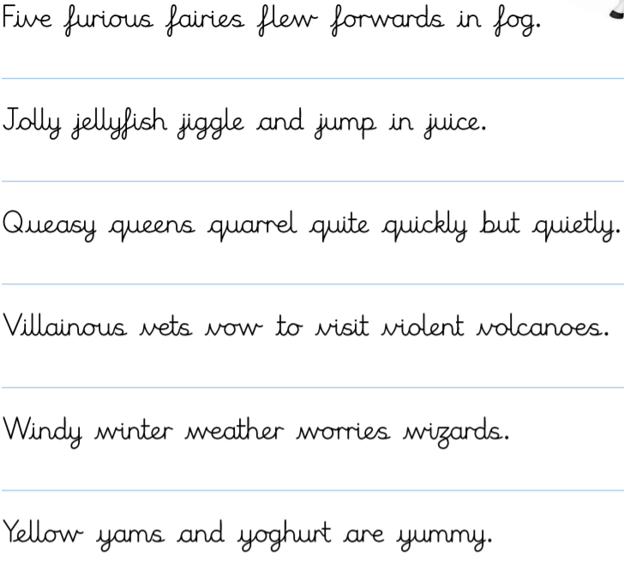
Have a go at writing the following sentences into your books.

Slide 7
English – Relative Clauses

Slide 8
Commas and Relative Clauses To recap:
There are two types of relative clauses: non-essential and essential.
The lamp post, where the girl was standing, was lit.
Non-essential relative clauses offer additional information about the noun.
This gives the reader the extra information about the lamp post.
They are separated from the rest of the sentences by commas because the information they provide can be left off without changing the meaning of the sentence.
The lamp post where the girl was standing was lit.
This specifies the particular lamp post – the one where the girl was standing rather than the one by the bus stop, for example.

Slide 9
Commas and Relative Clauses To recap:
The test which we did yesterday was really easy.
There are no commas in this sentence.
This is because the relative clause information defines the subject of the main clause.
In this example, there might have been lots of tests, but we are only interested in yesterday’s test.
This is an essential relative clause, so we don’t use commas.

Slide 10
Commas and Relative Clauses
Another example:
Dogs that howl annoy me.
I can't get rid of the words ‘that howl’ because then I'd be saying all dogs annoy me, not just the ones that howl, which isn't true.
The relative clause in this example is essential.

Slide 11
Commas and Relative Clauses
Which of these sentences need commas adding in?
The meerkat who bit the zookeeper had to be calmed down.
The baby giraffe, who had a delicate soft nose, ambled towards her mother.
The hotel where my parents got married was on television last night.
My school, which recently won a sports award, was holding a Christmas fair.
The crown that was worn by a famous ancient king came to the town museum.
The crown, which had been recently cleaned, was placed on the head of the new king.
Remember – if you are adding in non-essential, additional information, add commas.

Slide 12
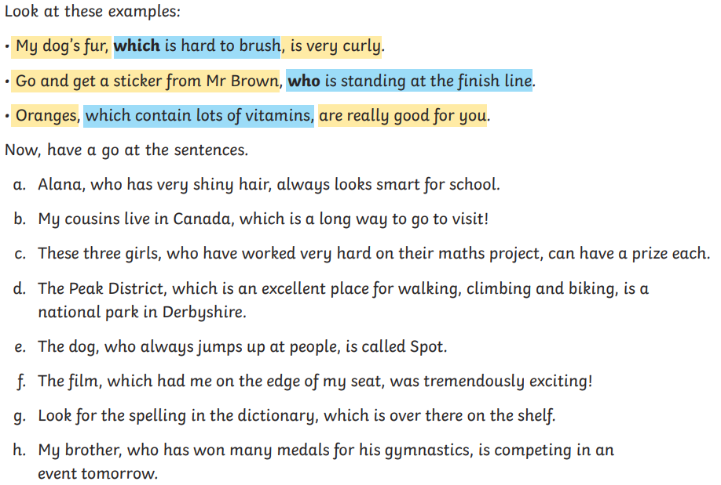

Slide 13
Break

Slide 14
Maths I can solve problems using line graphs.

Slide 17
Kim drives 78 km.
Dan drives 109 km.
How much further does Dan drive?
2) What is the product of 6 and 7?
3) ____ mm = 4 cm
4) 11 km = ______ m

Slide 18
Kim drives 78 km.
Dan drives 109 km.
How much further does Dan drive?
2) What is the product of 6 and 7?
3) ____ mm = 4 cm
4) 11 km = ______ m
31 km
42
40
11,000

Slide 20
A 65 km bike ride
65
1) How far does the cyclist cycle in the first 15 minutes?
60
55
Have a think
22 km
50
43 km
65 – 43 =
45
22
40
2) How long does it take the cyclist to cycle the last 10 km?
Distance left to cycle (km)
35
30
6 minutes
25
10 km remaining =
47 mins
20
15
Finish = 53 mins
10
6
5
53 – 47 =
0
5
10
15
20
25
30
35
40
45
50
55
0
Cycling time (mins)

Slide 21
A 65 km bike ride
65
Have a think
60
55
3) Estimate the distance cycled after 22 minutes.
50
45
65 – 36 =
40
29 km
Distance left to cycle (km)
35
4) After 40 minutes, how many more kilometres are there to cycle?
30
25
20
19 km
15
10
5
0
5
10
15
20
25
30
35
40
45
50
55
0
Cycling time (mins)

Slide 22
Daily sunshine in August
12
10
8
Have a think
6
Sunshine (hours)
4
2
0
1
2
3
4
5
6
7
8
9
10
Day of the month
1) Which two days had an equal amount of sunshine?
1st and 6th
2) Which day do you think had the most cloud?
4th

Slide 23
Have a go at questions 1 and 2 on the worksheet

Slide 24
Pint to litre conversion
6
5
4
3
Litres
2
1
0
0
1
2
3
4
5
6
7
8
9
10
Pints
1) Tom has 4.5 litres of juice.
Sam has 7 pints of juice.
Who has more juice?
Under 4 litres
Tom

Slide 25
Pint to litre conversion
6
5
4
Litres
3
2
1
5.25
Have a think
0
0
1
2
3
4
5
6
7
8
9
10
Pints
1) 4 pints is approximately equal to how many litres?
2.25 litres
52.5
2) 30 litres ≈ _____ pints

Slide 26
Have a go at question 3 on the worksheet

Slide 27
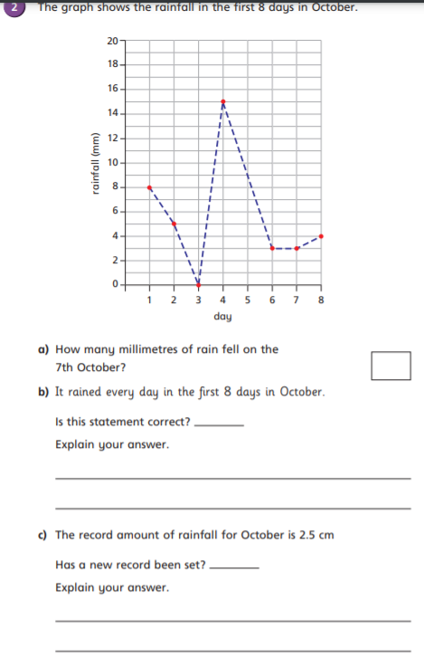

Slide 28
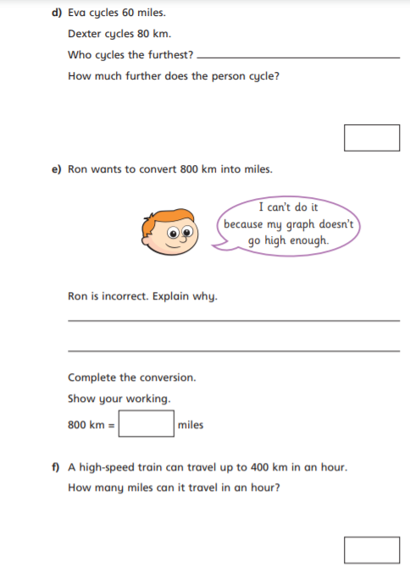

Slide 29
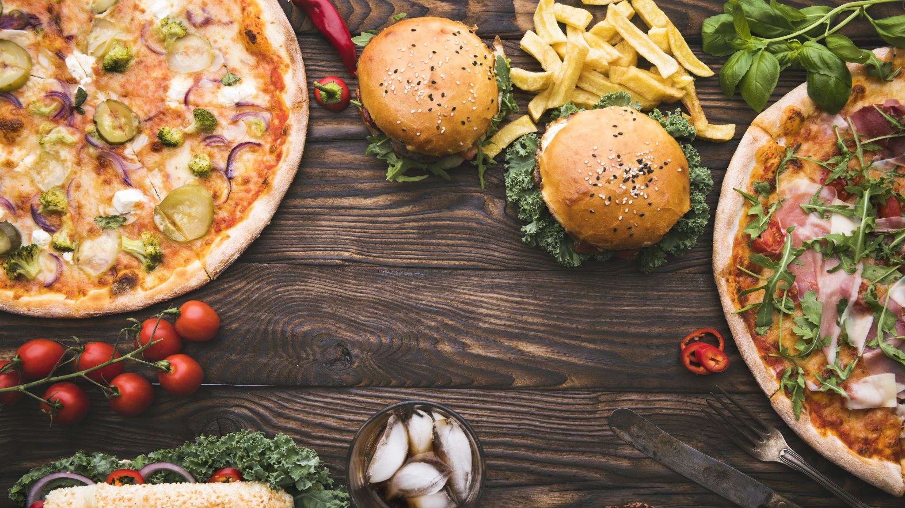
Lunch

Slide 30
Marking our Homework

Slide 31
Science (as we didn’t get time to complete this on Wednesday)

Slide 32
Assembly

