Slide 1
Subordinate Clauses
Friday 27th November

Slide 2
Aim
I can distinguish between a main clause and a subordinate clause.
Success Criteria
I can describe what subordinate clauses are for.
I can explain where subordinate clauses can be found.
I can use a subordinate clause to improve sentences.

Slide 3
Introductory Activity

Slide 4
Clauses and Subordinates
Simple Sentences
Can you add some adverbs to make these sentences more interesting?
On your whiteboard, fill in the blanks:
The chicken walked _________.
The chicken talked _________.
The chicken flew _________.
The chicken cheeped ________.

Slide 5
Clauses and Subordinates
Simple Sentences
Can you add some adjectives to make these sentences more interesting?
On your whiteboard, fill in the blanks:
The ________ chicken walked.
The ________ chicken talked.
The ________ chicken flew.
The ________ chicken cheeped.

Slide 6
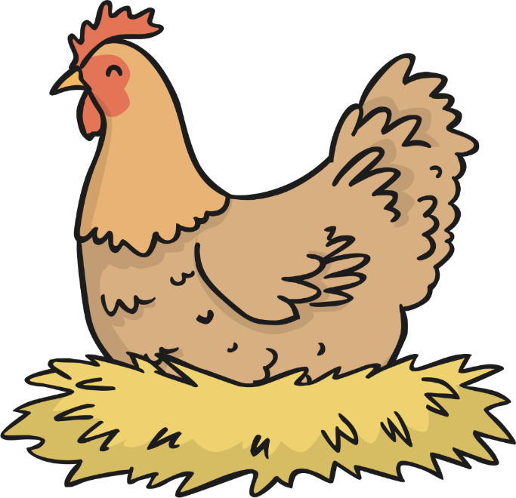
Clauses and Subordinates
Clauses are groups of words which are built around a verb.
There are different types of clauses.
I am the main clause chicken! Cluck, cluck.
Imagine this big, fat chicken is the main clause.
It makes sense all by itself.

Slide 7
Clauses and Subordinates
Here is a main clause.
I am the main clause chicken! Cluck, cluck.
The chicken sat on her eggs.

Slide 8
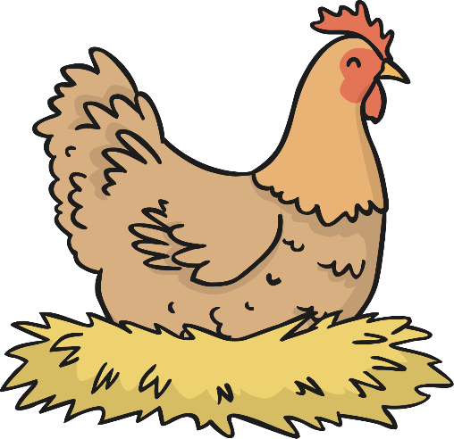
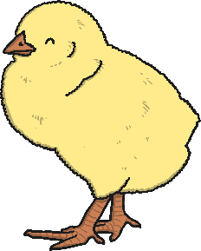
Clauses and Subordinates
Subordinate clauses are clauses that tell us more about the main clause.
Imagine the chick is the subordinate clause.
It relies on the big mother chicken (main clause).
The subordinate clause needs a main clause.
Cheep!
The subordinate clause only makes sense when it is with a main clause.
main clause +
subordinate clause

Slide 9
Clauses and Subordinates
Here is a main clause.
Look what happens if you add a subordinate clause.
The chicken sat on her eggs
waiting for them to hatch.
main clause
+ subordinate clause

Slide 10
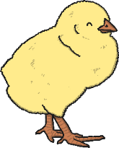
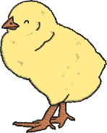
Clauses and Subordinates
A main clause can have more than one subordinate clause.
I am the most important.
The main clause remains the most important though.
main clause +
subordinate clauses

Slide 11
Clauses and Subordinates
Subordinate clauses can be at the beginning, the middle and the end of a sentence.
They can pop up anywhere!

Slide 12
Underline the main clause and subordinate clause
Although she didn’t ask for one, Aggie’s father gave her a book of fairy tales.
Aggie had realised that her marrying a prince was unlikely to happen, as princes did not come to Guttersbury looking for their brides.
As she had seen no heroes wandering around Guttersbury, Aggie would have to take matters into her own hands.
Aggie Lumpett was a determined girl, so she had decided she wanted to live in Glorious Luxury.
Magnifico was a little bit scared when they mentioned trolls and ogres.
Magnifico greedily ate the pork pies while Alfie talked to J. Jones.

Slide 13
Complete these sentences by adding more detail to the subordinate clause.
While the rain poured down, _________________________.
Before they left on their adventure, ___________________.
________________________, before it’s too late.
Whenever Magnifico was hungry, _____________________.
As they were entering the dark, vast forest, _____________.

