Slide 1
Our new text
English- Tuesday 17th November

Slide 2
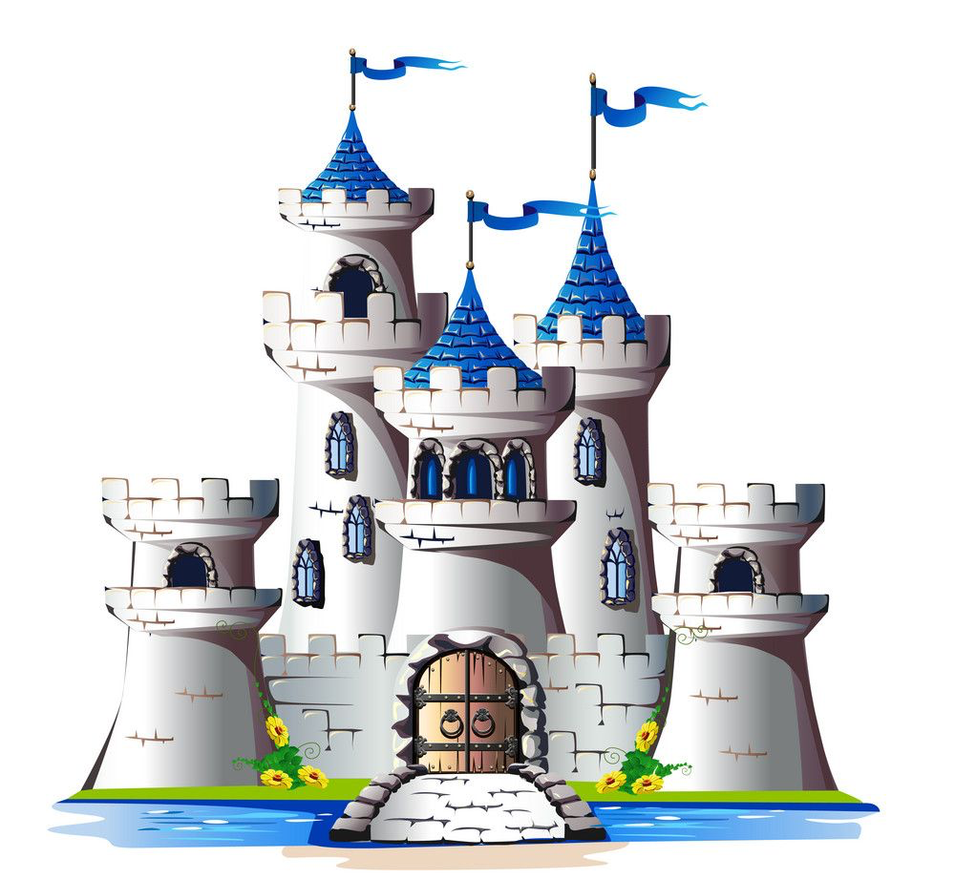
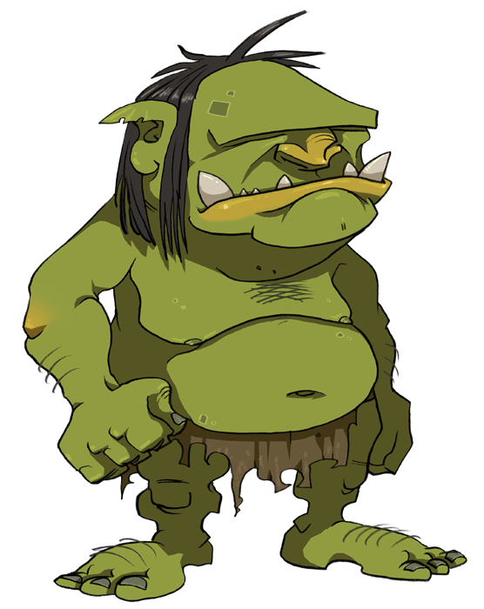
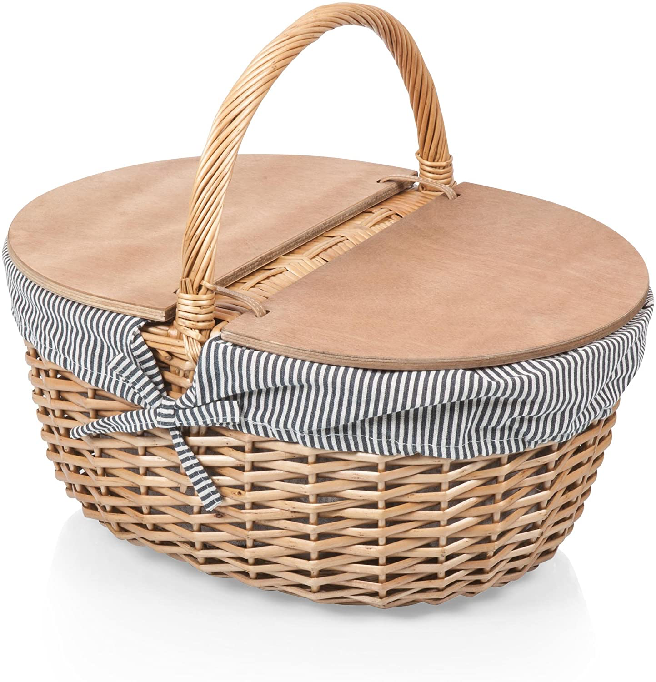
Yesterday, you created a mind map of your predictions.
Today, you are going to look at some paragraphs from the text.
Read the paragraphs, then make some further predictions about what our new story could be about.
Do you get an idea of what the characters might be like?

Slide 3
Long, long ago, when trolls lurked in deep dark forests and ogres grumbled and mumbled beyond the distant hills, there was a small and ordinary village called Guttersbury. The villagers were ordinary too, and Aggie Lumpett, the only daughter of the road sweeper , was just as ordinary as anyone else … until her tenth birthday. On this particular birthday, Aggie’s father gave her a book of fairy tales.

Slide 4
“He’s going to be a hero, “ she announced, “so we’re going to call him Magnifico.” Garf Onion shrugged and went back to his pigs, leaving Aggie to begin the hero’s training. She was mildly inconvenienced by the arrival of an eighth son a year later, but she put his cradle in the barn and told Yurt, the oldest boy, to look after him. “Magnifico needs me,” she explained. “He’s going to go adventuring one day and bring back gold and jewels and a princess”.

Slide 5
Seven pairs of eyes turned to look. The hero was slumped at the head of the table. Under his substantial bottom was a well-worn velvet cushion, and a piece of tarnished tinsel was wound in and out of the chair back. The expression on his face suggested that he was far from happy.

Slide 6
Magnifico was pale green. “But I don’t want to meet any ogres. Or trolls. You never said anything about trolls, Ma! You said all i had to do was find a princess and marry her and then I’d be rich and have all the chocolate I ever wanted!”

Slide 7
She put half the cake on the hero’s plate, then divided the other half into six slices. “What about Alfie, Ma?” Yurt asked. His mother looked annoyed. “Makes it awkward, seven slices,” she said. “Alf doesn’t mind, do you Alf?” Alfie shook his head. “I don’t mind, Ma.”

