Slide 1
Monday 9th November Morning Job
Put your Homework Diary, whiteboard and reading book on your desk.
Have you hung up your coat? Put your lunchbox TIDILY on the bench or ordered your lunch?
Read the Continents information on your desk.
Write some questions on your whiteboard that you can ask us about the Continents text.

Slide 2
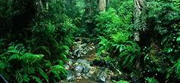
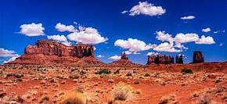
Our new topic…
Who would live in a habitat like this?

Slide 4
This week in English…
We will focus on reading comprehension and recap SPaG

Slide 5
What have we done so far in SPaG?
Name: noun, verb, adjective, adverb, determiner
Expended noun phrases
Plural nouns
Apostrophes for contractions
Possessive apostrophes

Slide 6
Reciprocal reading strategies
Summarise
Question
Clarify
Predict

Slide 7
Monday 9th November
I can retrieve information from a non-fiction text.
We will use skim reading to help us do this.

Slide 8
1. What is a continent?
A continent is a massive area of land separated by water or other natural features like mountains.

Slide 9
2.

Slide 10
3. Name a famous place you would find in…
Europe-
Africa-
Asia-
Eiffel Tower, Colosseum, Stonehenge
Sahara Desert, pyramids of Egypt, River Nile
Himalayas, Mount Everest, Dead Sea

Slide 11
4. Name an animal you would find in…
Australasia
North America
Antarctica
South America
Kangaroos, platypus, koalas, emus
Skunks, bears, moose
Penguins, albatross, seals
Sloths, llamas, jaguars

Slide 12
5. Which continent would you like to live in and why?
Remember to give a reason that uses information from the text.

Slide 13
Reflect
How did you locate the information in the text?
Today we used questions to clarify our understanding.
Which of the other reading strategies do you think we need to practise?

Slide 14
Tuesday 10th November Morning Job
Put your Homework Diary, whiteboard and reading book on your desk.
Have you hung up your coat? Put your lunchbox TIDILY on the bench or ordered your lunch?
Read the Oceans information on your desk.
Write some questions on your whiteboard that you can ask us about the Oceans text.

Slide 15
Reciprocal reading strategies
Summarise
Question
Clarify
Predict

Slide 16
Tuesday 10th November
I can skim read to locate information.
Can you remember how to skim read?
Answer the questions about Oceans then we will mark it together.
Remember the answers are in the text- don’t guess!

Slide 17
I can skim read to locate information.
1. What is an ocean?
2. In which ocean would you find Challenger Deep?
3. Which large mammal breeds in the Indian Ocean?
4. Which continent is completely surrounded by the Southern Ocean?
5. Why is the ice of the Arctic Ocean shrinking?

Slide 18
What have we done so far in SPaG? Let’s find out what we can remember.
Name: noun, verb, adjective, adverb, determiner
Expended noun phrases
Plural nouns
Apostrophes for contractions
Possessive apostrophes

Slide 19
How did you do? What could you remember?
Name: noun, verb, adjective, adverb, determiner
Expended noun phrases
Plural nouns
Apostrophes for contractions
Possessive apostrophes

Slide 20
Wednesday 11th November Morning Job
Put your Homework Diary, whiteboard and reading book on your desk.
Have you hung up your coat? Put your lunchbox TIDILY on the bench or ordered your lunch?
Adverb Activity- write the answers into your English Book.

Slide 21
I can infer answers using clues from the text.
What is inference?
Finding information that is hinted at but not directly said
You need to be like a detective to find the clues in the text
These clues must be added to what we already know
More than one correct answer is possible.

Slide 22
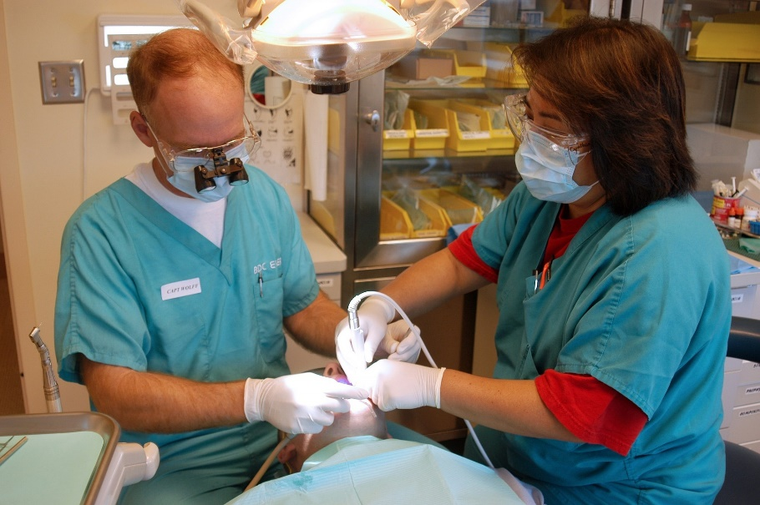
Reading a Picture
Look at this picture, then talk about these questions with a partner.
Why is the man wearing small binoculars clipped to his glasses?
Why are two people needed for this procedure?
Why is a bright light above the patient’s head?
How can you tell that the people want to stay safe from infection?

Slide 24
Example Answers
Why is the man wearing small binoculars clipped to his glasses?
The man is wearing small binoculars clipped to his glasses because he is working on something small inside the patient’s mouth and needs to be able to see it clearly.
Why are two people needed for this procedure?
Two people may be needed for this procedure because there are too many bits of equipment for one person to hold whilst treating the patient at the same time.
Why is a bright light above the patient’s head?
A bright light is above the patient’s head so that the dentists can see everything that they are doing clearly.
How can you tell that the people want to stay safe from infection?
I can tell that the people want to stay safe from infection because they are both wearing gloves, protective glasses and masks over their mouths.

Slide 25
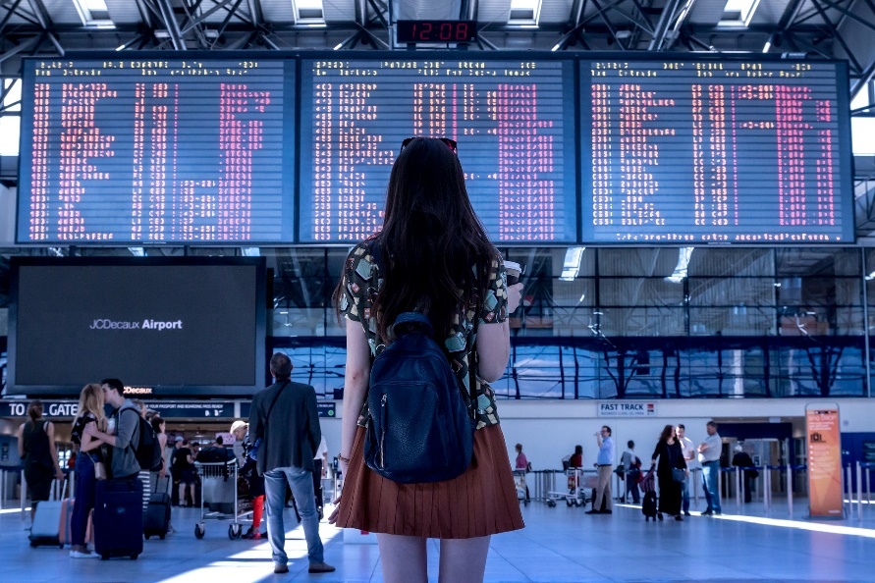
Reading a Picture
Look at this picture, then write the answer to the questions in your English book.
Where was this photograph taken?
Why do lots of people have suitcases with them?
Is the woman’s drink hot or cold? How do you know?
What is the weather like outside of this building?

Slide 27
Example Answers
Where was this picture taken?
I think that this photograph was taken at an airport. I think this because I saw big screens like that at the airport when I went on holiday.
Why do lots of people have suitcases with them?
Lots of people have suitcases with them because they are going on holiday and need to take clothes and toiletries with them.
Is the woman’s drink hot or cold? How do you know?
The woman’s drink is hot. I know this because only hot drinks are served in that type of cup. Cold drinks are usually in a bottle or plastic cup with a straw.
What is the weather like outside of this building?
The weather outside of this building is sunny and warm. I can tell this because I can see the sunlight on the floor. The woman is wearing sunglasses on her head and a short sleeved T-shirt so the weather must be warm.

Slide 28
Reflect- I can infer using clues from the text.
What does infer mean?
Did you find the clues?
Tomorrow you will find the clues in a written text.

