Slide 1
Monday 16th November Morning job:
This morning you are going to change your reading books.
Once you have a new book can you quietly read.

Slide 2
Today’s I can…
Monday 16th November.
I can predict what might happen from details of the book.
Notes:
I will ask the children to write the date and title in their english books. I will also model and ask them to write down two subheadings in their book that they will add to throughout the lesson.

Slide 3
Let’s discuss!
What can you see?
What do the illustrations make you think of?
What does the title tell you?
What are your thoughts and ideas?
Do you think the book will be fiction or non-fiction?
What do you predict?
Josh, look at the front cover of the book and read the blurb BUT DON’T OPEN THE BOOK!
Write some ideas and predictions.
Notes:
BOOK REVEAL!! I will have a photocopies of the front cover 1 between two and the children will be able to visual the front cover now. We will have another discussion about further predictions. Have the illustrations and title revealed anything else about what the book could be about. Have they changed your opinion?

Slide 4
Monday 16th November
I can predict what might happen from details of the book.
In your English books, I would like you to write down some of your thoughts and ideas of what you think this book could be about.
Can you write some sentences of predictions of what you think this book could be about.
Now can you write 1 more prediction down in your book after hearing the blurb.
Notes:
I will ask the children to write down the date and title in their books. I will ask them to write 2 or 3 sentences of their predictions of the book from looking at the prop box, book illustrations and title. Once the children have written 2/3 sentences I will read the blurb of the book. The children will have one more opportunity to write a new prediction bearing in mind the new information they have heard.

Slide 5
Reflect:
Notes:
For the plenary, I would like the children to write one sentence in their books with the above sentence starter. I will verbally model some examples. I might say “ I would like to find out more about the main characters in the story” or “I would like to find out more about the journey the characters go on involving the volcano”.

Slide 6
Tuesday 17th November Morning job:
Can you write a list of nouns that you would find in your bedroom?
Here is the start of my list to help you:
Reading lamp
Pillow
Curtains
Dressing table
Challenge! - Can you write a list of nouns you might find in a fairy tale?

Slide 7
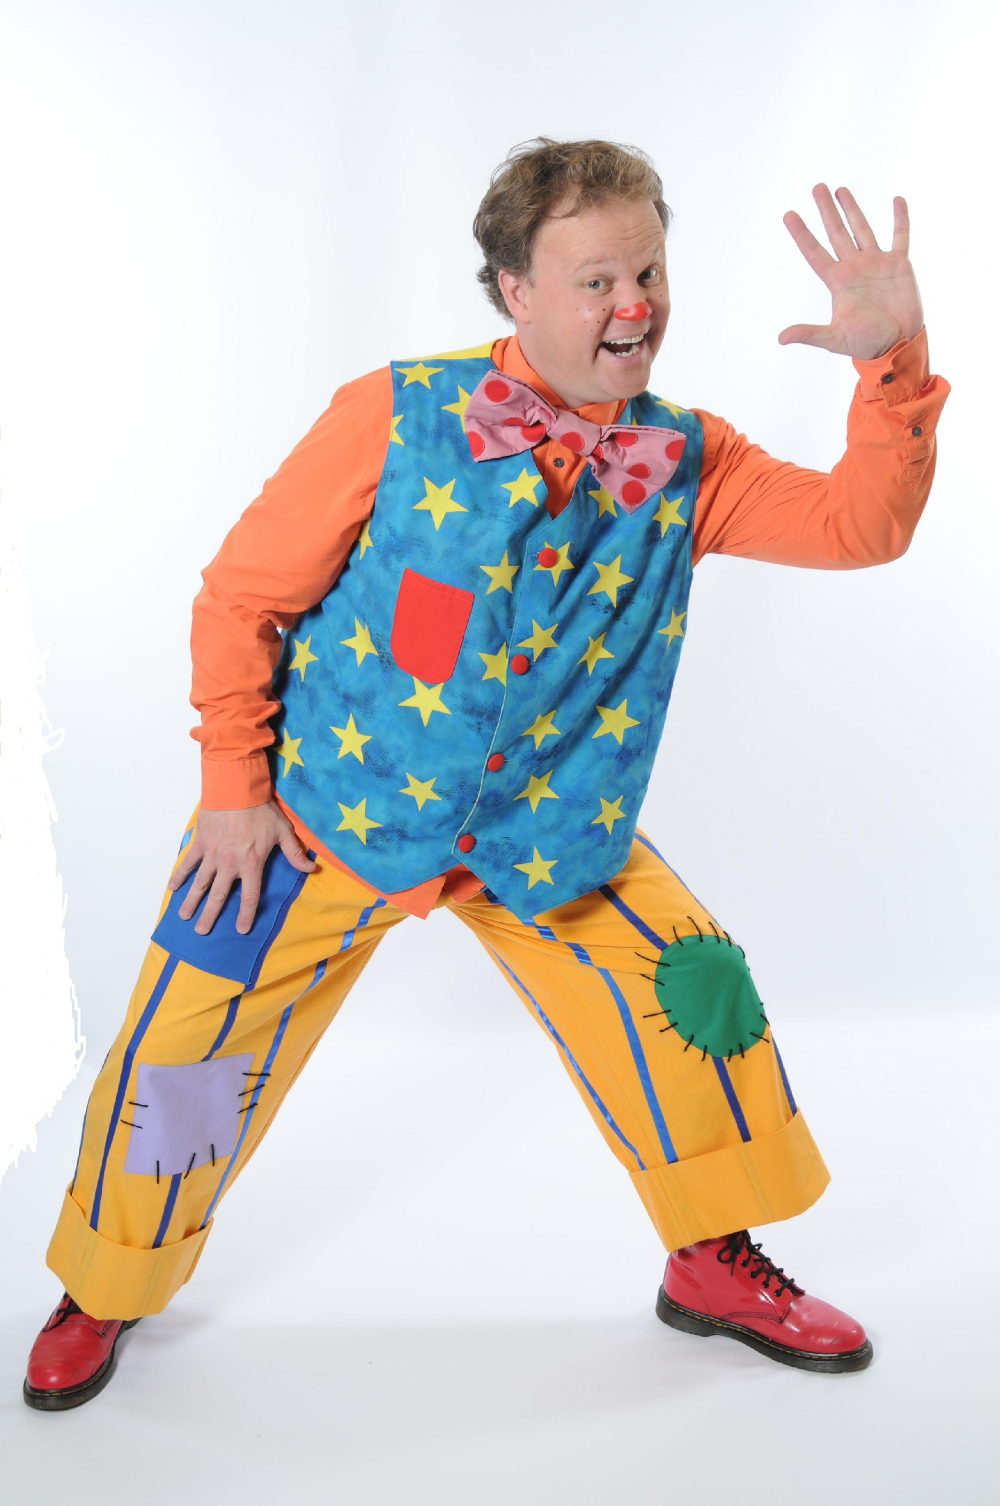
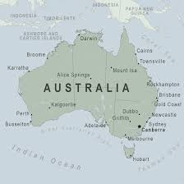
Nouns
What is a noun?
A noun is a word used to identify a class of people, a place or things.
Are all of these pictures nouns?
Be ready to explain your answer!

Slide 8
Tuesday 17th November Determiners
What is a determiner? – talk with your partner for 30 seconds about what you think a determiner might be.
A determiner is a word that modifies a noun within a sentence.
Here are some examples:
“This chair” or “My book”.
Which word is the determiner in each of these noun phrases?
What do we mean by the word modify or modifies?
Notes:
I will discuss the definition of a determiner and clarify what is meant by ‘modifies’. Then I will give some examples visually. I will ask the children when discussing the examples of what the determiners have done to each of these phrases – given us more information/context about the noun. I will ask the children to write the date and title in their book and write down the definition of a determiners – we will a

Slide 9
Determiners
A determiner comes BEFORE a noun in a noun phrase and give the reader more information about it.

Slide 10
Let’s have a go!
Notes:
This is where I am going to print off some sheets of paper – some with nouns on and some with determiners. I will ask some children to come to the front and hold up the nouns and determiners. As a class we will have a go putting the determiner in front of the different nouns and discuss what the determiner is telling us each time about the noun. E.g someone holds “chair” and someone holds “the” in front – telling us there is a chair here. Then someone holds “my” in front and this tells us that the chair belongs to the person talking about it.

Slide 11
Determiners
In your English books write down as many examples of determiners that you can remember from today’s lesson.

Slide 12
The Firework-Maker’s Daughter
Thinking back to last lesson:
What were your predictions?
What do you think might happen?

Slide 13
LET’S READ CHAPTER 1!
Notes:
We will read chapter 1 as a guided reading task.

Slide 14
Let’s recap something!
What do we mean by the word inference?
What inferences did you make yesterday when we looked at the front cover and read the blurb of the book?
What inferences can you make from the chapter today?

Slide 15
Todays I can…
I can identify main ideas from the text and summarise these.
I can draw inferences such as inferring characters’ feelings, thoughts and motives from their actions, and justify inferences with evidence.
Notes:
Check if they know what an ‘inference’ is? Explain this to them now and on multiple occasions in the lesson to ensure they can complete the worksheet and plenary task.

Slide 16
I can summarise what I have read.
Do you understand everything you have read?
What has happened so far?
What do you think might be important details so far?
What are you thinking?
Can you summarise what you have read so far?

Slide 17
Summarising the chapter.
Here are some of the key and minor facts of the chapter:
Lila spent a lot of time in her fathers firework workshop as a child.
Lila wants to be a firework maker but Lalchand wants her to marry a husband.
Chulak told off for the white elephant covered in graffiti.
The white elephant is assigned to people who have angered the king and is delivered to stay with those people resulting in them losing all their money taking care of the elephant.
Can you think of the next main and minor points in the chapter?
Notes:
I will let the children know they need to identify the key events first before summarising to be able to have a clear understanding of the chapter. I have given the children the first key and minor events and i will ask the children to identify the next main events as a class. I will let them know that they will be using these ley events to summarise the chapter.

Slide 18
Tuesday 17th November
I can summarise what I have read.
In your english books I would like you to write a summary of chapter 1.
Use the key points we have identified as a class to help you summarise this chapter.
REMEMBER - A summary is not writing every detail of the chapter, it is describing the key events in the story so far.

Slide 19
Reflect:
inference

Slide 20
Wednesday 18th November Morning Job:
In your English books yesterday, you made a list of determiners that we looked at in the lesson.
I would now like you to add a noun on the end of each determiner.
For example,
The king. – I have added king here.
Notes:
We will start our SPaG session talking about the ouns the children have added and what this tells us about the noun – in the example it tells us there is a king.

Slide 21
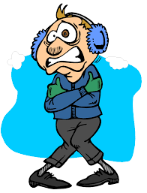
Let’s warm up!
Let’s share some of your phrases with determiners followed by a noun.
When sharing our phrases think about and take part in discussion about what the determiner has told you about that noun.
Notes:
We will begin by recapping the learning we did yesterday and discussing their phrases and what they could tell us.

Slide 22
Determiners
Determiners introduce the noun and can tell us important information about it.
Here are lots of examples of determiners:
Let’s discuss what these different determiners could tell us?
Notes:
Now we will look at these different determiners – I have purposely covered the titles of the different groups as I just want to start building the foundations of the chdlrens understanding by hosting a big discussion. I will ask the children questions such as what do these determiners tell us? Are they trying to ask a question? If I added ‘which’ first does this indicate they know what noun they are talking about or not? – is this trying to question? Do these show possession? I will encourage the children to give examples when they are discussing. There will be a lot of probing and questioning to expand learning. – I would like to follow on from this to grouping at a late stage with big laminated cards.

Slide 23
Identify the determiner!
I would like you to underline the determiner in each of these sentences using a colour pencil.
Once you have completed this, please stick this into your English books!
Notes:
I will explain to the children to underline the determiners in each of the sentences using a coloured pencil – the children should be able to attempt this following on from our prior discussion. Still early stages of determiners I do not anticipate all children to be bang on as of yet. This activity is a good assessment to see if the children have mastered the foundations before progressing onto grouping and categorising. We will mark this with our purple pens.

Slide 24
The Firework-Maker’s Daughter.
Thinking back to last lesson:
What does inference mean?
Can you summarise what happened in Chapter 1?

Slide 25
Today’s I can…
I can use a dictionary to check the meaning of words.
I can draw inferences such as inferring characters’ feelings, thoughts and motives from their actions.

Slide 26
LET’S READ CHAPTER 2!
Notes:
We will read pages 15-22 (7 pages) in chapter 2. Guided reading. We will discuss and summarise what has happened so far.

Slide 27
Wednesday 18th November
I can use a dictionary to check the meanings of words.
Use a dictionary to check the definitions of these words:
Merchant
Courtier
Procession
Pungent
Tarpaulin
Stout
Notes:
I will ask the children to use a dictionary to check the definitions of these words. If the children do not finish them all we will go through them as a class so that they have all at least been orally discussed.

Slide 28
How does Lalchand feel?
How do you think Lalchand is feeling?
What adjectives would you use to describe how Lalchand is feeling right now?
Let’s brainstorm some ideas together!
What synonyms can you think of for sad and scared?
In your English books write down one inference of how Lalchand is feeling right now.
Notes:
I will now start a discussion about how Lalchand is feeling following the disappearance of Lila. I want to focus on the children thinking of as many synonyms for his feelings. We have done a similar lesson a couple of weeks ago.

Slide 29
TOMORROW’S LESSON…
Tomorrow you will be writing a diary entry from Lalchand.
You will be describing how he feels (in 1st person) after Lila has set off on a mission to Mount Merapi.
YOU ARE PRETENDING TO BE LALCHAND!!!
What do we mean by 1st person?

Slide 30
Thursday 19th November
Morning Job:
Please read your reading book quietly during the register!

Slide 31
The Firework-Maker’s Daughter.
Thinking back to last lesson:
How would you describe how Lalchand is feeling?

Slide 32
Today’s I can…
I can organise my writing into paragraphs.
I can use ideas from my reading in my writing.

Slide 33
Thursday 19th November.
In todays lesson:
You are going to be pretending to be the character Lalchand and write a diary entry describing how you feel after Lila has set off for Mount Merapi without something important!
I want you to think about your choice of synonyms for sad and scared to make your writing exciting.
Consider how Lalchand is feeling right now and the events that have happened in the story to make him feel this way.

Slide 34
Diary entry checklist:
Checklist:
Start with 'Dear Diary’.
Describe the places where the events happened.
Write in the past tense.
Use pronouns like I, my and me to show that the events happened to you.
Talk about how you were feeling or what you were thinking when each event happened.
Use interesting vocabulary.
Notes:
I will walk through this check list to help the children. I have included a picture for the children to visualise.

Slide 35
Thursday 18th November
I can organise my writing into paragraphs.

Slide 36
Reflect:
Notes:
I will ask the children to discuss this with me verbally as they may have ran out of time to write down. However, if there is time we will write this in English books.

