Slide 1
Levers and Linkages
DT

Slide 2
I am successful if...
I can understand the difference between a lever and a linkage.
I can make a linkage.

Slide 3
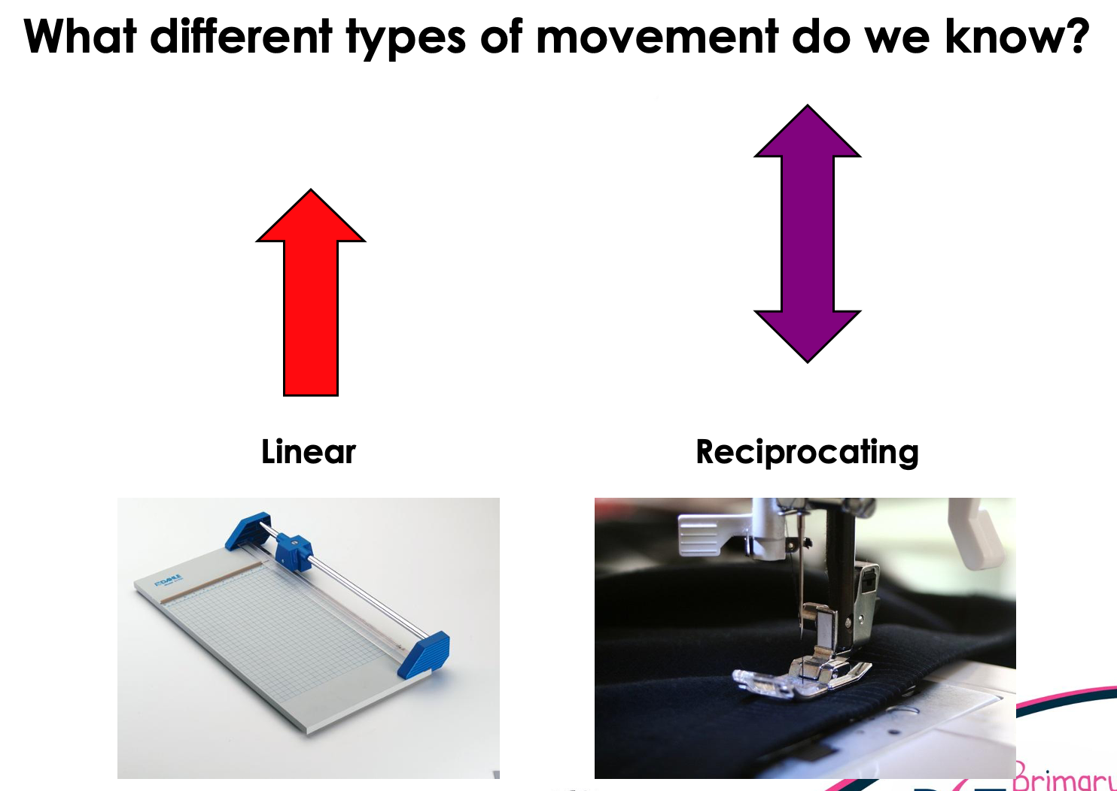
Recap from last week...

Slide 4
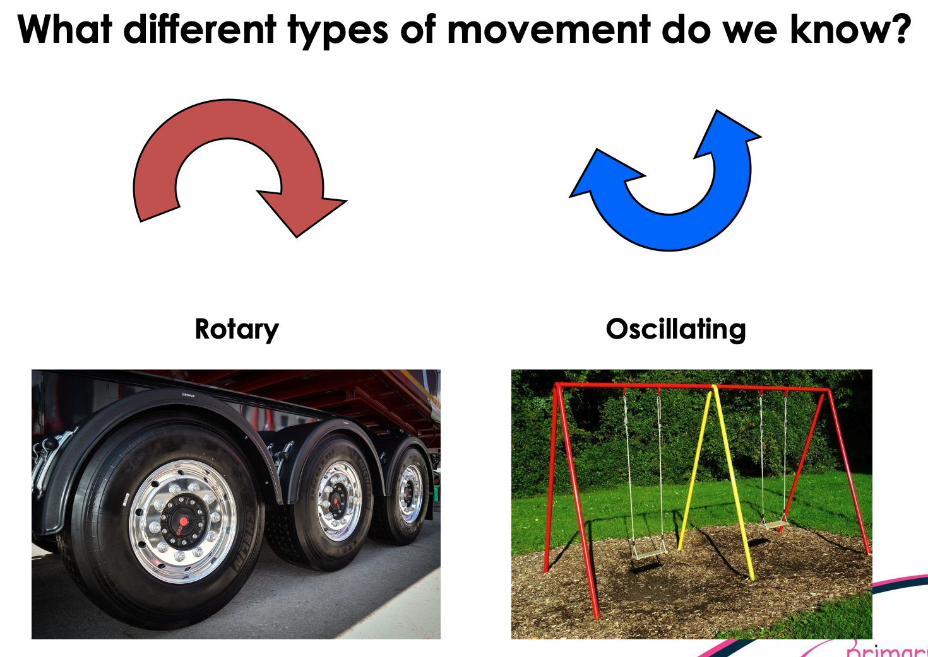

Slide 5
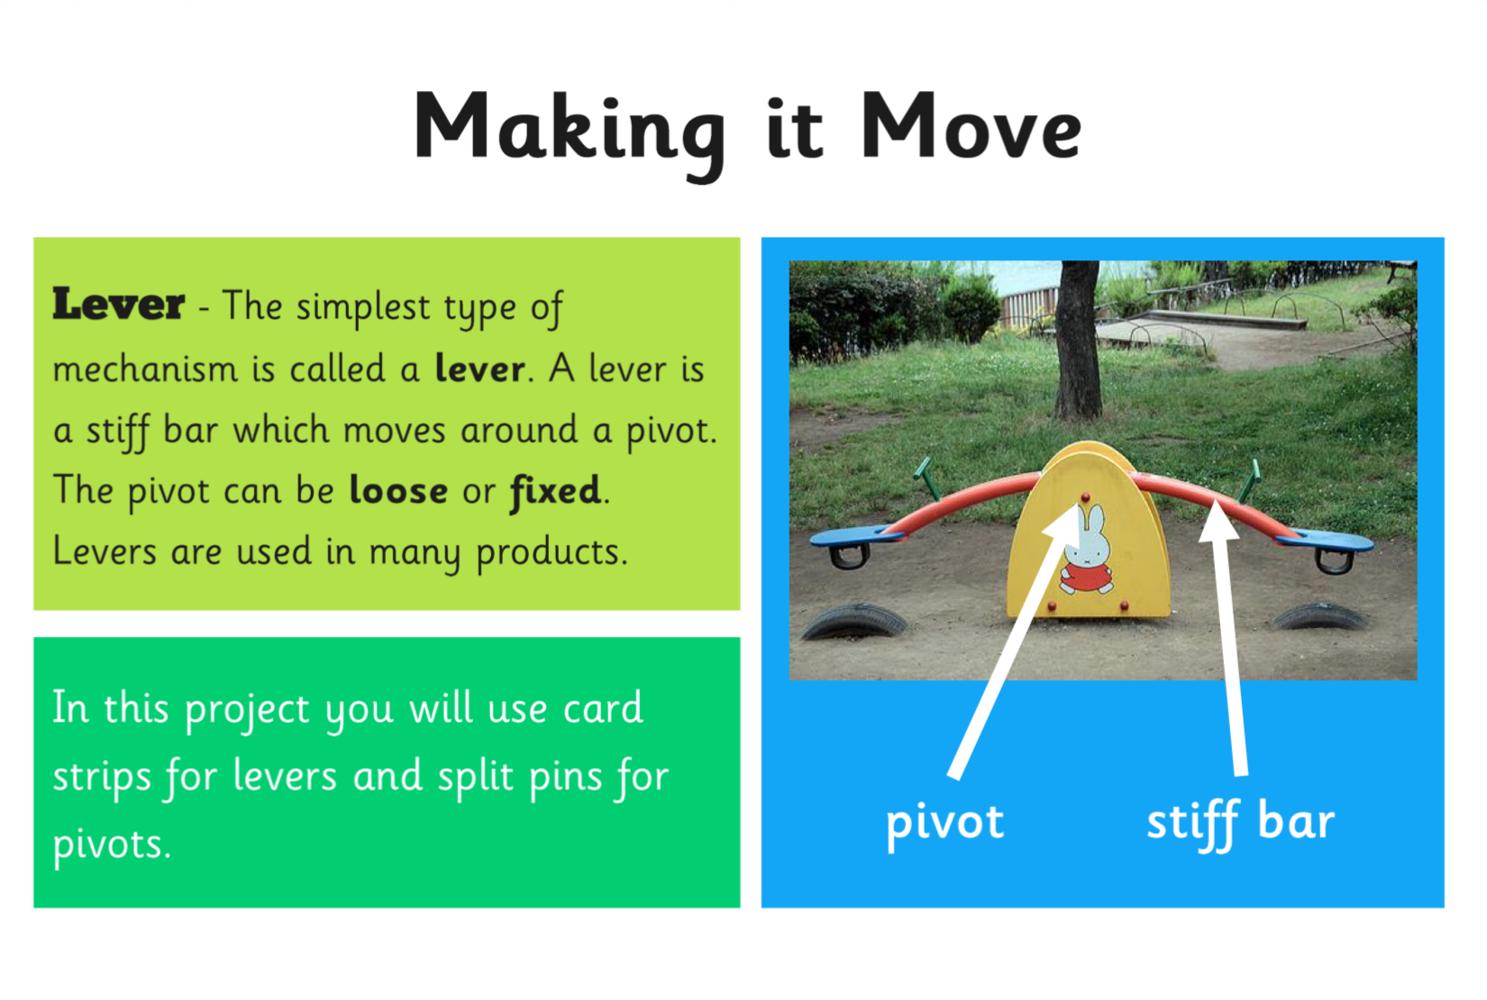

Slide 6
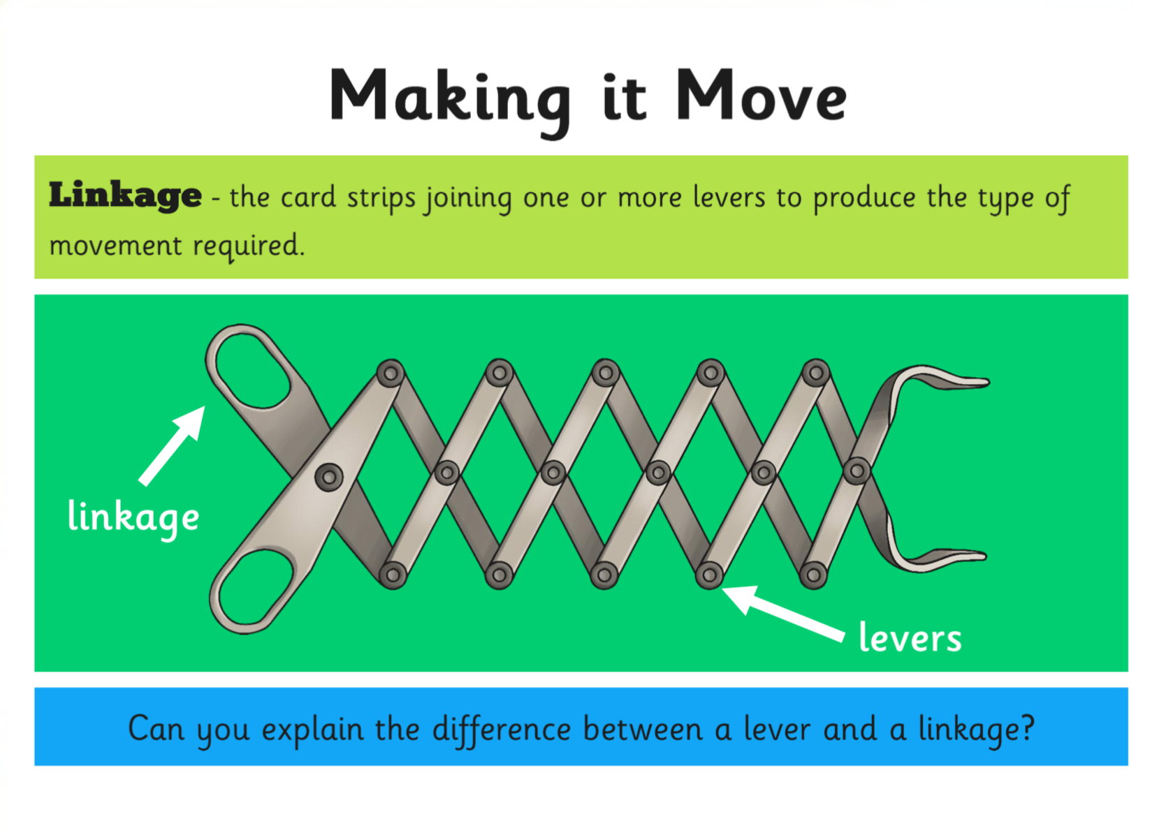

Slide 7
To recap...
A lever is something that turns on a pivot.
A linkage is a system of levers that are connected by pivots.
There is always an input and output involved in a mechanism.

Slide 8

Your turn...
Have a go at making a linkage, like the picture below.

