Slide 1
Creating a virtual space

Slide 2
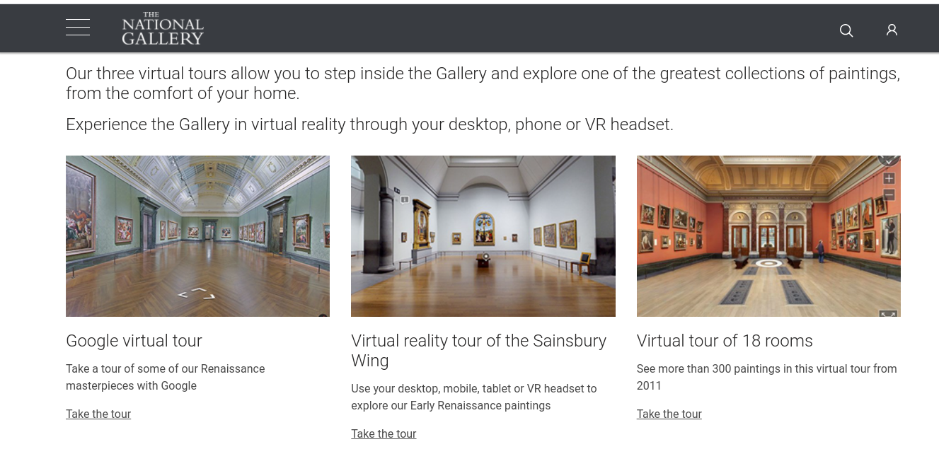
Take your own virtual tour...
Notes:
https://www.nationalgallery.org.uk/visiting/virtual-tours

Slide 3
Sketch some ideas for your own virtual space...
What will be on display in your gallery?
Think about the space you will need.
What furniture will be there?
The use of colours and materials.

Slide 4
Can you design and make your own 3D model?
Log in to your Purple Mash account.
You will have a 2Do task.
Follow the instructions. You can print the net out to make your 3D model.

Slide 5
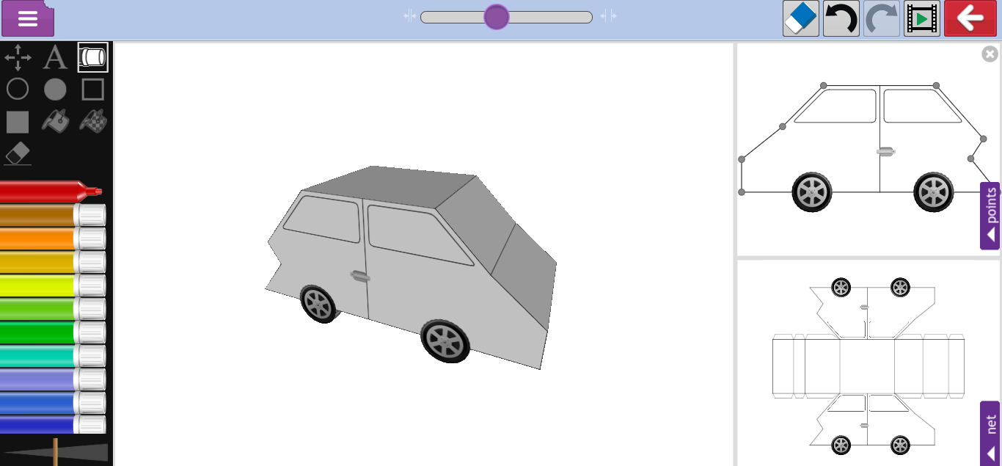
Can you design and make your own 3D model?
Click on the play button if you need some help.
Don’t forget to save and send me your work!

