Slide 1
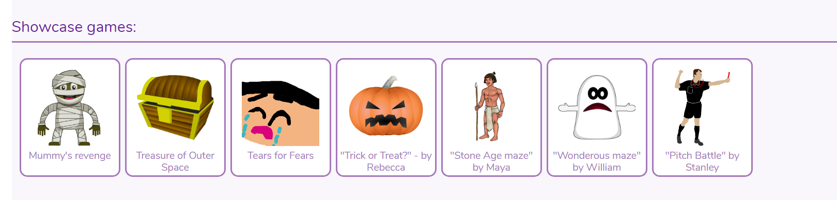
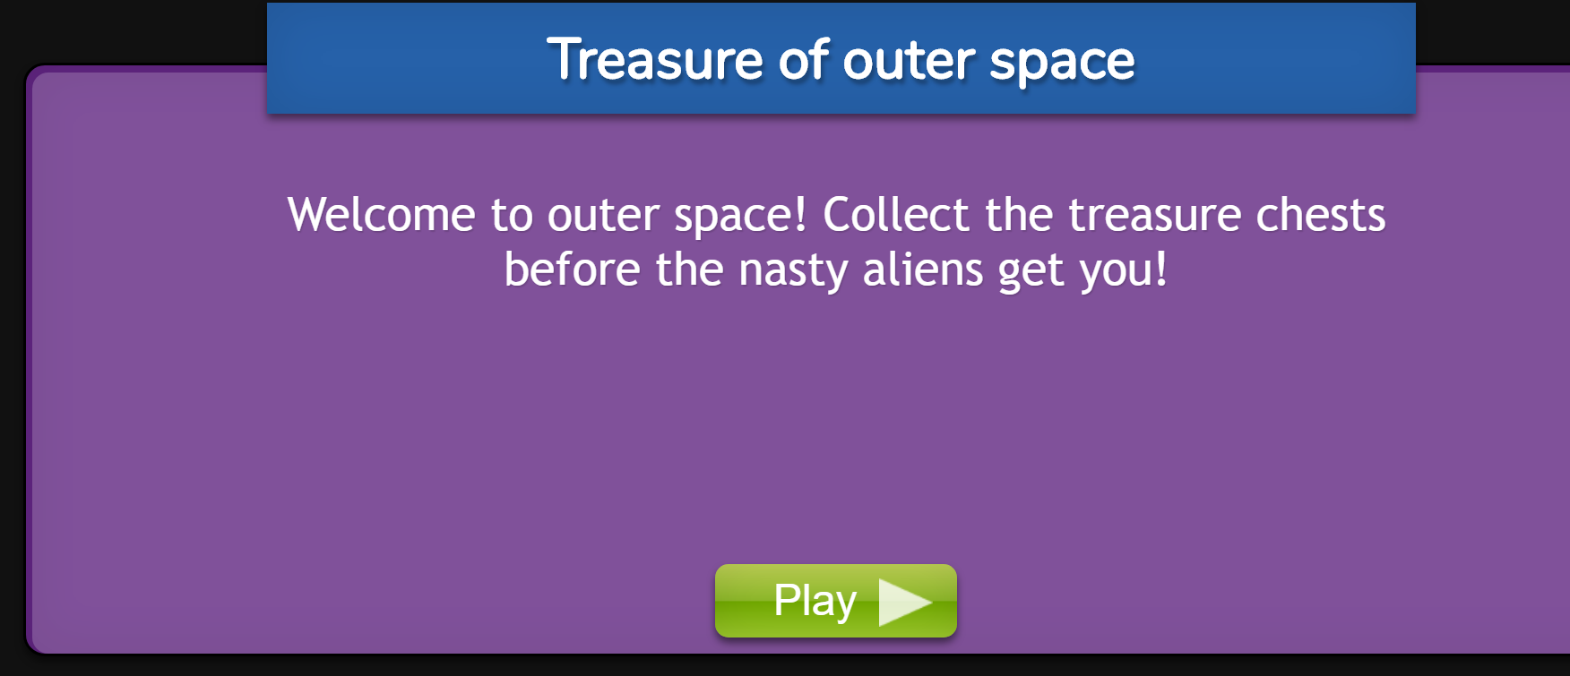
Review a virtual game...
Notes:
You need to log on to purple mash.
2DIY3D
Find showcase games
Review these games - create a presentation

Slide 2
Review a virtual game...
Open one of the games and look at it from a design perspective, rather than just playing it.
Look at the use of an instruction screen; why is this needed?
Play the game and show children the map screen at the top right.
What do the different coloured blobs represent?
Can they work out in which direction to head?
How does the scoring work?

Slide 3
Review a virtual game...
Can you lose lives? (Some of the example games do and some do not.)
Compare the first game to the other games; what is different and what is the same?

Slide 4
Review a virtual game...
You are to create your own presentation.
Use the questions to guide your review.

Slide 5
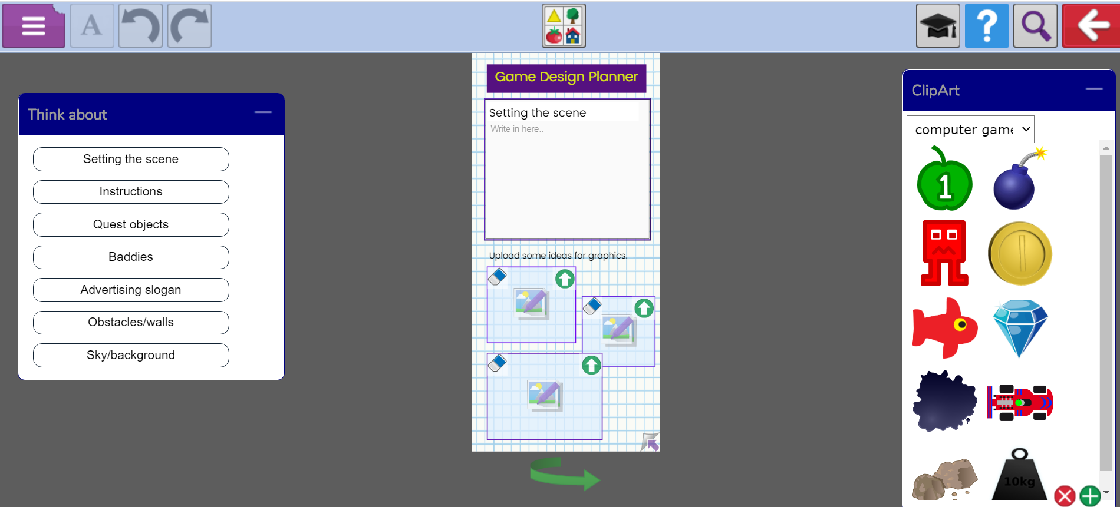
Design your own game...
Notes:
You need to start planning your own virtual game.
Use the template to help you.
2Do task

