Slide 1
LO: summarising
Thursday 12th November 2020

Slide 2
Summarising

Slide 3
Summarising
Can you verbally summarise Stave Two (which you read yesterday) in a clear and concise statement?
Practise with your partner.
Let’s hear some volunteers...

Slide 4
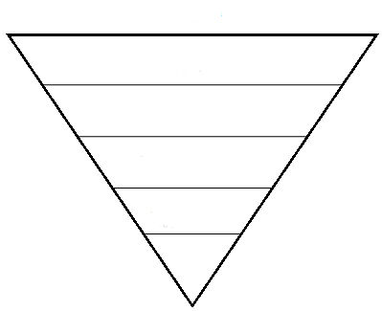
Summarising
Short paragraph
3 sentences
1 sentence
3-4 words
1 words which encapsulates the entire chapter!

